Slide 1

Jabber: Instant Messenger
Rahul Burman, Vaibhav Bajpai, Ritika Wadhwa
Class of 2009, Computer Science and Engineering

Slide 2
Why Instant Messaging?
Before IM
Unix talk and IRC
AIM: Introduced IM to mainstream
Applications of IM
CRM
B2B Exchanges
Leisure: File-sharing, Gaming, et al.
Ubiquity: Web, Database, Email and “IM”
Growth: JMS in J2EE; messaging system for enterprise

Slide 3
What is Jabber?
Jeremie Miller: Creator of Jabber.
Open Source
Jabber Community: A friendly community of end users and
developers who value freedom of communication
Jabber Inc and Jabber Software Foundation: to help Jabber grow
Based on Decentralized client/server architecture
XML Based Data Formats.
XMPP: A set of stable standards for real-time communications,
published by the IETF

Slide 4
Why Jabber?
It’s Open!
It’s Decentralised!
It’s Secure!
It’s Free!

Slide 5
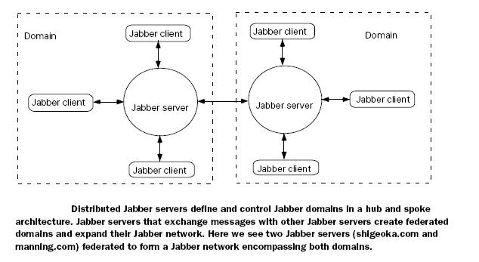
Jabber: Core Concepts
Network
Domain
Server
User
Resource

Slide 6
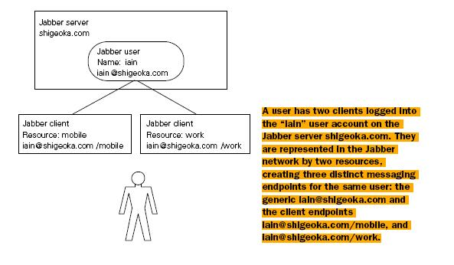
Jabber: Resources
Resource: “Particular” message delivery endpoint for a user

Slide 7
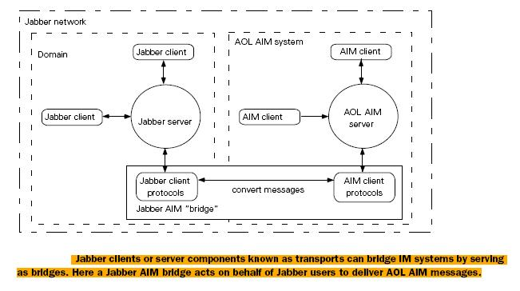
Jabber: Transports
Transports: bridge IM systems acting on behalf of Jabber users to deliver messages to non-jabber implementations

Slide 8

What is XMPP?
XML-inspired protocol for
near real time,
extensible instant messaging (IM)
presence information (a.k.a. buddy lists)
Voice over IP and file transfer signaling have been added.

Slide 9
Why XML?
Open
On track to replace HTML
Simple
Flexible
DTD and Namespaces
Portable
Marked up text files sent over network
Supported by C/C++, Delphi, Perl, Java et al.

Slide 10
Core Jabber Protocols
Message
Presence
Info/Query
Roster Management
Registration
Authentication

Slide 11
Types of IM Messages
Normal
Chat
Group Chat
Headline
Error
Out of Band

Slide 12
Project Details
Technologies Used:
Language: J2SE 6.0, XML
API: SAX (Xerces 1.0), Collections Framework, Swing
Protocol: Jabber

Slide 13
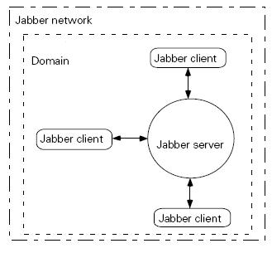
Project: Implementation Focus

Slide 14
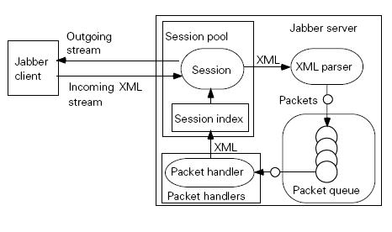
Project: Server Architecture

Slide 15
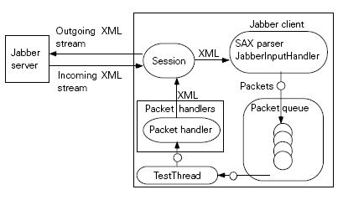
Project: Client Architecture

Slide 16
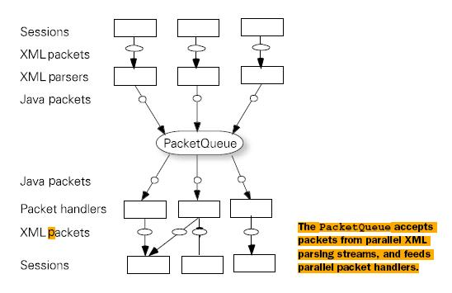
Project: PacketQueue as FocalPoint

Slide 17
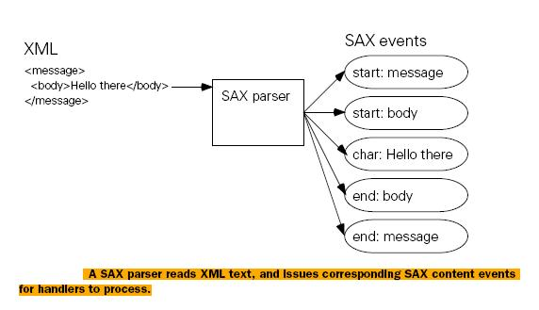
Project: SAX Parser

Slide 18
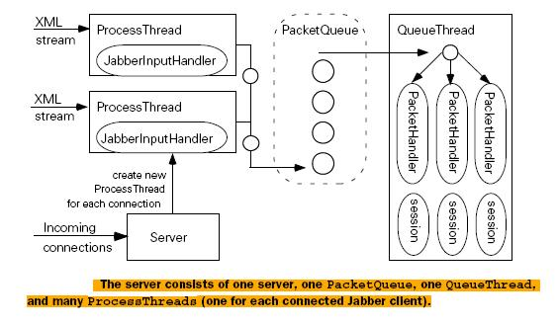
Project: PacketHandlers

Slide 19
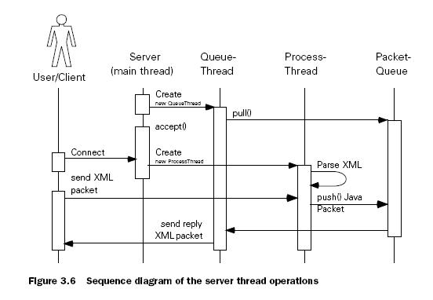
Project: Server Timeline Sequence

Slide 20
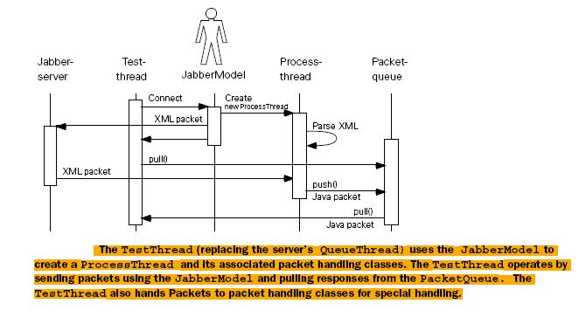
Project: Client TimeLine Sequence

