Slide 1

McDonald’s Sales Performance Dashboard
Presented by Vishal Bajpai

Slide 2
Executive Summary
The analysis reveals that burgers lead in orders, while Side Salad is the most frequently purchased item. Meatball Marinara tops monthly sales, with category revenue remaining stable from January to March 2023. Both weekdays and weekends show consistent growth trends.
Order and sales patterns differ — with peaks just before lunch and early evening, and a midweek dip (Monday–Wednesday) before rising toward the weekend.
To enhance performance, it’s recommended to introduce combo deals for the top five items, offer weekday discounts to lift sales early in the week, and optimize staffing during peak demand hours.

Slide 3
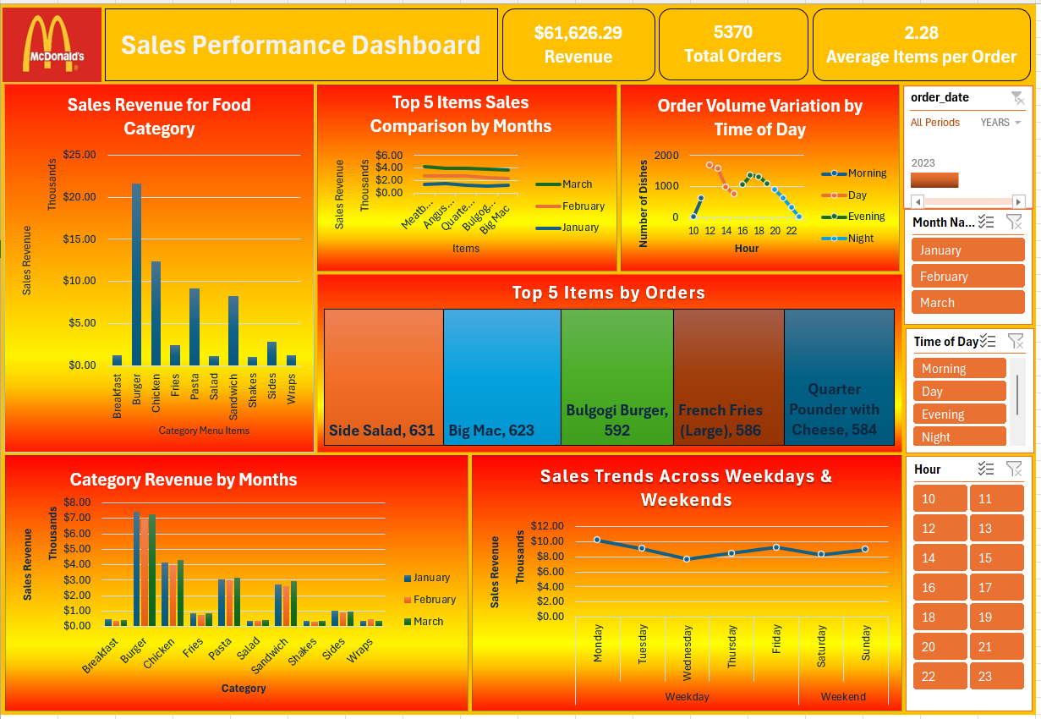

Slide 4
Findings
The leading category is burger, while Side Salad dominates among all orders.
Meatball Marinara is ahead in sales comparison by months.
Category revenue is steady across Jan-March 2023.
Weekdays and weekends contribute to consistent growth.
Total Revenue: $61,626.29
Total Orders: 5,370
Average Items per Order: 2.28
Top Revenue Category: Burgers (≈ $21.5K)
Top Selling Item by Orders: Side Salad (631 orders)

Slide 5
Top 5 Items by Orders
🥗 Side Salad — 631 orders
🍔 Big Mac — 623 orders
🍔 Bulgogi Burger — 592 orders
🍟 French Fries (Large) — 586 orders
🍔 Quarter Pounder with Cheese — 584 orders
Insight: Balanced mix of core (Big Mac, Fries) and variety (Salads, Bulgogi Burger) items shows product diversity is resonating with customers.

Slide 6
Category Findings
Burgers lead overall revenue, showing the strongest and most consistent performance across all months.
Chicken and Fries are steady contributors, driving major meal-time sales.
Salads and Shakes have moderate sales — potential upsell opportunities for combo offers.
Wraps and Sides generate the least revenue, signaling a need for promotional campaigns.

Slide 7
Timeline Trends
January–March show consistent sales growth in high-volume categories.
February records slightly higher overall revenue, possibly due to offers or seasonal promotions.
Most categories maintain stable demand — strong brand loyalty across months.
Lunch (12–2 PM) and Dinner (5–8 PM) are the peak order hours, accounting for the majority of daily revenue.
Morning (8–10 AM) sees moderate traffic — mainly breakfast items.
Night (after 9 PM) experiences a sharp decline in orders.
📊 Actionable Insight: Introduce late-night snack combos or digital app offers to boost off-peak hours.

Slide 8
Weekday vs Weekend Trends
Highest Sales: Monday and Sunday (~$11K each)
Midweek Dip: Wednesday (~$8.5K)
Weekends maintain consistent order volume, suggesting steady dine-in and delivery mix.
Insight:
Promotional campaigns on Wednesdays could stabilize midweek revenue.

Slide 9
Recommendations
Solidify burger and chicken categories with premium combos.
Come up with Wednesday-specific offers to fix midweek dips.
Offer late-night promotions to capture additional revenue.
Highlight side items and salads in digital marketing for better order balance.

