Slide 1
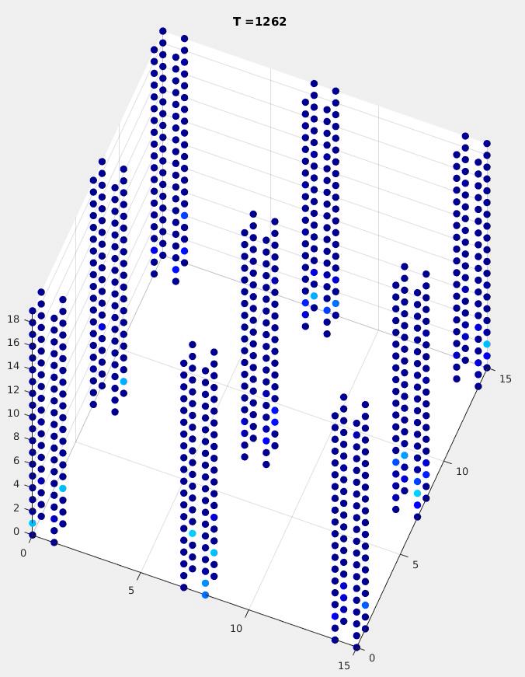
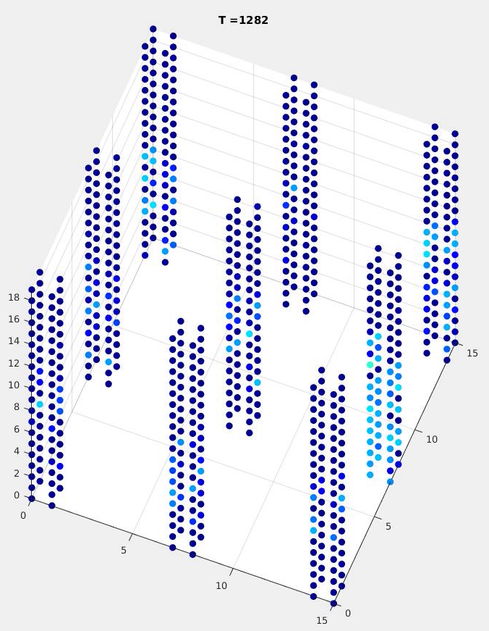
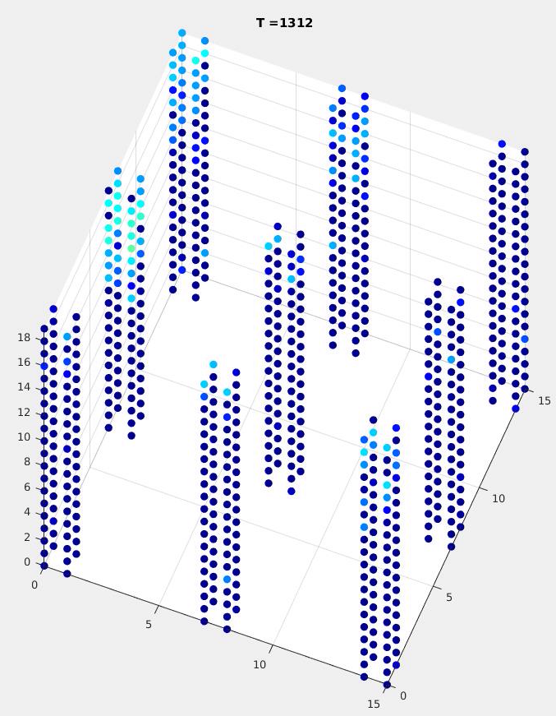

Slide 2
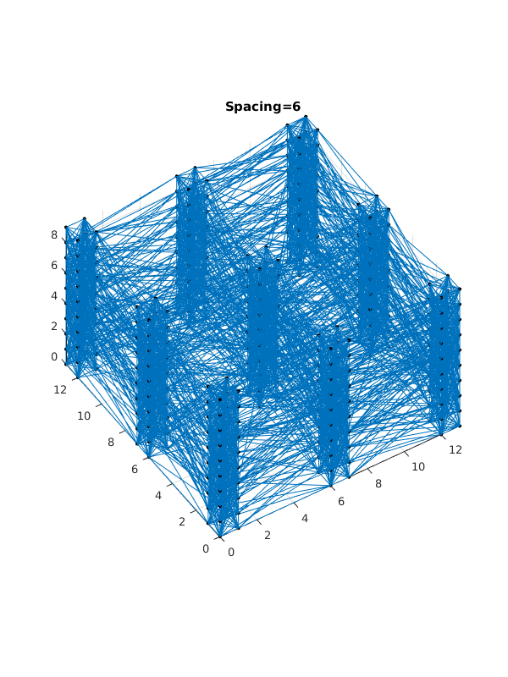
Topology
Output from top layer of minicolumn ensemble
Ensemble of minicolumns (9 minicolumns, each 2x2 neurons wide)
Input to base layer of minicolumn ensemble
Pool of input neurons

Slide 3
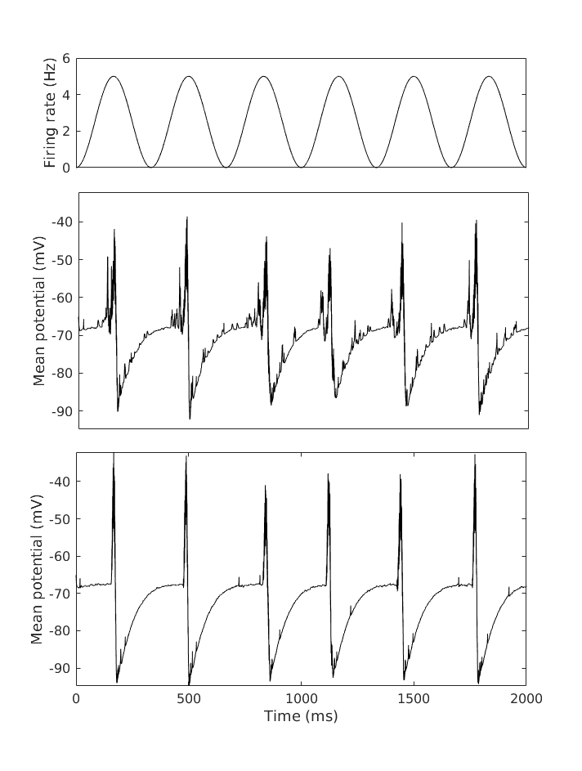
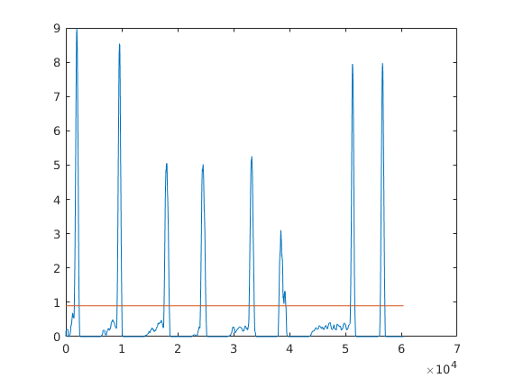
Spike
Resting potential
Refractory period
Detection threshold 10%

Slide 4
