Slide 1
Coupling microwave and photonic systems through nanomechanical resonators
Quantum Mechanics III final presentation
Vincent Baker
Drexel University

Slide 2
Motivation
Quantum entanglement normally studied at optical (THz) frequencies
Entanglement at Microwave (GHz) frequencies opens new areas of study and applications
Quantum computing
Quantum illumination
Recent advances in the theory and construction of nanomechanical resonators allow coherent coupling of optical and microwave systems

Slide 3
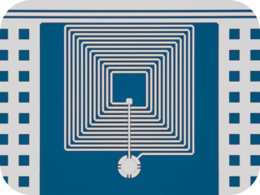
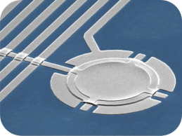
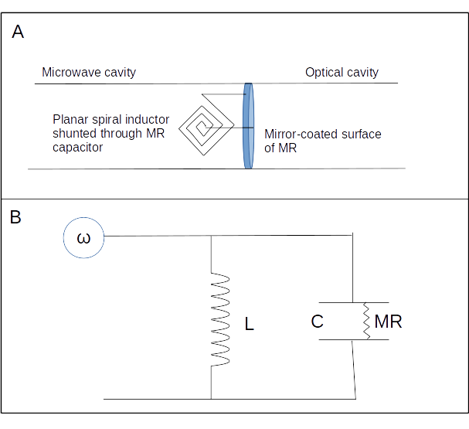
Example 1: Drum-head capacitor
Drum-head capacitor coupled to microwave stripline by a planar inductor
Proposal: mirror coat other surface, put at one end of an optical cavity
Would result in coupled microwave/optical signals
From []

Slide 4
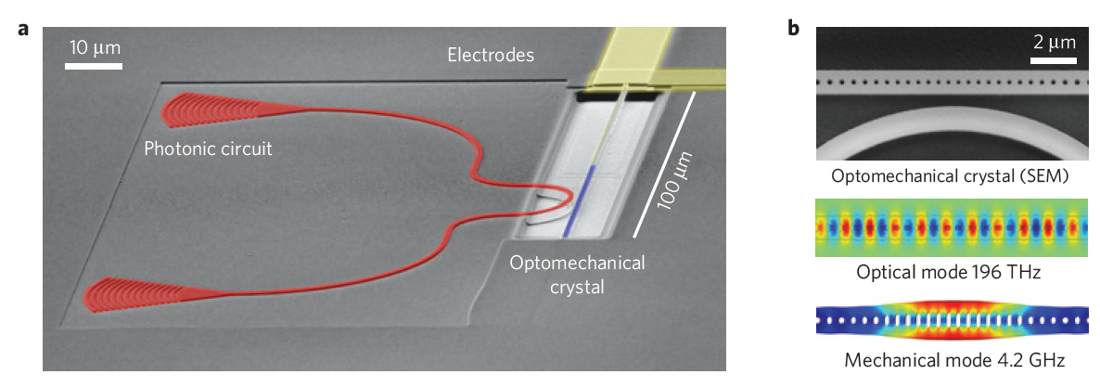
Example 2: Opto-mechanical crystal[2]
Optical crystal made from piezoelectric material
Microwave and optical resonances
Experimental measurement of phase/amplitude fidelity and optical transparency controlled by microwave signal

Slide 5
System dynamics [3]

Slide 6

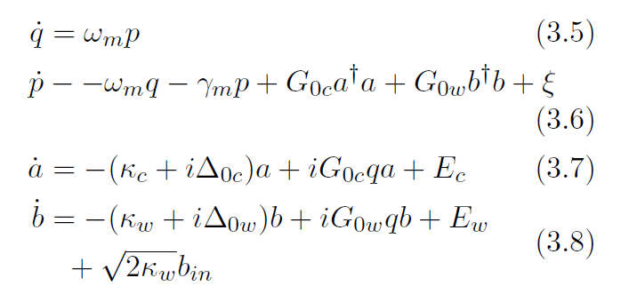
Quantum Langevin equations [3]
Thermal noise is important in microwave regime
QLEs: differential equations for system evolution (“slow” system plus “fast” noise terms)
Microwave (4 GHz)
Optical (500 THz)

Slide 7
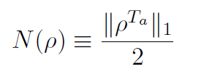
Entanglement metrics
Systems are separable (not entangled) if we can write state as a tensor product
If the entangled systems are in a pure state, can use reduced density matrix
For a general mixed state it’s more complicated
One computable metric is the negativity [6]

Slide 8
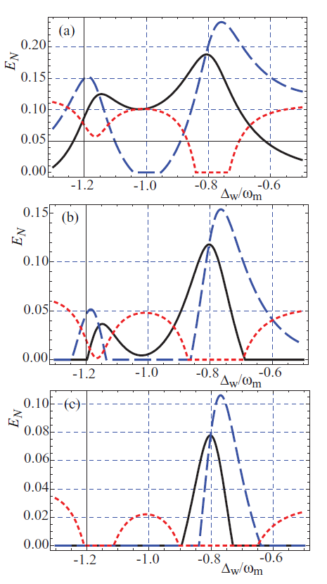
Entanglement results [3]
Correlation analysis from QLEs (fluctuations about steady state)
Log-negativity shows substantial entanglement between optical and microwave modes
Enhancing OC-MC entanglement
Minimize resonator mass
Low temperature
100 mK
200 mK
250 mK
OC-MC
MC-MR
OC-MR

Slide 9
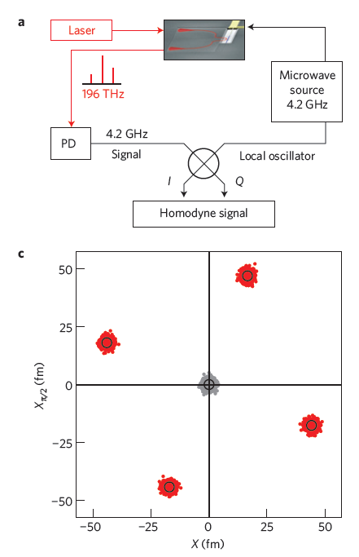
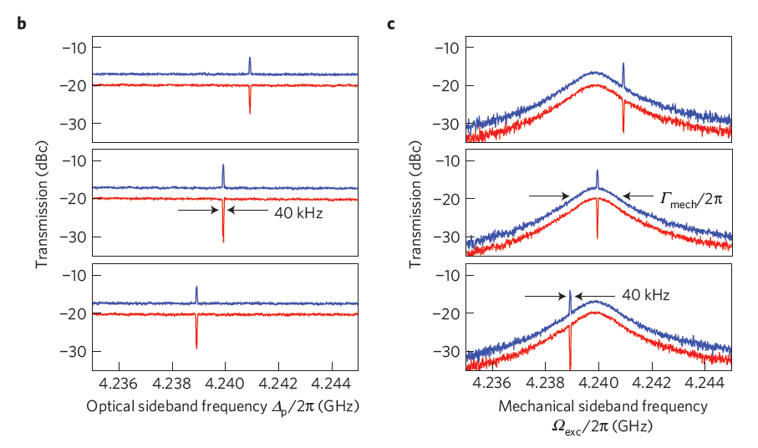
Photonic crystal result [2]
Experimentally showed phase/amplitude transfer from microwave to optical carriers
Also showed microwave-controlled optical sideband transparency

Slide 10
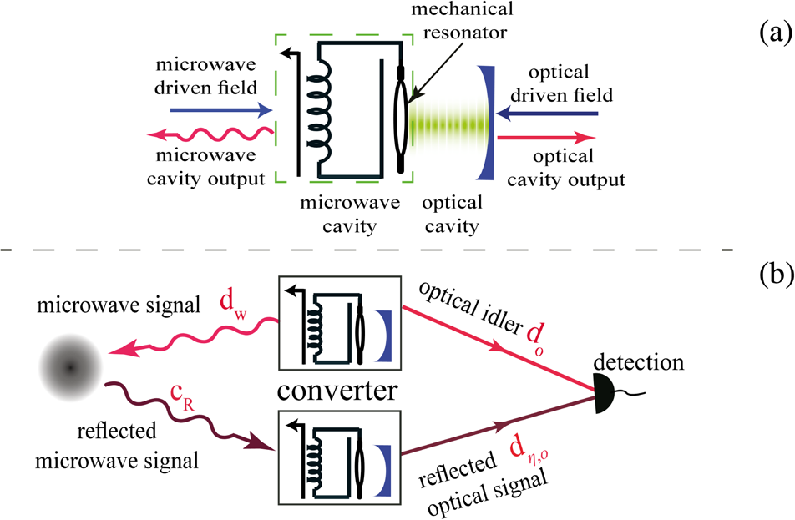
Quantum illumination
Uses entangled photons for enhanced sensing
Create entangled pair, retain one “idler”, correlate with received signal
From [5]
From [4]
Quantum upper bound
Classical lower bound
Classical upper bound

Slide 11
Application to radar systems
Current analyses focus on thermal noise, but radar systems usually limited by unwanted reflections (“clutter”)
Space sensing might be an exception
Not clear how to use single idler to search multiple range gates
Not clear how to apply to electronically steered arrays
Space-fed passive array
Active array

Slide 12
References
[1] J. Bochmann A. Vainsencher D. Awschalom A. Cleland. “Nanomechanical coupling between microwave and optical photons". In: Nature Physics 9 (2013), pp. 712{716. doi: 10.1038/NPHYS2748.
[2] Integrated Photonics Institute for Manufacturing Innovation. url: http://manufacturing.gov/ip-imi.html.
[3] Sh. Barzanjeh D. Vitali P. Tombesi G.J. Milburn. “Entangling optical and microwave cavity modes by means of a nanomechanical resonator". In:
[4] Sh. Barzanjeh S. Guha C. Weedbrook D. Vitali J. Shapiro S. Pirandola. «Microwave quantum illumination". In: Physical Review Letters 114 (2015). doi:
[5] S. Tan B. Erkmen V. Giovannetti S. Guha S. Lloyd L. Maccone S. Pirandola J. Shapiro. “Quantum Illumination with Gaussian State". In: Physical Review Letters 101.253601 (2008). doi: http://dx.doi.org/10.1103/PhysRevLett.101.253601.
[6] G. Vidal R.F. Wener. “Computable measure of entanglement". In: Physical Review A 65 (2002). doi: http://dx.doi.org/10.1103/PhysRevA.65.032314.

