Slide 1
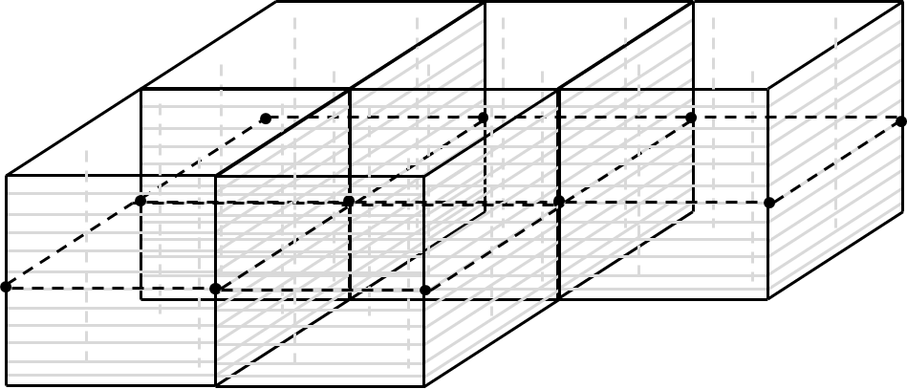
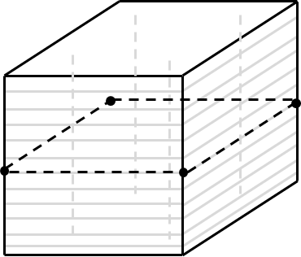
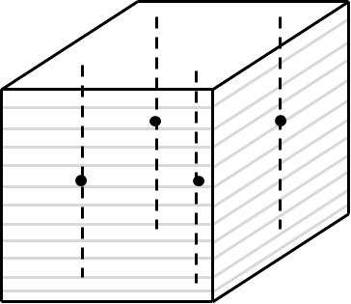
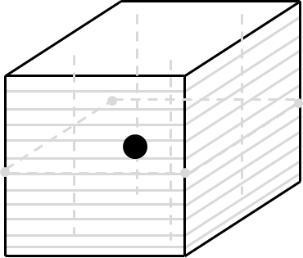
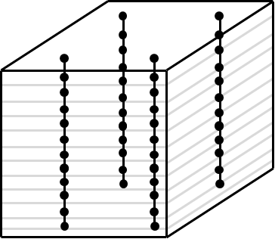




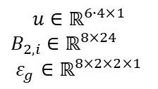








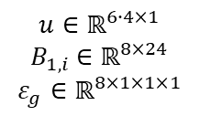









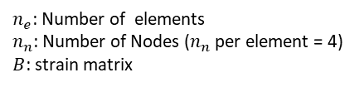


Standard NLFEA
NN-hybrid NLFEA
gauss order = 2
*
gauss order = 1
0 - Linear Solve
$u_{0}=f(ε_{i}, σ_{i}, B, F)$
$$u, F∈ℝ^{6∙n_{n}×1}$$
$B_{i}$ $∈ℝ^{8×24}$
0 - Linear Solve
$$u_{0}=f(ε_{g}, σ_{g}, B, F)$$
$$u, F∈ℝ^{6∙n_{n}×1}$$
$B_{i}$ $∈ℝ^{8×24}$
$$u∈ℝ^{6∙4×1}$$
$B_{2,i}$ $∈ℝ^{8×24}$
$$ε_{g}∈ℝ^{8×2×2×1}$$
$$u∈ℝ^{6∙4×1}$$
$B_{1,i}$ $∈ℝ^{8×24}$
$$ε_{g}∈ℝ^{8×1×1×1}$$
1 –Strains
$ε_{g}=Bu$
1 –Strains
$ε_{g}=f(u_{0}, B)$
2 – layer strains
$ε_{i}=f(ε_{g})$
$$ε_{i}∈ℝ^{3×3}$$
2 –stresses
$σ_{g}=NN(ε_{g})$
$$σ_{g}∈ℝ^{8×1×1×1}$$
3 –layer stresses
$σ_{i}=f(ε_{i})$
$$σ_{i}∈ℝ^{3×3}$$
iterate
iterate
4 –stresses
$σ_{g}=f(σ_{i})$
$$σ_{g}∈ℝ^{8×2×2×1}$$
3 –residuals
$ΔF=f(σ_{g},B)$
$$ΔF∈ℝ^{6∙n_{n}×1}$$
$B_{1,i}$ $∈ℝ^{8×24}$
5 –residuals
$ΔF=f(σ_{g},B)$
$$ΔF∈ℝ^{6∙n_{n}×1}$$
$B_{2,i}$ $∈ℝ^{8×24}$
4– New solve
$$u_{1}=f(ε_{g}, σ_{g}, B,F)$$
$$u, F∈ℝ^{6∙n_{n}×1}$$
$B_{1,i}$ $∈ℝ^{8×24}$
6 – New solve
$u_{1}=f\left(ε_{i}, σ_{i}, B, F\right)$
$$u, F∈ℝ^{6∙n_{n}×1}$$
$B_{2,i}$ $∈ℝ^{8×24}$
7 – Final iteration
Steps 1…4 with
go = 1 to get $ε_{g}$ and $σ_{g}$ in centroids
All above
$B_{1,i}$ $∈ℝ^{8×24}$
Code lines 502…507 in main.py
$n_{e}$: Number of elements
$n_{n}$: Number of Nodes ($n_{n}$per element = 4)
$B$: strain matrix
* Aber: Resultate sind wie gauss order = 2, da sie ja aus dem NN kommen, das mit gauss order = 2 trainiert wurde

Slide 2
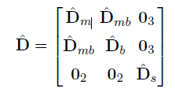







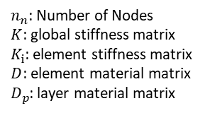
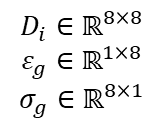

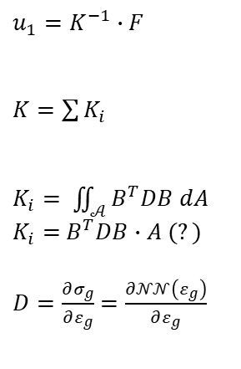


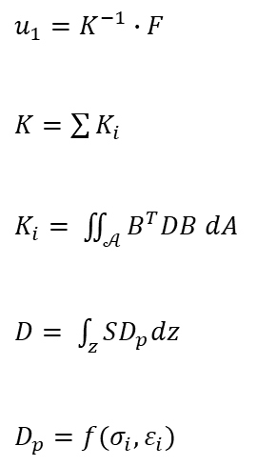

Standard NLFEA
NN-hybrid NLFEA
$u_{1}=f\left(ε_{i}, σ_{i}, B, F\right)$
$$u_{1}=f(ε_{g}, σ_{g}, B,F)$$
gauss order = 2
gauss order = 1
$u_{1}=K^{−1}∙F$
$K=\sum{K_{i}}$
$K_{i}= \iint_{𝒜}^{ }{B^{T}DB dA}$
$D= \int_{z}^{ }{SD_{p}dz}$
$D_{p}=f(σ_{i}, ε_{i})$
$$u, F∈ℝ^{6∙n_{n}×1}$$
$u_{1}=K^{−1}∙F$
$K=\sum{K_{i}}$
$K_{i}= \iint_{𝒜}^{ }{B^{T}DB dA}$
$K_{i}=$ $B^{T}DB∙A (?)$
$D=\frac{∂σ_{g}}{∂ε_{g}}$ $=\frac{∂𝒩𝒩\left(ε_{g}\right)}{∂ε_{g}}$
$$u, F∈ℝ^{6∙n_{n}×1}$$
$$K∈ℝ^{6∙n_{n}×6∙n_{n}}$$
$$K∈ℝ^{6∙n_{n}×6∙n_{n}}$$
$K_{i}∈ℝ^{6∙4×6∙4}$
$B_{i}$ $∈ℝ^{8×24}$
$K_{i}∈ℝ^{6∙4×6∙4}$
$B_{i}$ $∈ℝ^{8×24}$
$$D_{i}∈ℝ^{8×8}$$
$$S∈ℝ^{8×8}$$
$$D_{i}∈ℝ^{8×8}$$
$$ε_{g}∈ℝ^{1×8}$$
$$σ_{g}∈ℝ^{8×1}$$
$$D_{p}∈ℝ^{?}$$
Differentiable
surrogate model
$n_{n}$: Number of Nodes
$K$: global stiffness matrix
$K_{i}$: element stiffness matrix
$D$: element material matrix
$D_{p}$: layer material matrix

