Slide 1
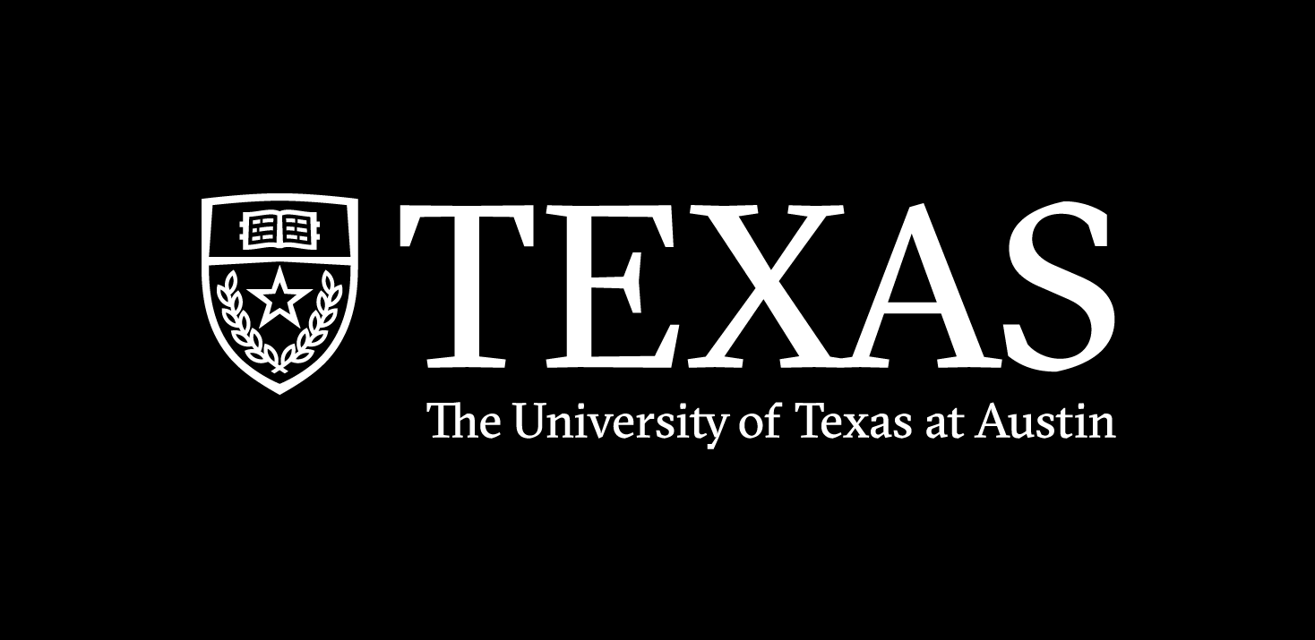
Spring 2024
hidden markov models
Programming and Data Analysis for Modern Neuroscience
NEU 365P
Marcel Goldschen-ohm
Assistant Professor in the Department of Neuroscience, The University of Texas at Austin

Slide 2
Hidden Markov Models (HMMs)
States
represent the distinct
configurations of the
system being modeled.
e.g., Sunny, Rainy, Cloudy
for a model of the weather
e.g., Inactive, Active, Blocked
for a model of a protein
State A
State C
State B
Transitions
occur at a constant average rate.
Notes:
Their dysfunction is related to disorders such as epilepsy, autism spectrum disorder, intellectual disability, schizophrenia, and neurodevelopmental disorders such as fragile X syndrome. Altered GABAAR expression is also a common feature of Alzheimer’s, Parkinson’s and Huntington’s disease.

Slide 3
Hidden Markov Models (HMMs)
States
represent the distinct
configurations of the
system being modeled.
e.g., Sunny, Rainy, Cloudy
for a model of the weather
e.g., Inactive, Active, Blocked
for a model of a protein
State A
What distribution describes the stochastic lifetimes in each state?
State C
State B
Transitions
occur at a constant average rate.
Notes:
Their dysfunction is related to disorders such as epilepsy, autism spectrum disorder, intellectual disability, schizophrenia, and neurodevelopmental disorders such as fragile X syndrome. Altered GABAAR expression is also a common feature of Alzheimer’s, Parkinson’s and Huntington’s disease.

Slide 4
Transition probabilities per time step.
States
represent the distinct
configurations of the
system being modeled.
e.g., Sunny, Rainy, Cloudy
for a model of the weather
e.g., Inactive, Active, Blocked
for a model of a protein
State A
0.6
State C
0.2
0.3
0.4
Transitions
For discrete time steps, transitions are often parameterized as a probability of occurring each time step.
State B
0.1

Slide 5
HMMs are memoryless.
Memoryless
Only care where we are,
not where we’ve been.
State A
State C
State B

Slide 6
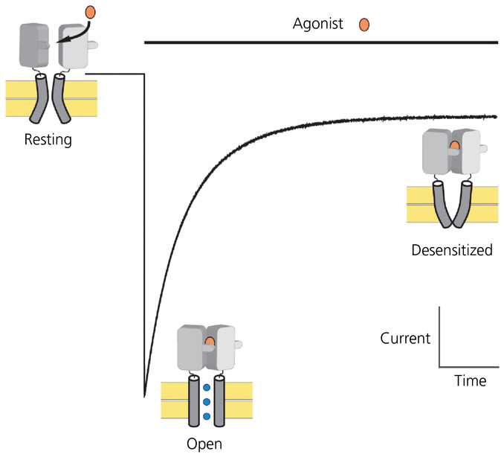
Simple HMM for an Ion Channel

Slide 7
Simple HMM for an Ion Channel
Closed
Open
Desensitized

Slide 8
One possible state sequence (discrete time steps):
COOCODDDDOOCCOOODDDDDDDDODDDDOOOCCCO…
Closed
Open
Desensitized

Slide 9
COOCODDDDOODDDDDDDDDDODDDDOOOCOCC…
Hidden States: Observed (pA):
055050000550000000000500005550500…
Closed
Open
Desensitized
0 pA
5 pA
0 pA

Slide 10
COOCODDDDOODDDDDDDDDDODDDDOOOCOCC…
Hidden States: Observed (pA):
054161001560001100100301014450610…
Closed
Open
Desensitized
N(0,1) pA
N(5,2) pA
N(0,1) pA

Slide 11
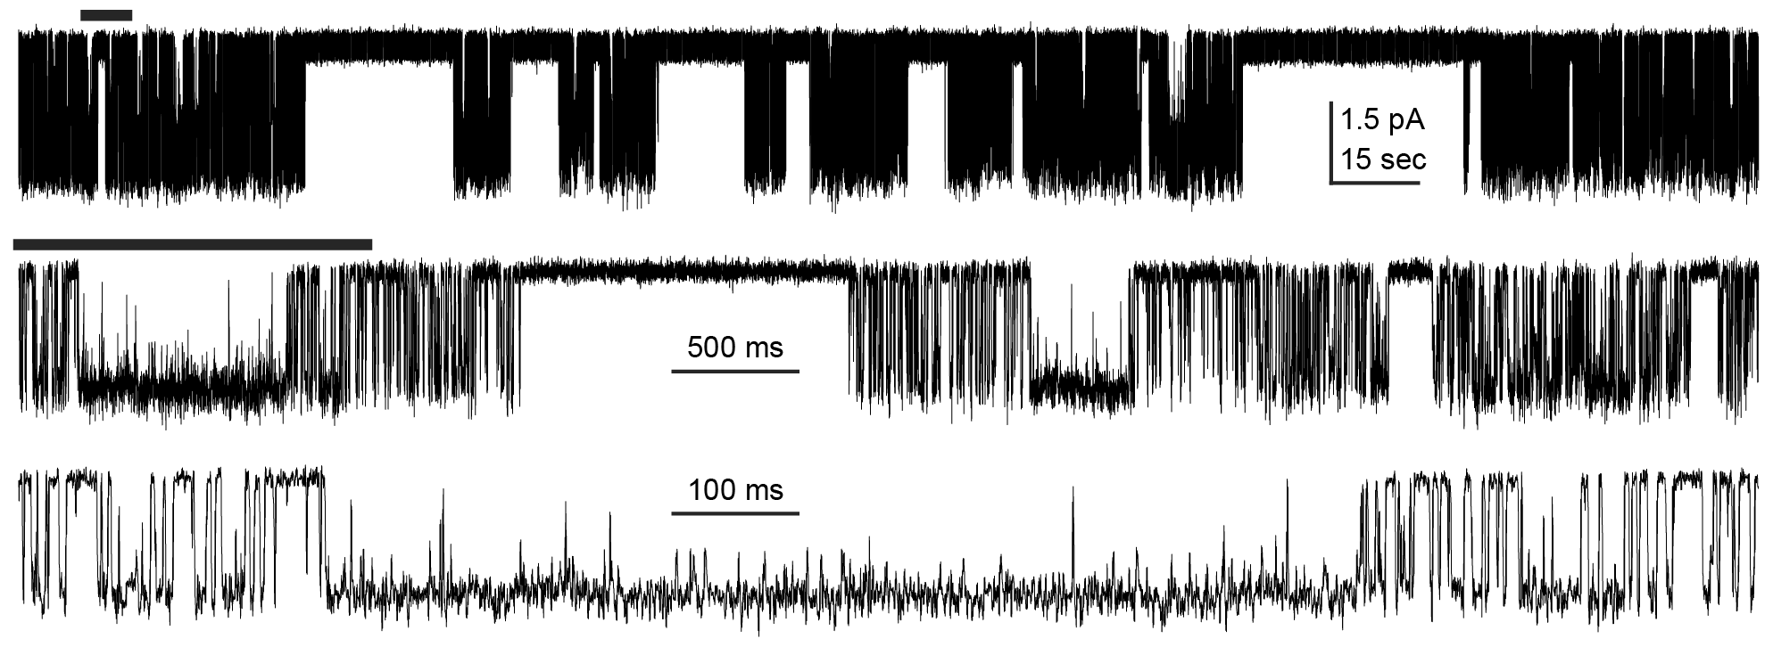
Can you guess how many closed and open states the channel visits (openings are downwards)?

Slide 12
HMM
Simulation
Hidden States
COOCODDDDOODDDDDDDDDDODDDDOOOCOCC…
Observations
054161001560001100100301014450610…
Modeling

Slide 13
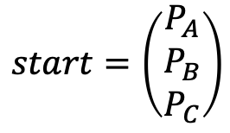
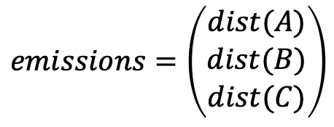
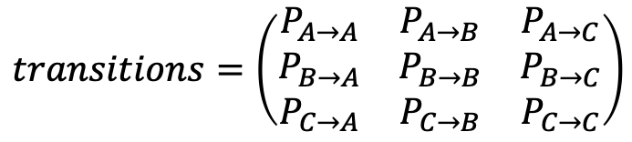
Parts of an HMM (this example has three states: A, B, C)
$$start=\left(\begin{matrix}P_{A} \\ P_{B} \\ P_{C}\end{matrix}\right)$$
Starting probability in each state.
Must sum to one.
$$transitions=\left(\begin{matrix}P_{A→A} & P_{A→B} & P_{A→C} \\ P_{B→A} & P_{B→B} & P_{B→C} \\ P_{C→A} & P_{C→B} & P_{C→C}\end{matrix}\right)$$
Transition probabilities between all states.
Each row must sum to one.
$$emissions=\left(\begin{matrix}dist(A) \\ dist(B) \\ dist(C)\end{matrix}\right)$$
Distribution of random observations for each state.

Slide 14
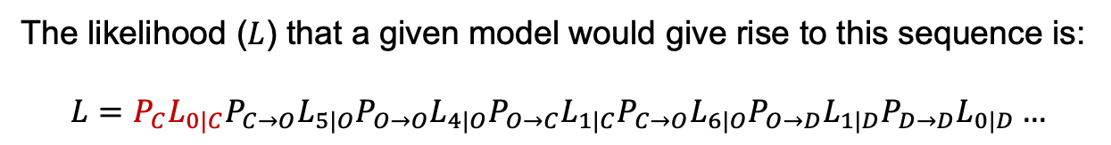
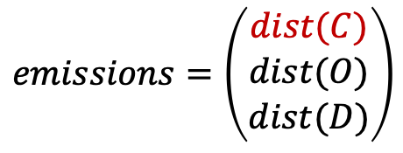
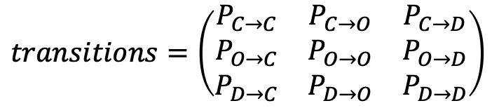
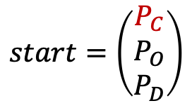
Consider the following sequence:
COOCODD…
Hidden States: Observed (pA):
0541610…
The likelihood ($L$) that a given model would give rise to this sequence is:
$$L=P_{C}L_{0|C}P_{C→O}L_{5|O}P_{O→O}L_{4|O}P_{O→C}L_{1|C}P_{C→O}L_{6|O}P_{O→D}L_{1|D}P_{D→D}L_{0|D}…$$
$$start=\left(\begin{matrix}P_{C} \\ P_{O} \\ P_{D}\end{matrix}\right)$$
$$transitions=\left(\begin{matrix}P_{C→C} & P_{C→O} & P_{C→D} \\ P_{O→C} & P_{O→O} & P_{O→D} \\ P_{D→C} & P_{D→O} & P_{D→D}\end{matrix}\right)$$
$$emissions=\left(\begin{matrix}dist(C) \\ dist(O) \\ dist(D)\end{matrix}\right)$$

Slide 15
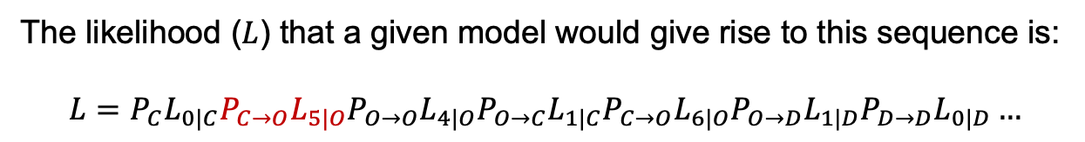
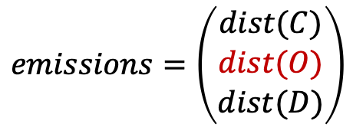
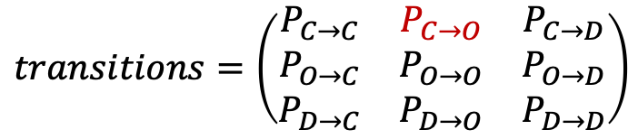
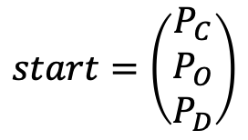
Consider the following sequence:
COOCODD…
Hidden States: Observed (pA):
0541610…
The likelihood ($L$) that a given model would give rise to this sequence is:
$$L=P_{C}L_{0|C}P_{C→O}L_{5|O}P_{O→O}L_{4|O}P_{O→C}L_{1|C}P_{C→O}L_{6|O}P_{O→D}L_{1|D}P_{D→D}L_{0|D}…$$
$$start=\left(\begin{matrix}P_{C} \\ P_{O} \\ P_{D}\end{matrix}\right)$$
$$transitions=\left(\begin{matrix}P_{C→C} & P_{C→O} & P_{C→D} \\ P_{O→C} & P_{O→O} & P_{O→D} \\ P_{D→C} & P_{D→O} & P_{D→D}\end{matrix}\right)$$
$$emissions=\left(\begin{matrix}dist(C) \\ dist(O) \\ dist(D)\end{matrix}\right)$$

Slide 16
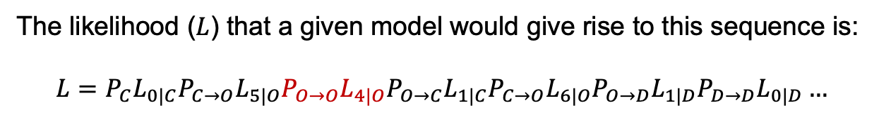
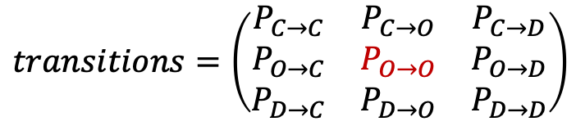
Consider the following sequence:
COOCODD…
Hidden States: Observed (pA):
0541610…
The likelihood ($L$) that a given model would give rise to this sequence is:
$$L=P_{C}L_{0|C}P_{C→O}L_{5|O}P_{O→O}L_{4|O}P_{O→C}L_{1|C}P_{C→O}L_{6|O}P_{O→D}L_{1|D}P_{D→D}L_{0|D}…$$
$$start=\left(\begin{matrix}P_{C} \\ P_{O} \\ P_{D}\end{matrix}\right)$$
$$transitions=\left(\begin{matrix}P_{C→C} & P_{C→O} & P_{C→D} \\ P_{O→C} & P_{O→O} & P_{O→D} \\ P_{D→C} & P_{D→O} & P_{D→D}\end{matrix}\right)$$
$$emissions=\left(\begin{matrix}dist(C) \\ dist(O) \\ dist(D)\end{matrix}\right)$$

Slide 17
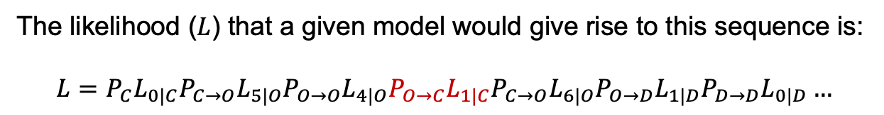
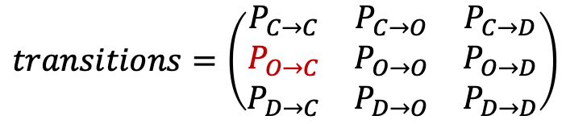
Consider the following sequence:
COOCODD…
Hidden States: Observed (pA):
0541610…
The likelihood ($L$) that a given model would give rise to this sequence is:
$$L=P_{C}L_{0|C}P_{C→O}L_{5|O}P_{O→O}L_{4|O}P_{O→C}L_{1|C}P_{C→O}L_{6|O}P_{O→D}L_{1|D}P_{D→D}L_{0|D}…$$
$$start=\left(\begin{matrix}P_{C} \\ P_{O} \\ P_{D}\end{matrix}\right)$$
$$transitions=\left(\begin{matrix}P_{C→C} & P_{C→O} & P_{C→D} \\ P_{O→C} & P_{O→O} & P_{O→D} \\ P_{D→C} & P_{D→O} & P_{D→D}\end{matrix}\right)$$
$$emissions=\left(\begin{matrix}dist(C) \\ dist(O) \\ dist(D)\end{matrix}\right)$$

Slide 18
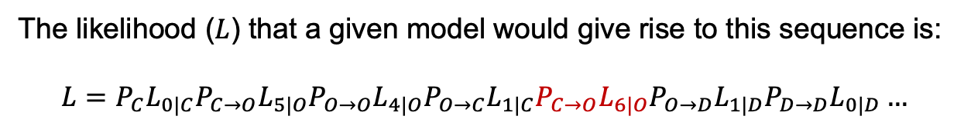
Consider the following sequence:
COOCODD…
Hidden States: Observed (pA):
0541610…
The likelihood ($L$) that a given model would give rise to this sequence is:
$$L=P_{C}L_{0|C}P_{C→O}L_{5|O}P_{O→O}L_{4|O}P_{O→C}L_{1|C}P_{C→O}L_{6|O}P_{O→D}L_{1|D}P_{D→D}L_{0|D}…$$
$$start=\left(\begin{matrix}P_{C} \\ P_{O} \\ P_{D}\end{matrix}\right)$$
$$transitions=\left(\begin{matrix}P_{C→C} & P_{C→O} & P_{C→D} \\ P_{O→C} & P_{O→O} & P_{O→D} \\ P_{D→C} & P_{D→O} & P_{D→D}\end{matrix}\right)$$
$$emissions=\left(\begin{matrix}dist(C) \\ dist(O) \\ dist(D)\end{matrix}\right)$$

Slide 19
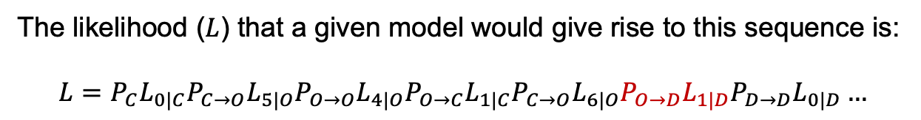
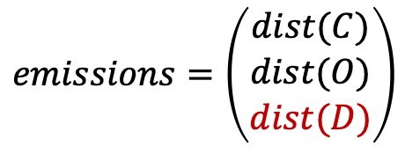
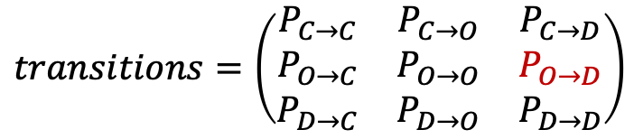
Consider the following sequence:
COOCODD…
Hidden States: Observed (pA):
0541610…
The likelihood ($L$) that a given model would give rise to this sequence is:
$$L=P_{C}L_{0|C}P_{C→O}L_{5|O}P_{O→O}L_{4|O}P_{O→C}L_{1|C}P_{C→O}L_{6|O}P_{O→D}L_{1|D}P_{D→D}L_{0|D}…$$
$$start=\left(\begin{matrix}P_{C} \\ P_{O} \\ P_{D}\end{matrix}\right)$$
$$transitions=\left(\begin{matrix}P_{C→C} & P_{C→O} & P_{C→D} \\ P_{O→C} & P_{O→O} & P_{O→D} \\ P_{D→C} & P_{D→O} & P_{D→D}\end{matrix}\right)$$
$$emissions=\left(\begin{matrix}dist(C) \\ dist(O) \\ dist(D)\end{matrix}\right)$$

Slide 20
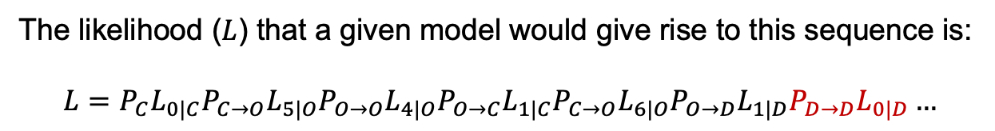
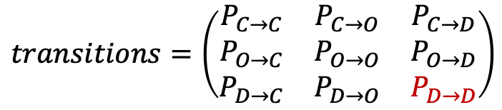
Consider the following sequence:
COOCODD…
Hidden States: Observed (pA):
0541610…
The likelihood ($L$) that a given model would give rise to this sequence is:
$$L=P_{C}L_{0|C}P_{C→O}L_{5|O}P_{O→O}L_{4|O}P_{O→C}L_{1|C}P_{C→O}L_{6|O}P_{O→D}L_{1|D}P_{D→D}L_{0|D}…$$
$$start=\left(\begin{matrix}P_{C} \\ P_{O} \\ P_{D}\end{matrix}\right)$$
$$transitions=\left(\begin{matrix}P_{C→C} & P_{C→O} & P_{C→D} \\ P_{O→C} & P_{O→O} & P_{O→D} \\ P_{D→C} & P_{D→O} & P_{D→D}\end{matrix}\right)$$
$$emissions=\left(\begin{matrix}dist(C) \\ dist(O) \\ dist(D)\end{matrix}\right)$$

Slide 21
But the states are hidden.
???????…
Hidden States: Observed (pA):
0541610…
There are many sequences of states that might give rise to the same sequence of observations.

Slide 22
Consider two of the many possible state sequences.
COOCODD…
Hidden States 1: Hidden States 2: Observed (pA):
COODODD…
0541610…

Slide 23
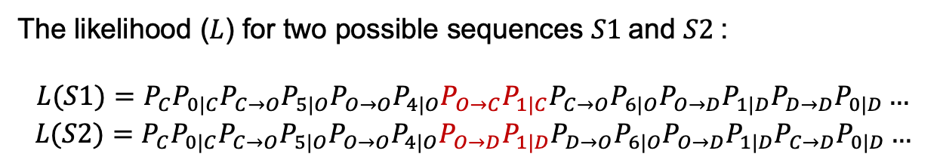
Consider two of the many possible state sequences.
COOCODD…
Hidden States 1: Hidden States 2: Observed (pA):
COODODD…
0541610…
The likelihood ($L$) for two possible sequences $S1$and $S2$:
$$L(S1)=P_{C}P_{0|C}P_{C→O}P_{5|O}P_{O→O}P_{4|O}P_{O→C}P_{1|C}P_{C→O}P_{6|O}P_{O→D}P_{1|D}P_{D→D}P_{0|D}…$$
$$L(S2)=P_{C}P_{0|C}P_{C→O}P_{5|O}P_{O→O}P_{4|O}P_{O→D}P_{1|D}P_{D→O}P_{6|O}P_{O→D}P_{1|D}P_{C→D}P_{0|D}…$$

Slide 24
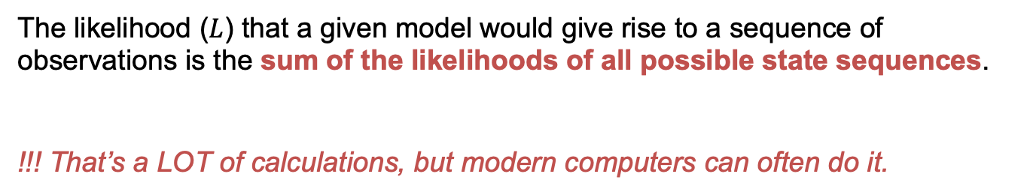
But the states are hidden.
???????…
Hidden States: Observed (pA):
0541610…
The likelihood ($L$) that a given model would give rise to a sequence of observations is the sum of the likelihoods of all possible state sequences.
!!! That’s a LOT of calculations, but modern computers can often do it.

Slide 25
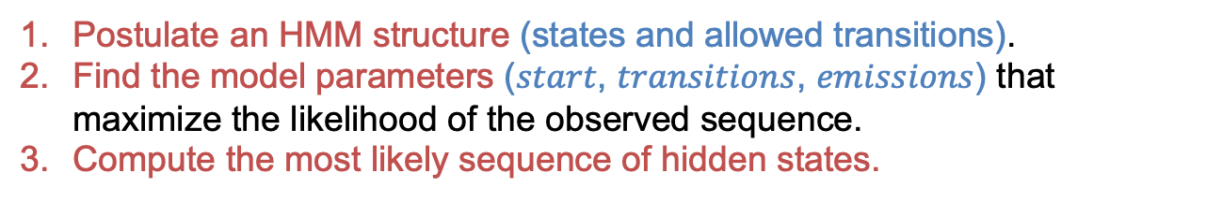
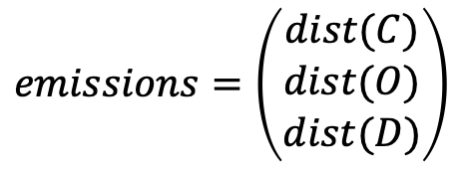
Modeling an observed sequence.
?????????????????????????????????…
Hidden States: Observed (pA):
054161001560001100100301014450610…
Postulate an HMM structure (states and allowed transitions).
Find the model parameters ($start$, $transitions$, $emissions$) that maximize the likelihood of the observed sequence.
Compute the most likely sequence of hidden states.
$$start=\left(\begin{matrix}P_{C} \\ P_{O} \\ P_{D}\end{matrix}\right)$$
$$transitions=\left(\begin{matrix}P_{C→C} & P_{C→O} & P_{C→D} \\ P_{O→C} & P_{O→O} & P_{O→D} \\ P_{D→C} & P_{D→O} & P_{D→D}\end{matrix}\right)$$
$$emissions=\left(\begin{matrix}dist(C) \\ dist(O) \\ dist(D)\end{matrix}\right)$$

