Slide 1
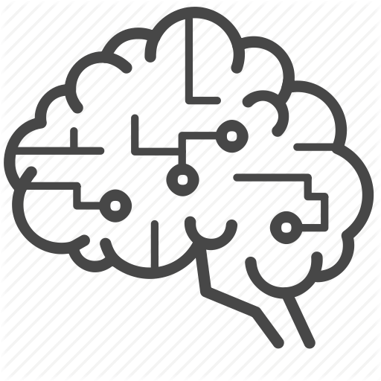


Visual Notes:
AI and Deep Learning
A short demonstration…
Notes:
Hi and welcome to this quick demonstration of our steps towards adapting Deep learning.

Slide 2


Visual Notes: Fade in the icons one by one. Show clock moving fast and time changing from 1995 to 2000.
Medical
Manufacturing
Retail
Financial
Media
Life Sciences
1995
Deep Learning
Notes:
For the past many years computer age has been transforming every major industries. Today, same can be said about AI. Today businesses are reaping the benefits of AI to create exponential value.

Slide 3







Visual Notes: Show AI icon in sync with audio and change the icons.
Time changes to 2000 to 2018.
2018
Deep Learning
Notes:
Today, same can be said about AI. Today businesses are reaping the benefits of AI to create exponential value. Today businesses are reaping the benefits of AI to create exponential value. One of the approach to AI that is rising rapidly and showing great promise, is deep learning. Deep learning is helping develop the autonomous, self-teaching systems which are revolutionizing many industries.

Slide 4







Visual Notes:
Please see if we can show the same thing with better visuals.
IMAGE AND VIDEO
ANALYZE
OUTPUT
Alert
Report
COMPUTER VISION
Classify
DEEP LEARNING
Notes:
Deep Learning has empowered many areas and one of them is Computer vision which gives the machine or computer, the capability to see and make sense of the world . With deep learning, computers can gain high-level understanding from digital images or videos. It can automate the tasks that human do today and can provide faster and better decision-making. To demonstrate the power of AI deep learning in computer vision we have done a proof of concept in this area.

Slide 5
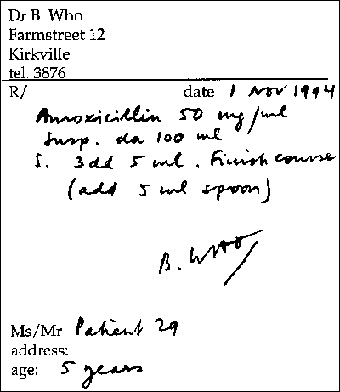




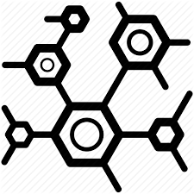
Visual Notes:
AX1: Show the neural network in half circle at the middle bottom of the page and image 1.
AX2: Show the image 1 being scanned. Then show image 2.
AX3: Zoom inside image 2 and show image 3.
Ax4: Zoom inside image 3 and show image 4.
Ax5: Zoom inside image 4 and show image 5.
Ax6: Zoom inside image 5 and show image 6 and then show image 7.
1
2
3
4
5
7
6
AMOXICILLIN
Notes:
AX1:
For this P O C, we trained a deep neural network to take images of doctor’s prescription and recognize the prescribed medications. Interesting isn't it? This will automate the digitization of prescription records.
The neural network system scans the doctor’s handwritten prescription and
AX2:
Segments the page text into logical segments
AX3:
Next level deals with text, scanning out the textual prescription
AX4:
The words are now segmented from the scanned text
AX5:
Finally the words are further segmented and letter are produced.
AX6:
And ultimately, the digitized version of the letters are attained.

Slide 6
Visual Notes: recreate the images in a better form.
After showing these steps in sync with audio.
Form Segmentation
Form Segmentation
Text Segmentation
Text Segmentation
Scanned Rx Form
Scanned Rx Form
Segmented Form
Segmented Text
Segmented Form
Segmented Text
Word Segmentation
Letter Segmentation
Segmented Words
Segmented Letters
Notes:
Starting from the form scan and segmentation to text, work, and finally letter segmentation, the procedure utilizes the power of deep learning building this solution.
Being automated, this process is going to have accuracy that is better than human and will be done in fraction of the time it use to take earlier.

Slide 7
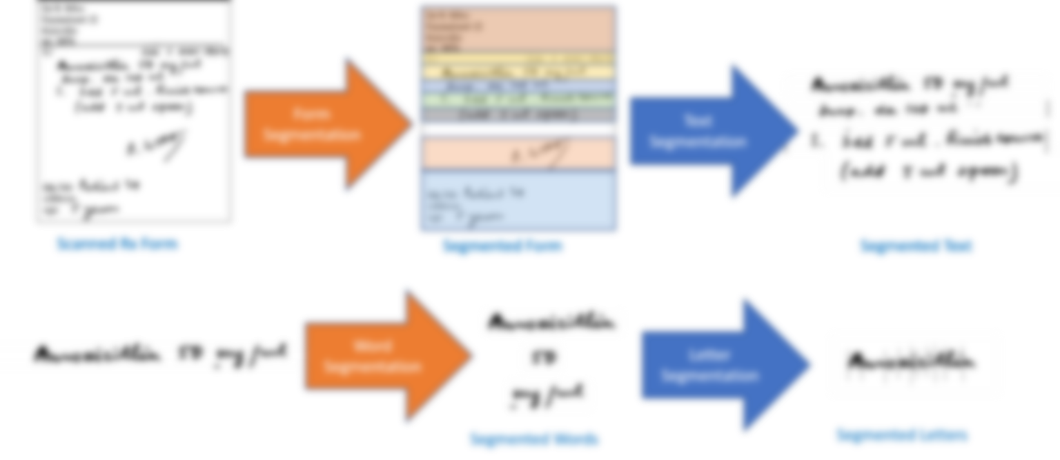
Visual Notes: Blur the previous image. Show the text boxes in sync with the audio.
State of the Art Frameworks
Cutting Edge Technology
Latest Architectures
Technical Trends
Result Oriented
Notes:
To keep the P O C in line with the top tech trends in the field of computer vision and deep learning, state of the art frameworks and architecture has been used. The architecture from latest research papers has been consulted so that the POC remains relevant in this every advancing field.

Slide 8



Visual Notes:
Clock with speed, Hand with Accuracy and efficiency, and cost with coins.
Notes:
Deep Learning will help in getting high quality results with greater speed, accuracy and efficiency together bringing down the cost. Consequently, the defect detection and resolution costs are reduced.

Slide 9

Visual Notes:TFS Short Term and Long Term Funding.fla (frames 9995 – 9990). Show the faces happy.
Notes:
Deep Learning helps automate mundane task freeing up the resources to concentrate on more valuable tasks providing job satisfaction!

Slide 10


Visual Notes:
Show appealing animation on the green image and the gear icons revolving.
Artificial Intelligence is future!
Notes:
So Like these, many more areas are yet to be explored for the best we can get out of AI to evolve and build a magnificent future. Thanks for watching!

