Slide 1
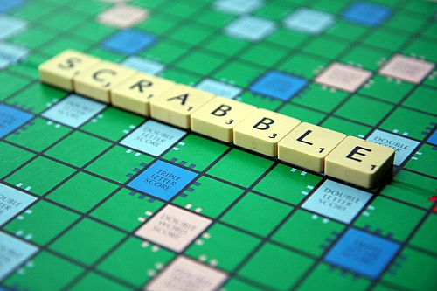
SharpScrabble
A multiple agent implementation of the classic word game Scrabble
Tim Goric, Will Sanville, and Matt Simmons

Slide 2
Agenda
Scrabble Overview - Matt
Our Implementation – Matt
Player Strategies – Matt
AI Strategies – Tim
Utility Functions – Will (Matt)
Tests and Analysis – Tim
Demos
Wrap-up and Q&A

Slide 3
About the Game of Scrabble
Typically 2-4 players
Players attempt to create intersecting words on a 15x15 playing surface and out-score all other players before all letters are gone
Players have up to 7 letters at a time, randomly selected from a bag at each turn
100 tiles in standard Scrabble
  98 letters
  2 blanks (wildcards)

Slide 4
About Our Implementation
Game State / Game Engine / Dictionary
  F# .NET 4.0
    .NET functional programming language
  Dictionary containing ~179,000 words
    US & Canada official Tournament Word List
User Interface
  C# 4.0
  WPF

Slide 5
The Scrabble Environment
Partially Observable
  Players/Agents can not see other players' tiles
  Remaining Tiles left in bag are not observable
  Board state and players' own tiles are fully observable at all times.
Deterministic
  A player knows what will happen when they place tiles or Pass
  When replenishing tiles or dumping letters, the resulting letters are unknown
    Unless there are sufficiently few tiles left in the bag

Slide 6
Scrabble Environment (contd.)
Multi-agent
  2-4 agents or human players
  Typically competitive agents
Static
  While a player is taking their turn, the game state does not change until an action is performed
Discrete
  Technically, while gigantic in size, there is a finite set of possible states
    100 separate tiles, with 27 distinct values, placed in variable length word sequences on a 15x15 board

Slide 7
Player Strategy
Most Typical -- ( Brute-Force )
  Make the highest scoring word possible, taking advantage of modifier squares
  Do not take into account any future moves of other players
Other Strategies
  Defensive play
    Attempt to reduce opponents' chances of playing likely words or keeping opponents' away from multipliers
    Utility function takes into account minimizing that of the opponents' utilities
    Short words (2 and 3 letter) accomplish both

Slide 8
Player Strategy (contd.)
Look ahead
  Attempt to figure out what might happen in the next n turns
  Try to anticipate what words opponents might play and what state the board will be in when your next turn starts
  Unless the tile bag is close to empty, this is very difficult
    In a 4 player game, there are 21 player tiles unknown to each player, not even taking into account the tiles left in the bag, each having one of 27 possible values
    Calculating all of the various positions and intersections adds additional complexity

Slide 9
Other Potential Utilities/Rewards
Games aren't just about winning
Amusing words or sequences
  Human players might play a word that is not necessarily maximal scoring in favor of a higher entertainment value
Cooperative agents/players
  Players might cooperate to minimize another player's or agent's score
    Maybe Players 1-3 don't like Player 4

Slide 10
Our AI Strategies
Brute Force
  Find all possible moves for the given tiles on the board
Hill Climbing
  Start at a random tile on the board
  Find possible moves until a move's utility is lower than the previous (local maximum is found)
Random-restart Hill Climbing
  Same as hill climbing, but after finding a local maximum, restart at a randomly chosen tile n times

Slide 11
Our Utility Functions
Maximum Score
Save Common Letters
  In hopes of being able to make 7-letter word later
Smart S moves
  Only play an S if it will be part of two words
Use Bonus Tiles
  Defensive strategy, so opponent can't use them
Only Words > 5 letters
Combinations of any of the above

Slide 12
Agent Strategy Analysis
Brute-Force is best
  It turns out Score is king
  Typically maximizes outcomes
Other possible considerations
  Rack management
    Don't leave yourself with a tray full of vowels
  Modifier Squares
    Save high-scoring tiles for play on letter or word multipliers

Slide 13
Strategy Analysis
Based on AI v AI simulations, 300 games each

Slide 14
Utility Function Analysis

Slide 15
Demos
Human vs. Agent(s)
Agent(s) vs. Agent(s)

Slide 16
Other Games We Considered
(and why we didn't pick them)
Connect 4
  Too simple, known to be solvable
Chess
  Too well documented, it's already been done
Stratego
  Board setup makes initial branching factor too large to manage

Slide 17
Lessons Learned
Chance nodes / Randomization causes very large increases in complexity
In the interest of time, we should have picked an open-source game implementation and added AI
  Too much time spent creating engine and UI
Sometimes the simple and most obvious approach works the best

Slide 18
Questions?

