Slide 1
Special Function Registers

Slide 2
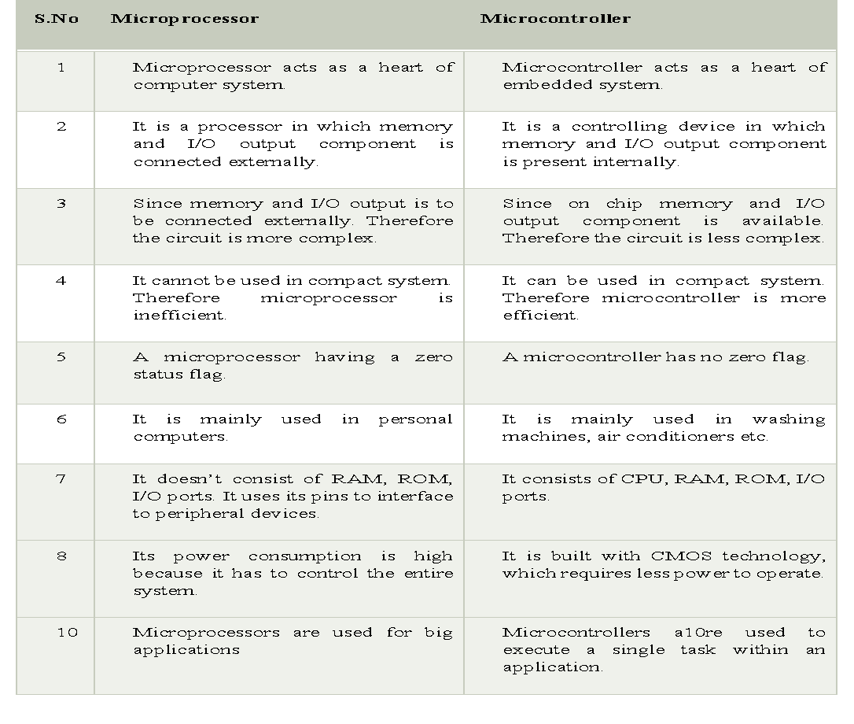

Slide 3
Registers
General purpose and special purpose registers
General purpose register : Banks, bit addressable area, scratch pad memory
Special purpose registers:

Slide 4
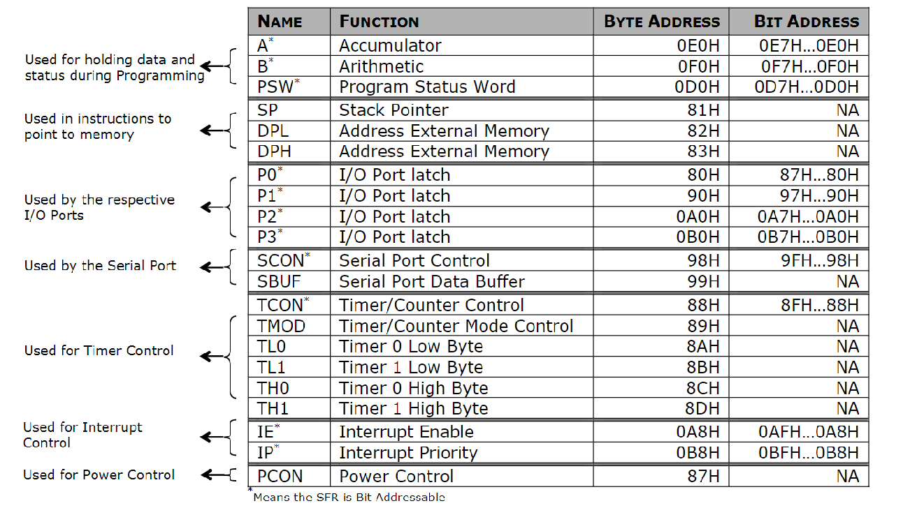
Special Function Registers (SFRs of 8051)
21 8-bit SFR’s are there in 8051

Slide 5

Timer Control Register(TCON)
TF0/TF1: Timer0/1 overflow flag is set when the timer/
counter overflows, reset by program
TR0/TR1: Timer0/1 run control bit is set to start, reset to
stop the timer0/1
IE0/IE1: External Interrupt 0/1 edge detected flag: 1 is set
when an external interrupt edge is detected.
IT0/IT1 External Interrupt Type (1: falling edge triggered, 0
low level triggered)

Slide 6

Timer Mode Register(TMOD)
GATE: This bit is used to start or stop the timers by hardware/software .When GATE= 1 ,the timers can be started / stopped by the external sources. When GATE= 0, the timers can be started or stopped by software instructions like SETB TR0 or SETB TR1
C/T (counter/Timer) : C/T = 0 ,the Timer is used as delay generator and if C/T=1 the timer is used as an event counter.

Slide 7
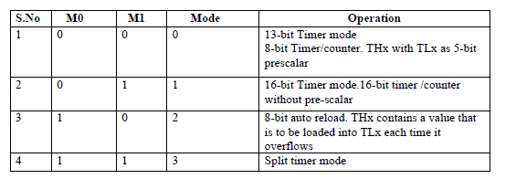
Timer Mode Register(TMOD)

Slide 8
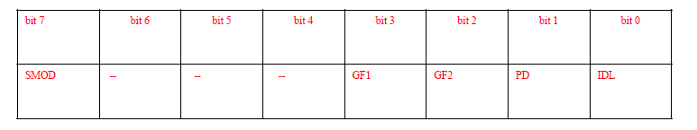
PCON ( Power Control Register)
SMOD(serial mode) 1= high baud rate, 0 = low baud rate
• GF1, GF2 flags for free use
• PD: 1= power down mode for CMOS
• IDL: 1= idle mode.
In Power Down mode, the oscillator clock provided to system is OFF i.e. CPU and peripherals clock remains inactive in this mode.
In Idle Mode, only the clock provided to CPU gets deactivated ,whereas peripherals clock will remain active in this mode.
Hence power saved in power down mode is more than in idle mode.

Slide 9
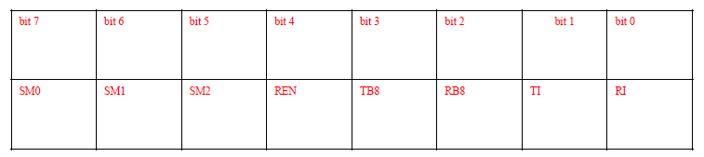
SCON ( Serial Port Control Register)
REN: Receiver enable is set/reset by program
TB8: This selects 9th bit that will be transmitted in mode2 and mode3
RB8: In mode 2 ,3 this is the 9th data bit that was received.
TI: Transmit Interrupt is set at the end of 8th bit (mode 0)
or at the stop bit (other modes) indicating the completion
of one byte transmission, reset by program
• RI: Receive Interrupt is set at the end of 8th bit (mode 0)
or at the stop bit (other modes) indicating the completion
of one byte receiving, reset by program
RI and TI flag in SCON SFR are used to detect the interrupt events.
If RI = 1 then a byte is received at the RxD pin. If TI = 1 then a byte is
transmitted from the TxD pin.
SM2-This enables multiprocessor commn feature in mode2 and mode3.

Slide 10
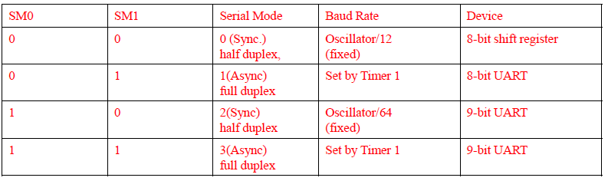
SCON ( Serial Port Control Register)

Slide 11

Interrupt Enable Register (IE)
EA : Global enable/disable. To enable the interrupts this bit must be set High.
Undefined-reserved for future use.
ET2 : Enable /disable Timer 2 overflow interrupt.
ES : Enable/disable Serial port interrupt.
ET1 : Enable /disable Timer 1 overflow interrupt.
EX1 : Enable/disable External interrupt1.
ET0 : Enable /disable Timer 0 overflow interrupt.
EX0 : Enable/disable External interrupt 2

Slide 12

Interrupt Priority Register (IP)
IP.7: reserved
IP.6: reserved
IP.5: Timer 2 interrupt priority bit (8052 only)
IP.4: Serial port interrupt priority bit
IP.3: Timer 1 interrupt priority bit
IP.2: External interrupt 1 priority bit
IP.1: Timer 0 interrupt priority bit
IP.0: External interrupt 0 priority bit

Slide 13
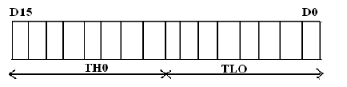
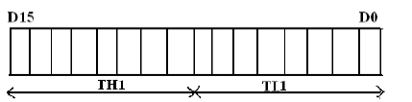
TIMER 0 and TIMER 1

