Slide 1
Docker in 5
ATOS Lightning Talks
October 21, 2014

Slide 2


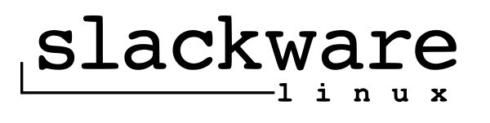

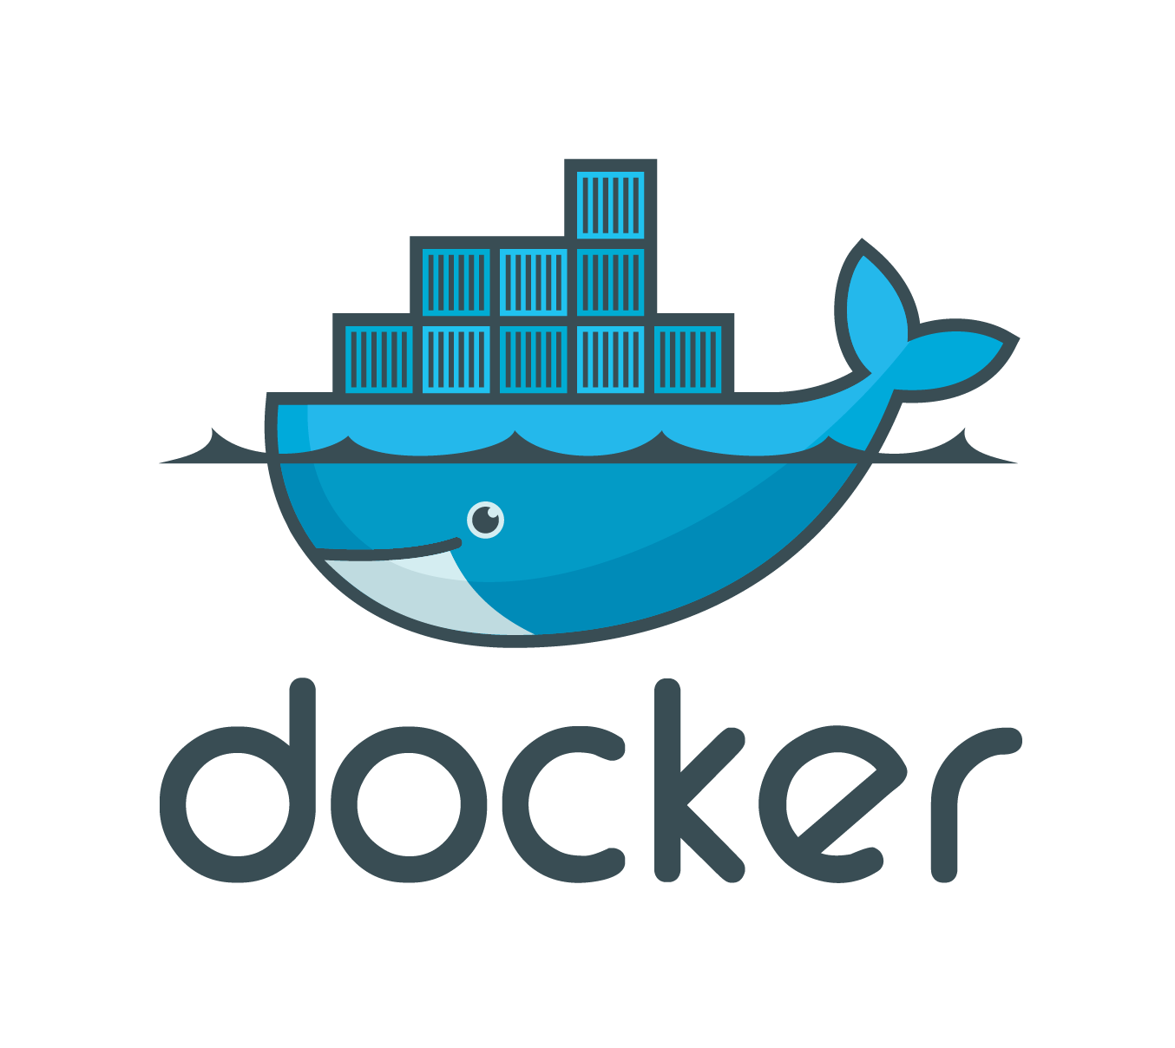




$> id vbatts

Slide 3

What is all this about?

Slide 4
History of the Pieces
Resource control groups (cgroups) ~2.6.24
Namespacing: mount 2.4.19; UTC and IPC 2.6.19; PID and network 2.6.24; User 3.8
Lxc ~2008, with a 1.0 in 2014
Docker ~2013, with a 1.0 in 2014

Slide 5
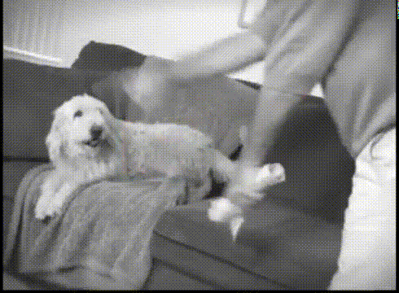
Conflicting Runtimes?

Slide 6
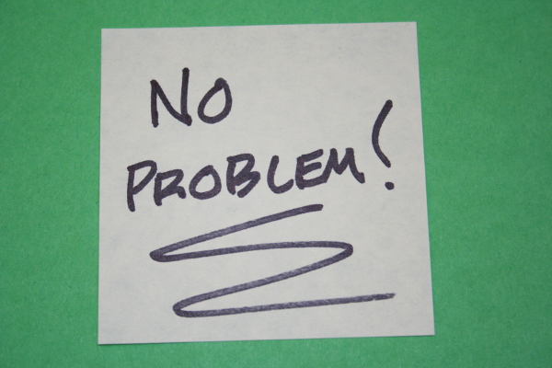

Slide 7

Mapping Ports and Services?

Slide 8


Slide 9

Hearing “it works for me” to much?

Slide 10


Slide 11
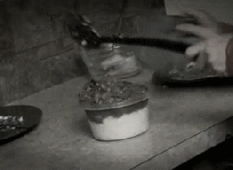
ops-to-dev: “you want to run WHAT?”

Slide 12


Slide 13

dev-to-ops: “you're doing WHAT?”

Slide 14
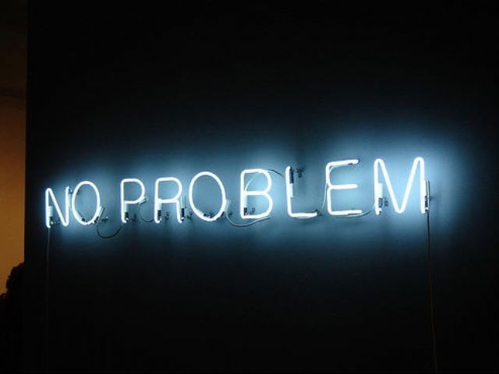

Slide 15


Slide 16

Reproducibility too complicated?

Slide 17


Slide 18
Wait, what are we talking about?
$> docker run busybox echo 'Hello, World!'
Hello, World!

Slide 19
> docker run -P -d crosbymichael/redis
25e7d262e8cec4a4b8549f7f6a668d2f3bdcfe09d13e43742ee16a3ecad11957
> docker ps
CONTAINER ID IMAGE COMMAND CREATED STATUS PORTS NAMES
49f5cb382147 crosbymichael/redis:latest "redis-server --bind 2 seconds ago Up 2 seconds 0.0.0.0:49155->6379/tcp berserk_lalande
> docker exec -it 49f5cb382147 cat /proc/1/cmdline
redis-server 0.0.0.0:6379

Slide 20
Build and share
> cat Dockerfile
FROM fedora
RUN yum install myapp
EXPOSE 8080
CMD /usr/bin/myapp
> docker build -t vbatts/myapp .
[...]
> docker push vbatts/myapp
[...]

Slide 21
Questions?
FIND ME vbatts

