Slide 1

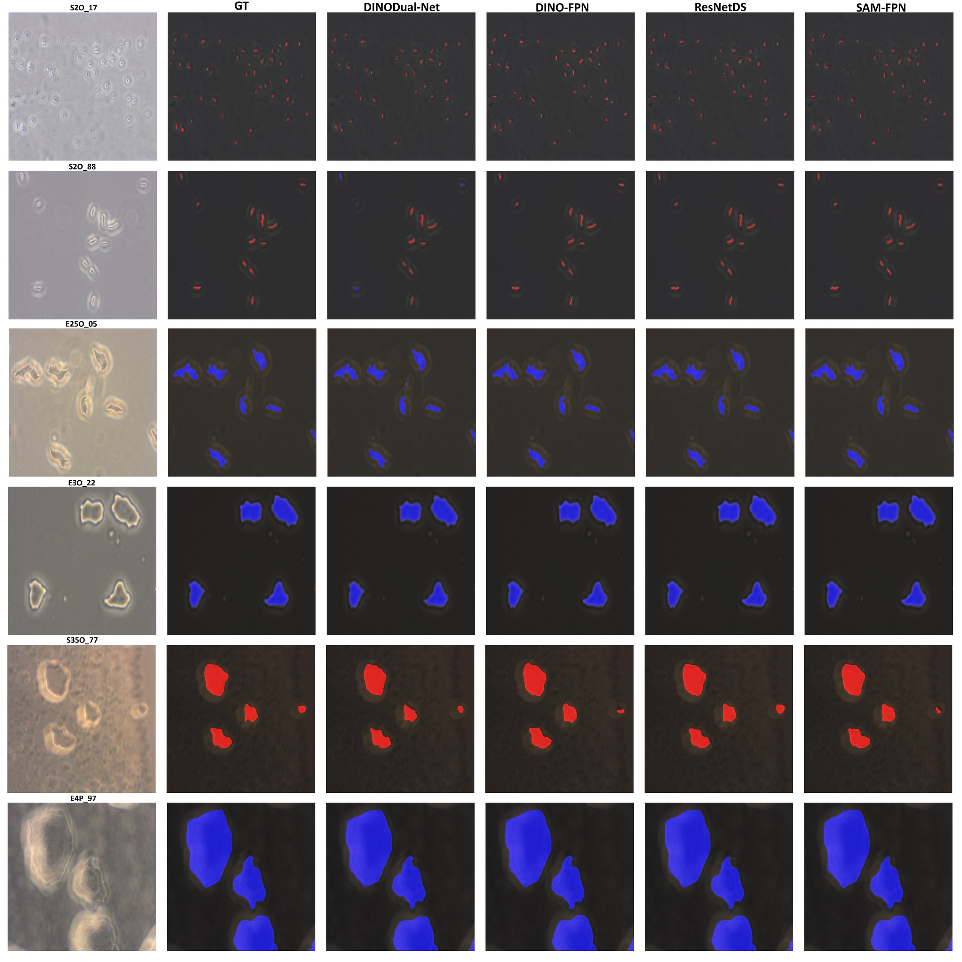
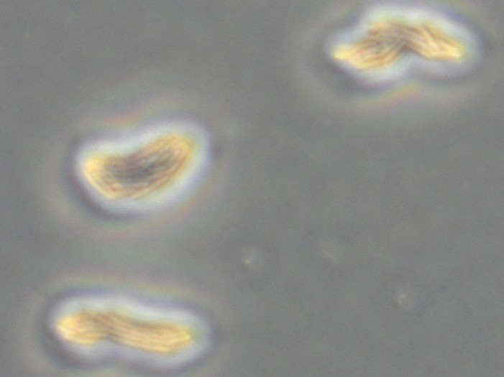
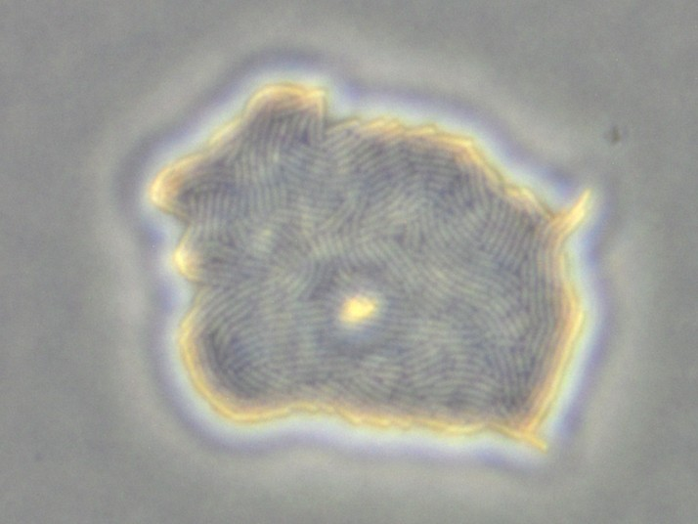
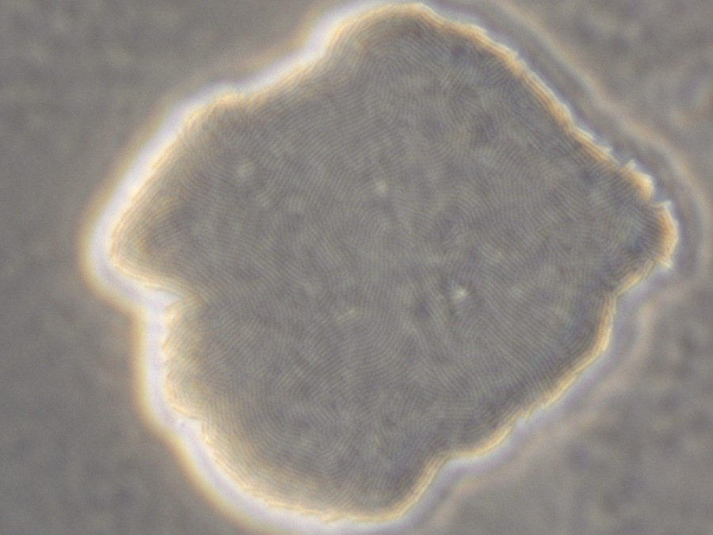
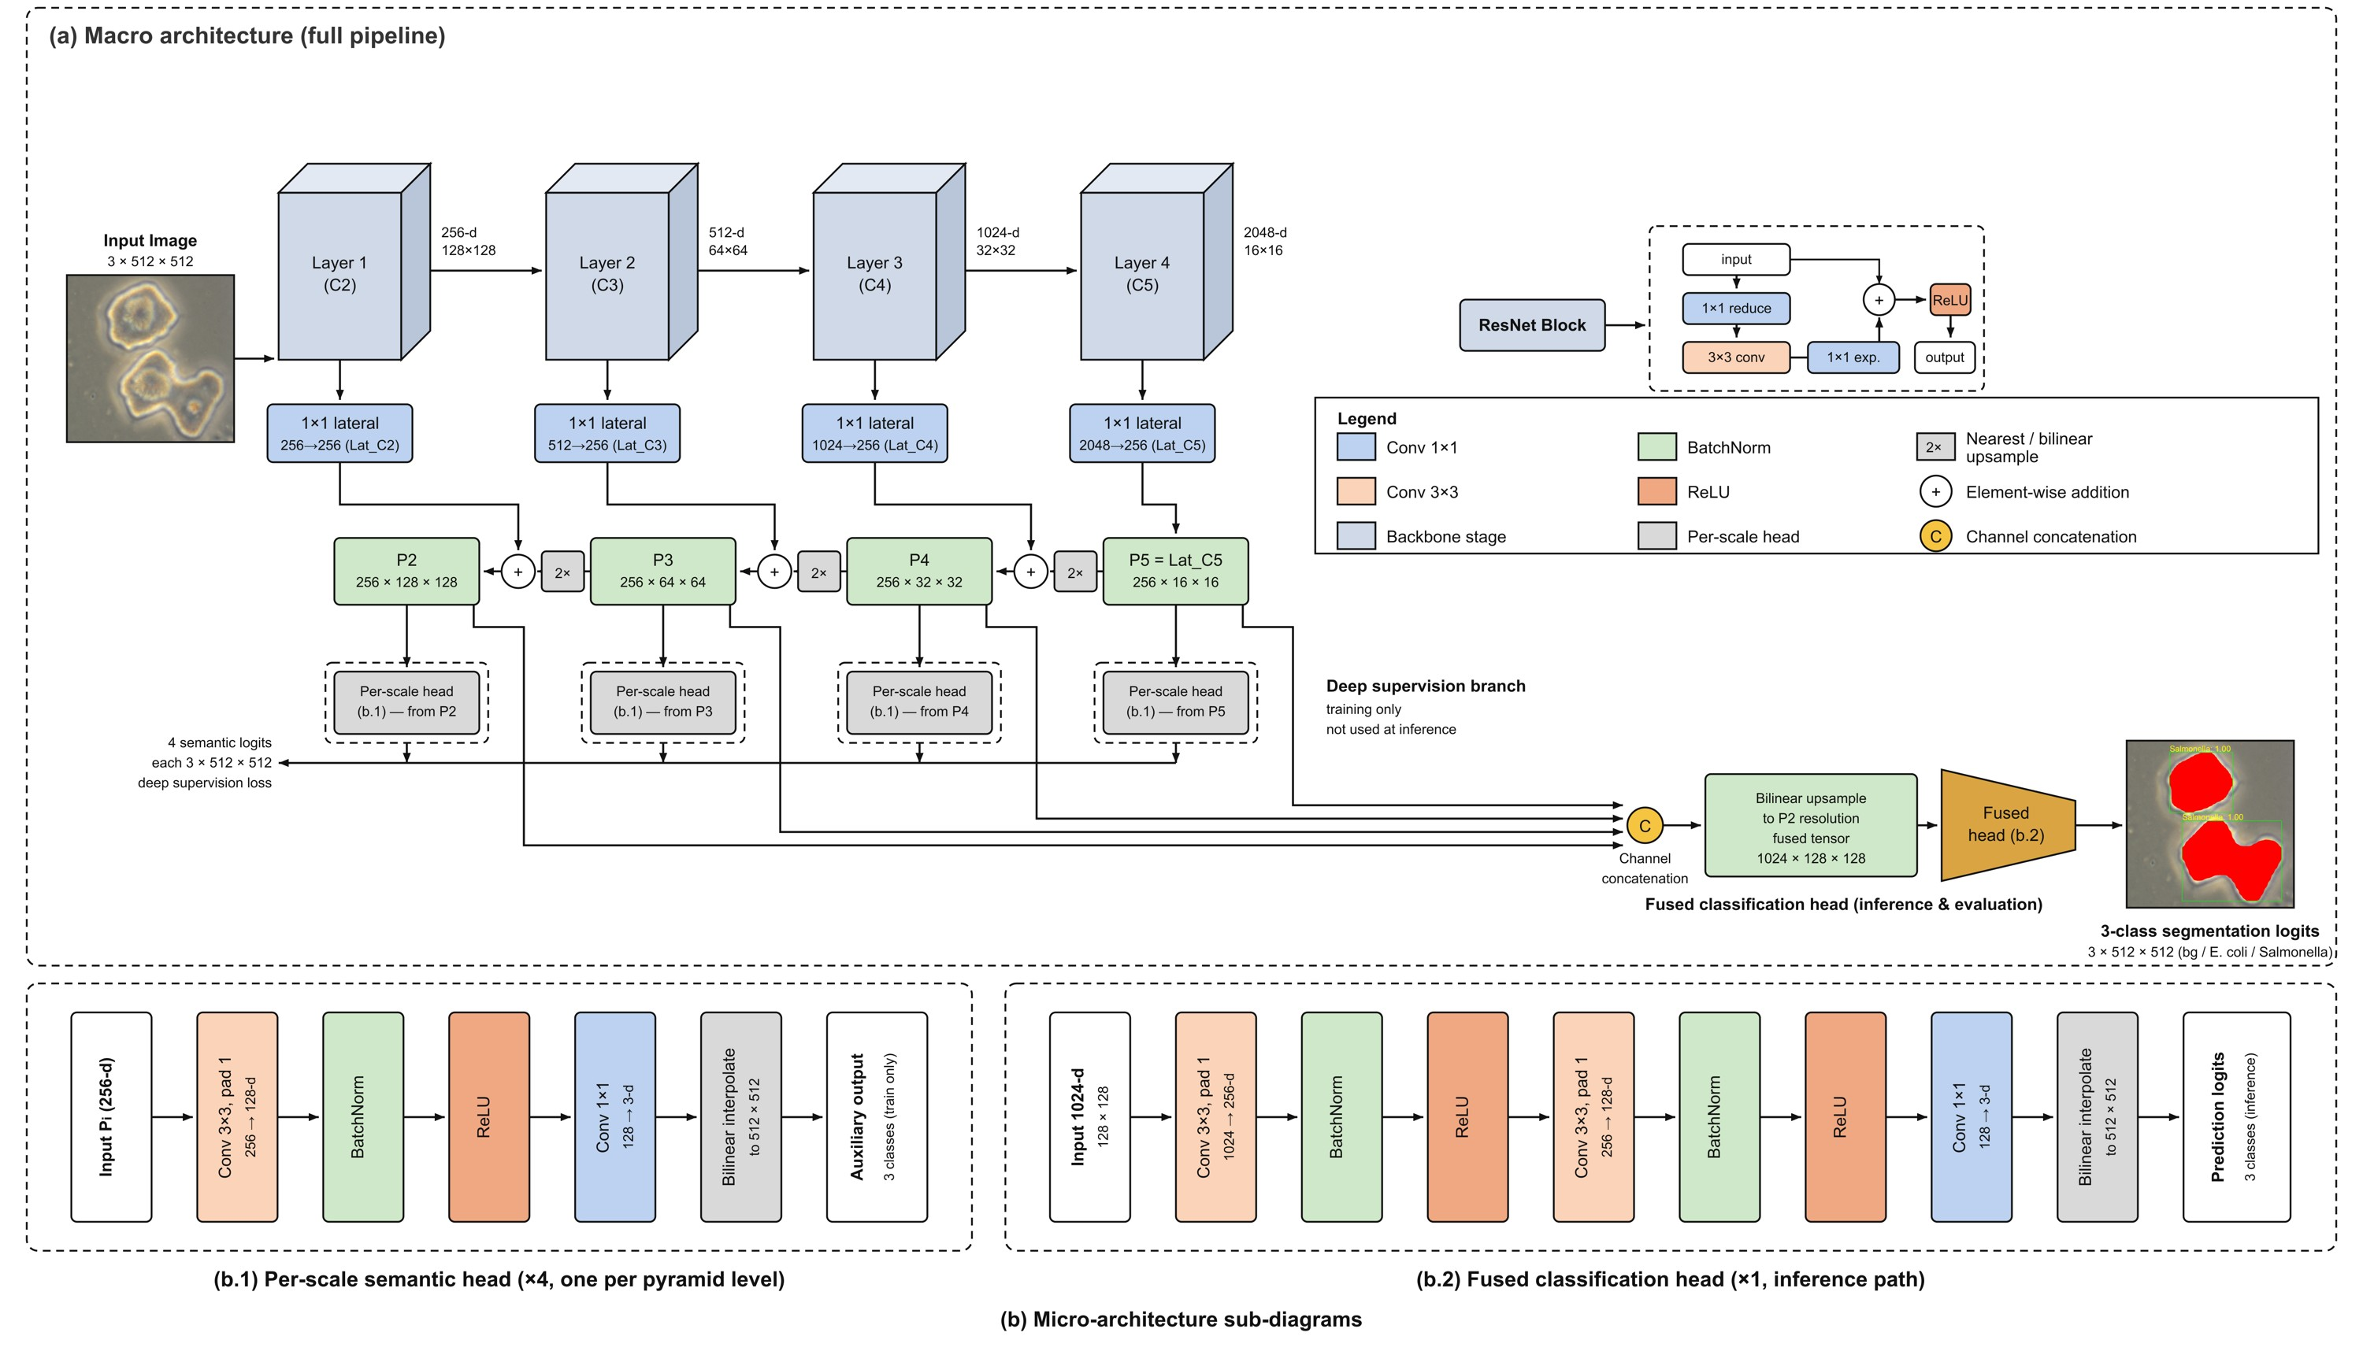
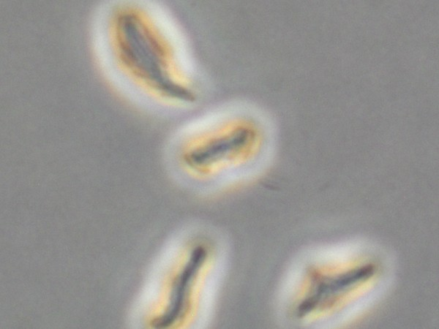
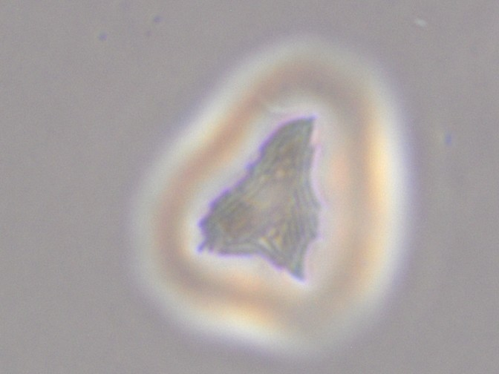
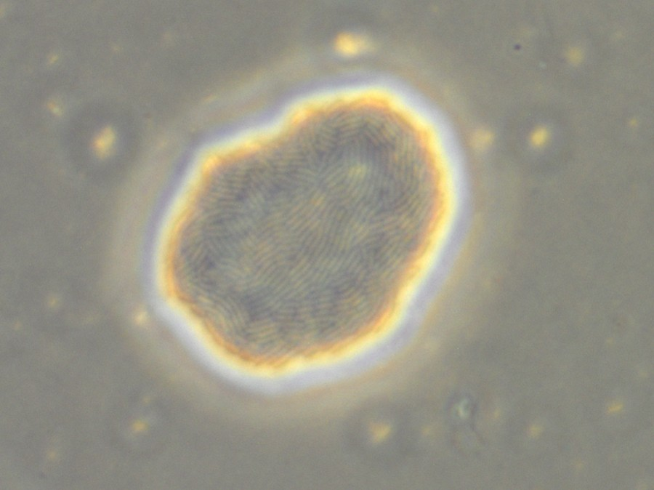
FOOD SAFETY · MICROSCOPY · DEEP LEARNING
Smaller, Faster, Just as Accurate
DETECTED & IDENTIFIED AT
2 h
A Compact Deep Learning Model for Rapid Detection of E. coli and Salmonella
of incubation, vs. 18–24 h
for culture-based counts
Bibek Koirala · Anas AlSobeh · Abdur Rahman Bin Shahid
School of Computing, Southern Illinois University Carbondale
0.901
FOREGROUND IOU
0.825
PANOPTIC QUALITY
8.1 ms
PER IMAGE
22×
FASTER
14×
LESS GPU MEMORY
0.16
COUNT ERROR
best of four models
best of four models
123 images / s on one GPU
than the SAM-based model
671 MiB vs. 9.6 GB
colonies / image, E. coli
1
WHY THE FIRST HOURS MATTER
3
A CONTROLLED COMPARISON
5
ACCURACY: COMPACT MATCHES LARGE
8
WHAT THE MODELS SEE
Culture-based detection of foodborne pathogens needs 18–24 h or longer before colonies can be counted, delaying intervention in the food supply chain. Imaging micro-colonies by phase-contrast microscopy moves that decision into the first hours of growth — if a model can find colonies only tens of pixels wide.
Four segmentation models were trained and tested under one protocol. Only the backbone and the decoder change, so every difference is attributable to architecture — and pairing one backbone with two decoders (and one decoder with two backbones) separates the two.
Metric
ResNetDS
SAM-FPN
DINODual
DINO-FPN
Foreground IoU ↑
0.901
0.900
0.893
0.889
Foreground Dice ↑
0.944
0.943
0.936
0.937
FOUNDATION MODEL
SELF-SUPERVISED VIT
Boundary F1 ↑
0.962
0.957
0.936
0.949
Culture confirmation
> 1 week
SAM-FPN
DINO-FPN
HD95, px ↓
6.85
5.14
5.98
5.53
Preliminary culture result
2–3 days
SAM ViT-B encoder, mask-pretrained · FPN + ASPP-lite + SE head
same decoder,
swap backbone
DINOv3 ViT-S/16, self-supervised · 32×32 tokens · SAM-FPN decoder
Species purity ↑
0.990
0.996
0.989
0.998
Colony plate count
18–24 h
Corpus mIoU ↑
0.942
0.936
0.932
0.940
Micro-colony imaging (this work)
2 h
94.5 M params · 662 GFLOPs
26.1 M params · 66.7 GFLOPs
F1 @ IoU 0.50 ↑
0.947
0.951
0.940
0.938
F1 @ IoU 0.75 ↑
0.817
0.810
0.815
0.759
Time to a screening decision (bar length approximately to scale).
Mean F1 [0.5:0.95] ↑
0.745
0.737
0.736
0.698
RESEARCH QUESTION
same backbone,
swap decoder
Panoptic quality ↑
0.825
0.823
0.817
0.798
Can a carefully designed compact CNN detect and identify both species at 2 h as accurately as large foundation-model backbones — at a fraction of the cost?
COMPACT CNN · OURS
SELF-SUPERVISED VIT
Count MAE, E. coli ↓
0.16
0.18
0.20
0.12
ResNetDS
DINODual-Net
Count MAE, Salmonella ↓
0.66
0.52
0.71
0.53
ResNet-50 (ImageNet) + FPN with deep supervision
≈ same size
& compute
DINOv3 ViT-S/16 · 14×14 tokens + full-resolution edge branch
ResNetDS is best on 7 of 12 metrics.
28.3 M params · 67.0 GFLOPs
26.7 M params · 48.2 GFLOPs
E. coli
Salmonella
2
DATASET: 20 CONDITIONS
6
EFFICIENCY: 22× FASTER
Columns: input · ground truth · DINODual-Net · DINO-FPN · ResNetDS · SAM-FPN
HELD FIXED
Same 2,000 images & split
Same loss toolbox
Latency ms / image, lower is better
Compute GFLOPs
Rows ordered by incubation time (2 h Salmonella on onion → 4 h E. coli on agar). From 2.5 h on, all models agree on colony extent and differ mainly in boundary tightness.
2
×
2
×
5
×
100
=
2,000
Same 5-view evaluation
512×512 · NVIDIA A30
ResNetDS
8.1
178.9
ResNetDS
67.0
662.4
species
backgrounds
time points
images
images
SAM-FPN
9.7
SAM-FPN
48.2
DINODual
15.3
DINODual
66.7
2 h
3 h
4 h
4
RESNETDS: THE COMPACT MODEL
DINO-FPN
DINO-FPN
9
CONCLUSIONS
E. coli
Peak GPU memory MiB
Parameters millions
ResNetDS
671
9,601
ResNetDS
28.3
94.5
2 h is enough
SAM-FPN
591
SAM-FPN
26.7
1
Both species are detected and identified after 2 h of incubation, on plain agar and on an onion food matrix.
DINODual
457
DINODual
26.1
135 µm²
1,909 µm²
9,960 µm²
DINO-FPN
DINO-FPN
2
Small is enough
Salmonella Typhimurium
SAM-FPN's two wins (HD95, F1 @ 0.50) cost 22× the latency, 10× the compute and 14× the memory of ResNetDS.
The 28.3 M-parameter ResNetDS matches or beats a 94.5 M SAM-based model and two DINOv3 models on IoU, Dice, boundary F1 and panoptic quality.
3
Cheap to run
63 µm²
264 µm²
1,269 µm²
7
THE HARD CASE: 2-H SALMONELLA
8.1 ms and 671 MiB per image make low-cost, in-line screening practical.
Representative micro-colonies with measured area. Between 2 h and 4 h, E. coli grows ≈ 74× and Salmonella ≈ 20× in area.
4
Signal, not model
IMAGING
Phase-contrast, 60×; 2160×1620 frames resized to 512×512
F1 at IoU > 0.5 after only 2 h of incubation. Every backbone drops on Salmonella (F1 0.75–0.91):
The 2-h Salmonella gap persists across all backbones; next gains come from imaging and data, not bigger models.
BACKGROUNDS
Plain agar and an onion food matrix (background-aware)
ImageNet-pretrained ResNet-50 → Feature Pyramid Network (256 channels). The fused head concatenates all four pyramid levels (1024 channels) and outputs a 3-class mask; connected components give per-colony instances and counts.
E. coli · agar
E. coli · onion
Salm. · agar
Salm. · onion
ACKNOWLEDGMENTS
ResNetDS
0.98
0.97
0.82
0.86
Dr. Namariq Dhahir and Dr. Amer AbuGhazaleh (bacterial culture, incubation, image acquisition); SIU Information Technology and Texas A&M HPRC (GPU resources). Supported by USDA-NIFA Capacity Building Grant No. 2024-70001-43667.
LABELS
Separately incubated pure cultures — species fixed by the plate, not guessed by eye
Multi-scale
Deep supervision
Imbalance-aware
SAM-FPN
0.90
0.99
0.91
0.83
FPN levels P2–P5 follow colonies from ≈ 25 µm² to ≈ 10,000 µm².
Four per-scale heads train every pyramid level; discarded at inference.
Focal + Dice + boundary-weighted + class-weighted cross-entropy.
DINODual
0.98
0.98
0.79
0.85
CLASSES
Pixel masks: background, E. coli, Salmonella
DINO-FPN
0.98
0.97
0.86
0.75
SPLIT
Fixed: 1,400 training · 400 held-out test images

