Slide 1
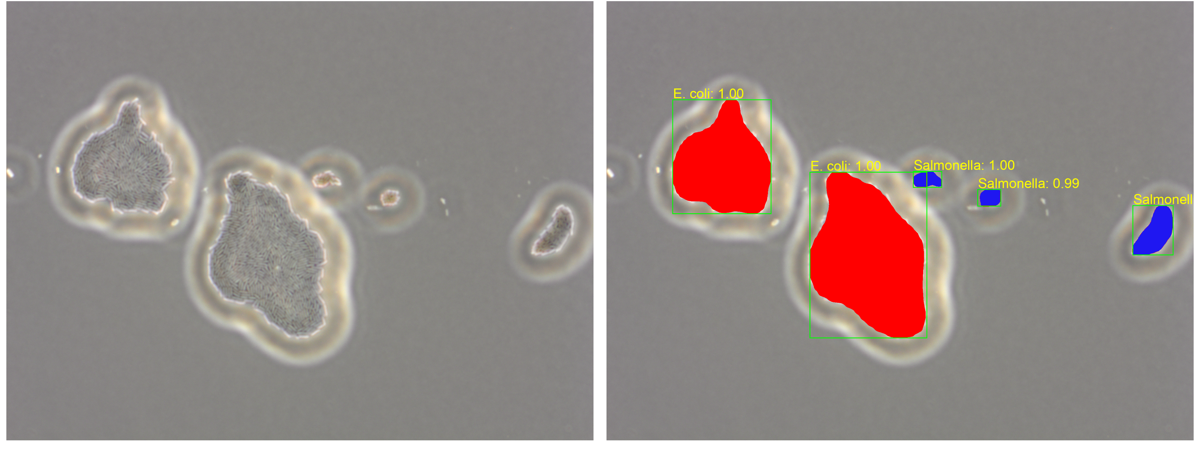
M.S. THESIS DEFENSE
Deep Learning Approaches for Early Detection and
Identification of Escherichia coli and Salmonella Typhimurium in
Time-Stamped Microscopy Images
Bibek Koirala
School of Computing, Southern Illinois University Carbondale
Chair: Dr. Abdur Rahman Bin Shahid
Committee: Dr. Anas AlSobeh · Dr. Henry Hexmoor
September 30, 2026

Slide 2
Food-safety testing is slower than the food supply chain
Culture confirmation
≈ $90 B
> 1 week
annual U.S. cost of foodborne illness
Preliminary culture result
2–3 days
Rapid assays (PCR, immunoassays, biosensors) are faster but costly or expertise-heavy;
Onion outbreaks (2020–2023) motivate a realistic onion food-matrix background
Micro-colonies are visible under a microscope after only 2–4 h
Colony-forming-unit plate count
18–24 h
Micro-colony imaging (this thesis)
≈ 2 h
Bars drawn to scale in hours (0–168 h). Turnaround times as reported in thesis Ch. 1–2.
Takeaway If a model can recognise a micro-colony at ~2 h, the screening decision moves from days to hours.

Slide 3
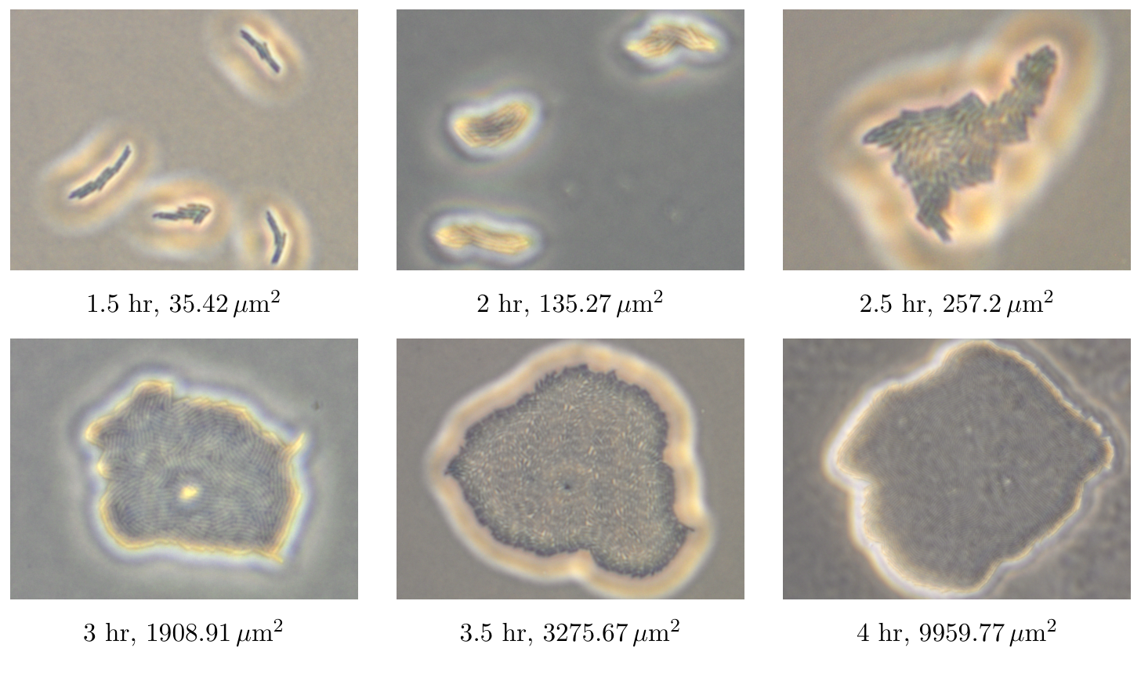
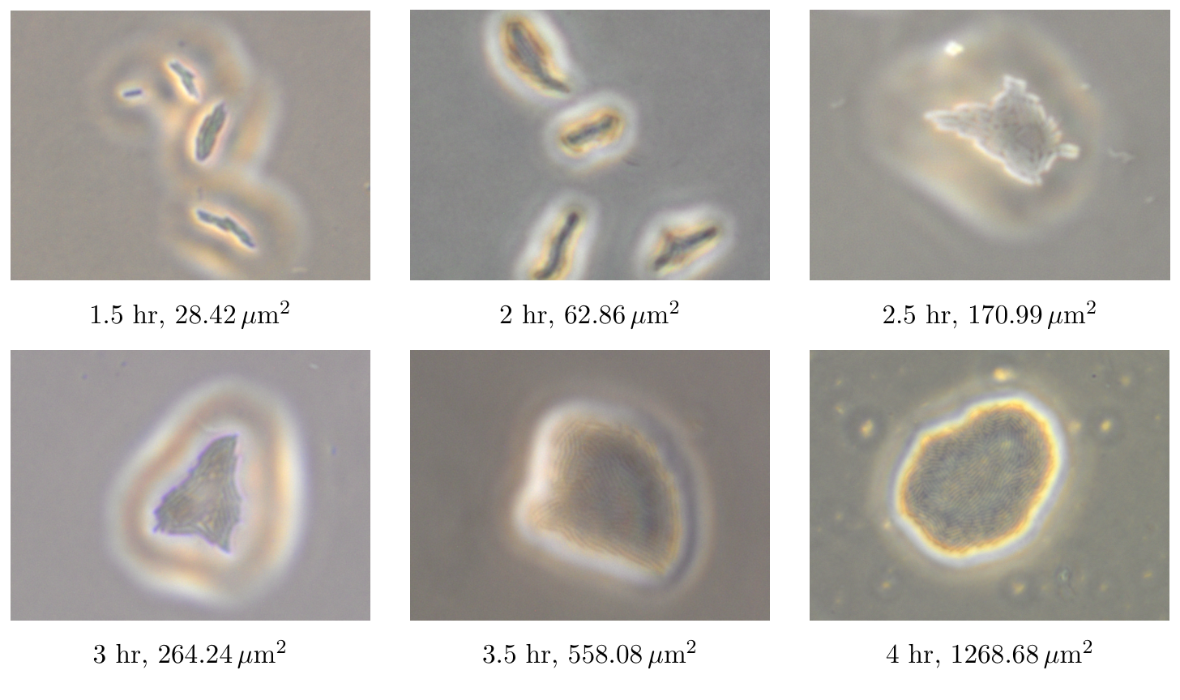
Why early detection is hard: tiny, look-alike, and cluttered
1
Scale shifts > 100×
2
Extreme imbalance
3
Look-alikes & clutter
Salmonella ≈ 50 → > 1,000 µm²; E. coli ≈ 100 → up to ≈ 10,000 µm² in 2–4 h.
A 2-h colony can be ≈ 64 × 64 px in a 2160 × 1620 frame; > 99.5 % of pixels are background.
Two related species with similar colonies; onion debris resembles small Salmonella colonies.
E. coli
Salmonella
Representative colonies 1.5–4 h with measured area (thesis Figs. 3.3, 3.4)

Slide 4
Research gaps this thesis addresses
A1
A2
A3
G1
Data
Limited background-aware, time-stamped early-detection corpus pairing both species on plain and food-matrix backgrounds
A1
A2
A3
G2
Size prior
Cell-segmentation tools (like Cellpose) require a diameter — unusable when
area varies > 100× over time
A2
G3
Architecture
Limited comparison of convolutional vs. foundation vs. self-supervised backbones with data, loss and protocol fixed
A3
G4
Evaluation
Results reported as one headline number (usually mAP@0.50) — insufficient for a deployment decision
A3
Tags show which approach closes each gap (thesis §2.7).

Slide 5
Research questions
RQ1
When?
RQ2
Trust?
How early can E. coli and Salmonella micro-colonies be reliably detected and identified?
How does label provenance (expert guesses on mixed plates vs. protocol-determined labels) change what we can trust?
RQ3
Cost?
RQ4
Limit?
Can a carefully designed convolutional model match a larger mask-pretrained transformer and comparably sized self-supervised transformers — and is their cost justified?
Which errors come from model or decoder design, and which reflect a limit of the visual signal at short incubation times?

Slide 6
One story, three approaches
A1
A2
A3
Each approach is motivated by a specific limitation of the one before it
Approach 1 — Journal Paper
Rapid Detection of Salmonella Typhimurium Microcolonies Using Phase-Contrast Imaging and Deep Learning
Journal of Food Protection
Accepted for Publication
Approach 2 — Conference Paper
Background-Aware Instance Segmentation for Early
Detection of E. coli and Salmonella in
Time-Stamped Microscopy Images
IEEE ICMLA 2025 Published
Approach 3 — Manuscript in Preparation
Rapid Detection of E. coli and Salmonella in
Microscopy Images: A Comparative Study of
ResNetDS, SAM–FPN and DINODual-Net,
DINO–FPN Architectures
APPROACH 1
APPROACH 2
APPROACH 3
Real-time detection
Clean-label instance segmentation
Controlled architecture comparison
A1
YOLOv8x · mixed + pure cultures
Mask R-CNN · separately incubated cultures
4 segmentation models · same data, loss, protocol
Q: Can a single-stage detector identify both species early and quantify growth?
Q: What is achievable once species labels are trustworthy?
Q: Can a convolutional model match transformer-based ones?
A2
Limitation → Mixed-field labels are assigned by
eye → model vs. label error not separable
Limitation → task vs. model effects confounded
A3
A1 → A2: improve supervision quality A2 → A3: isolate the architecture

Slide 7
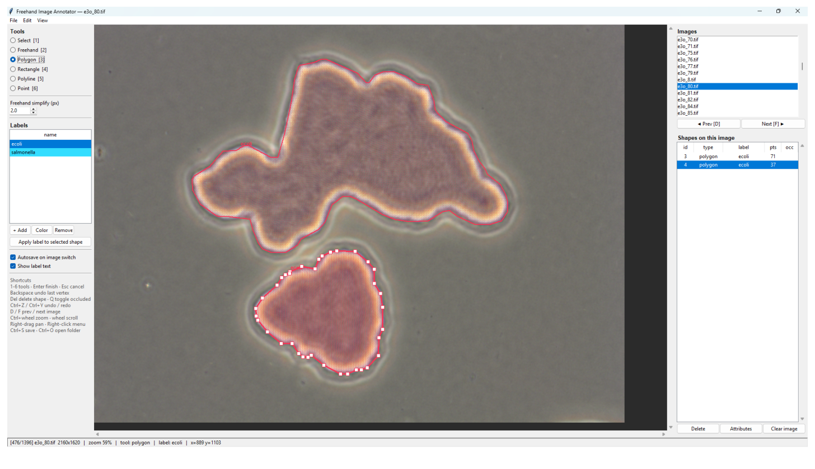
Shared experimental foundation
A1
A2
A3
Culture
(2 strains)
Plate
plain / onion
Incubate
37 °C
Image every
30 min · 60×
Annotate
(masks)
Train &
evaluate
Strains: Salmonella and Ecoli - related enteric bacteria with comparable colony morphology
Selective media: Chromogenic coliform agar
Backgrounds: plain medium and onion food matrix ("background-aware")
Optics: IX73 inverted microscope, 60× phase contrast, 2160 × 1620 px
Calibration: 2160 x 1620 → 270 x 202.5 µm²; used in all three approaches
Annotation: my Tkinter tool (offline, pixel-level, human-in-the-loop) + CVAT; COCO RLE; classes:E. coli, Salmonella
Custom annotation tool (thesis Fig. 3.1)

Slide 8
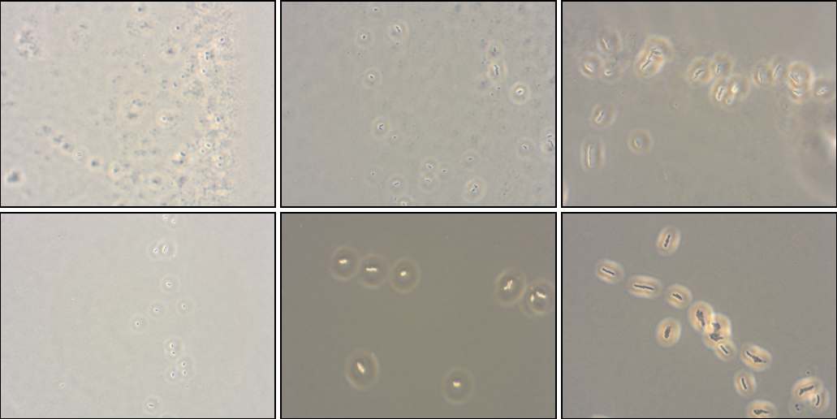
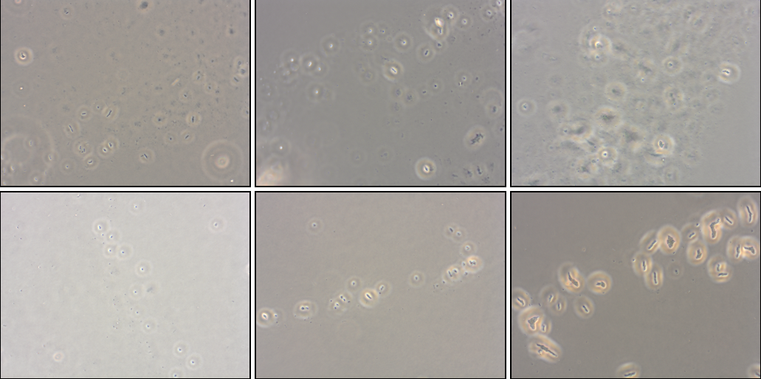
Exclusion of datasets
E. coli
Salmonella
30 m
1 hr
1.5 hr
30 m
1 hr
1.5 hr
W/O
WT/O

Slide 9
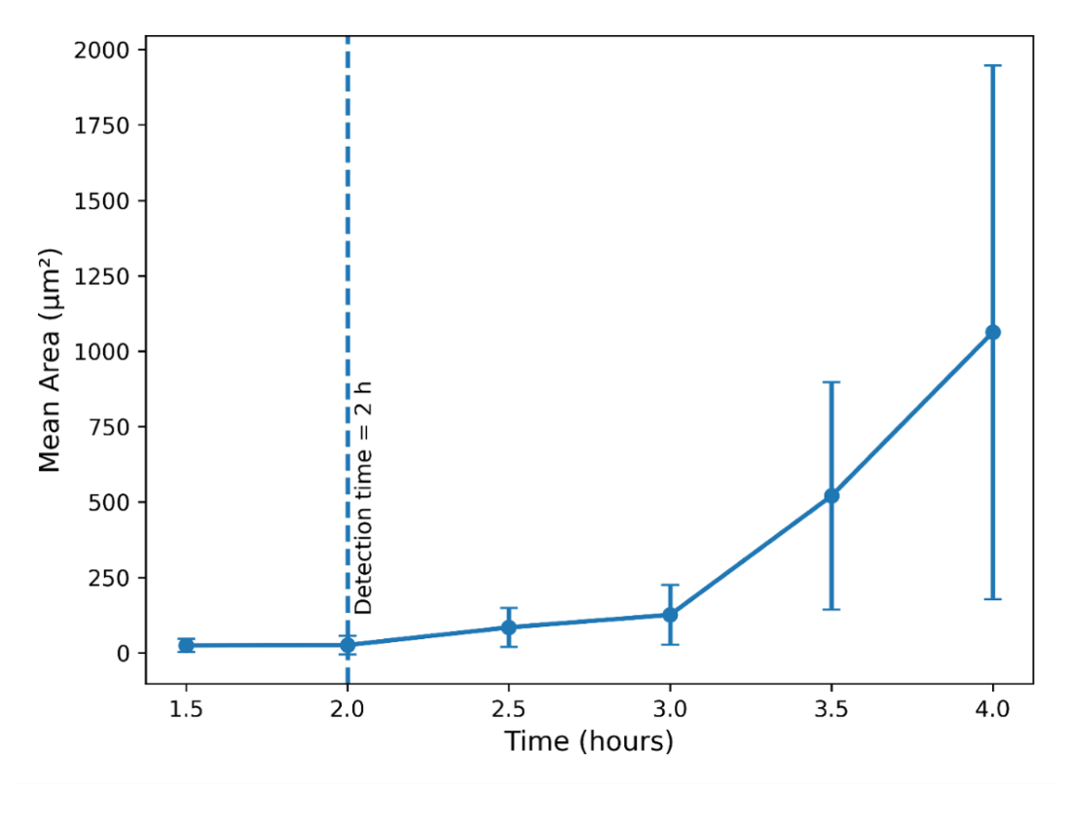
Approach 1 — growth in calibrated units
A1
A2
A3
4,981 images acquired (0.5–4 h)
≈ 25
µm² at 2 h
2,381 expert-verified images, 2–4 h
≈ 1,050
15,445 annotated micro-colony instances
µm² at 4 h
≈ 40×
3,181 pure · 1,200 mixed · 200 background-only
≤ 1.5 h excluded: colonies indistinguishable from onion debris and agar artefacts
Split: 1,663 / 240 / 478 (70/10/20), every condition in every split
YOLOv8x: CSP-Darknet + PAN-FPN, anchor-free head (strides 8/16/32); 100 epochs, 640 × 640
growth after 2 h
Mean colony area ± SD (thesis Fig. 4.2)
SD > 80 % of mean by 4 h

Slide 10
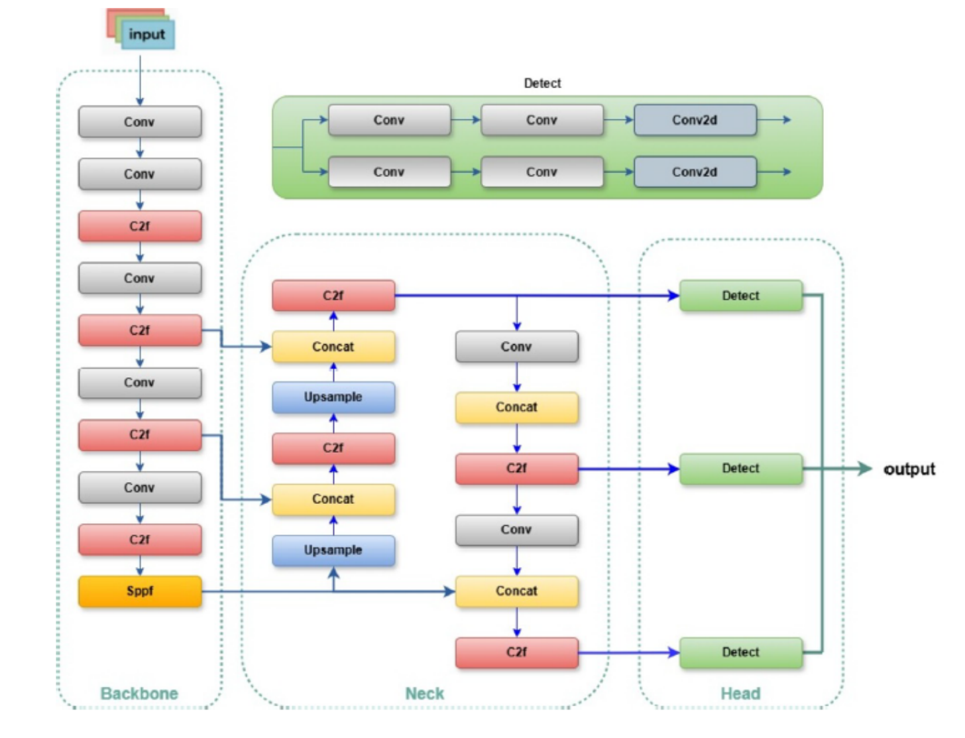
Approach 1 — detecting and naming both species
A1
A2
A3
YOLOv8x architecture (thesis Fig. 3.2)

Slide 11
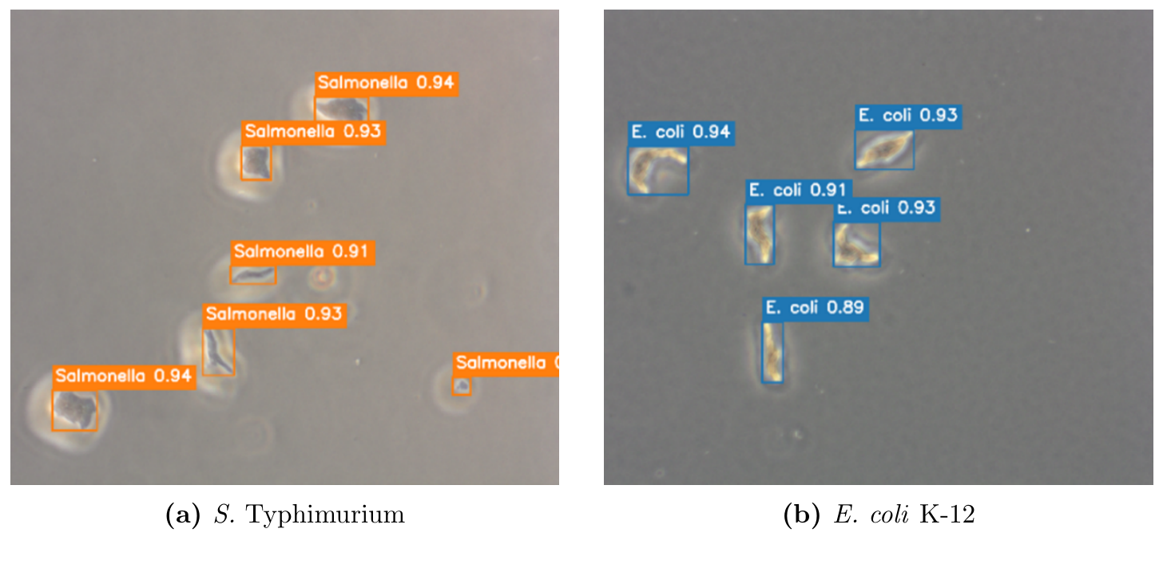
Approach 1 — detection works from 2 hours
A1
A2
A3
0.891
0.867
0.898
Precision
Recall
mAP@0.50
One forward pass localises and classifies both species; confidences mostly 0.85–0.99
≈ 1 in 9 detections unmatched — likely debris; in screening this triggers a re-test, the less costly error
Scope: pooled 2–4 h test set
YOLOv8x detections: (a) S. Typhimurium, (b) E. coli (thesis Fig. 4.5)

Slide 12
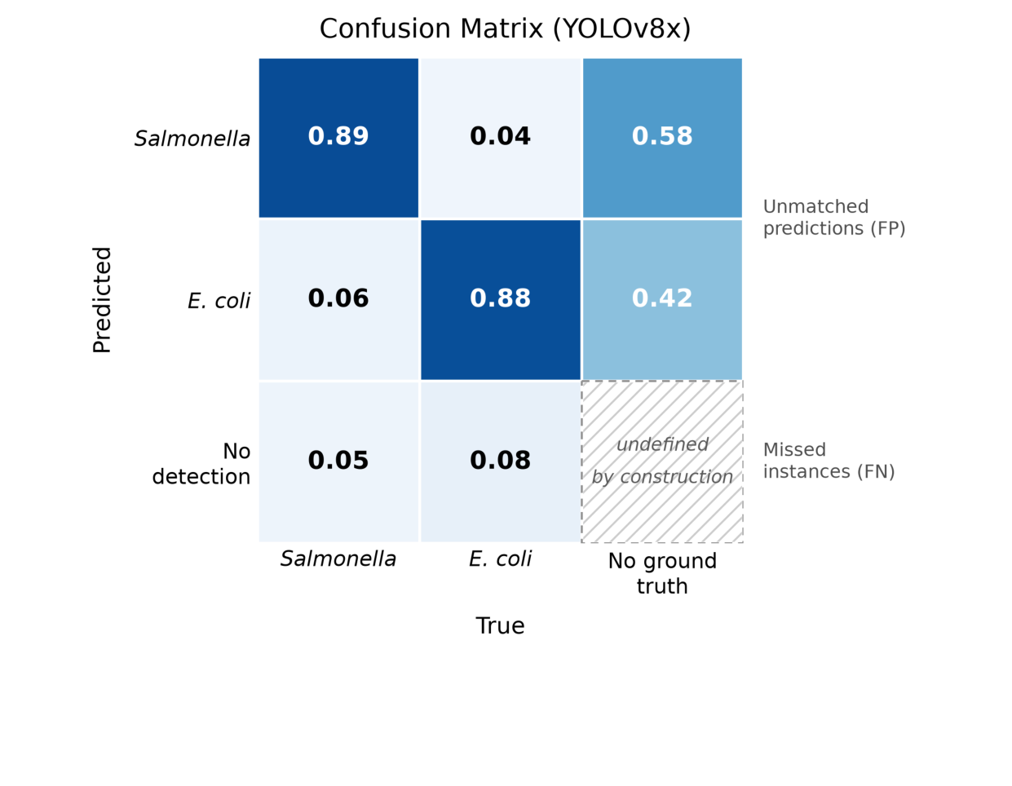
Approach 1 — can we trust the species labels?
A1
A2
A3
0.89 / 0.88 correct identification (Salmonella / E. coli)
0.06 / 0.04 cross-class confusion, in both directions
The hidden problem
On mixed plates, each colony’s species was assigned by expert eye
At 2–3 h, colonies are tens of pixels and look alike → false labels can enter training
Expert labels are the only ground truth → model error ≠ separable from label error
Column-normalised confusion matrix (thesis Fig. 4.6)
Takeaway The remedy is not a bigger model or a better annotator — it is a different experiment.

Slide 13
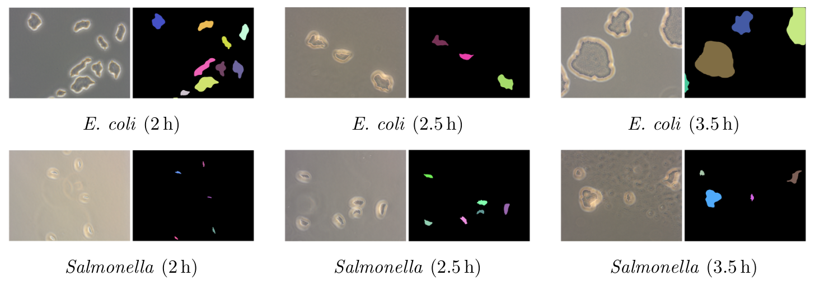
Approach 2 — the protocol assigns the label
A1
A2
A3
Approach 1 (mixed fields)
Approach 2 (separate plates)
?
E. coli plate
Salmonella plate
label = expert’s guess
Label fixed by protocol: every colony on an E. coli plate is E. coli
Mixed cultures withheld from training — qualitative generalization test only
2,200 images, 1.5–4 h, plain + onion (~100 per condition); split 80/10/10
Excluded: Salmonella on onion at 1.5 h and 2 h — colonies ≈ size of onion particles
Cost: smaller corpus, no mixed-culture training signal
Ground-truth instance masks at 2, 2.5, 3.5 h (thesis Fig. 3.5)
Annotation workflow
Manual masks with the Tkinter tool
CVAT-AI used for annotation
Converted to COCO RLE

Slide 14
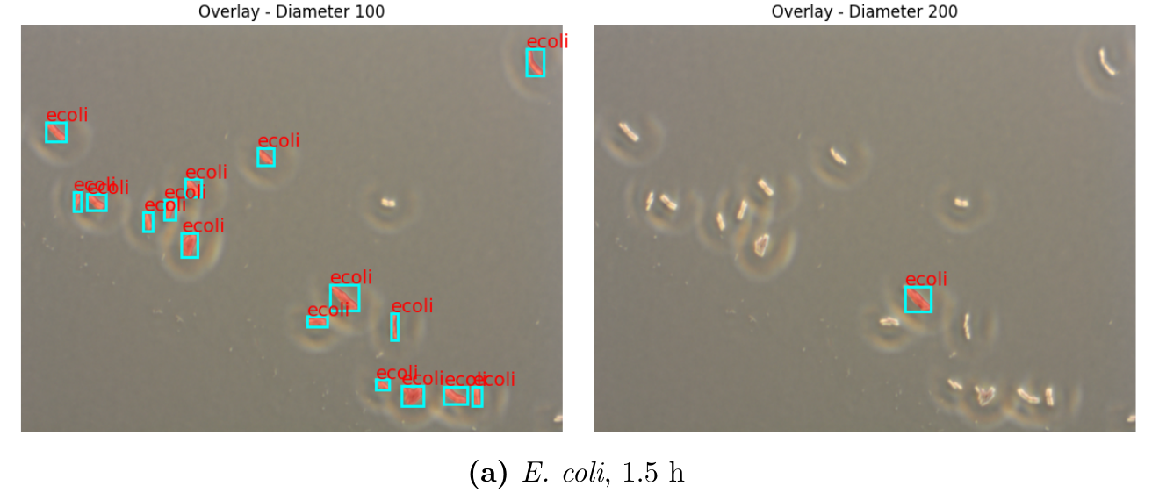
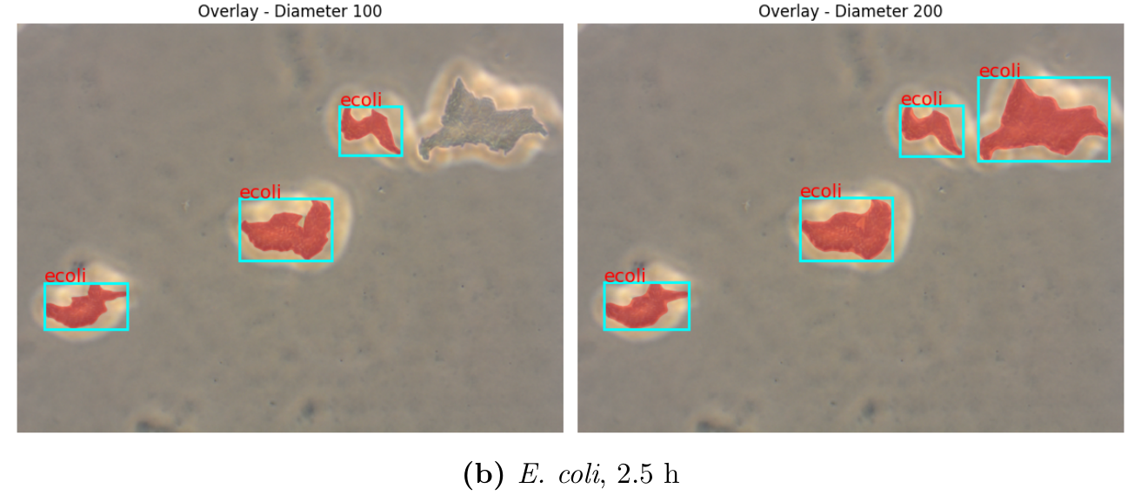
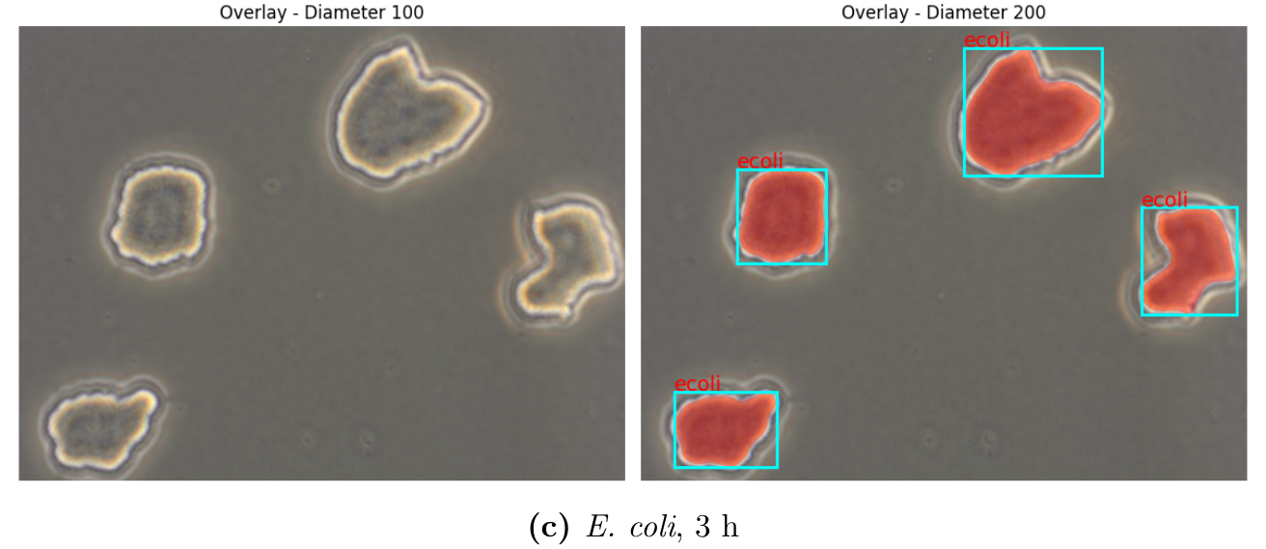
Approach 2 — a size prior cannot follow a growing colony
A1
A2
A3
Cellpose + ViT pipeline · each panel: diameter 100 px (left) vs 200 px (right)
Panels from thesis Fig. 4.7 (E. coli)
1.5 h 100 px ✓ · 200 px misses nearly all
2.5 h 100 px misses the largest colony
3 h 100 px finds none · 200 px ✓
Takeaway Scale must be learned from data, not supplied as a parameter.

Slide 15
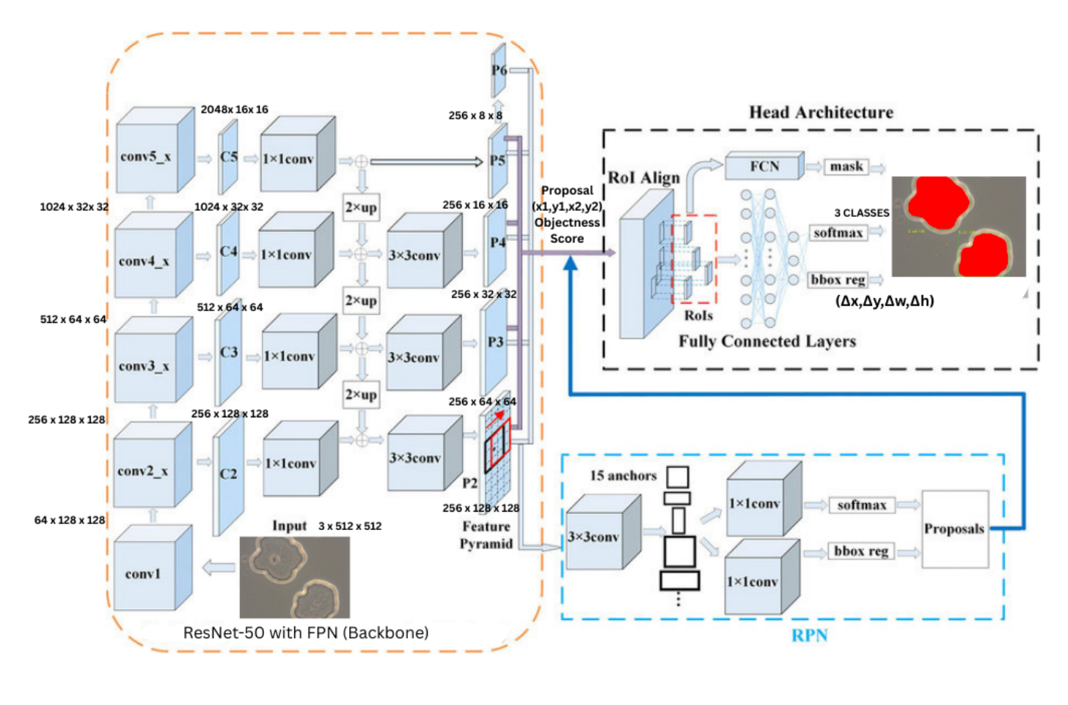
Approach 2 — Mask R-CNN learns scale from the data
A1
A2
A3
Scale-invariant: FPN levels P2–P6 span ≈ 25 → ≈ 10,000 µm², no size parameter
Heads replaced for E. coli, Salmonella (COCO-pretrained)
Training: 20 epochs, lr 1e-4, batch 4, ≈ 8 h on RTX A6000
Post-processing: drop duplicate masks with IoU > 0.9
Mask R-CNN, ResNet-50 + FPN (thesis Fig. 3.6)

Slide 16
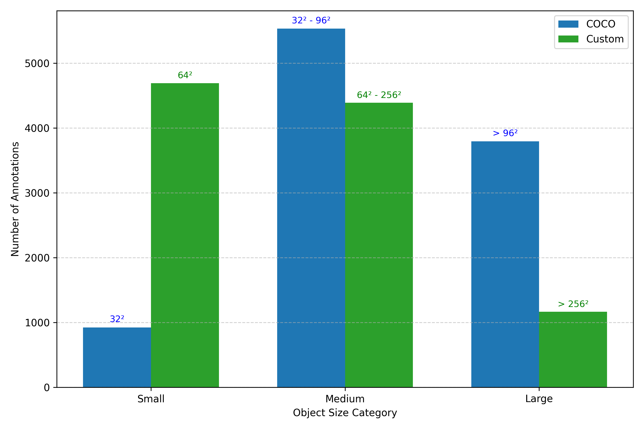
Approach 2 — Mask R-CNN learns scale from the data
A1
A2
A3
Size-aware evaluation thresholds
Small
≤ 64 px²
Medium
64–1,024 px²
Large
> 1,024 px²
Default COCO thresholds would reclassify most small colonies as "medium" — hiding the early-detection weakness.

Slide 17
Approach 2 — results with trustworthy labels
A1
A2
A3
0.95
mAP@0.5 at the 2-hour time point
0.91–0.98
mean IoU across growth stages
Test split (IoU 0.5, after NMS)
E. coli: mAP 0.93 · AR 0.96
Salmonella: mAP 0.945 · AR 0.975
Takeaway These metrics measure the model, not the annotator — the clean baseline for Approach 3.

Slide 18
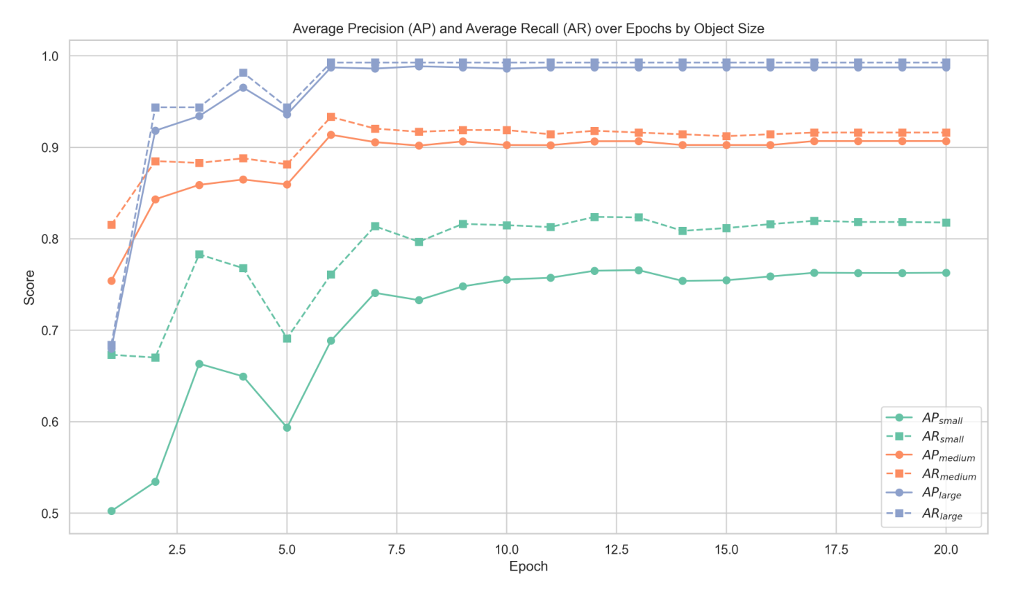
Approach 2 — error lives in the smallest colonies
A1
A2
A3
AP (solid) and AR (dashed) by size over training (thesis Fig. 4.10)
≈ 0.99 Large · AP / AR
≈ 0.91 / 0.92 Medium · AP / AR
≈ 0.76 / 0.82 Small · AP / AR
Takeaway Size tracks time: the hardest colonies are the youngest — the ones early detection needs.

Slide 19
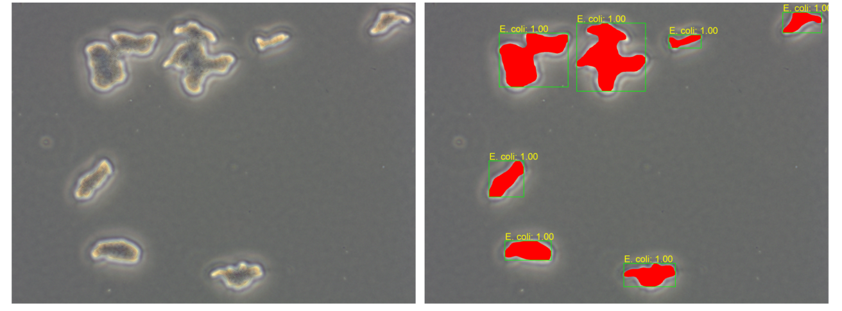
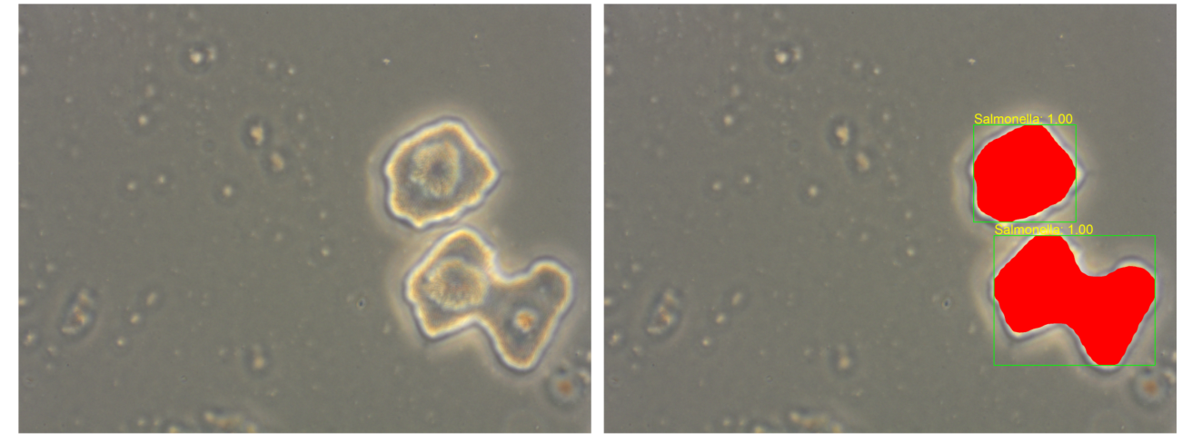
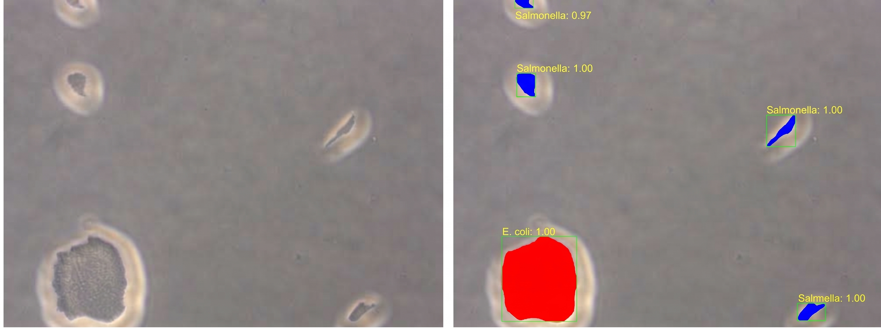
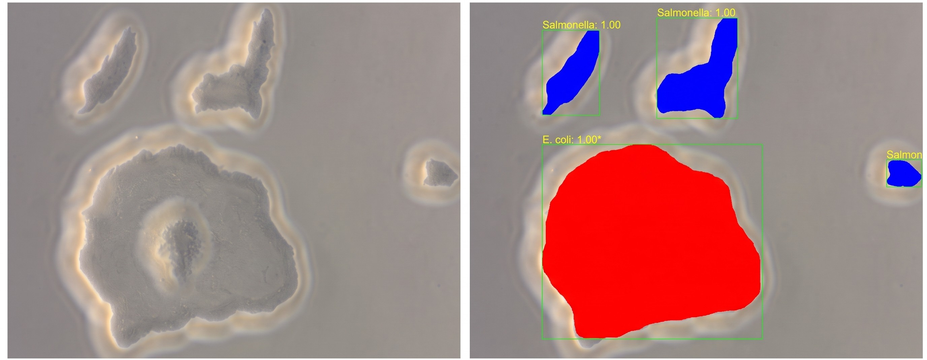
Approach 2 — scale invariance & mixed cultures
A1
A2
A3
Pure cultures (original | prediction)
Same weights, no size parameter: 2-h E. coli to 4-h Salmonella
Mixed cultures: predictions closely matched expert identification (2.5–4 h)
Qualitative only — reference is expert inspection
Ecoli 2hr
Salmonella 4hr
Mixed cultures — never seen in training (original | prediction)
Limitation →
One architecture. Evaluation only on AP/AR. Is evaluation sufficient?
Mixed 3hr
Mixed 4hr
Thesis Figs. 4.12(b), 4.13(c), 4.14(b–c)
Takeaway Clean labels tell us what is achievable — but not yet why.

Slide 20
Approach 3 — task or model? A controlled test
A1
A2
A3
20 conditions × 100 images = 2,000
SAM-FPN
SAM ViT-B · mask-pretrained
DINO-FPN
DINOv3 ViT-S/16 · self-sup.
2 h
2.5
3
3.5
4 h
E. coli · plain
same decoder,
swap backbone
same backbone,
swap decoder
E. coli · onion
Salm. · plain
ResNetDS
ResNet-50 CNN · anchor
DINODual-Net
DINOv3 ViT-S/16 · dual-res
Salm. · onion
ResNetDS: comparable size/compute to the DINOv3 models, far smaller than SAM
Held fixed: dataset · split (1,400 train / 400 test) · loss toolbox · evaluation protocol
Varied: backbone and decoder only · 512 × 512 input · NVIDIA A30
Takeaway Pairing one backbone with two decoders, and one decoder with two backbones, attributes each difference to the right component.

Slide 21
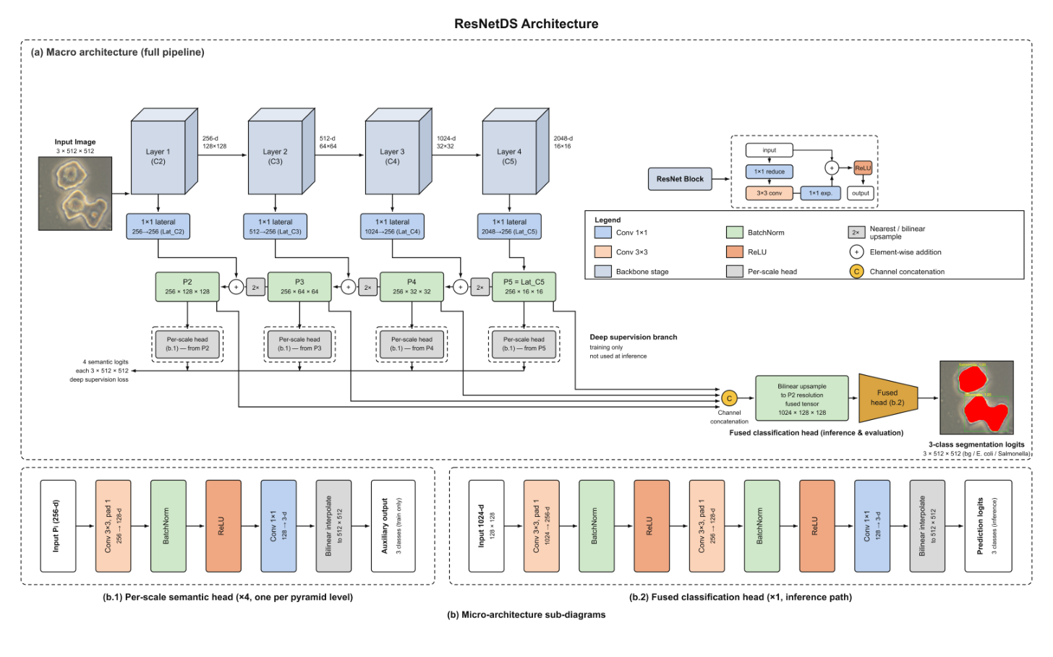
Approach 3 — four architectures, three backbone families
A1
A2
A3
ResNetDS CNN · deep supervision
28.3 M · 67.0 GFLOPs
Architecture diagrams: thesis Figs. 3.7; size and compute: Table 4.5

Slide 22
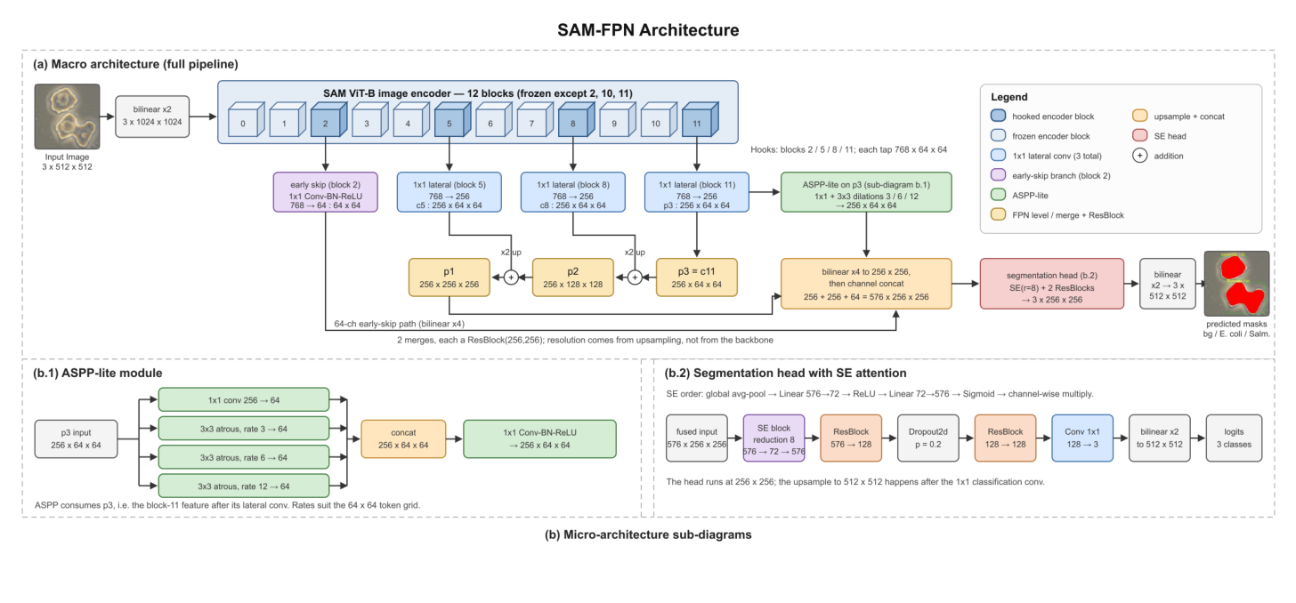
Approach 3 — four architectures, three backbone families
A1
A2
A3
SAM-FPN mask-pretrained ViT-B
94.5 M · 662.4 GFLOPs
Architecture diagrams: thesis Figs. 3.8; size and compute: Table 4.5

Slide 23
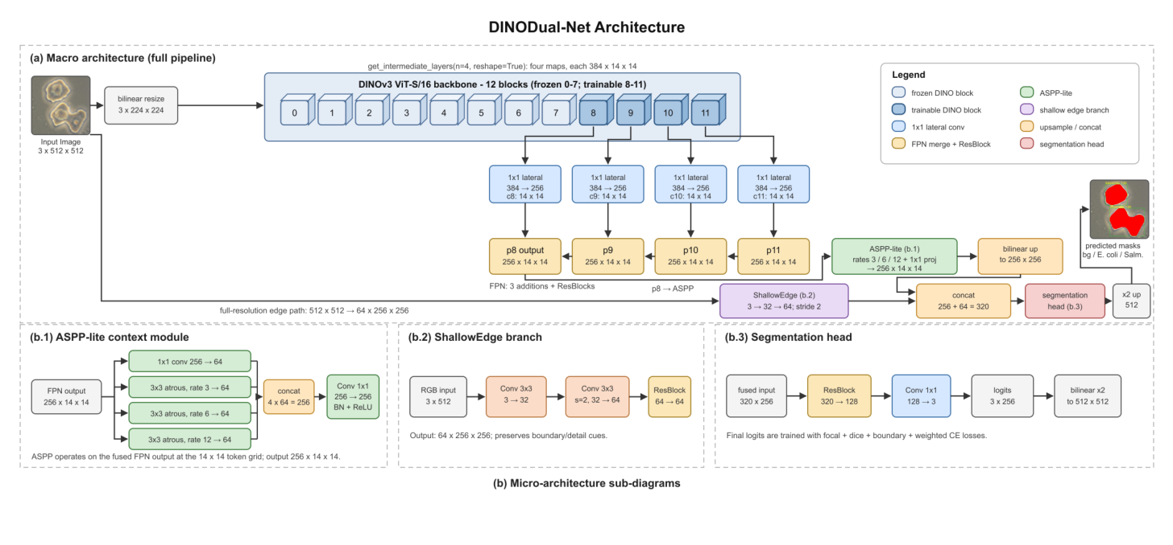
Approach 3 — four architectures, three backbone families
A1
A2
A3
DINODual-Net DINOv3 ViT-S · 14×14 + edge branch
26.7 M · 48.2 GFLOPs
Architecture diagrams: thesis Figs. 3.9; size and compute: Table 4.5

Slide 24
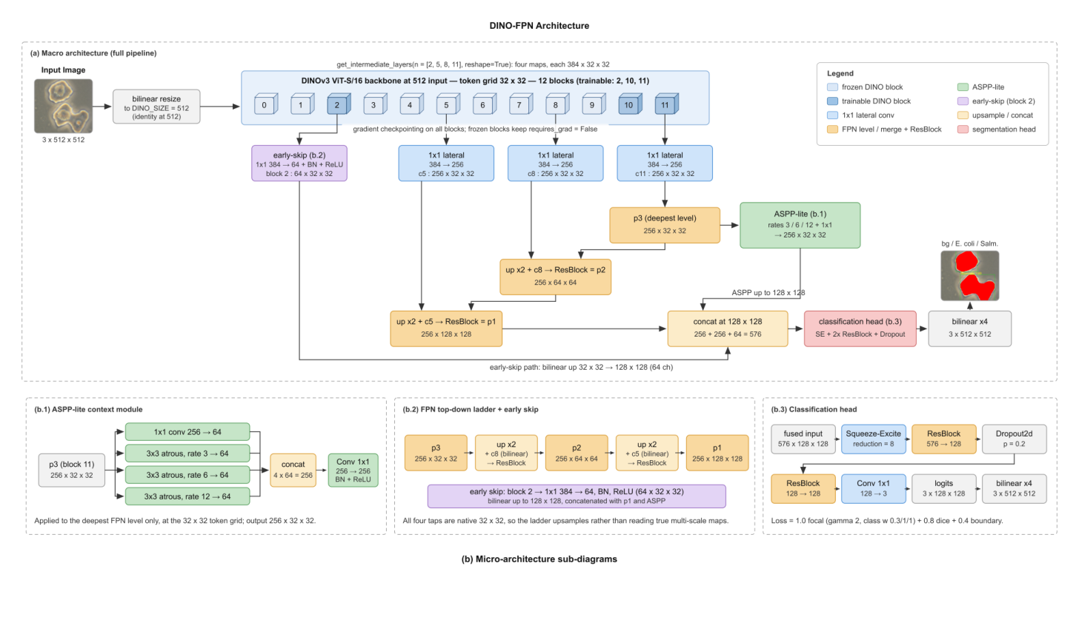
Approach 3 — four architectures, three backbone families
A1
A2
A3
DINO-FPN DINOv3 ViT-S · 32×32 + SAM-FPN decoder
26.1 M · 66.7 GFLOPs
Architecture diagrams: thesis Figs. 3.10; size and compute: Table 4.5

Slide 25
Approach 3 — one loss toolbox, five views
A1
A2
A3
Compound loss (imbalance-aware)
Five evaluation views (operator needs)
Focal
γ = 2 — focuses on hard pixels, not easy background
Pixel-wise fg-IoU · Dice · boundary F1 · HD95 · species purity
Instance F1 swept over IoU 0.50 → 0.95
Dice
region overlap — a small colony counts as much as a large one
Panoptic PQ = segmentation × recognition quality
Boundary-weighted CE
×3 weight near edges — protects area → biomass
Counting MAE · RMSE · R² per species
Class-weighted CE
stable, non-saturating classification gradient
Efficiency GFLOPs · params · latency · peak VRAM
Same weights for the three transformer models; ResNetDS re-weighted for its deep-supervision heads.
Takeaway A single mAP number cannot support a deployment decision; multiple views necessary.

Slide 26
Approach 3 — CNN matches or exceeds transformers
A1
A2
A3
Metric | ResNetDS | SAM-FPN | DINODual-Net | DINO-FPN
fg-IoU ↑ | 0.901 | 0.900 | 0.893 | 0.889
fg-Dice ↑ | 0.944 | 0.943 | 0.936 | 0.937
Boundary F1 ↑ | 0.962 | 0.957 | 0.936 | 0.949
HD95 [px] ↓ | 6.85 | 5.14 | 5.98 | 5.53
Species purity ↑ | 0.990 | 0.996 | 0.989 | 0.998
Corpus mIoU (fg) ↑ | 0.942 | 0.936 | 0.932 | 0.940
F1 @ IoU 0.50 ↑ | 0.947 | 0.951 | 0.940 | 0.938
F1 @ IoU 0.75 ↑ | 0.817 | 0.810 | 0.815 | 0.759
Mean F1 [.5:.95] ↑ | 0.745 | 0.737 | 0.736 | 0.698
Panoptic quality ↑ | 0.825 | 0.823 | 0.817 | 0.798
Count MAE E. coli ↓ | 0.16 | 0.18 | 0.20 | 0.12
Count MAE Salmonella ↓ | 0.66 | 0.52 | 0.71 | 0.53
How to read it
ResNetDS best on 7 of 12 rows — pixel, region, panoptic, strict-IoU
SAM-FPN best worst-case boundary (HD95) and F1@0.50
DINO-FPN best purity and E. coli counting
ResNetDS vs SAM-FPN: overlapping 95 % CIs on IoU/Dice
All-condition macro-F1: 0.955–0.966
Highlighted = best in row. Source: thesis Table 4.5 (400-image test set).

Slide 27
Approach 3 — 22× the latency for marginal gains
A1
A2
A3
SAM-FPN vs ResNetDS
≈ 22×
slower
≈ 10×
GFLOPs
≈ 14×
peak VRAM (9.6 GB)
NVIDIA A30, 512 × 512 input (thesis Table 4.5)
Takeaway ResNetDS: 8.1 ms/image (123 FPS) — best or near-best accuracy at the lowest latency.

Slide 28
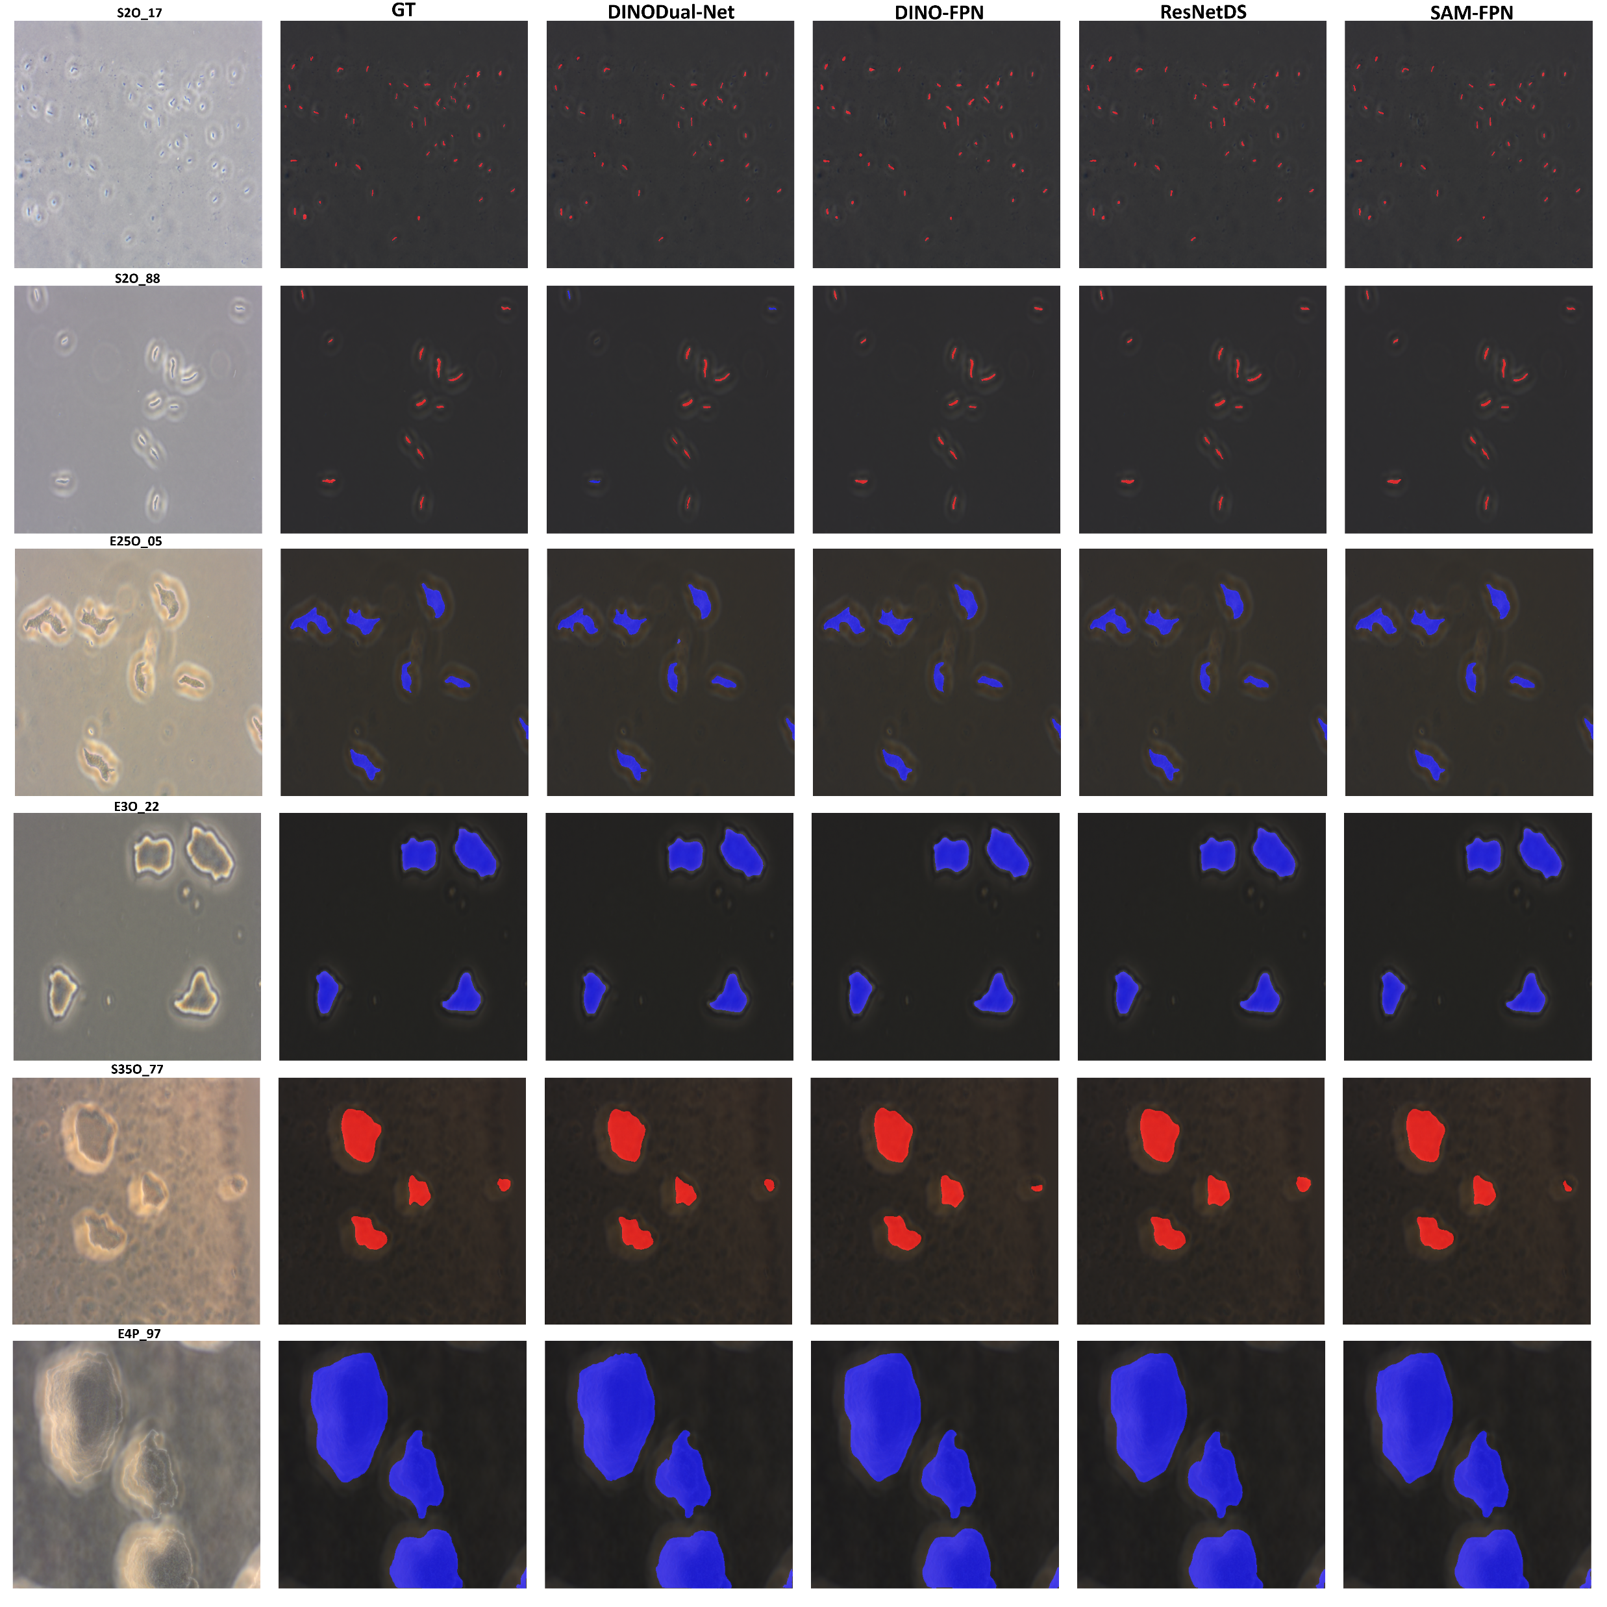
Approach 3 — Sample Prediction
A1
A2
A3
Sample inference from each model compared to GT(thesis Fig. 4.16)

Slide 29
Approach 3 — the 2-hour Salmonella failure mode
A1
A2
A3
F1 0.75–0.91 on s2o / s2p for every model
7 of 8 model–background pairs below 2-h E. coli
Labels fixed by protocol + error persists across 3 backbone families and 2 decoders → a limit of the visual signal
Takeaway More architecture search will not close this gap; changing the input (magnification, data, plate-level pooling) might.

Slide 30
Approach 3 — from metrics to a deployment choice
A1
A2
A3
ResNetDS
DINO-FPN
DINODual-Net
SAM-FPN
Default for in-line screening
Species purity · counting · edge GPUs
When FLOPs are the constraint
Offline confirmation only
Fastest (8.1 ms, 123 FPS); best or near-best on most accuracy metrics; no foundation-model dependency
Best purity (0.998) and E. coli counting (MAE 0.12); smallest memory (457 MiB); ≈ 2× ResNetDS latency
Lowest compute (48.2 GFLOPs); second-fastest (9.7 ms); middling accuracy, weakest Salmonella counting
Best HD95 (5.14 px) and F1@0.50 (0.951) — at 662 GFLOPs, 178.9 ms and 9.6 GB
Takeaway For a narrow, fixed inspection task, a well-tuned CNN is enough
B. Koirala · M.S. Thesis Defense · School of Computing, SIU Carbondale

Slide 31
Answers to the research questions
A1
A2
A3
RQ1
When?
RQ2
Trust?
2 hours, under both backgrounds. The limit is set by the onion matrix; the hardest case is 2-h Salmonella.
Expert labels in mixed fields make model and label error inseparable; protocol-determined labels fix this. Detection, instance and semantic segmentation are complementary.
RQ3
Cost?
RQ4
Limit?
Yes. ResNetDS is best or co-best on most accuracy metrics and fastest (8.1 ms); SAM-FPN’s marginal gains cost ≈ 22× latency.
2-h Salmonella error is intrinsic to the visual signal. Strict-IoU and boundary differences are architectural — decoder as much as backbone.

Slide 32
Contributions
A1
A2
A3
DATA Background-aware, densely time-stamped, instance-annotated corpus of both species
METHOD Controlled 2×2 comparison isolating decoder from backbone
1
5
METHOD Detection + growth quantification in calibrated units (YOLOv8x)
EVALUATION Five-view, 20-condition protocol that supports deployment decisions
2
6
INSIGHT Mixed-culture label limitation identified and removed experimentally
INSIGHT Backbone-independent 2-h Salmonella failure mode → redirects effort to the input
3
7
METHOD Clean-label Mask R-CNN (mAP@0.5 0.95 at 2 h); size-aware thresholds; Cellpose failure documented
4
Dots mark the approach(es) behind each contribution.

Slide 33
Limitations and future work
A1
A2
A3
Limitation
Future direction
2 species, 2 backgrounds; one microscope at 60×
More pathogens and food matrices; cross-instrument and cross-magnification tests
2-h Salmonella limited by the visual signal
Early-time data and augmentation, higher magnification
Latency/boundary measured only for A3; no shared test split across approaches
Unified benchmark; real-time edge deployment with escalation to confirmation

Slide 34
CONCLUSION
18–24 h → ≈ 2 h
A screening decision that waits on a plate count can move to ≈ 2 h of incubation — accurate enough for triage, on standard lab microscopy.
Labels first
Small is enough
Signal, not model
Trustworthy conclusions needed protocol-determined labels (label = plate).
With clean labels, a compact CNN (8.1 ms, > 100 FPS on one A30) matches or exceeds far larger transformers.
The remaining 2-h Salmonella error is in the image — the next gains come from optics and procedure.

Slide 35
Thank you
Questions?
Acknowledgments
Dr. Abdur Rahman Bin Shahid (advisor) and committee members Dr. Anas AlSobeh and Dr. Henry Hexmoor
Dr. Namariq Dhahir & Dr. Amer AbuGhazaleh - bacterial culture, incubation and image acquisition
SIU Information Technology and Texas A&M HPRC - GPU resources
USDA-NIFA Capacity Building Grant No. 2024-70001-43667

