Slide 1


Application Administration User Guide:
Notes:
Welcome to the Sales Cloud
Our flagship application – The world’s leading sales application
No one has invested more over the last 10 years on a sales application in the cloud

Slide 2
Application Administration Sharing with your Users
Notes:
Welcome to the Sales Cloud
Our flagship application – The world’s leading sales application
No one has invested more over the last 10 years on a sales application in the cloud

Slide 3
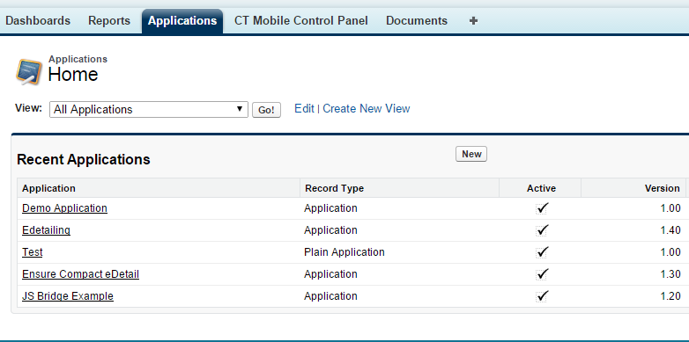
Review All Applications
Go to Application tab to find the application you need to share
Click on the Application name to gain access

Slide 4
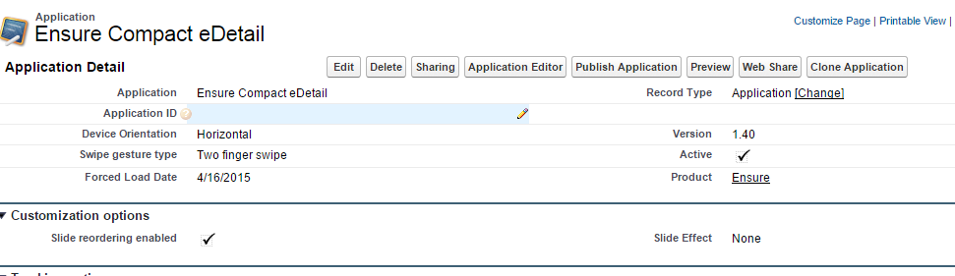
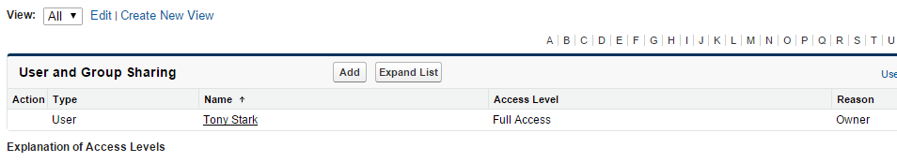
Sharing eDetailing
Click on the Sharing button
Click Add to add more people
Check the list of existing Users who have access to the presentation

Slide 5
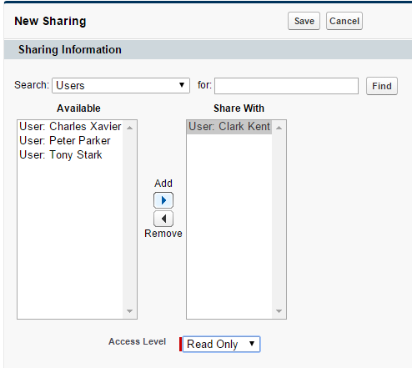


Sharing eDetailing
You can Search User by name
You can share with Roles, Public Groups, Users
Click an arrow to add new users
You can define level of access. Either read only or read and edit

Slide 6
Application Administration Uploading Power Point
Notes:
Welcome to the Sales Cloud
Our flagship application – The world’s leading sales application
No one has invested more over the last 10 years on a sales application in the cloud

Slide 7
Review All Applications
Go to Application tab to find the application you need to share
Click New to create new presentation type

Slide 8
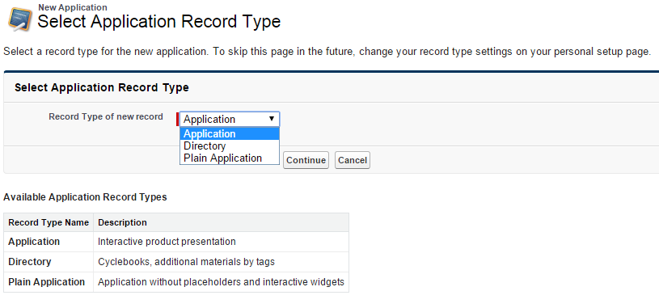
Create New Application
To upload PPT presentations please select Application from the list and click Continue

Slide 9
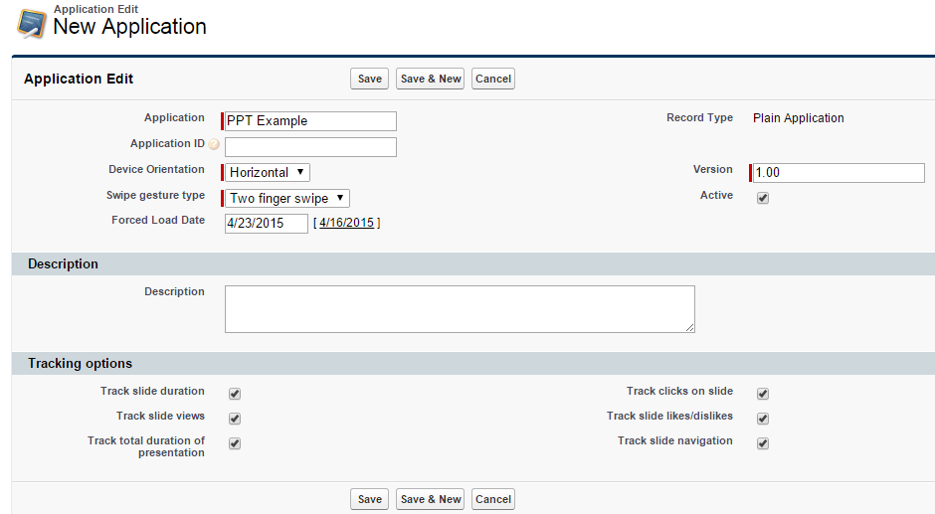
Creating New Application
Put the application name
Write Description
Check all the required tracking
Save when you are ready

Slide 10
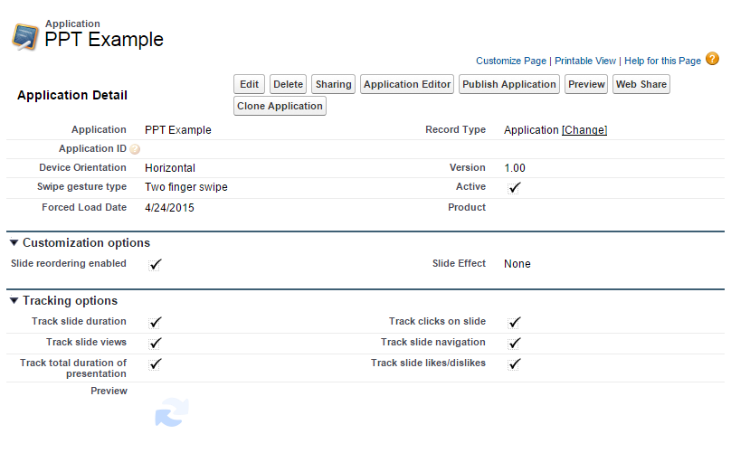
Creating New Application
Click Application Editor
Verify all the details

Slide 11
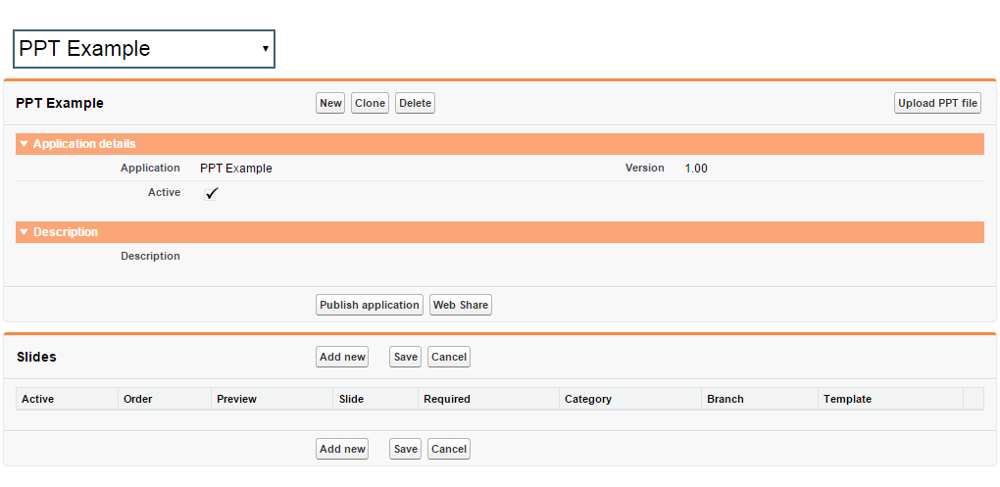
Uploading PPT File
Click Upload PPT file
NOTE: Only *.ppt is supported (pptx is not currently supported)

Slide 12
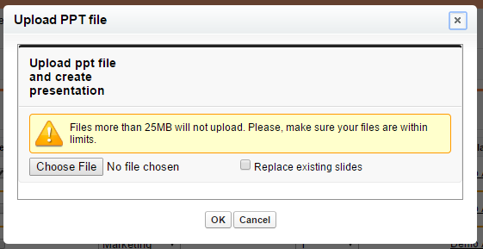
Uploading PowerPoint File
You can replace existing slides if required
Click Choose file to get access to presentations on your computer

Slide 13
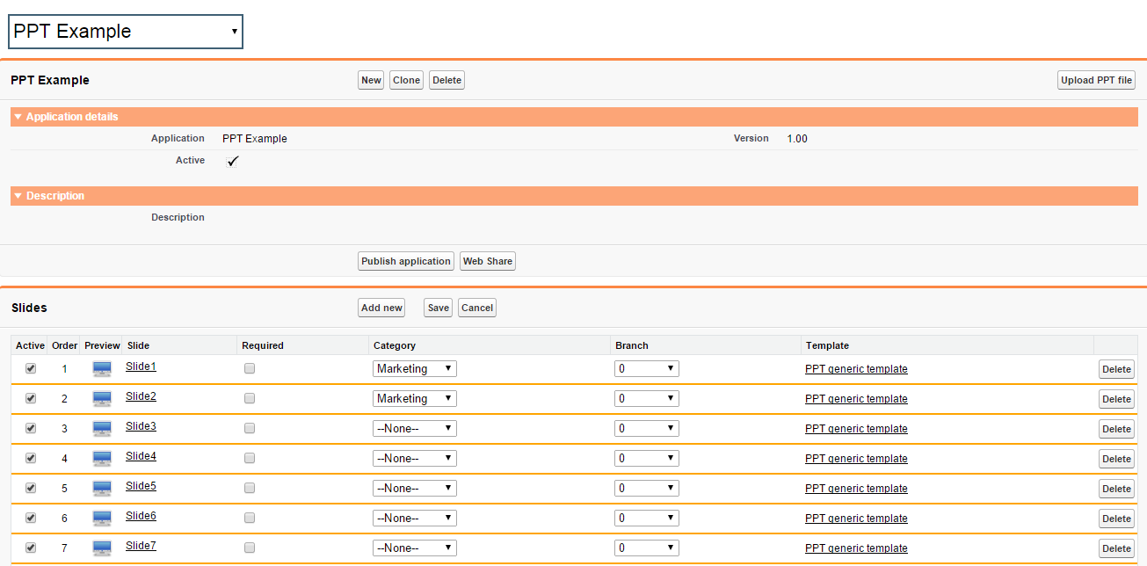
Working with PPT Presentation
When you are ready click Publish Application and it will appear on your iPad after sync
Define a presentation branch to in case you have a selection of presentation routes
Activate or Deactivate Slides
You can choose a category

Slide 14
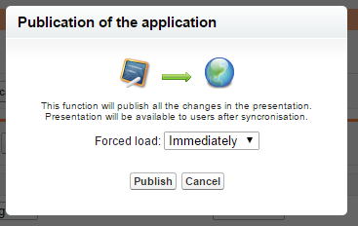

Publishing Application
After clicking Publish Application you can choose when the publishing actions would take place

Slide 15
Application Administration Create a presentation from Application object menu :
Notes:
Welcome to the Sales Cloud
Our flagship application – The world’s leading sales application
No one has invested more over the last 10 years on a sales application in the cloud

Slide 16
Review All Applications
Go to Application tab to find the application you need to share
Click New to create new presentation type

Slide 17
Create New Application
To upload PPT presentations please select Application from the list and click Continue

Slide 18
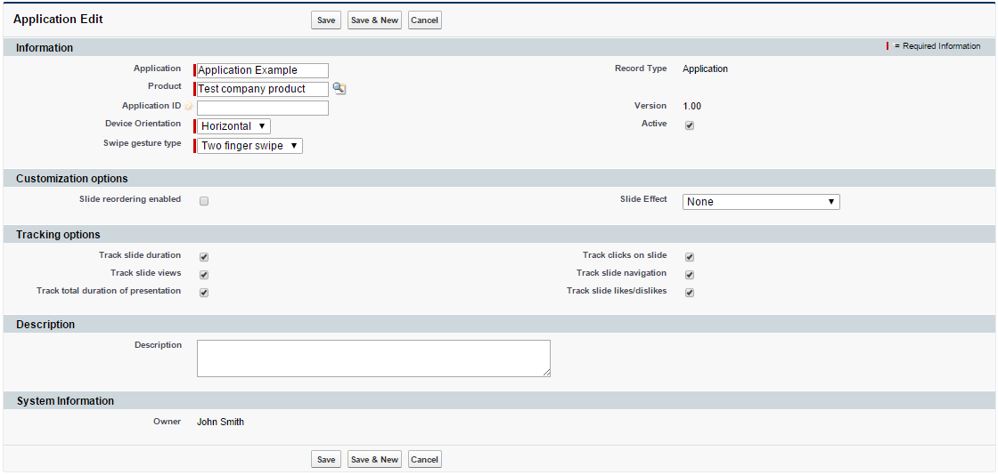
Creating New Application
Put the application name
Check all the required tracking
Write Description
Save when you are ready

Slide 19
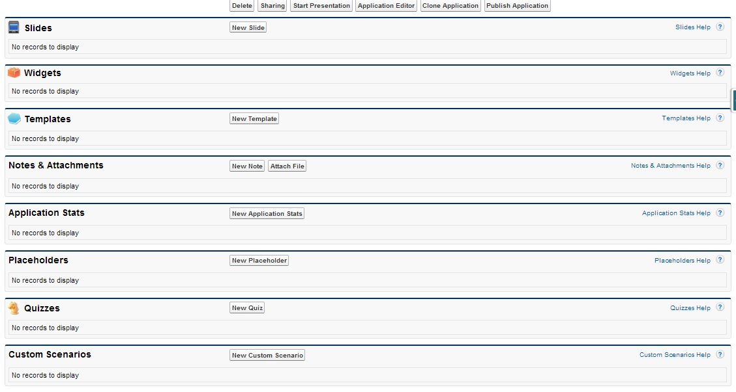
Main window where you can find all the presentation components

Slide 20
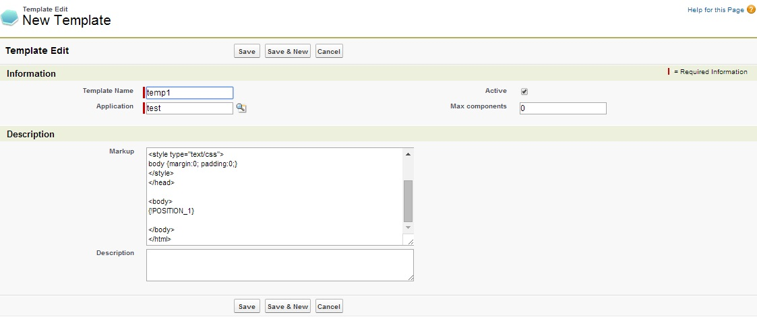
Creating Template
To create a new Template you should go to Templates section and click “New Template”.
You need to fill in the required fields and in Markup, you put HTML code page.
The HTML code should query the script "JSLibrary/app.js" (<script type="text/javascript" src="../JSLibrary/js/app.js"></script>).
Templates and placeholders should be included taking into consideration presentation name (For example: e-Detailing2: Test Template, where e-Detailing2 is a name of the presentation).
Salesforce allows to create several slides based on one template. You can use widgets to make slides look and feel different.
To use widget you need to choose a place where it would be located (Placeholder). To create a placeholder in the Markup field we change {!POSITION_X} on the Template object, where X is a sequential number of a Placeholder.

Slide 21
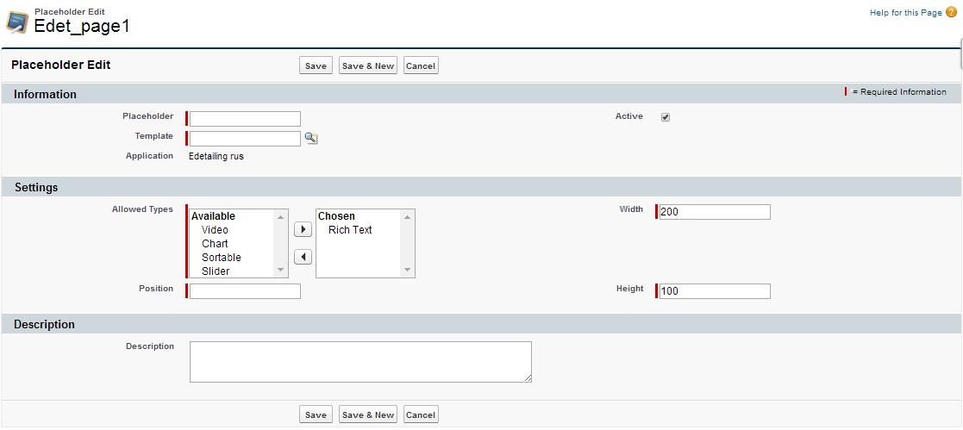
Creating a Placeholder
To create a new Placeholder you need to click “New Placeholder” in the Template window. Call it Placeholder and attach to Template.
Please specify a type of Placeholder it can be Rich Text, Chart, Sortable, Slider or Video. It is also required to put the sequential number in the Position.

Slide 22
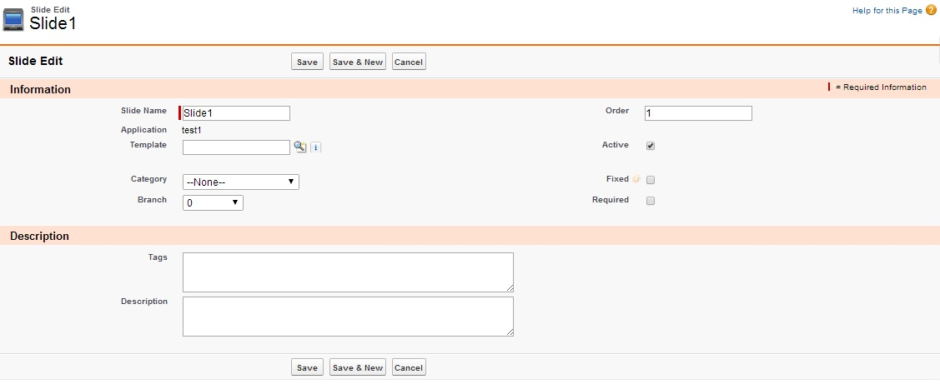
Creating a Slide
Please click “NEW Slide” in the Template window.
To create a new slide you need to pay attention on the fields:
Order – sequential number of the slide;
Template – Template based on what the slide would be created.

Slide 23
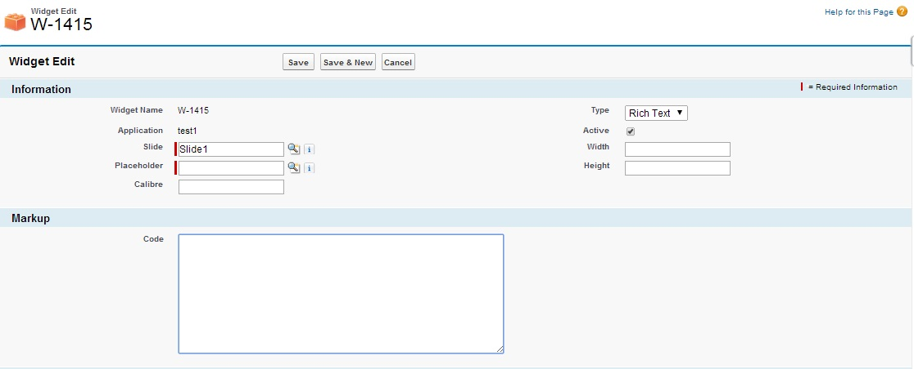
Creating a Widget
Click “NEW Widget” in slide window. Next select Slide and Placeholder the widget relates to.
Please place HTML code in the Code field.

Slide 24
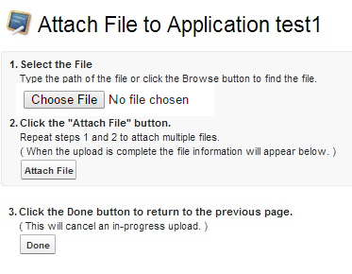
Create an Attach
Project files are archived in the Zip archive and attached to Application. The exception is pdf files. They should be attached separately same as archives.
Archive requirements:
File size should be no more than 25 MB. If the size of the archived presentation exceeds the size, please save the data to several smaller archives.
The file extension should be .zip with name sources.
The archive should have its sequential number (sources.zip, sources2.zip, sources3.zip).
To attach an archive to the project it is required to click Attach File. When all the files are loaded please click Done.

Slide 25
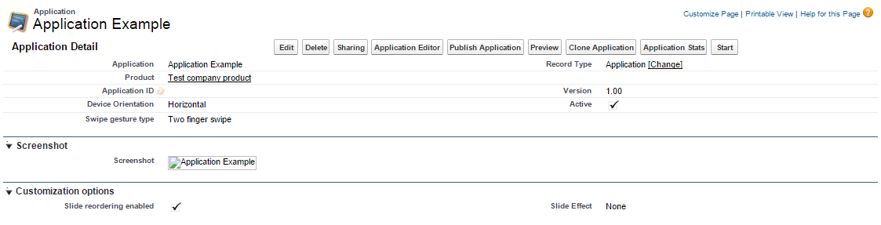
Publishing Application
When all the necessary information is placed to slides and widgets it is required to press “Publish Application” on the Application object

Slide 26
Publishing Application
After clicking Publish Application you can choose when the publishing actions would take place

Slide 27
Application Administration Making Minor Changes:
Notes:
Welcome to the Sales Cloud
Our flagship application – The world’s leading sales application
No one has invested more over the last 10 years on a sales application in the cloud

Slide 28
Review All Applications
Go to Application tab to find the application you need to work with
Click on the Application name to gain access

Slide 29
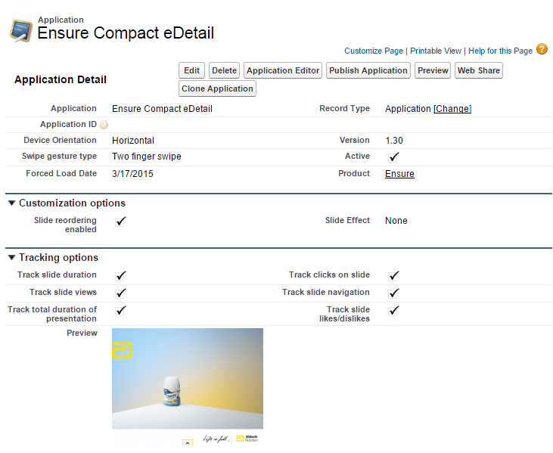
Application Tracking
You can Preview your Application
You can Clone your Presentation
Activate or Deactivate
You can review you presentation tracking statistics in the Tracking section

Slide 30
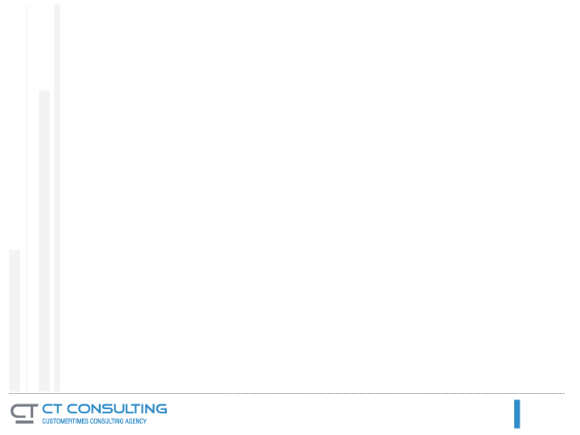
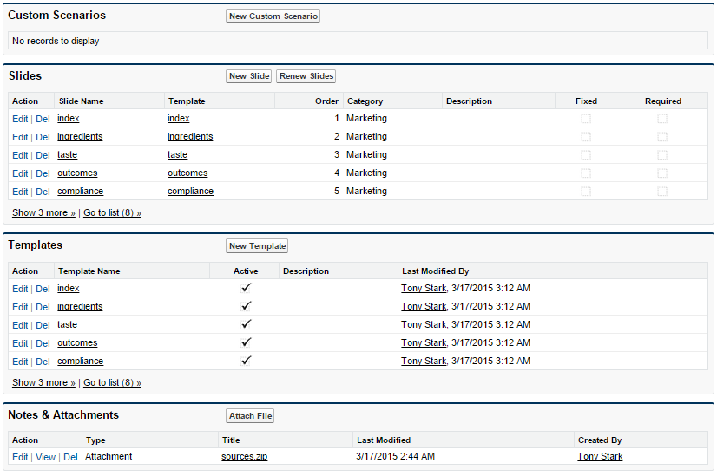
Working with Application
You can create Custom Scenario
You can make any slide Fixed and Required

Slide 31
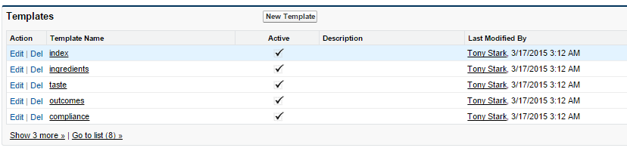
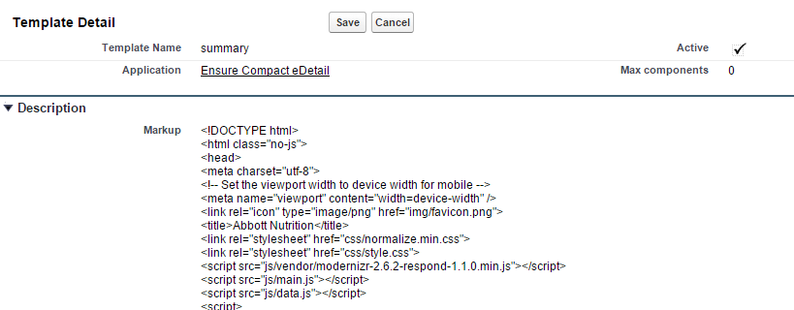
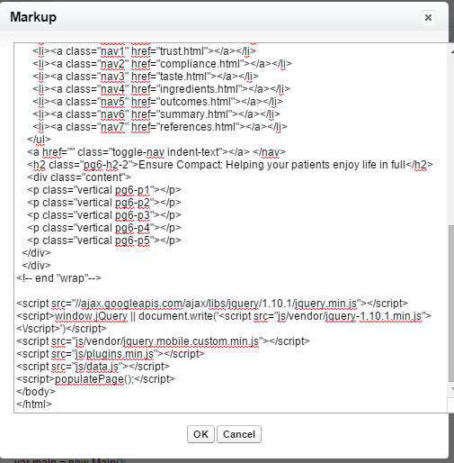
Editing Application Details
Step 1: Select the Template you want to make changes in
Step 2: Go to Markup on Template to edit text
Step 3: Find text you want to change and click OK and Save the Template

Slide 32
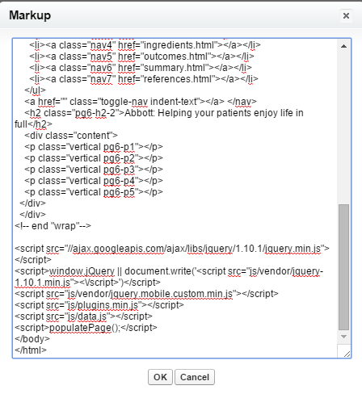
Make Required Changes
After Change
Before Change

Slide 33
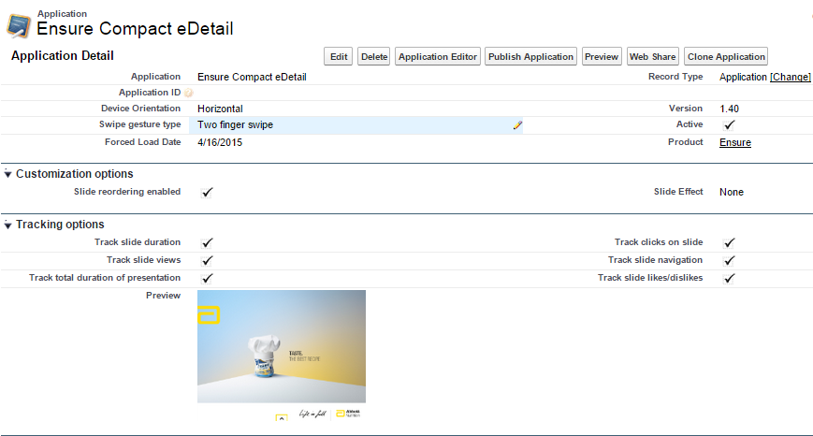
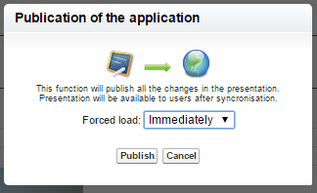
Publish Application
When All the changes are made select Publish Application
After Publishing your application version would change
In the Publish Application window you select Immediate publishing or with a delay

Slide 34
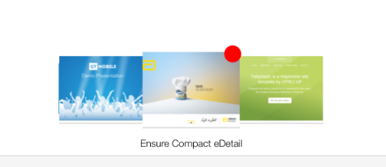
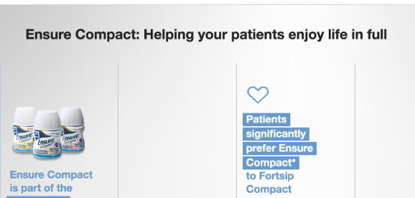
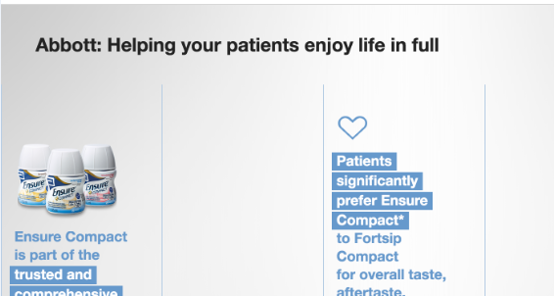
Verify the Content Changes
After you have Published Application and sync the indicator will notify your user on any changes made
Go to the necessary slide to confirm the changes

