Slide 1
Automated Deep Learning

Slide 2
Orchestration vs. Automation
Automation is provisioning (Infrastructure as a Service, IaaS)
Cloud Providers use automation to create a Virtual Machine when you click a button
Great for provisioning servers in a repeatable fashion
Orchestration is the coordination of IaaS with middleware and software
Create one (or more) GPU-enabled server(s) in the Cloud
Install the correct NVIDIA libraries
Install the correct Python version
Install the correct libraries and frameworks
Enable clustering, if desired (ex: High-Performance Computing)

Slide 3
Public Cloud DL Services
NGC – The NVIDIA hub for GPU-optimized DL software
https://www.nvidia.com/en-us/gpu-cloud/
Containerized “DL in a box”
Supported by many Cloud Providers
Deep Learning as a Service for “simple” tasks
Train and infer image recognition/classification
Sentiment analysis
ChatBot services
https://cloud.google.com/vision/
https://www.ibm.com/cloud/watson-visual-recognition

Slide 4
Public Cloud DL Services – Continued
Pick your Framework/Language
Automated provisioning – Infrastructure only exists when needed
https://azure.microsoft.com/en-us/services/machine-learning/
https://aws.amazon.com/sagemaker/
https://www.ibm.com/cloud/machine-learning
https://cloud.google.com/ai-platform/

Slide 5
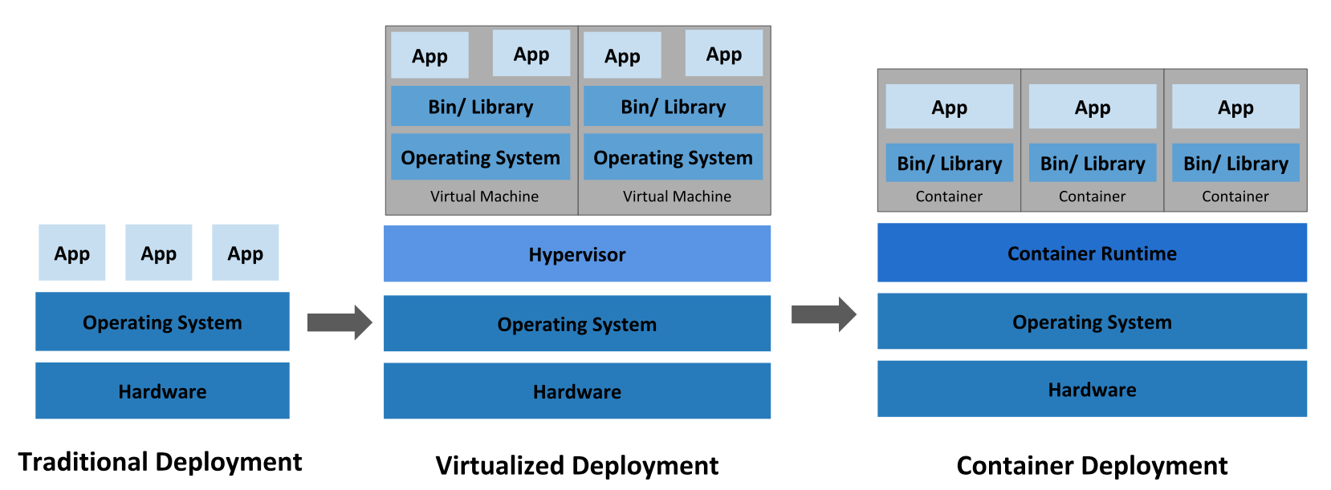
What is Kubernetes (K8s)?
We are familiar with Containers…

Slide 6
What is Kubernetes?

Slide 7
What is Kubernetes (K8s)?
Orchestrate containers across multiple hosts
Maximize resources (reduce idle hardware)
Easier update rollout
Scale applications on the fly
Health-checking and self-healing

Slide 8
Kubernetes for DL/ML
Allow pods to request one ore more GPUs
Schedule workloads to share GPUs
Red Hat OpenShift allows simple K8s install & maintenance on-prem
Consistent flavor of K8s across Cloud Providers
Full GPU support
Requires NVIDIA drivers and container runtime on worker nodes

