Slide 1
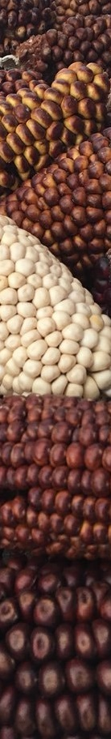

Building a Shiny App to Explore Your Complex Data
Vivian Bernau, PhD
Maize Curator
USDA/ARS North Central Regional Plant Introduction Station
13 September 2019
LunchinatoRs/Rgronomists

Slide 2
Outline
What is Shiny?
How am I using Shiny apps?
Exploring environmental and geographic space
Genebank management
Let’s build a Shiny app together
Where do I put my Shiny app?
Where do I go from here?

Slide 3
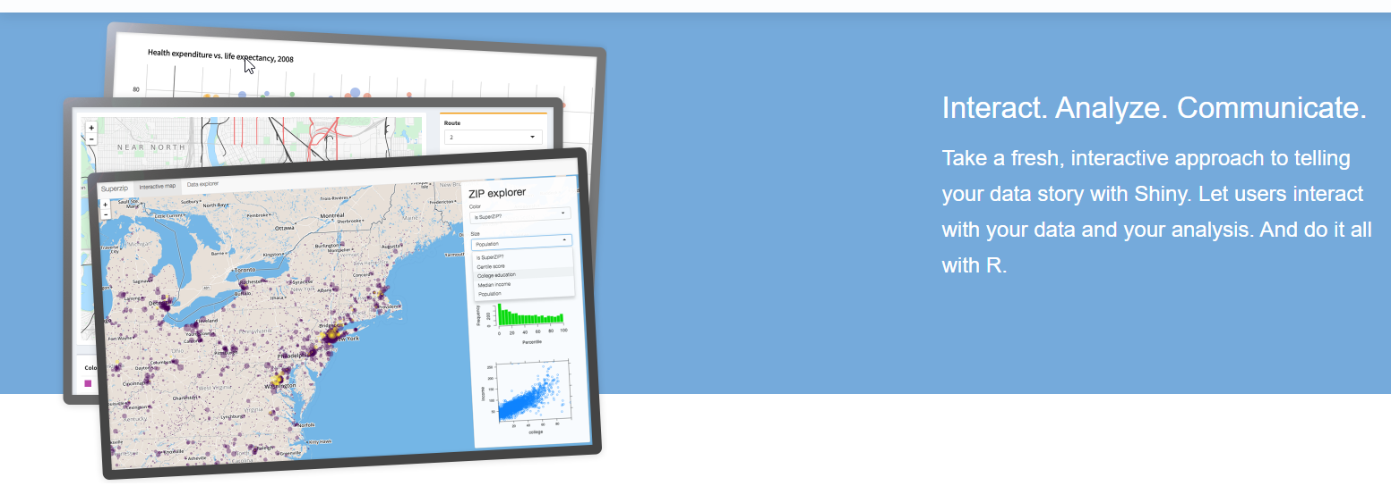
What is Shiny?
“Shiny is an R package that makes it easy to build interactive web apps straight from R.”
shiny.rstudio.com

Slide 4
How does it work?
Shiny apps have two components:
User interface (UI): uses shiny code to write HTML controlling the layout and appearance of the app
Server: contains the code which controls the app output
No knowledge of HTML, JavaScript, or CSS is required.

Slide 5
What do Shiny apps look like?

Slide 6
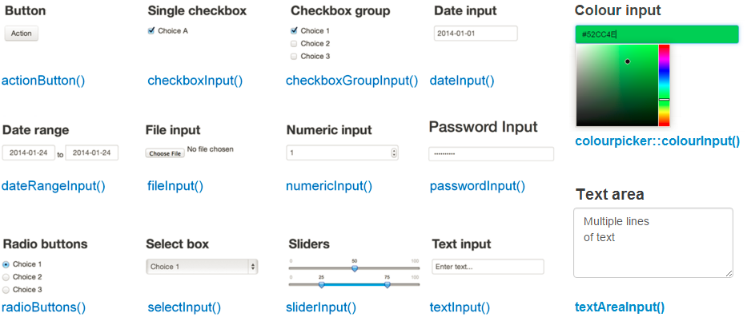
What input options are available?

Slide 7
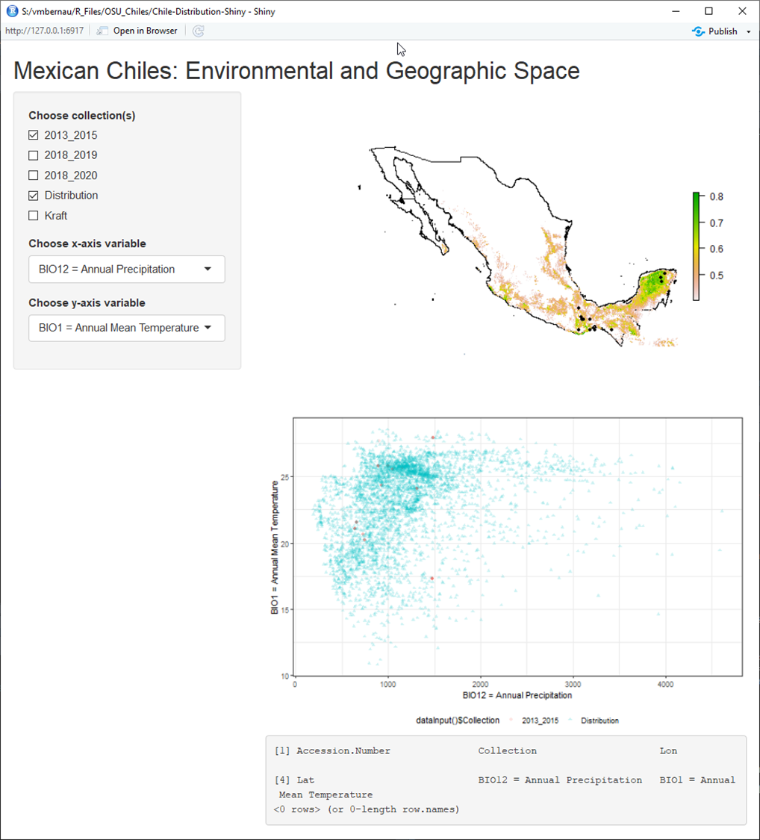
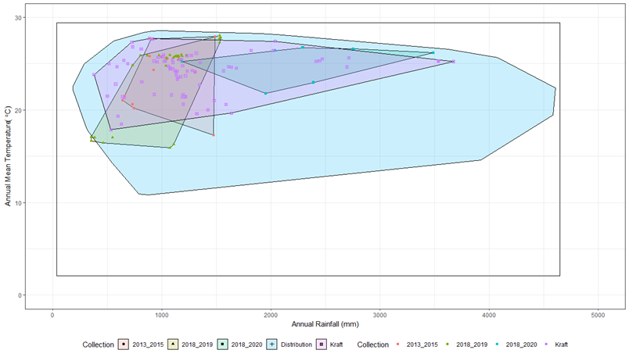
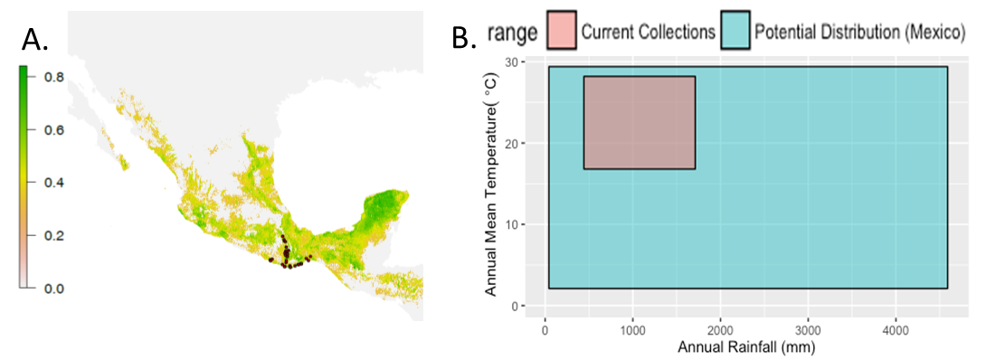
How am I using Shiny apps?
Exploring geographic and environmental space
Figure from proposal:

Slide 8
How am I using Shiny apps?
Exploring geographic and environmental space
Managing the USDA maize germplasm collection
Input data pulled from RStudio database connection
One page live, three pages under development

Slide 9
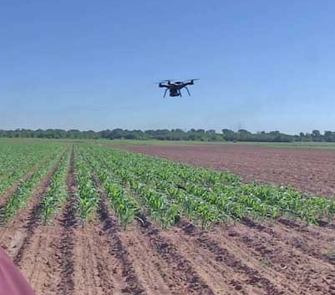
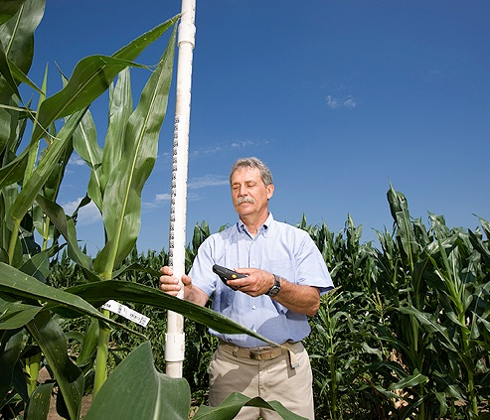
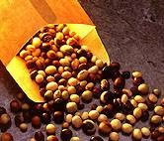
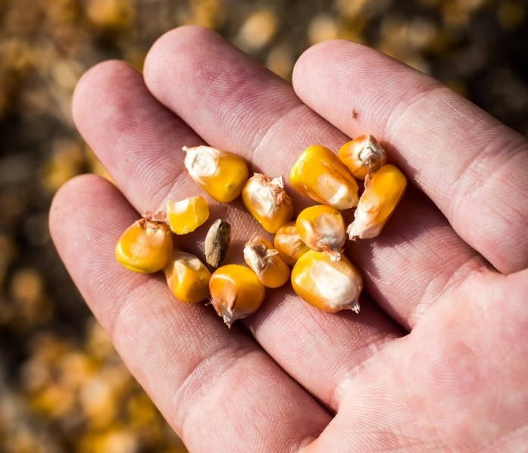
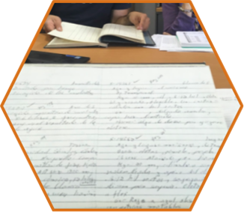
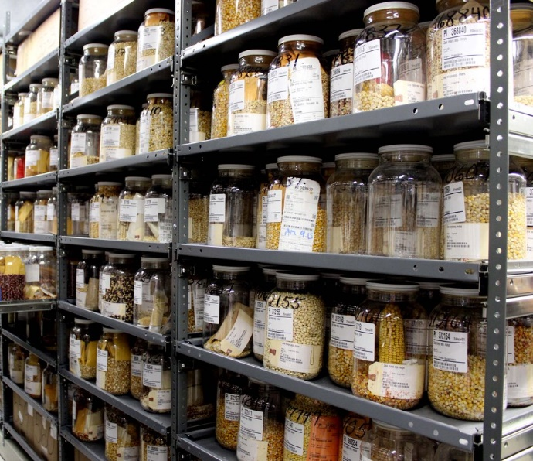
National Plant Germplasm System mission:
DISTRIBUTE
CHARACTERIZE
DOCUMENT
CONSERVE
ACQUIRE
CROP GERMPLASM

Slide 10
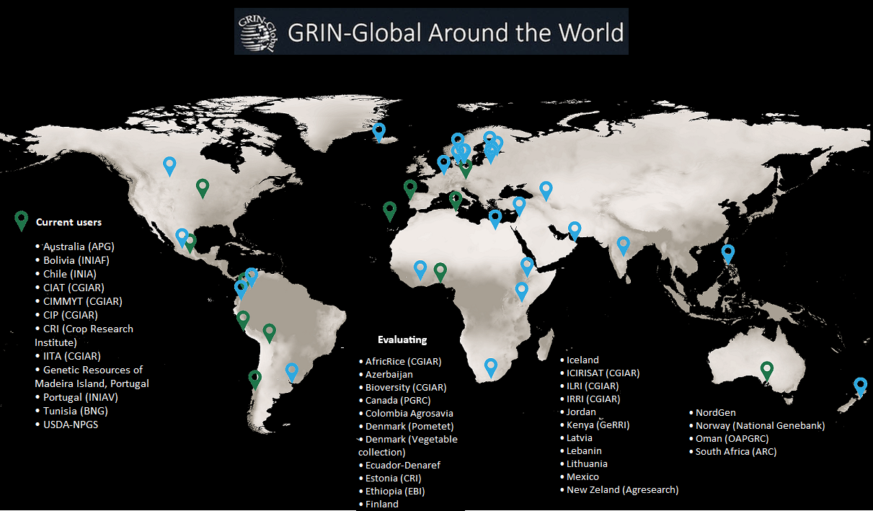

Slide 11
GRIN-Global Database Structure
Taxonomy
Accession Passport Data
Orders
Inventory
Descriptors
Images
Field/Lab Actions

Slide 12
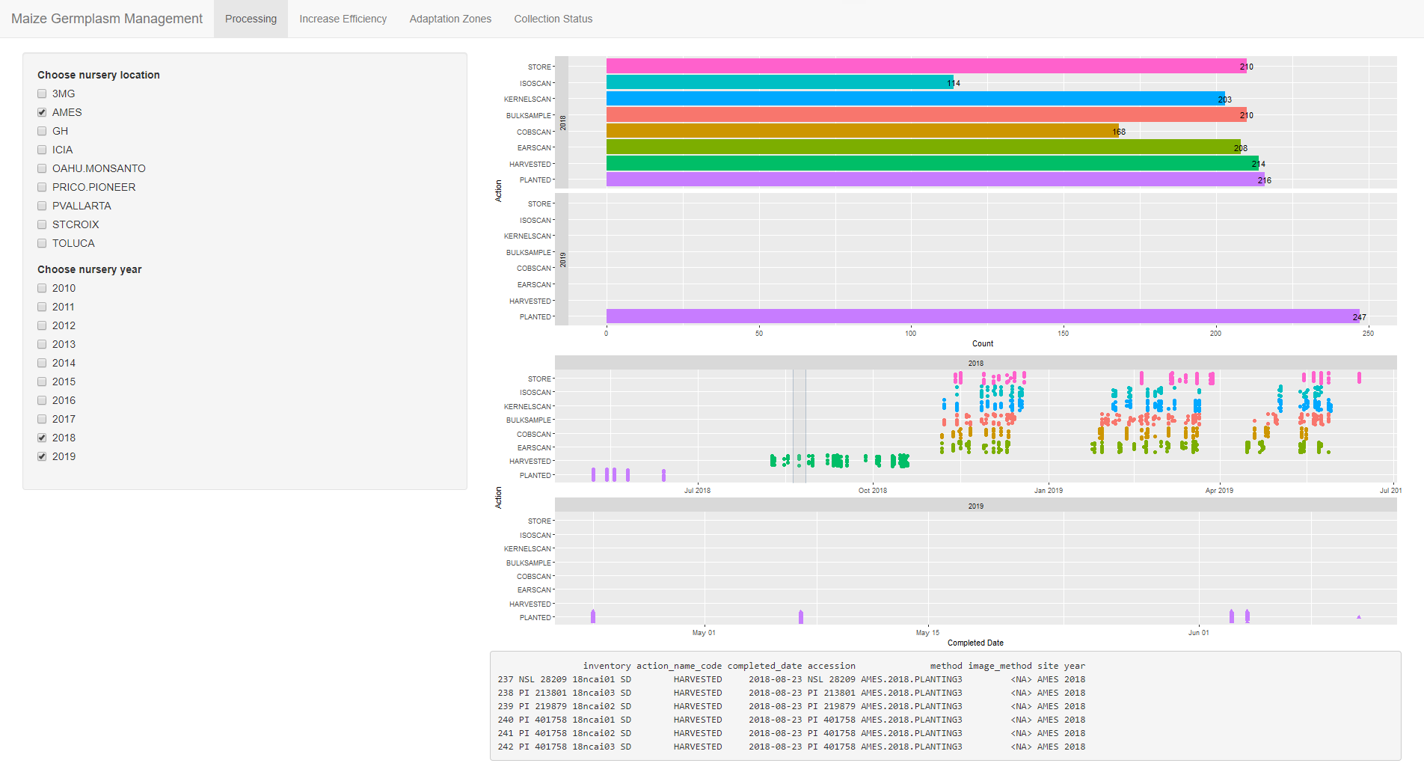

Slide 13
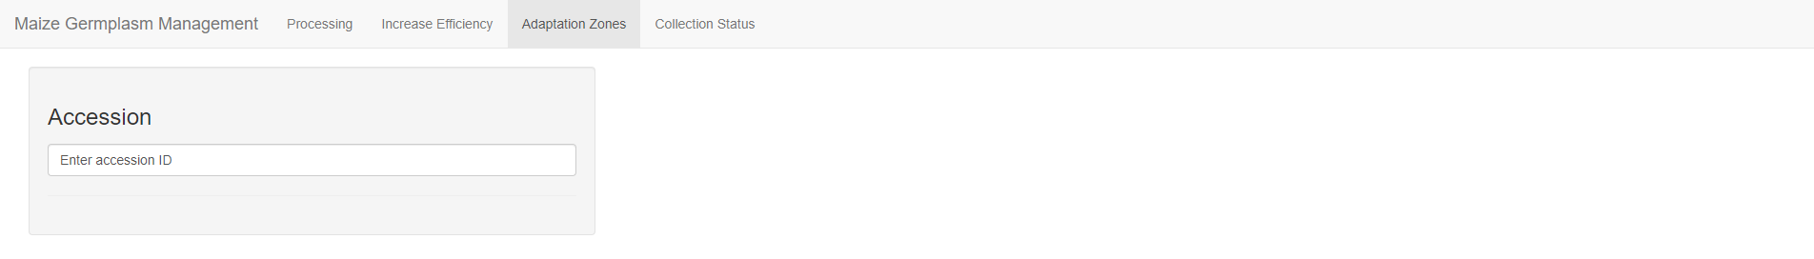
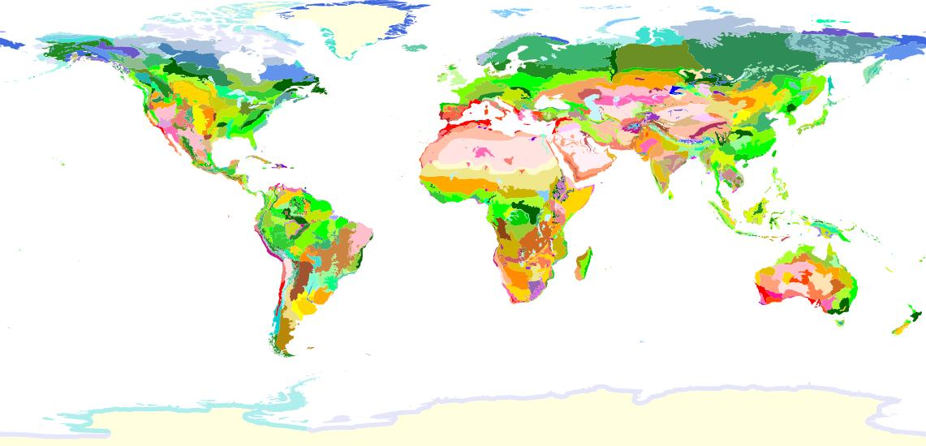
Adaptation Zone: XXXXX
Regeneration history:
Site | Year | K Planted | K Returned

Slide 14
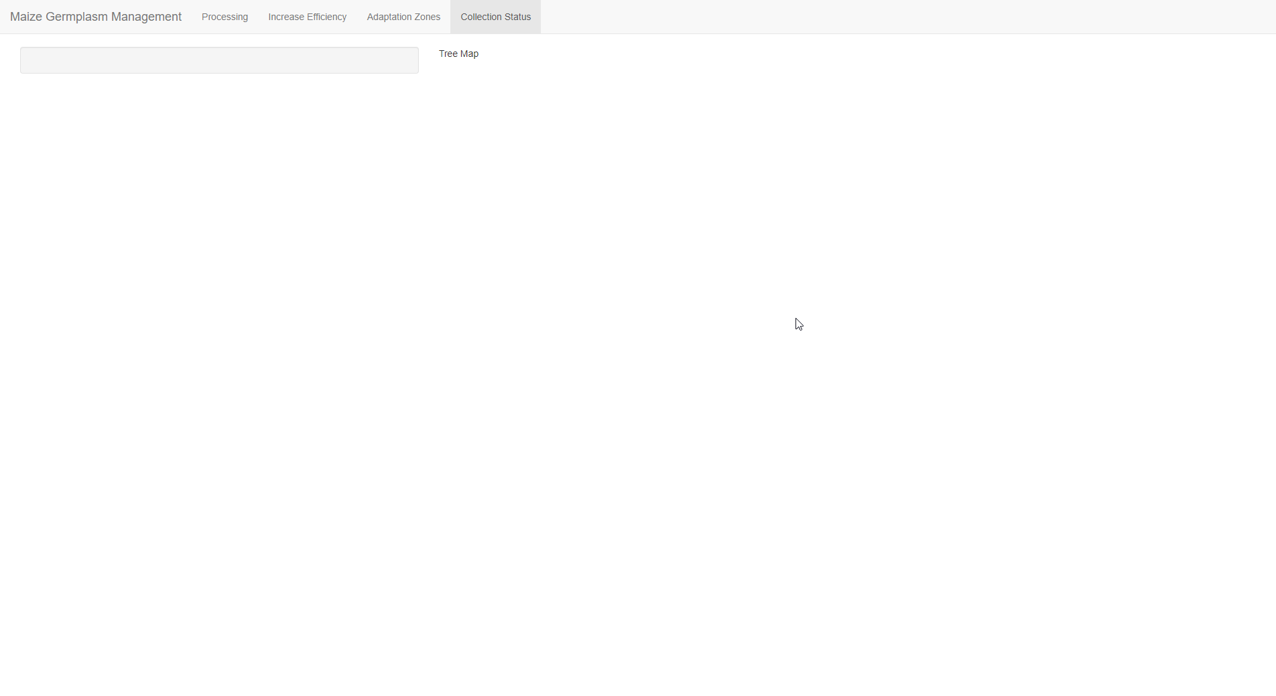
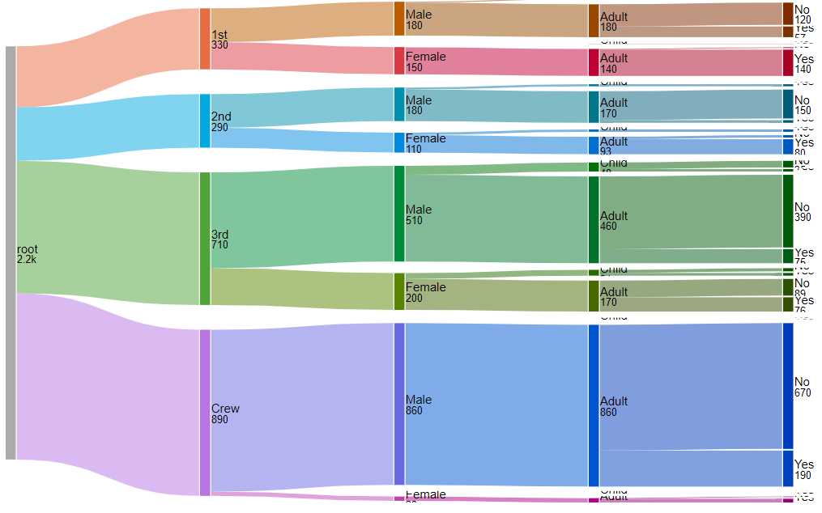
Maize Collection
Wild
Cultivated
Zea
Tripsacum
Coix
Populations
Inbreds
GEM
PVPs
Available
Unavailable
Available
Unavailable
Available
Unavailable
Available
Unavailable
Available
Unavailable
Available
Unavailable
Available
Unavailable

Slide 15
Where do I put my Shiny app?
Deploy on shinyapps.io
limits on activity, no. of apps/user
Free and paid versions
Deploy on your own server
Open source Shiny Server (UNIX)
Commercial Rstudio Connect
Run from a local copy

Slide 16
Where do I go from here?
Shiny Gallery: https://shiny.rstudio.com/gallery/
Interactive visualizations, user showcase
Widget, layout examples
Articles: Start → Build → Improve → Share https://shiny.rstudio.com/articles/
Tutorials: written and video https://shiny.rstudio.com/tutorial/

Slide 17
vivian.bernau@usda.gov

