Slide 1
Decision trees

Slide 2
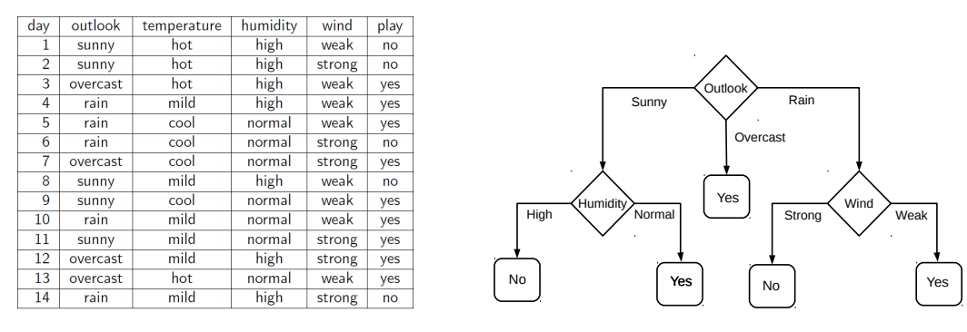
Decision Trees: A Machine Learning Algorithm
A simple yet powerful tool for both classification and regression.
It uses a tree-like structure to classify data or predict continuous outcomes.
It's a supervised learning algorithm.
Example of decision trees

Slide 3
The Decision Tree Algorithm
Root Node: The decision tree starts with a root node, which represents the entire dataset.
Splitting: The algorithm selects the best feature to split the data, based on a criterion such as information gain or Gini impurity.
Decision Node: The data is split into two or more subsets, based on the selected feature.
Leaf Node: Each subset is then assigned to a leaf node, which represents the predicted class or value.
Recursion: Steps 2-4 are repeated for each subset until a stopping criterion is reached, such as a maximum depth or a minimum number of samples.
Root Node
Gender
Female
Male
Diabetic
An Decision Node
A Leaf Node
BP
High
Low
Diabetic
Non-Diabetic

Slide 4
Gini Impurity
Gini Impurity is a measure of the impurity or uncertainty of a dataset
Formula:
Gini Impurity (G) = 1 - ∑(p^2)
where p is the proportion of each class in the dataset.
Example:
Suppose we have a dataset with two classes, A and B, with 60% and 40% of the samples, respectively.
Gini Impurity (G) = 1 - (0.6^2 + 0.4^2) = 1 - (0.36 + 0.16) = 1 - 0.52 = 0.48
A Gini Impurity of 0.48 indicates that the dataset is somewhat impure, but not highly impure.
Interpretation:
A Gini Impurity of 0 indicates a pure dataset (all samples belong to the same class).
A Gini Impurity of close to 1 indicates a highly impure dataset (samples are evenly distributed across all classes).

Slide 5
Entropy
Entropy is a measure of the uncertainty or randomness of a dataset.
Formula:
Entropy (H) = -∑(p * log2(p))
where p is the proportion of each class in the dataset.
Example:
Suppose we have a dataset with two classes, A and B, with 60% and 40% of the samples, respectively.
Entropy (H) = - (0.6 * log2(0.6) + 0.4 * log2(0.4)) = - (-446 - 0.529) = 0.970
An entropy of 0.97 suggests a mixed dataset that can benefit from a good split

Slide 6
Advantages of Decision Trees
Easy to Interpret: Decision trees are simple to understand and visualize, making them a great choice for explaining complex data.
Handling Missing Values: Decision trees can handle missing values by using surrogate splits or imputation.
Handling Non-Linear Relationships: Decision trees can capture non-linear relationships between features and targets.
Disadvantages of Decision Trees
Overfitting: Decision trees can suffer from overfitting, especially when they are deep or have a large number of features.
Greedy Algorithm: The algorithm is greedy, which means it may not always find the optimal solution.

Slide 7
Types of Decision Trees
Classification Trees: Used for categorical targets, where the goal is to predict a class label.
Regression Trees: Used for continuous targets, where the goal is to predict a numerical value.
Common Applications of Decision Trees
Customer Segmentation: Decision trees can be used to segment customers based on demographic and behavioral features.
Credit Risk Assessment: Decision trees can be used to assess credit risk based on features such as credit score, income.
Recommendation Systems: Decision trees can be used to build recommendation systems based on user behavior.

