Slide 1

Impact of Infectious Diseases on Flights
Ryan Ashcraft
Vikash Bhakta
Luis Olguin
Maria Soto
Project 1_Group 3
March 21, 2020

Slide 2

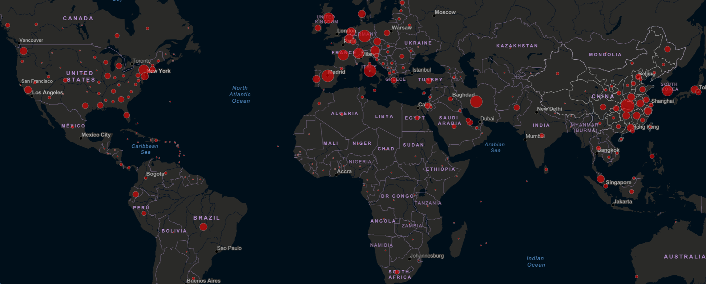
Our Motivation Seeking Answers
Inspired by COVID-19’s massive impact on airline industry
Have other disease outbreaks caused similar impacts on flying?
Does the amount of cases or deaths influence a disease’s impact?
Does the mortality rate play a role?
https://www.transtats.bts.gov/
http://apps.who.int/flumart/Default?ReportNo=12
https://www.kaggle.com/imdevskp

Slide 3
Detailed Data Sources
Epidemics data:
CDC: https://open.cdc.gov/data.html
https://emergency.cdc.gov/recentincidents/index.asp
Harvard: https://dataverse.harvard.edu/dataverse/mit
SARS: https://www.who.int/csr/sars/country/en/
WHO: https://www.who.int/csr/sars/country/en/
H1N1 Flu Data: http://apps.who.int/flumart/Default?ReportNo=12
H1N1 CDC Total Count: https://www.cdc.gov/flu/pandemic-resources/2009-h1n1-pandemic.html
Travel:
Flight Data: https://rapidapi.com/Travelpayouts/api/flight-data
http://apps.who.int/flumart/Default?ReportNo=12
https://www.kaggle.com/imdevskp
https://www.transtats.bts.gov/

Slide 4
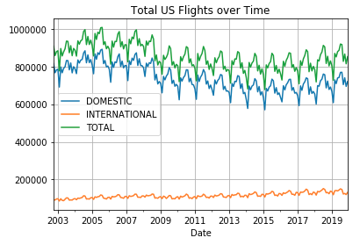
Flight Datasets
https://www.transtats.bts.gov/

Slide 5
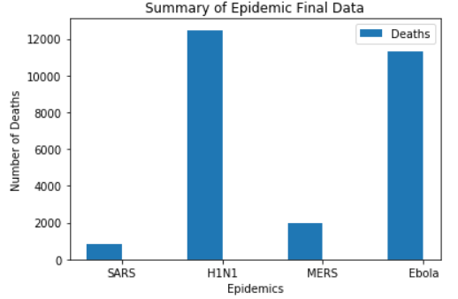
Epidemic Comparison
*Note: H1N1 TOTAL estimates according to the CDC

Slide 6

SARS Analysis
March 2003 – July 2003

Slide 7
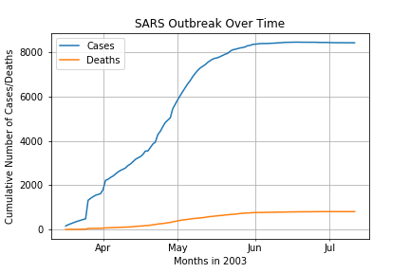
SARS: March 2003 – July 2003

Slide 8
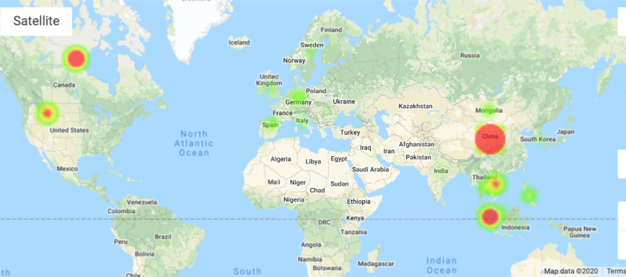
SARS – Worldwide Impact

Slide 9
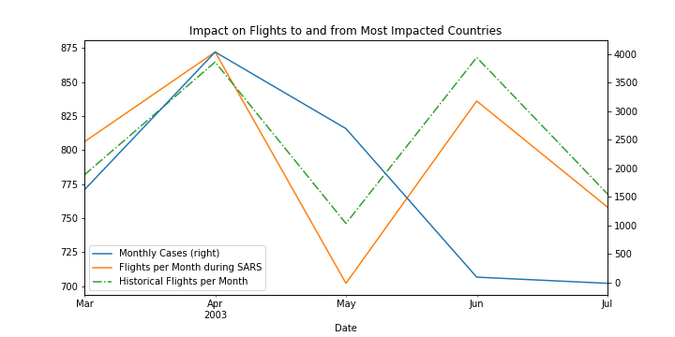
SARS Cases vs. Flights Canada, China, and Singapore

Slide 10
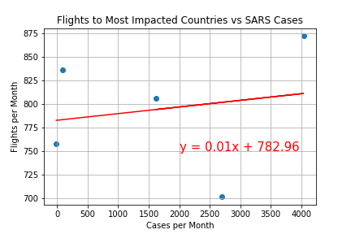
Correlation between SARS Cases and Flights
r_value = 0.182

Slide 11
Ebola Analysis
September 2014 – March 2016

Slide 12
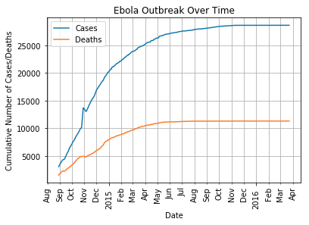
Ebola: September 2014 – March 2016

Slide 13
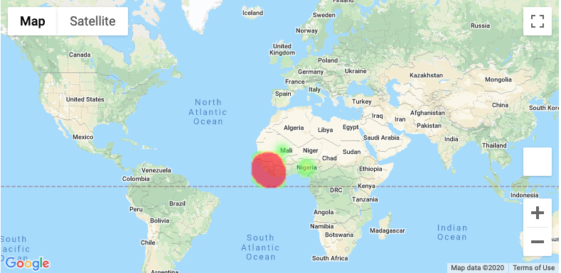
Ebola – Worldwide Impact

Slide 14
Ebola Cases vs Flights Sierra Leone, Guinea, Liberia, Nigeria

Slide 15
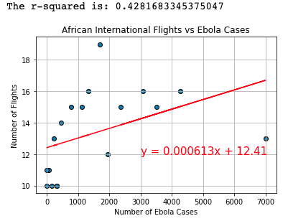
Correlation between Ebola Cases and Flights

Slide 16
H1N1 Analysis
March 2009 – April 2010

Slide 17
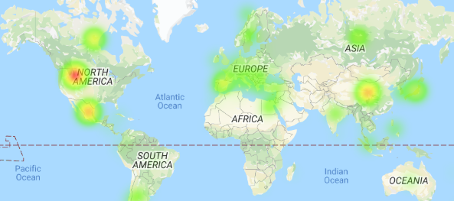
H1N1 – Worldwide Impact

Slide 18
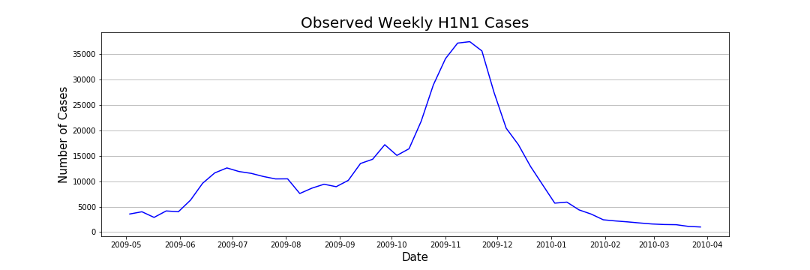
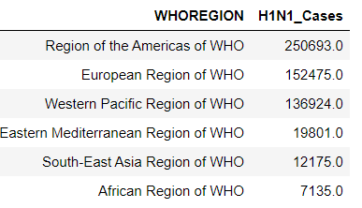
H1N1 Cases* (March 2009 – April 2010)
Total Cases*: 579,203
*Note: These are Lab Confirmed Cases

Slide 19
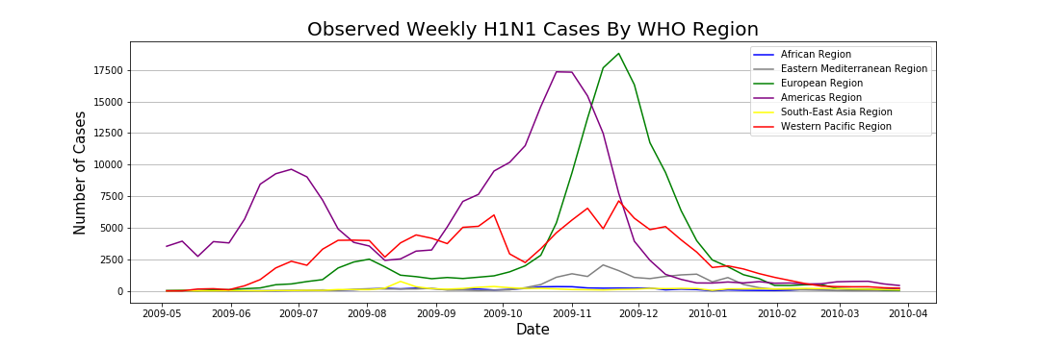
H1N1 Cases* (March 2009 – April 2010)
Total Cases*: 579,203
Note* These are Lab Confirmed Cases

Slide 20
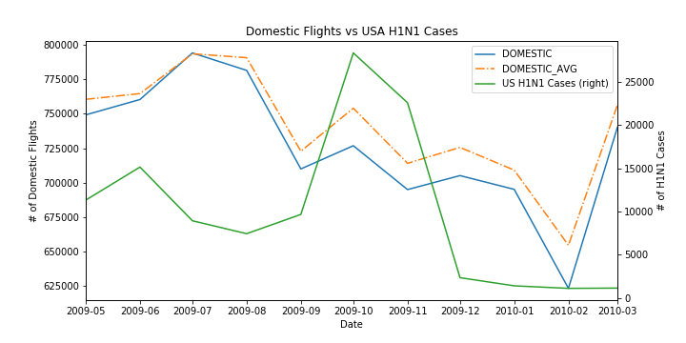
H1N1 Domestic Flights vs Cases*
Note* These are Lab Confirmed Cases

Slide 21
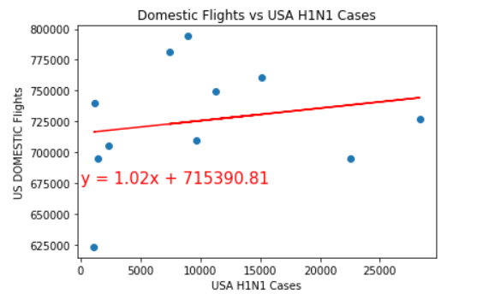
H1N1 Domestic Flights vs Cases*
r_value = 0.193
Note* These are Lab Confirmed Cases

Slide 22
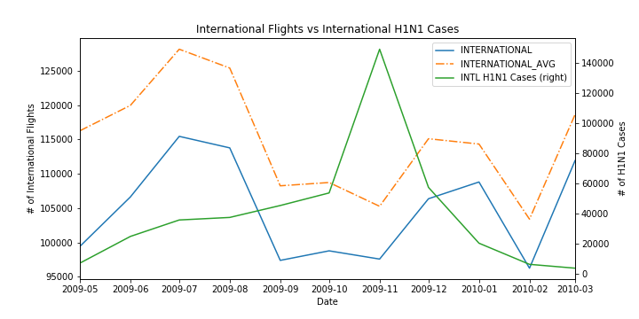
H1N1 Int’l Flights vs Cases*
Note* These are Lab Confirmed Cases

Slide 23
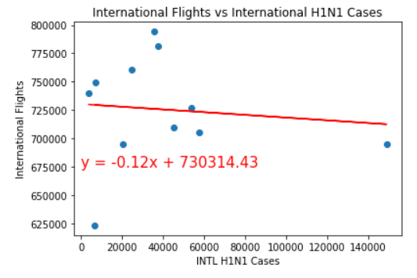
H1N1 Int’l Flights vs Cases*
r_value = -0.102
Note* These are Lab Confirmed Cases

Slide 24
MERS Analysis

Slide 25
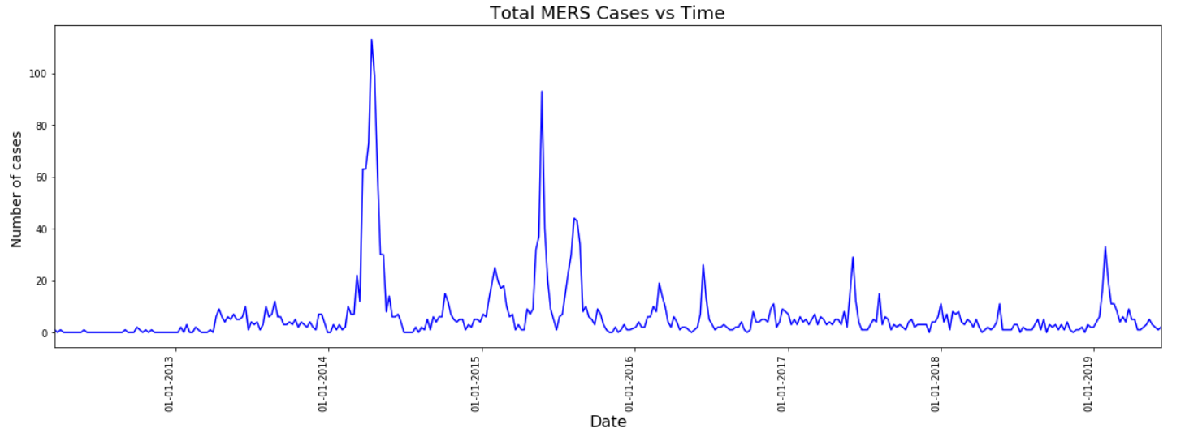
MERS 2012 – 2019
Total cases (dataset) = 2449
Total cases CDC = 2442
Total cases WHO = 2494
27 affected Countries
Data exploration & constrains
Data was already cleaned and organized by Country and Region
MERS #deaths were not available

Slide 26
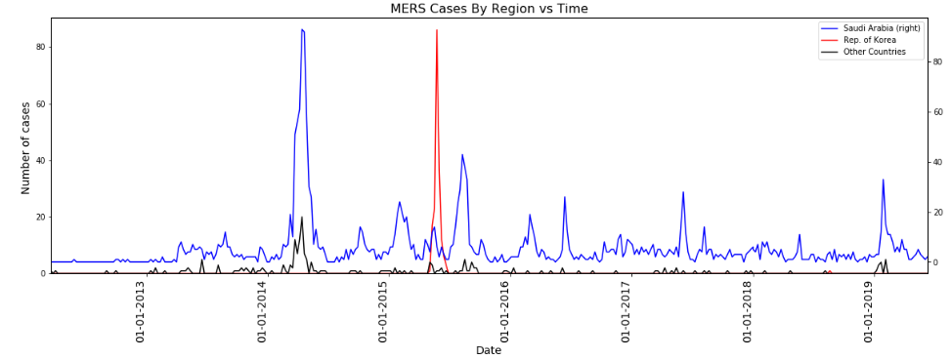
MERS 2012 – 2019
Korea Rep = 186
7.5%
Saudi Arabia Cases = 2058
84%
Fact
~92% of total cases were in Saudi Arabia & Rep. of Korea

Slide 27
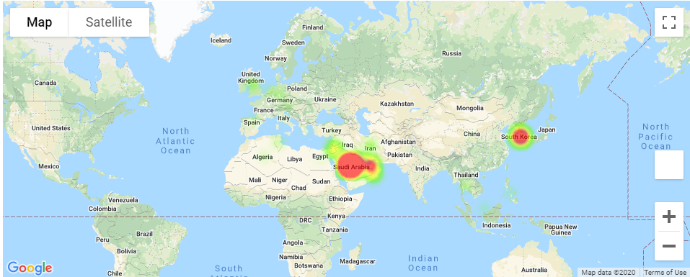
MERS – Worldwide Impact

Slide 28
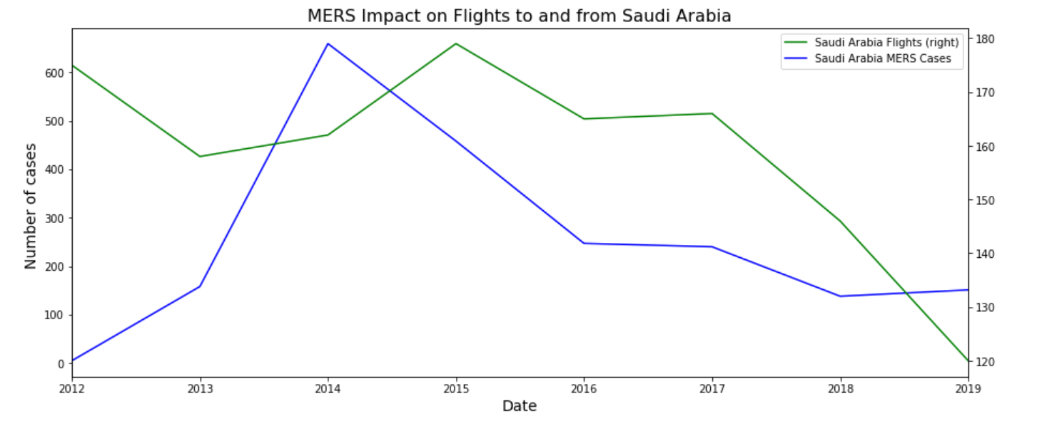
MERS cases vs Flights
Visual impact of MERS on Flights
No historical data was available due to the disease time length (2012-2019)

Slide 29
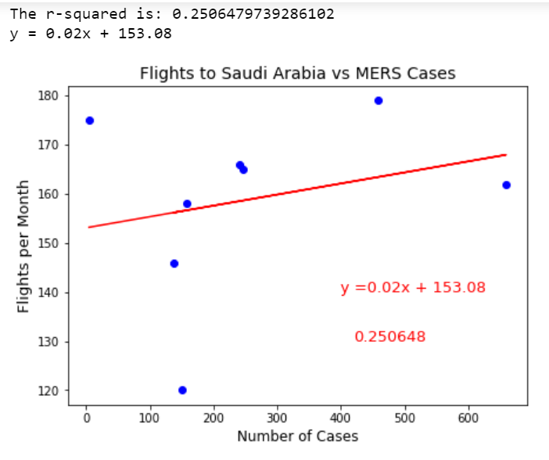
MERS cases vs Flights
r_value =

Slide 30

Findings

Slide 31
Summary of Findings
Based on r value results, flight and epidemic data do not show a statistically significant correlation
A greater amount of flight data points is necessary to increase certainty regarding the Epidemics impact on Flights
 | r_values
Epidemic | Domestic | International
EBOLA Case |  | 0.4282
H1N1 Cases | -0.1019 | 0.1929
SARS Case |  | 0.1824
MERS Case |  | 0.2506

Slide 32
Conclusions
The flight data shows a cyclical behavior throughout the years
There is not a significant correlation between flight and epidemic datasets
Seems to be an impact of epidemics on flight frequency. However, there is uncertainty in this regard
Higher outbreaks of SARS, H1N1 and MERS seem to negatively impact flight frequency
Ebola and flight data do not show a consistent response

Slide 33

Impact of Infectious Diseases on Flights
Project 1_Group 3

