Slide 1
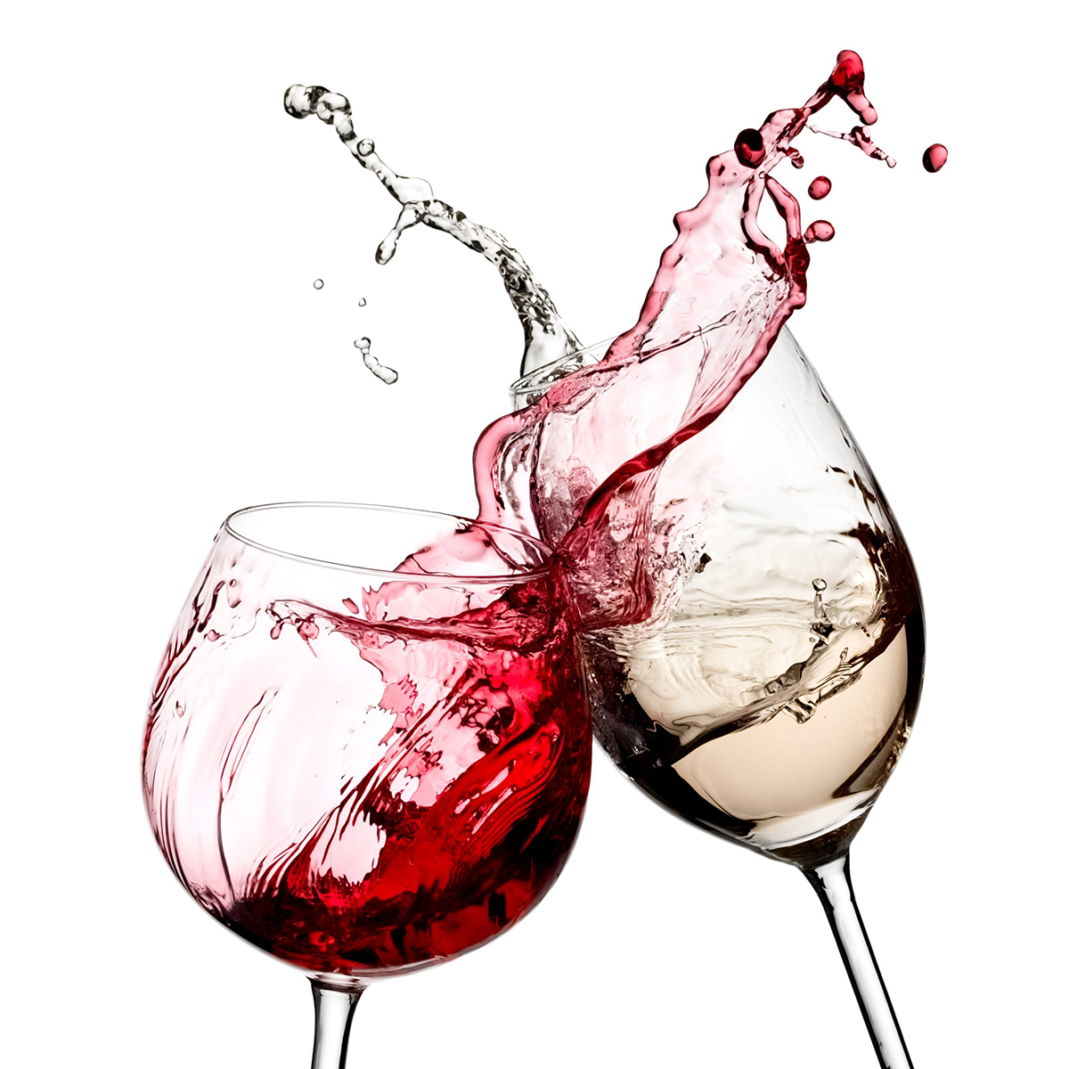

EDA Project –wine quality JAN 2021 cohort
Vishnupriya Bhakthavatsalam

Slide 2
Problem Statement-wine quality dataset
Reverse engineer a exact wine that will suit palates of younger generation, If a new wine is to be introduced in the market what parameters will fetch the new wine higher quality rating and how can we arrive at those parameters with the dataset in hand?
Some questions which were explored in the dataset are:
How many wines have that particular quality rating from 3-9?
How Sour are these Wines?
Is the wine softer and subtle enough to suit all food? Observed relationship of Fixed acidity to pH and how is this a contributing factor to softness ?
Alcohol distribution in these wines and differences-between-medium-bodied-and-light-bodied-wine?
How much of these wines are dry, medium dry, medium in sweetness?
What is the relationship of residual sugar to denser wines? Is it Citric acid which is giving freshness to wine?
Are these wines old world style? Meaning suitability of these wines to current market?

Slide 3
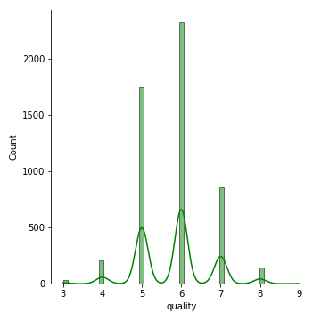
How many wines have that particular quality rating from 3-9?
While,4074 wines are falling into medium rating of 5 & 6, rest of the 1003 are rated as 7 to 9. Among the several features, which are contributing ones to quality? How much differences are there in features such as sweetness, sourness, body of the highly rated wines ?

Slide 4
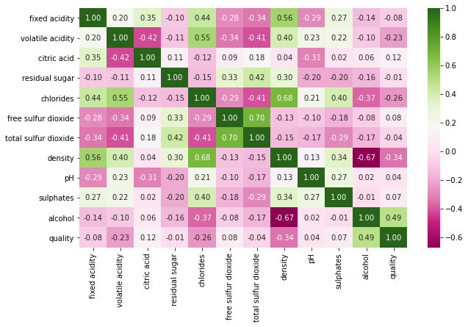
Multivariate Correlation- which are contributing features to quality?
Observations: Quality and Alcohol (positively correlated),Density, chlorides and Acidity (positively correlated) Density and Alcohol (negatively correlated),Free SO2 and Total SO2 (positively correlated) Acidity and pH (negatively correlated)

Slide 5
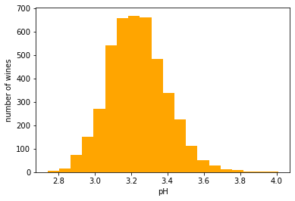
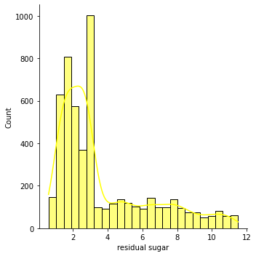
Count of Sour and Sweet wines
How Crisp are these Wines?
How Sweet are these Wines?
These are tart red wines with most of them in <3.2 pH, best red wines are with a pH of 3.3 to 3.6, 1283 fall into that category. 2355 wines are with low fruit (sugar content) `2g -6g after outliers removal fall into dry wines category.

Slide 6
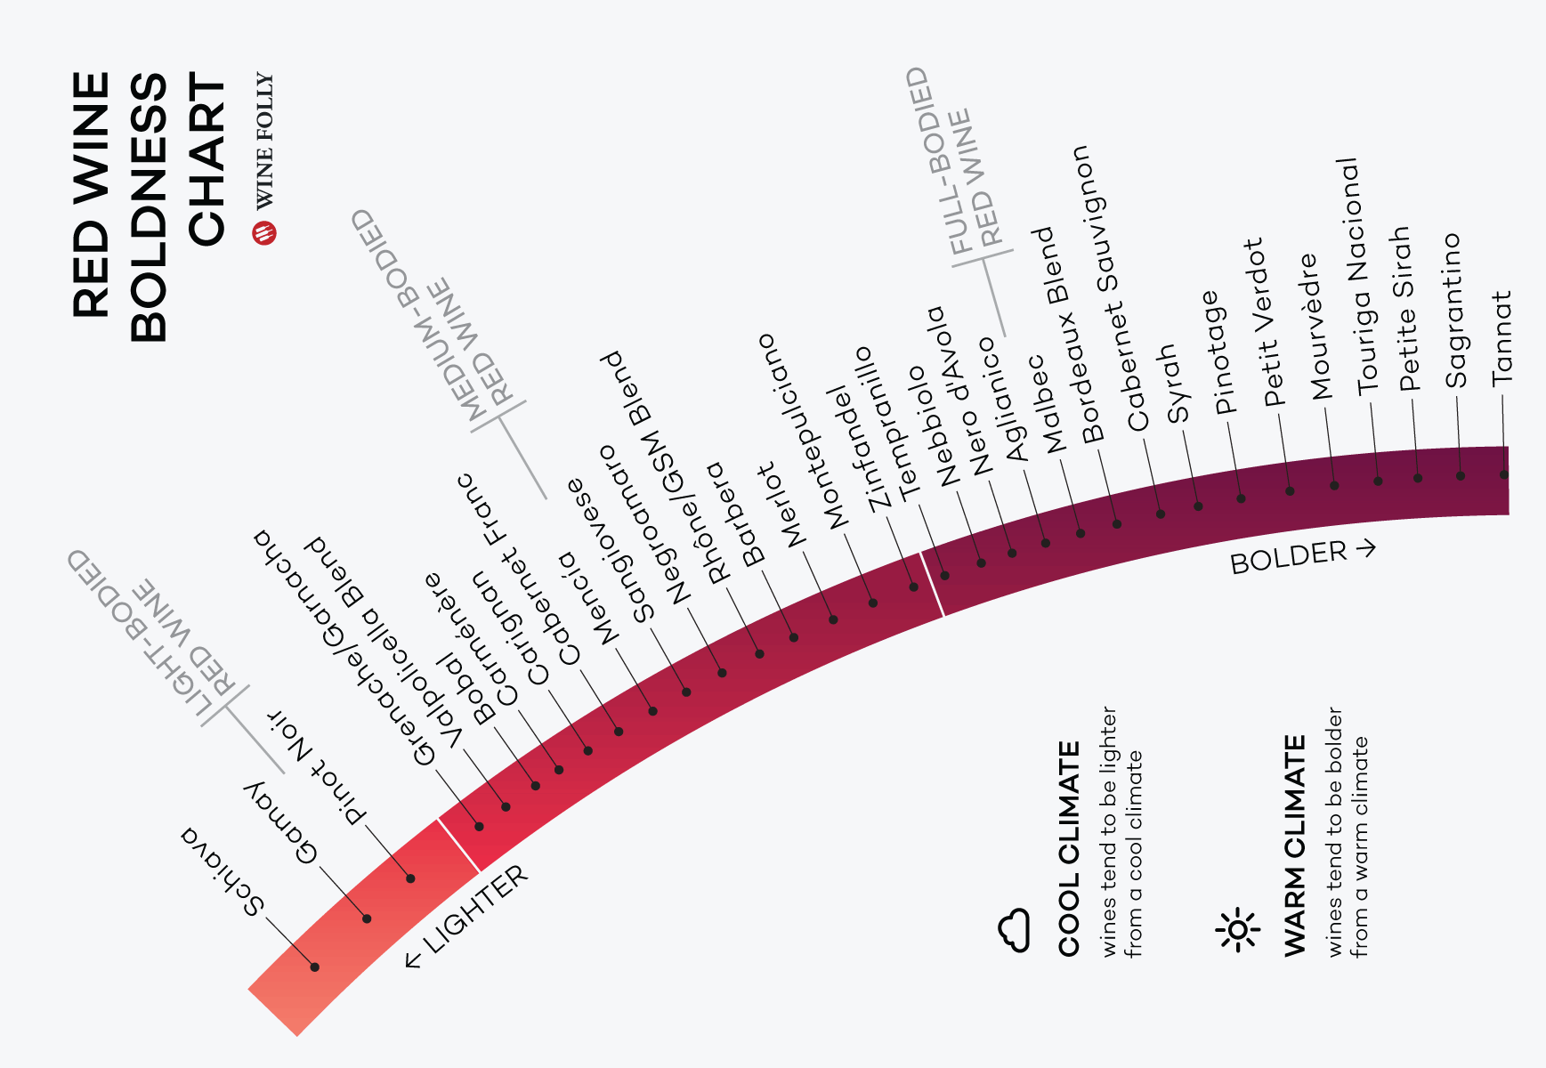
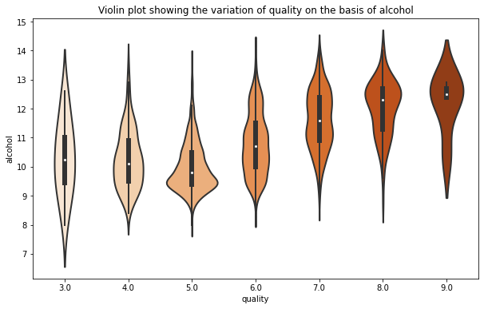
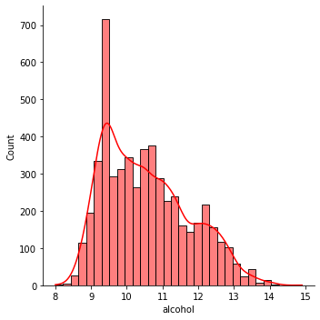
Alcohol distribution in wines and differences-between-medium-bodied-and-light-bodied-wine
Majority of these are light bodied wines with low alcohol content ,305 wines are in medium category(12.5 to13.5%) are bubbly wines , as you can see only 23 are wines above 13.5 to 14% alcohol content.

Slide 7
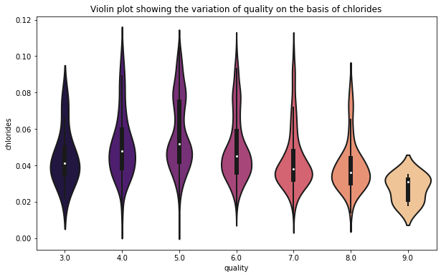
Lower the Chlorides higher the quality
The experts perceived salty flavors that were positively associated with bitterness in wines from districts with saline soil As you can see wines with 7 to 9 ratings has lower chlorides Interesting to note, out of the 5 wines of rating 9 have bimodal distribution curve indicating that even lowest chlorides content are present in couple of wines in its population .

Slide 8
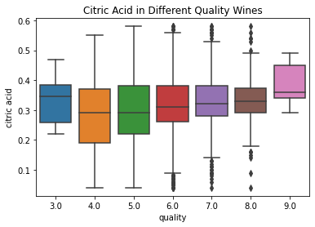
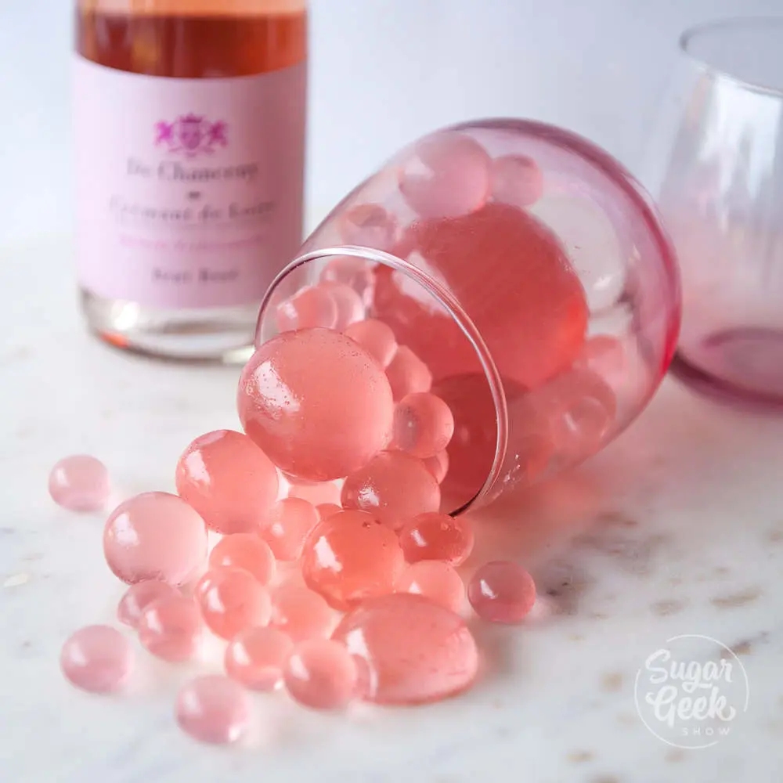
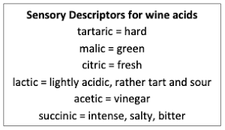
How fresh are these wines
Sensory testers seems to be increased liking to citric acid, hence they give high rating to freshness of citric acid

Slide 9
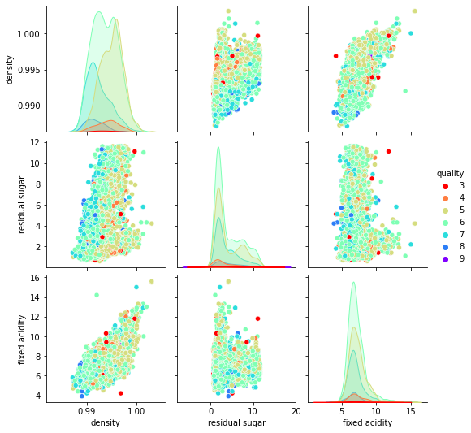
What is the relationship of residual sugar to denser wines?
Interesting to note that residual sugar seems highly correlated to density.
Also fixed acidity is having positive correlation to density as mixture of acids exist due to fermentation.
Density has high negative correlation to alcohol.
Chlorides are also influencing density due to salty water irrigation of grapes

Slide 10
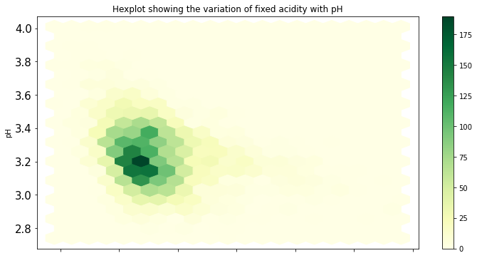
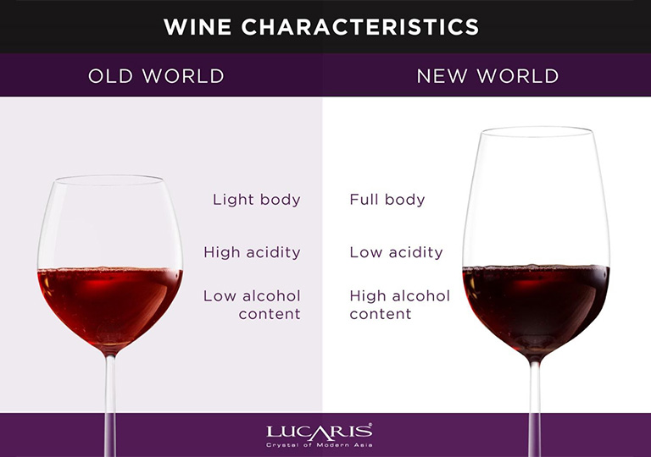
Are these wines old world style?
Strong correlation of pH with fixed acidity in turn to softness of wine are explored. What we see are a few well balanced above pH 3.4 wines, while majority are highly acidic wines, (pH of 3.1 3.3). Very much old style wines.
Dataset’s wines are quite tart red category ,light bodied and with low alcohol

Slide 11
Reflections
Conclusions
Overall the wines are old world style with which are highly acidic ,light bodied and with low alcohol
Using Exploratory data analysis we understood the variable distribution patterns in all wines taken for sensory studies to make quality rating exercise and feel unnecessary variables could be dropped.
The features are understood using univariate, bivariate and multivariate analysis, and slicing and dicing the dataset
9.2 Actionable Insights
Most of the wines are tart wines having low content of alcohols and sugar in dataset, these go well with tomato-laced dishes .It goes nicely with chicken and salmon as it is light bodied, It may even work nicely with roasted red meats, steaks, and stews. However, most of these are not desert wines and neither of these can be paired with delicate foods. So, cant be priced very high.
Dataset has wines with acidity that’s too high. For wines which are too acidic and sour, malolactic fermentation is suggested. It converts harsh malic acid, the kind found in green apples, into softer lactic acid, This can help wines to achieve softness and well rounded taste.
Quality rating of wines are dictated by higher alcohol , high alcohol level (over 12) fetches good ratings, fermenatation /fortification using distilled grape brandy can help
Wineries needs to avoid the use of salt water for grapes irrigation, as it increase chlorides which in turn increase the density of wines , bringing down the quality rating due to bitterness in taste
Overall, if wines are brought from old world style to new world style it can fetch higher price

