Slide 1


Slide 2


Awk
Programming!

Slide 3
Introduction
Alfred Aho
Peter Weinberger
Brian Kernighan ( in 1977 )
A field-oriented pattern processing language with ‘C’ like syntax.
Other variants of awk:
1. Gawk - Paul Rubin and Jay Fenlason.
( Free Software Foundations GNU version. )
2. Mawk - Michael Brennan
3. Bell Labs awk

Slide 4
Using Awk
1. At command line ( or inside shell scripts ).
awk [options] ‘/pattern/ { actions }’ files
2. Write “/pattern/ { actions }” in to a file ( say scriptfile )
then type
awk -f scriptfile inputfile(s)
3. In the above scriptfile put first line as #! /bin/awk -f
Make scriptfile executable by “chmod 0700 scriptfile”
then execute as
./scriptfile inputfile(s)

Slide 5
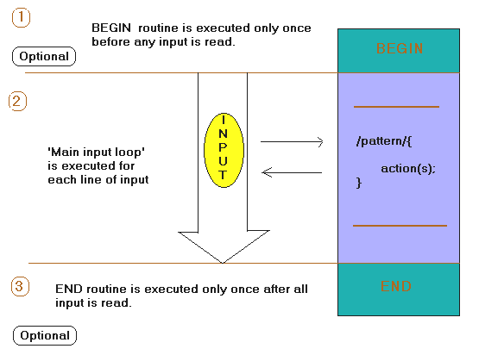
Awk’s working model

Slide 6
Pattern-Action Structure
Every program statement has to have a pattern, an action, or both
Default pattern is to match all lines
Default action is to print current record
Patterns are simply listed; actions are enclosed in { }s
Awk scans a sequence of input lines, or records, one by one, searching for lines that match the pattern
  Meaning of match depends on the pattern
  /gesl/ matches if the string ”gesl" is in the record
  $3 > 0 matches if the <condition> is true
Notes:
Note that I and most sources will use the terms lines and records interchangeably

Slide 7
Examples:
1.Print 1st fields in all lines containing “URGENT” in “file”
awk ‘/URGENT/ { print $1}’ file
2.Print 3rd,2nd fields in “file” where 1st field is “URGENT”
awk ‘ $1 ~ /URGENT/ { print $3, $2 }’ file
3.Awk Program to Count number of blank lines in file “file”
awk ‘ BEGIN { count = 0 }
/^[ ]*$/ { count++}
END {
print “There are”, count, “Blanklines in file”
}’ file

Slide 8
Regular Expressions in Awk
Awk uses the following regular expressions
  ^ - begining of line
  $ - end of line
  . - any character
  [abcd] - character class
  [^abcd] - negated character class
  [a-z] - range of characters
  (regex1 | regex2) - alternation
  * - zero or more occurrences of preceding expression
  + - one or more occurrences of preceding expression
  ? - zero or one occurrence of preceding expression

Slide 9
Awk Variables
AWK variables are automatically declared upon use and initialized to an empty string
-- Variable names are strings of letters and underscore
-- Case sensitive
-- Variables hold strings or double precision numbers
-- No declarations needed.
-- Initially a variable equals "" or 0
-- Variable type is inferred from contents and use
-- If it contains a number, it might be a number or a string otherwise it is a string.

Slide 10
Built-in variables :
NR Current input line number
FILENAME Current input file
FNR Current input line number in current file
NF Number of fields in the current input line
FS Field separator regular expression (space or tab)
RS Input record separator character
OFS Output field separator ( default blank )
ORS Output record separator ( default newline )
OFMT Output format for numbers
ARGC Number of command line arguments

Slide 11
Positional Parameters
These are set internally by awk for each input record.
$0 Current input line
$1 First field
. . .
$n nth field
$NF Last field
( since NF is number of fields in current line )
Example:- print only first and last fields swapped;
awk ‘{ print $NF, $1 }’ input-file

Slide 12
Awk script that adds line numbers to a text file.
#!/bin/awk –f
BEGIN {
printf(“Line numbers by awk\n”);
}
{
printf("%d: %s\n",NR,$0);
}

Slide 13
AWK Arrays
AWK arrays are automatically declared upon use and initialized to an empty string
Awk array subscripts can be any string, not necessarily numeric.( known as Associative arrays ).
Awk array insertions are made by
array[expression]=value
Awk array deletions are made by
delete array[expression]
Awk array increment and decrement
array[“pattern”]++ array[“pattern”]--

Slide 14
Arrays Continued...
... Array can be created with the split function
Examples:-
1. array[2] = 10; i = 2;
print “array[2] = “, array[$i]; # Or directly array[2];
2. myarray[name]=“gesl”
myarray[age]=“23”
print “myage = “, myarray[age];
3. split( “this is five words string”, wordarray, “ “);
‘wordarray’ is array containing the words ‘this’ , ‘is’ , ‘five’, ‘words’, ‘string’.

Slide 15
Built in Arrays
ARGV
The command line arguments array
( Similar to C’s argv[] )
ENVIRON
Associative array of environmental variables
ARGV[1] - first command line argument
ARGV[ARGC] - last argument
ENVIRON[“HOME”] - current home
ENVIRON[“PATH”] - the current path.

Slide 16
Built-In Functions
Arithmetic
    cos, exp, int, log, sin, sqrt, rand, srand
String
    gsub, index, length, match, sub, substr, split, tolower, toupper
Input/Output
    getline, print, printf
Others
    system - executes a Unix command
    exit - stop reading input and go immediately to the END pattern-action pair if it exists, otherwise exit the script

Slide 17
Continued...
gsub(r,s,t) - Globally replace regex r with string s, applied to data t; return no. of substitutions; if t is omitted, $0 is used.
index(s,t) - Return the index of t in s, or 0 if s does not contain t
length (s) - Returns length of string s
substr(s,m,n) - Returns the n character sub-string of string s that begins at position m.
match(s,re) - Returns the position in string s where regular expression re occurs, or 0 if no match.
sub(re,t,s) - Substitutes string t for the first occurrence of regular expression re in string s.
split(s,a,fs) - Split s into array a on fs, return no. of fields; if fs is omitted, FS is used in its place.

Slide 18
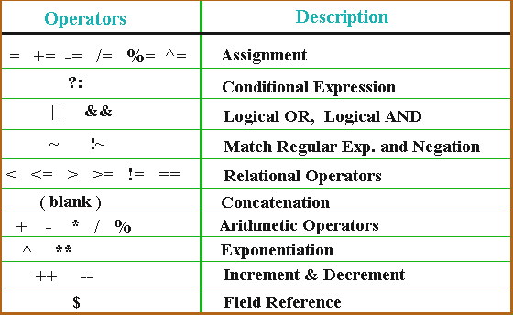
AWK Operators:

Slide 19
AWK’s Control Structures
AWK Control Structures are...
  if (expression) { .. } [ else { .. }]
  while (expression) { …}
  for (expression; expression; expression) { ..}
  do { … } while (expression)
  break; continue; exit;
  for (variable in array ) { .. }

Slide 20
Continued...
If-Else
  if (expression is true or non-zero){
  statement1
  }
  else {
  statement2
  }
  where statement1 and/or statement2 can be multiple statements enclosed in curly braces { }s .the else and associated statement2 are optional
Notes:
Computes the total and average pay of employees making more than $6/hour and uses the if to defend against a divide by zero error

Slide 21
Loop Control
While
  while (expression is true or non-zero) {
  statement1
  }
Example:- While loop to print numbers b/n 1-10.
  awk ‘ BEGIN { Count = 1;
  while ( Count < 10 ) {
  print “Count = “, Count;
  Count++;
  }
  exit;
  }’
Notes:
uses formula value = amount(1 + rate) ^ years
^ is the exponentiation operator
\t is a TAB
# is a comment symbol, every thing following is ignored by Awk
Get into the habit of commenting your scripts, I will require it and it will help you remember what you did a week or a month later

Slide 22
Continued...
For
  for(expression1; expression2; expression3) {
  statement1
  }
Example:- For loop to print even numbers b/n 1-20
  awk ‘ BEGIN {
  for( Count; Count < 20; Count++) {
  if ( Count % 2 == 0 )
  print “Number = “, Count;
  }
  exit;
  }’

Slide 23
Continued...
Do While
  do {
  statement1
  } while (expression)
Example:- Do-While loop for printing “gesl” 10 times;
  awk ‘ BEGIN { Count=0;
  do {
  print “gesl\n”
  Count++;
  } while ( Count <= 10 );
  exit;
  }’

Slide 24
User-Defined Functions
Defined as :
function name( parameter list ) { statements }
> Arrays are passed by reference, others variables are passed by value.
Example :-
#! /bin/awk -f
function display( str) {
print “The String i got is “, str ;
}
BEGIN {
display(“global edge\n”); # Calling
exit;
}

Slide 25
“getline” function
The getline function is used to read extra lines of input which can be from input data stream, input from files, and pipes.
Example :-
1. Reading from files
while ( (getline < “datafile”) > 0)
print ;
2. Assigning the input to a variable.
BEGIN {
print “Enter your name”;
getline name < “-”
print name
}

Slide 26
Books
Sed & Awk
  Dale Dougherty & Arnold Robbins
  Second edition
See the manpage “man awk”

Slide 27

Questions?

