Slide 1

Expect
Automating Interactive Programs!
- Bhaskar. V

Slide 2
Index
Pre-Requisites
What is expect
Why expect
How it works
How to use
Expect commands explained
Examples
Limitations
Expectk
AutoExpect
Resources for Expect

Slide 3
Pre-Requisites
Unix / Linux Shell Scripts
Tcl - Tool Command Language
Tk ( Optional )

Slide 4
What is Expect?
Expect is a program that “talks” to other interactive programs according to a script. Following the script, Expect knows what can be expected from a program and what the correct response should be.
This was developed by Don Libes at NIST ( National Institute of standards & Technology) in 1987.
Expect is used to automate interaction with
non-GUI applications that prompt the user
for input.

Slide 5
Continued..
An interpreted language provides branching and high-level control structures to direct the dialogue.
User can take control and interact directly when desired, afterwards returning control to the script.
Expect is an extension to TCL ( Tool Command Language ).

Slide 6
Continued…
expect can actually talk to several programs at the same time.
expect is useful for running any character oriented program which requires interaction between the program and the user.
The interactive facilities Expect offers open new dimensions of opportunity in automation, capability, and testing.

Slide 7
Continued..
expect can use any UNIX program whether or not it is interactive.
Interactive applications that can be automated using Expect are telnet, FTP, passwd, fsck etc.

Slide 8
Why Expect?
If a piece of software only works when a human is interacting with it, testing it is very expensive.
Humans are “unreliable”. Repeating an interaction for the 10th time, people won’t be paying nearly as much attention as they had on first time.
We can’t do automated interactions using shell.

Slide 9
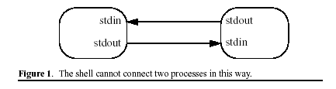
Continued…
The unix / linux notation proc1 | proc2 indicates that output flows from proc1 to proc2. There is no data flow from proc2 to proc1. Indeed, the only entity that the shell can interact with on a 2-way basis is the user.

Slide 10
Continued…
The shell has no way to prevent a program from bypassing the standard input and output conventions. Programs are free to open /dev/tty to communicate directly with the user.

Slide 11
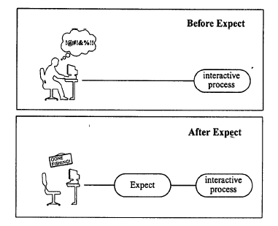
Before / After

Slide 12
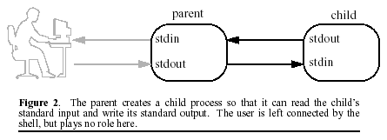
How it works?
A program is created (by the shell) which internally spawns the process to be controlled. The spawned process will have its standard input and standard output remain connected to the original program.

Slide 13
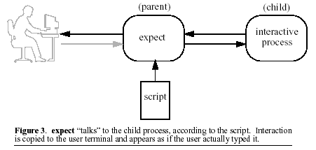
The parent reads a command script. When it finds send commands, it sends data to the child. When it finds expect commands, it checks the output of the child for a pattern. If the pattern is matched, the parent goes to the next command in the script.

Slide 14
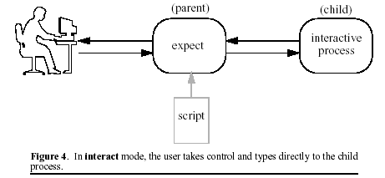
When an interact command is found, the parent simply copies characters from the user to the child and vice versa. Control may be returned to the script at the user’s convenience.

Slide 15
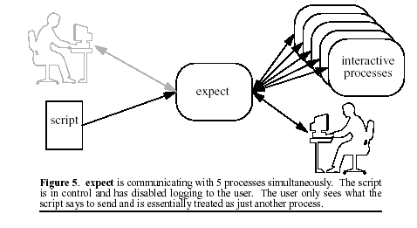
Expect at work!

Slide 16
Classes of problems expect addresses
Programs that demand interactivity
Programs that cross machine or program boundaries
Programs that read and write /dev/tty
Programs that flush input
Passing control from user to/from script
Ostensibly non-interactive programs
Programs with poorly written interfaces
Multiple programs never designed to work together
Dynamic and complex pipes and redirection

Slide 17
expect [-dDinN] [-c cmds] [-[f|b]] cmdfile] [args]
Expect reads cmdfile for a list of commands to execute. Expect may also be invoked implicitly on systems which support the ‘#!’ ( hash-bang ) notation by marking the script executable, and making the first line in your script:
#!/usr/bin/expect -f

Slide 18
The -c flag prefaces a command to be executed before any in the script. The command should be quoted to prevent being broken up by the shell. This option may be used multiple times. Multiple commands may be executed with a single -c by separating them with semicolons. Commands are executed in the order they appear.
The -d flag enables some diagnostic output, which reports internal activity of commands such as expect and interact. This flag has the same effect as “exp_internal 1” at the beginning of an Expect script
The -D flag enables an interactive debugger.

Slide 19
The -f flag prefaces a file from which to read commands from.
The -i flag causes Expect to interactively prompt for commands instead of reading them from a file.
-v causes Expect to print its version number and exit.
Optional args are constructed into a list and stored in the variable named argv. argc is initialized to the length of argv.

Slide 20
argv0 is defined to be the name of the script (or binary if no script is used)
The file $exp_library/expect.rc is sourced automatically if present, unless the -N flag is used.
Immediately after this, the file ~/.expect.rc is sourced automatically, unless the -n flag is used.

Slide 21
How to Use?
Using it interactively
prompt$ expect
expect>
at Command line
prompt$ expect –f exp_script args
Hash-Bang Notation
make first line in file => #! /usr/bin/expect –f
make it executable => chmod +x scriptname
execute the script => prompt$ ./scriptname

Slide 22
Interaction Commands
send [-flags] string
expect patlist1 action1 patlist2 action2 . . .
interact [string1 body1] .. [stringn [bodyn]]

Slide 23
send [-flags] string
Sends string to the current process.
The command send "hello world\r”
sends the characters, h e l l o <blank> w o r l d <return> to the current process.
Characters are sent immediately although programs with line-buffered input will not read the characters until a return character is sent.
The -i flag declares that the string be sent to the named spawn_id.

Slide 24
send Continued..
The -null flag sends null characters (0 bytes). By default, one null is sent. An integer may follow the -null to indicate how many nulls to send.
The -break flag generates a break condition
The -h flag forces output to be sent (somewhat) like a human actually typing. Human-like delays appear between the characters

Slide 25
send Continued..
The -s flag forces output to be sent "slowly", thus avoids the common situation where a computer outtypes an input buffer that was designed for a human who would never outtype the same buffer
exp_send is an alias for send

Slide 26
expect patlist1 action1 patlist2 action2 . . .
Waits until the output of the current process matches a pattern, or a specified time period has passed.
Each patlist consists of a single pattern or list of patterns. If a pattern is matched, the corresponding action is executed. The exact string matched is stored in the variable expect_match.

Slide 27
expect Continued..
If patlist is eof or timeout, the corresponding action is executed upon end-of-file or timeout, respectively. The default timeout period is 10 seconds.
timeout can be changed with ‘set’ command.
set timeout 30. # sets timeout to 30 seconds.
set timeout -1. # Infinite timeout

Slide 28
expect Continued..
expect {
Password: {
send “password\r"
} timeout {
send_user "connection timed out\n"
exit
} eof {
send_user "connection failed"
exit
}
}

Slide 29
interact [string1 body1] ... [stringn [bodyn]]
Gives control to the user. User keystrokes are sent to the current process, and the standard output and standard error of the current process are returned to the user.
String-body pairs can be specified as arguments, in which case the body is executed when the corresponding string is entered.

Slide 30
Interact Continued..
Any valid script commands may be entered after pressing the optional escape-character. Control is returned to interact if the continue command is entered. If the return command is entered, interact immediately returns with the argument of return (or the empty string if none is given).
During interact (except when entering commands via the escape character), job control is disabled so that all characters may be passed to the current process.

Slide 31
Interact Continued..
Set CTRLZ \032
interact {
-reset $CTRLZ { exec kill -STOP [pid] }
\001 { send_user "you typed a control-A\n"; }
$ { send_user "The date is [exec date].“ }
foo { send_user "bar“ }
\003 exit
}
When ^Z is pressed, Expect is suspended
When ^A is pressed, the user sees "you typed a control-A"
When $ is pressed, the user sees the date
When ^C is pressed, Expect exits.
If "foo" is entered, the user sees "bar".

Slide 32
Job Control Commands
close [-slave] [-onexec 0|1] [-i spawn_id]
spawn [args] program [args]
select spawn_id1 spawn_id2 ...

Slide 33
close [-slave] [-onexec 0|1] [-i spawn_id]
Closes the connection to the current process. Most interactive programs will detect EOF on their standard input and exit;
Both expect and interact will detect when the current process exits and implicitly do a close.
The -i flag declares the process to close corresponding to the named spawn_id

Slide 34
close Continued..
The -onexec flag determines whether the spawn id will be closed in any new spawned processes .
0 -> Leave the spawn id open
non zero -> Force the spawn to close. Default
The -slave flag closes the slave associated with the spawn id.
Whether the connection is closed implicitly or explicitly, wait should be called to clear up the corresponding kernel process slot.

Slide 35
spawn [args] program [args]
Creates a new process running program args. Its standard input, standard output, and standard error are connected to expect, so that they may be read and written by other expect commands.
The connection is broken by close or if the process itself closes any of the file descriptors.
When a process is started by spawn, the variable spawn_id is set to a descriptor referring to that process. The process described by spawn_id is considered the current process.

Slide 36
spawn Continued..
spawn returns the UNIX process id. If no process is spawned, 0 is returned
By default, spawn echoes the command name and arguments. The -noecho flag stops spawn from doing this.
The -console flag causes console output to be redirected to the spawned process.

Slide 37
spawn Continued..
The -open flag causes the next argument to be interpreted as a Tcl file identifier (i.e., returned by open.). The spawn id can then be used as if it were a spawned process.
The -ignore flag names a signal to be ignored in the spawned process.

Slide 38
spawn Continued..
spawn telnet 172.16.2.59
set telnet_id $spawn_id
a telnet program is spawned and its spawn_id is stored in a variable for later use.

Slide 39
select spawn_id1 spawn_id2 ...
returns a subset of the given spawn_ids that have input pending.
select waits until at least one spawn_id can be read or until the timeout has expired.

Slide 40
Miscellaneous commands
Classes of miscellaneous commands :
tracing - Programs may be traced to assist
debugging.
exiting - expect can return an exit code,
allowing it to be intelligently used in
shell scripts.
logging - Logging to files and/or the user
terminal is flexible. This allows
interaction with the user while hiding
some or all of the interaction taking
place with programs.

Slide 41
Continued..
fork
interpreter
log_file
log_user
match_max
overlay
parity
remove_nulls
send_error
send_log
send_tty
send_user
sleep
strace
stty
system
timestamp
trap
wait

Slide 42
Continued..
exp_send_log
exp_send_tty
exp_send_user
exp_version
expect
expect_after
expect_background
expect_before
expect_tty
expect_user
debug
disconnect
exit
exp_continue
exp_internal
exp_open
exp_pid
exp_send
exp_send_error

Slide 43
Sample ftp session
expect spawns ftp program to ip 172.16.2.154, then feeds the username and password for logging in then gives control back to user.
# Start an interactive process
spawn ftp 172.16.2.254
# Wait for response & Send string
expect “Login:“
send “username\r“
expect “Password:“
send “password\r”
expect “ftp>”
send “bye\r”
expect “ftp>”
# Pass control from script to user
interact

Slide 44
Automating ‘fsck’ The File System Checker
Expect is driving the fsck program so that one class of questions is answered “yes” while another is answred “no”. If anything else appears, control is temporarily turned over to a user to answer it.
spawn fsck /dev/hda6
while {1} {
expect {
eof break
-re "UNREF FILE.*CLEAR.*?“ { send "y\r“ }
-re "BAD INODE.*FIX.*?" { send "n\r“ }
-re "? " { interact }
}
}

Slide 45
Limitations
Automating character-oriented applications
only.

Slide 46
Expectk
A Tk/X11 version of the expect program.
Expectk is a mixture of Expect and Tk. It behaves just like Expect and Tk’s wish.

Slide 47
AutoExpect
Automating Automating Interactive Programs!!
Autoexpect is a program which watches a user interacting with another program and creates an Expect script that reproduces the interactions.

Slide 48
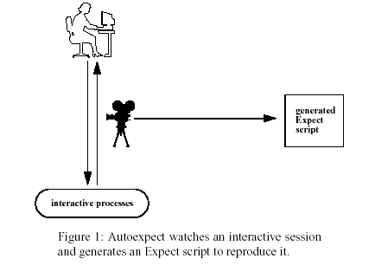
AutoExpect at Work

Slide 49
Resources
Book : Exploring Expect By Don Libes
Man Page
Other Info. URL : http://expect.nist.gov/
Expect Package & Examples for Unix
URL : http://expect.nist.gov/expect.tar.gz

Slide 50
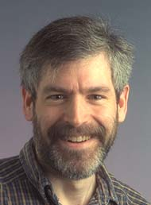
Don Libes

