Slide 1
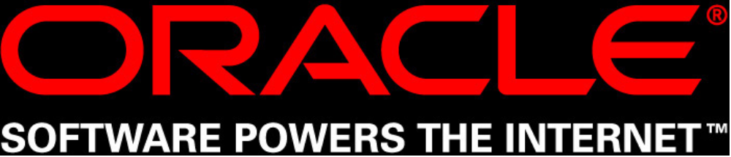

Slide 2

"OPatch in 11g"

Slide 3
OPatch so far…
Patched databases/agents/OMS from EM and at backend.
Supported copy/jar/archive/make actions
Had options to run pre/post scripts before/after patching actions.
CRS RAC Patching
  Minimize downtime
  All nodes
  Rolling
Applying and Removing multiple patches at once using nApply/nRollback

Slide 4
Requirements for 11g
SQL related actions were done from pre/post scripts.
  Database was required to be shutdown/startedup by users for full patching
Custom actions
  Support for user defined actions.
Patching support for other products from OPatch
  AS
  Portal
  Stand alone OHs [non-OUI]
Options to enforce/override Patch dependencies.

Slide 5
What OPatch can do in 11g?
Online Patching
  Database is patched without shutting it down.
  “HOT” patching!
  <filename>.pch Pre-Compiled Header files.
  OH/bin/mkpatch
  “oradebug” to install/enable remove/disable
  Patch files would always be in OH/hpatch

Slide 6
Continued…
Multi SID support
  Single node
    One OH, Two or more DBs running out of it.
  RAC
    CRS + DB
    Database could be only the shared one
    Host’s can have their own DBs along with shared DB.

Slide 7
Continued…
SQL Patching
  SQL scripts in one-off ship home.
  SQL Procedures.
  Custom SQL scripts.
  Patchmd.xml
  connectString, runSql, sqlScript options
  applySql, rollbackSql Utils
  checkRollbackSids prereq

Slide 8
Continued…
Portal patching
  Portal Repository and Mid-tier patching
  Inventory keeping and normal patching actions by OPatch
  Invoke ptlpatch.csh for portal stuff
  ptlpatch.csh will invoke opatch.pl
  Patching commands will always be run from mid-tier home
  ptlSchema, ptlPassword and ptlConnect options.

Slide 9
Continued…
AS Patching
  MAS does “few” things before invoking OPatch internally.
  AS Instance, oc4j, OHS, MDS etc components
  Patching APIs available
  Patching can be done from asctl CLI
  AS Patching from EM is being developed
  Flow is
    asctl => MAS => OPatch => MAS => asctl

Slide 10
Continued…
Stand-Alone OH
  Oracle Homes that are not installed using OUI
    MSI/RPM based products
  No cental inventory and component checks
  OPatch commands are same as that for OUI based homes.
  product.xml, sainventory, platform.xml will be created and maintained by OPatch
  Product type TAG in inventory.xml

Slide 11
Continued…
Prereq
Coreq
Overlay
One way copy
PlugIn actions
Init script
OPack enhancements to support all these.

Slide 12
OPatch in 11g Rocks!!!

