Slide 1


Slide 2

Oracle 10g Express Edition
- Bhaskar. V

Slide 3
What is Oracle Database 10g Express Edition?
Oracle Database 10g Express Edition (Oracle Database XE) is an entry-level, small-footprint (150MB) database.
It is based on the Oracle Database 10g Release 2 code base.
Free & Fast to download
Free to develop, deploy, and distribute.
Simple to administer.

Slide 4
Who should use Oracle Database XE?
Oracle Database XE is a great starter database for:
Developers working on PHP, Java, .NET, and Open Source applications
DBAs who need a free, starter database for training and deployment
Independent Software Vendors (ISVs) and hardware vendors who want a starter database to distribute free of charge
Educational institutions and students who need a free database for their curriculum

Slide 5
Other info…
Oracle Database XE can be installed on any size host machine with any number of CPUs.
Currently available as a Beta release for Windows and Linux
A production release is scheduled for early 2006.

Slide 6
Can I use Oracle Database XE for free deployment?
Oracle Database XE is free for runtime usage with the following limitations:
• Supports up to 4GB of user data (in addition to Oracle system data)
• Single instance only of Oracle Database XE on any server
• May be installed on a multiple CPU server, but only executes on one processor in any server
• May be installed on a server with any amount of memory, but will only use up to 1GB RAM of available memory

Slide 7
Additional info..
http://st-curriculum.oracle.com/tutorial/DBXETutorial/index.htm

Slide 8

Shell Scripting Basics
( bash Shell )

Slide 9

What Is Shell ?
The Shell is a Command line interpreter.
The user interacts with the Kernel through Shell.
( Analogous to command.com in DOS )
Why learn Shell Programming?
1. To become adept at System Administration.
2. A Shell script is “a quick and dirty” method of prototyping an application.
3. Developing job is made easy.
4. “Recyclable knowledge”.
5. Scripting avoids the compiler slow down ... you think-try-fix ...this is better than think-edit-compile-wait-fix

Slide 10
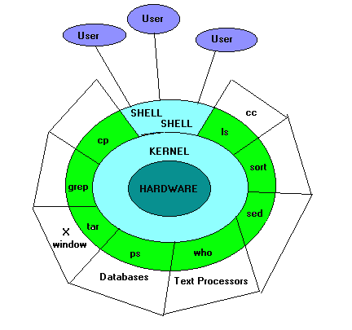
Kernel-Shell-User Relationship:-

Slide 11
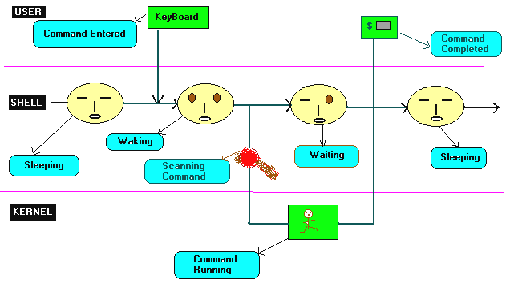
The Shell’s Interpretive Cycle:

Slide 12
Types Of Shells
1. Bourne Shell -- Stephen bourne in 1970’s
2. C-Shell -- Bill Joy 1980’s
3. Korn Shell -- David Korn
4. Bourne Again Shell (Bash) -- Brian Fox for GNU Project
Now maintained by chester ramey
( We will be talking about this shell )
5. Tenex and Tops C-Shell.

Slide 13
Logging On/Off
  LogOn
Users must identify themselves to the system— this is called logging on
At the login: prompt enter your id then press Enter
At the password: prompt enter your password — note that you cannot see what you are typing
Change your password with the passwd command
  LogOff
Disconnecting from the system is called logging off
Varies from system to system
exit or logout or ^D

Slide 14
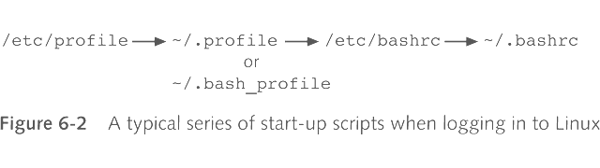
START-UP FILES
Bash Start-Up Files
.bash_profile Defaults to /etc/profile
.bashrc Default to /etc/bashrc
.bash_history
.bash_logout

Slide 15
Shell’s treatment of command line
1.Parsing : The shell first breaks up the command line into
words, using spaces, delimiters.
2.Variable Substitution : All words preceded by a $ are
evaluated as variables.
3. Command Substitution : Any command surrounded by
a back quotes is executed by the shell, which then
replaces the standard output of the command into the
command line.
4. Redirection : The shell looks for the characters >, <
and >> to open the files they point to.
5. Wild-card Interpretation : The shell finally scans for the
wild-cards characters .
6. PATH Evaluation : It looks for the PATH variable to determine
the sequence of directories it has to search in order to hunt
for the command.

Slide 16
The five basic types of shell variables :
1. USER DEFINABLE -
These are variables defined as needed by the user.
2. POSITIONAL PARAMETERS-
These are variables given as arguments to a shell procedure
3.COMMAND SUBSTITUTION –
These are variables made from commands surrounded by grave accents.
4. PARAMETER SUBSITITUTION –
These are variables whose values are dependent on other variables.
5. SPECIAL VARIABLES –
These are variables defined by the shell

Slide 17
User Definable
HOME, PATH, TERM, MAIL, MAILCHECK, MAILPATH, PS1, PS2, IFS etc.
HOME - your home directory
PATH - the paths where to search for executables
TERM - the terminal type
PS1 - Primary Shell Prompt ( default $ for user and # for root in bash shell )
echo “Your Terminal is $TERM”
echo “You are $USER”
echo “Your Home is $HOME”

Slide 18
Positional Parameters
$0 - The Script name
$1 - First parameter
$2 - Second parameter
$n - Nth parameter
$# - The number of command line arguments.
$* - All the command line arguments passed.
$@ - similar to $*.
Note :- All these holds good inside functions also.

Slide 19
Shifting Positional Parameters
We can only refer directly to 9 positional parameter $1 to $9
  Korn/Bash shells allows ${10} etc
We can “pull” parameters after the 9th into view with the shift command
  After a shift
    $1 -> $0
    $2 -> $1
    ....
    ${10} -> $9

Slide 20
Command Substitution
The Output of a command can assigned to a variable.
Syntax:
var=`command` or var=$( command )
Example: Number of people currently logged in?
usersLogged= `who | wc - l`
or
usersLogged=$(who | wc -l)
echo “Users Logged = $usersLogged”

Slide 21
Parameter Substitution
${variable} same as $variable
${#variable} The length of $variable
${variable:-word} If $variable is set and nonnull, its value; otherwise “word”
${variable:+word} If $variable is set and nonnull, “word”; otherwise nothing
${variable:=word} If $variable is not set or is null,set it to “word”
${variable:?word} If variable is set and of non-zero length, its value; otherwise print word and exit from the shell
${variable#pattern} $variable, with the shortest matching pattern removed from the front

Slide 22
Continued.....
${variable##pattern} $variable, with the longest matching pattern removed from the front
${variable%pattern} $variable, with the shortest matching pattern removed from the rear
${variable%%pattern} $variable, with the longest matching pattern removed from the rear
Ex:
DIR=${1:-$HOME}
echo ${2:?”Postitional variable must be set”}
Q=/usr/local/bin/X11/Mosaic
echo ${Q##*/}
echo ${Q%/*}

Slide 23
Special variables
$! The PID of the last background command
$? The exit status of the last command
$$ The process id of the shell itself
$_ The last word of the previous command line
$- The shell’s currently set options.

Slide 24
Operators:
Arithmetic :- + , - ,*, /, % ( modulus ), ** ( Exponentiation)
Assignment :- +=, -=, *=, /=, %=
Bit-wise :- <<, <<=, >>, >>=, &, &=, |, |=, ~ ( negate), !, ^, ^=
Relational :-
Integer :- -lt, -le, -gt, -ge, -eq, -ne
Within double parenthesis (( )) :- <, >, <=, >=
String :- =, = = ( same as = ), != , <, >, -n ( not null ), -z string is null, i.e, has zero length.
Comparison ( Compound) :-
-a logical AND, -o logical OR
Logical Operators :- &&, ||

Slide 25
Reading from standard input
read : a Shell built in.
The read command will pause the os to wait for input from the keyboard and then place that input into a variable.
  echo “What is your name?”
  read name # From now $name gives the value entered
Other Options for read :
-p msg Print message before reading the input
read -p “enter a number : “ var
-n<number> To read ‘number’ characters only
read -n1 -p “yes or no?” var
-t<number> Wait for “number” seconds only.
read -t4 -p “enter something before 4 seconds” var

Slide 26
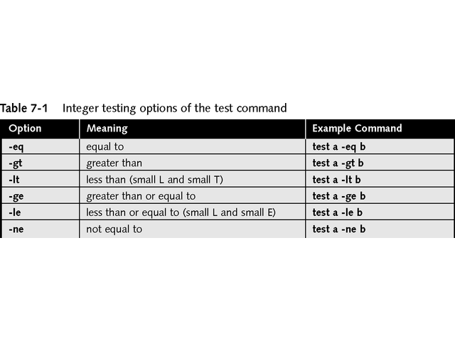
Relational Integer Tests
The test command returns a value known as an exit status, which is a numeric value and indicates the results of the test performed: true if 0 (zero) and false if 1 (one)

Slide 27
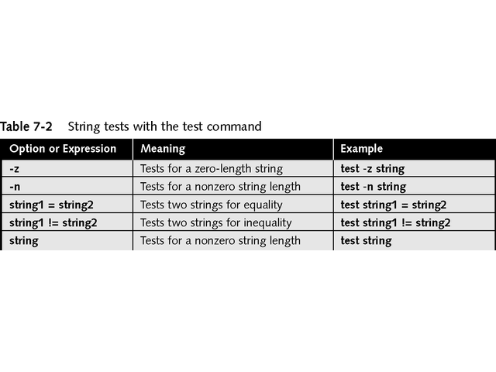
String Tests

Slide 28
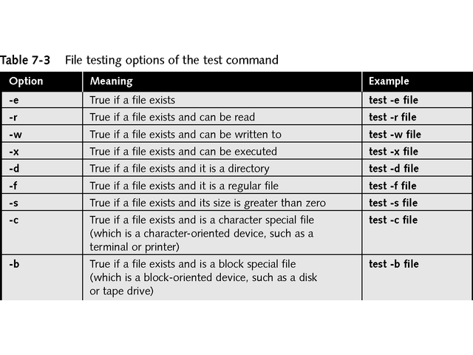
Testing Files

Slide 29
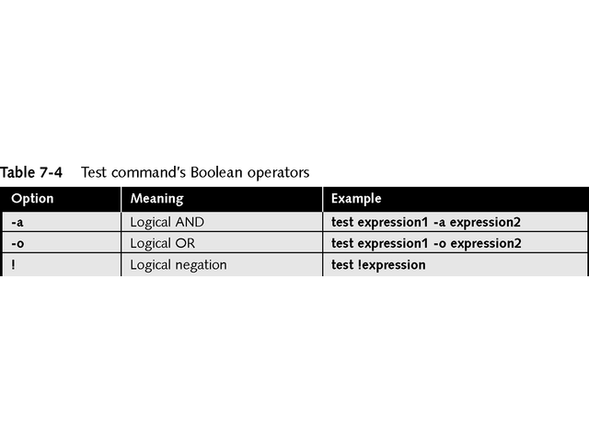
Performing Boolean Tests
AND – returns true (0) if both expressions are true, otherwise returns false (1)
OR – returns true if either expression is true, otherwise if neither is true, returns false
! – negates the value of the expression

Slide 30
Shell Arithmetic
1. The shell function “expr” :
result=`expr 5 + 6` or result=$(expr 5 + 6)
( Use \* for multiplication in expr )
2. The shell function “let” :
let “q = 5 * 8” # would set “q” to 40.
3. “C” equivalent way:
((q = 5 * 8))
In the shell “let” command, numbers are assumed to be decimal unless they are preceded with a base and a “#”.
let “q=16#100+10” #would set “q” to 256+10 or 266.

Slide 31
Example.
Script #1 – adding 3 and 5
    x=5
    y=3
    let z=x+y
    echo $z
Script #2 – adding two input numbers
    echo “Enter a number:”
    read numb1
    echo “Enter a second number:”
    read numb2
    let total=$numb1+$numb2
    echo “$numb1 + $numb2 = $total”
Script #3 – operating on two input numbers
  echo “Enter a number:”
  read numb1
  echo “Enter a second number:”
  read numb2
  echo “Enter an operator(+ - * /):”
  read oper
  total=`expr $numb1$oper$numb2`
  echo “$numb1$oper$numb2 = $total”

Slide 32
Conditionals :- if
1. if condition; then <do>;fi
2. if condition; then <do>;else <do>; fi
3. if condition; then < do >
elif condition_2;then < do >
else < do >; fi
Example:- # read a number tell whether it is lessthan 10.
echo “Enter a Number”
read number
if test $number -lt 10 # or if [ $number -lt 10 ]
then
echo “The Number $number is Lessthan 10”
else
echo “The Number $number is Not Lessthan 10”
fi

Slide 33
Looping Constructs :
1. While :-
while [ condition ]
do
commands
done
Example:- # Printing numbers from 1 to10 using while
count=1
while [ $count -le 10 ]
do
echo “Count = $count”
let “count = $count + 1”
done

Slide 34
2.Until:-
until [ condition-is-true ]
do
commands..
done
Example:- # to print welcome message for a name, till end
until [ “$name” = end ]
do
echo “enter a name ( end to exit ) :”
read name
echo “Hello, $name”
done

Slide 35
3. For :-
for name [ in word …]
do
commands
done
Example : # to print oracle india 5 Times
title=“Oracle India”
for i in 1 2 3 4 5
do
echo $title
done

Slide 36
Break
A loop that requires premature termination can include the break statement within it:
#!/bin/sh
for i in 0 1 2 3 4 5 6 7 8 9 ; do
NEW_FILE=$1.BAK-$i
if test -e $NEW_FILE ; then
echo "$NEW_FILE already exists - exitting"
break
else
cp $1 $NEW_FILE
fi
done
which causes program execution to continue on the line after the done. If two loops are nested within each other, then the command break 2 causes program execution to break out of both loops; and so on for values above 2.

Slide 37
Continue
The continue statement is also useful for terminating the current iteration of the loop. This means that if a continue statement is encountered, execution will immediately continue from the top of the loop, thus ignoring the remainder of the body of the loop:
#!/bin/sh
for i in 0 1 2 3 4 5 6 7 8 9 ; do
NEW_FILE=$1.BAK-$i
if test -e $NEW_FILE ; then
echo "$NEW_FILE already exists- skipping"
continue
fi
cp $1 $NEW_FILE
done
Both break and continue work inside for, while, and until loops

Slide 38
Loop control
The loop can be controlled using break and continue statements.break [numeric value] Numeric value argument tells how many of enclosed while, until and for loops to break.
Multi-way Branching:-
case word in
pattern_1) command_1
;; # ;; => is ‘break’
pattern_2) command_2
;;
pattern_n) command_n
;;
*) default_commands ;;
esac

Slide 39
Example:
echo “Please enter the letter for the program you wish to execute:”
echo ‘a - For the current date’
echo ‘b - For who is logged on the system’
echo ‘c - For a list of your files’
read choice
case $choice in
a) date;;
b) who;;
c) ls;;
*) echo “That was not a valid choice”;;
esac

Slide 40
Select
select identifier [in word…]
do
list;
done
select a in c d e f;do echo $a;done
Output:
1) c
2) d
3) e
4) f
#? 4
f
#?

Slide 41
Sample script for select & case
# Make a simple calculator using select & case
select choice in addition subtraction multiplication division
do
case $choice in
addition)
echo “Enter two integers for addition”
read a b
c=`expr $a + $b`
echo “The result for addition is $c”;;
subtraction)
echo “Enter two integers for subtraction”
read a b
c=`expr $a - $b`
echo “The result for subtraction is $c”;;

Slide 42
Script for select & case contd…
multiplication)
echo “Enter two integers for multiplication”
read a b
c=`expr $a \* $b`
echo “The result for addition is $c”;;
division)
echo “Enter two integers for division”
read a b
c=`expr $a / $b`
echo “The result for division is $c”;;
esac
done

Slide 43
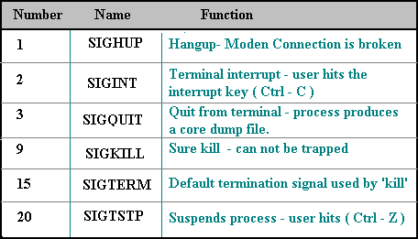
“Trap”
A Trap is a command used to catch UNIX system signals
trap ‘sequence-of-instructions’ list-of-signal-numbers.
The ‘instruction sequence’ executes immediately when any of ‘list-of-signals’ occurs. When it finishes, the program will resume.
The signal can be ignored by having no commands

Slide 44
Set
set -o vi => sets command line in vi mode
set -x => starts debugging.
set -v => print each command before executing.
set -n => read commands but do not execute them.
set -t => exit after reading & executing one command.
set -- => unset positional parameters.
Can be used to set the positional parameters.
set `date` ;
echo $2 $6
gives Jun 2001

Slide 45
Shell I/O Redirections
>file
Direct standard output to file
>>file
Append standard output to file
<file
Take standard input from file
p1|p2
Connect standard output of program p1 to input of p2
^
Obsolete synonym for |
n>file
Direct output from file descriptor n to file
n>>file
Append output from file descriptor n to file
n>&m
Merge output from file descriptor n with file descriptor m
n<&m
Merge input from file descriptor n with file descriptor m
<<s
Here document: take standard input until next s at beginning of a line; substitute for $, ‘…’, and \
<</s
Here document with no substitution
<<‘s’
Here document with no substitution

Slide 46
dirname / basename
These commands help in finding the directory name & the file name.
Example: ii=“/usr/bin/ls”
dirname $ii
/usr/bin
basename $ii
ls

Slide 47
Exit Status
The “exit status” of a command indicates whether it was successful or not.
0 = success
    non-zero = failure
- The exit status of a sequence of commands is the exit status of the last command executed in the sequence.
- The shell control flow constructs will all take a zero status to mean true and a non-zero status to mean false
Range : 0 - 255
127 - Command not found
126 - No Execute permission on command given.

Slide 48
Aliases
Aliases are used as shorthand for frequently used commands
Syntax: alias <shortcut>=<command>
> There should be no spaces around the equal sign
> If the value contains more than a single word, you must enclose it between quotation marks
> It doesn’t replace the actual command, it only gives it another name
To delete an alias : unalias <aliasname>
Examples: alias la=“ls -la”
alias up=“cd ..”
alias prompt=“echo $PS1”

Slide 49
Arrays
Declaring : declare -a Array # Optional.
Initializing :
Array[10]=2;
Array[]= ( 1 2 3 4 5 6 7 );
Array=( [0]=1 [1]=1 [2]=2 )
Indexing Starts From 0.
Accessed As :
    ${Array[0]} => First Element
    ${#Array[@]} => Total Elements In Array
    ${Array[*]}
    or => All the Elements
    ${Array[@]}

Slide 50
Write a Shell Script to Sort given elements in ascending order?
#! /bin/sh
echo “Enter the elements : ” ;
read -a Array # Read an array of elements
size=${#Array[*]} # get the total elements entered.
for (( i = 0; i < size; i++ )) { # C’ Style for loops
for (( j = 0; j < size; j++)) {
if [ ${Array[$i]} -lt ${Array[$j]} ]; then
temp=${Array[$i]} # Swapping
Array[$i]=${Array[$j]}
Array[$j]=$temp
fi
}
}
echo “The Sorted Array is : ${Array[*]}” # print the sorted array.

Slide 51
FUNCTIONS :
Declared as : function Fun_Name {
# Statements
}
or
function Fun_Name( ) {
# Statements
}
or
Fun_Name( ) {
# Statements
}
Parenthesis ( ) are Optional with ‘function’ Keyword

Slide 52
Calling a User Defined Function
Fun_Name
or
Fun_Name Arg1 Arg2
Returning Values From a Function
Fun_Name () {
… Statements …..
return $Count; # return value range 0 - 255
}
Collecting Return Value : ( Command Substitution )
Value=`Fun_Name`;
or
Value = $( Fun_Name )

Slide 53
Write a function to add two numbers?
#! /bin/sh
function add() { # Declare & Define
sum=`expr $1 + $2` #Find the sum of two arguments
return $sum # Return it.
}
echo “Enter two numbers : “
read num1 num2 # Read two numbers from user
result=$(add $num1 $num2); # Call function & collect return # value from function.
# display the result
echo “ $num1 + $num2 = $result”

Slide 54
Internal Commands
1. Internal commands are built-in to the shell code.
2. It is a function or subroutine compiled as a part of the shell program.
3. The shell does not have to search for the PATH variable for an internal command.
4. No new process are spawned to execute the command.
5. There is no disk reading or program loading is required.
The result is faster execution.
Example : pwd, cd.

Slide 55
External Commands
1. External command is a program.
2. It is a compiled binary file.
3. The shell searches for the PATH variable to find external command or the full path is specified in the command line.
4. Once the file is located, the shell spawns a child process for the program.
5. It attempts to execute the program by making an exec
system call.
6. If successful the program is loaded into memory and
executes the program as a new process.
Example : ls, file, cut ...

Slide 56
Directory Commands
mkdir Makes one or more directories.
cd Changes the current directory.
rmdir Removes a directory.
mvdir Moves (renames) a directory.
ls Lists the contents of a directory.
df Reports information about space
on file systems.

Slide 57
File Manipulation Commands
cp Copies files.
mv Moves (or renames) files.
rm Removes files or directories.
ln Links files.
cat Concatenates or displays files.
pg Formats files to the screen.
wc Counts the number of words in a file.

Slide 58
Continued..
chmod Changes file permission.
cmp Compares two files.
diff Compares text files.
grep Searches a file for a pattern.
cut Gives selected fields from each line of a file.
join Joins data fields of two files.
sort Sorts or merges files.

Slide 59
Miscellaneous Commands
who Lists all users on the same machine
finger Find people (white-page service)
rlogin Remote login.
lp Prints files to a printer queue.
cancel Cancel a print request.
umask Sets the default file permission masks.
ftp File transfer.
ps Lists all of the processes running by the user.
kill Kills (terminates) a process.
make Makes specified executables, object files, libraries, etc.

Slide 60
Patterns
Many Unix tools use the concept of a pattern matching
Similar to, but not exactly the same as, the wildcard or glob patterns
Examples:
  editors
  grep
  sed
  awk

Slide 61
Pattern Basics
A pattern matching string is called a regular expression
  . (dot, period) match any single character.
  * (star, asterisk) match any number (including zero) of preceding character
  ^ (caret) match start of line
  $ (dollar) match end of line
[ ] match any of enclosed characters
[^ ] match anything but the enclosed
+ match any number (greater than zero) of preceding regex
? match zero or one instances of preceding regex
\ turn off special meaning of next character

Slide 62
Examples
Some sample regular expressions and what they match:
  abc matches the string abc
  ^abc abc at the beginning of a line
  abc$ abc at the end of a line
  ^abc$ abc as the entire line
  [Aa]bc abc or Abc
  a[aeiuo]c a lowercase vowel c
  a[^aeiou]c a not lowercase vowel c

Slide 63
Searching Files with grep
The grep command is actually a family
  grep
  egrep
  fgrep
All search files for strings which match specified patterns
grep “^From: Deryk” Mail/*
grep’s behaviour is modifiable via command line options
  -c display only count of matching lines
  -i ignore case when matching
  -l display only names of files with matching lines
  -n display line numbers
  -v display only non-matching lines

Slide 64
grep examples
grep -c t687v1 /etc/passwd
  display count of users on this course
grep -l “[Uu]nix” ~/System/*
  display names of all files in my System directory which refer to Unix (or unix)
who | grep batch28
  which members of this batch are currently online

Slide 65
The find Command
The find command walks down a subtree of the file system looking for files which match certain creteria, such as:
  wildcards
  file type (e.g. file, directory, special, link)
  file’s owner
  access time
  modification time etc.

Slide 66
Examples
find ~ -name “*.sh” -print
  display names of all files in my hierarchy whose names end in .sh
  note quotes
find /etc -user root -print
  display names of all files under /etc owned by root
find /tmp -atime +5 -exec rm {} \;
  find all files under /tmp which have not been accessed in more than five days and delete them
find /tmp -atime + 7 -ok rm {} \;
  as above, but prompt for each file before removing.

Slide 67
Getting Help! ( Manual pages )
man command
man command name e.g. man ls
man sections:
man -k keyword
1. Commands
2. System Calls
3. Library Calls
4. Special Files
5. File Format + conversion
6. Games
7. Macros
8. System Management
9. Kernel

Slide 68
Books
Your Unix: The Ultimate Guide
    Sumitabha DAS
Unix Power Tools
    Jerry peek, Tim O’reilly & Mike loukides
See the man/info page
    “man bash” and “info bash”
advanced bash scripting guide ( pdf )

Slide 69
Questions?

