Slide 1
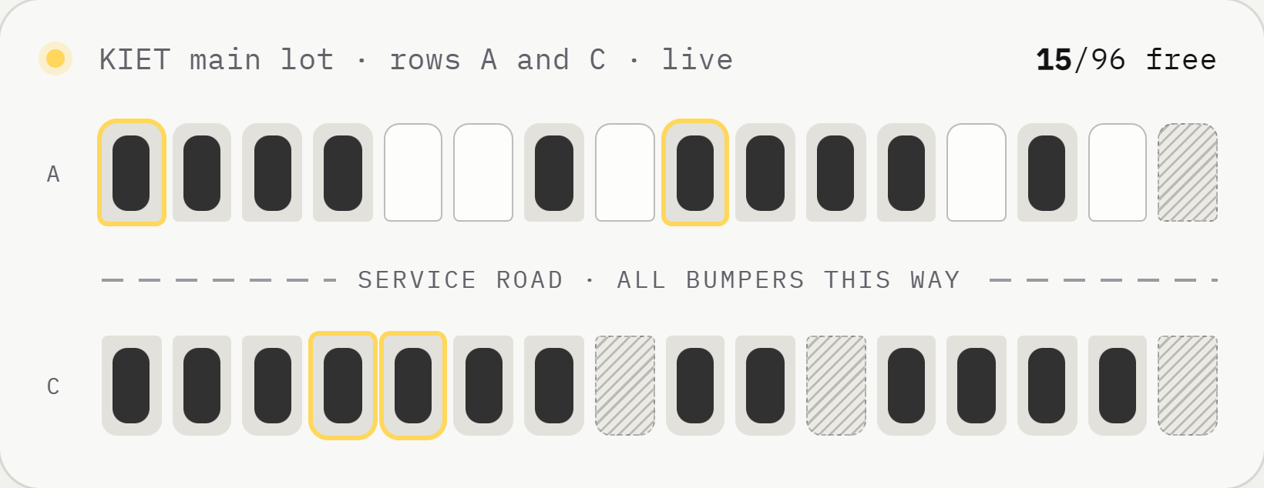
01 / 15
INNOTECH'26 · Arrivo
The story behind Arrivo
Why we built a seat map for parking, and the five things that make it different from anything else out there.
Team Arrivo
Krish Singh · Kritika Sakhuja
Prisha Soam · Vaibhav Kumar
Why it exists.
What makes it unique.
two questions, one deck.
Notes:
This is a short companion deck to our main pitch. It answers the two questions we get asked most: why did we build Arrivo, and what makes it different from what already exists?

Slide 2
02 / 15
Part 01 —— Why it was made
Why it was made.
09:58
the minute it all goes wrong
Arrivo didn't start as an app idea. It started as a problem we ran into almost every morning at college.
Notes:
Part one: why it was made. The short version: we were the people circling the lot.

Slide 3
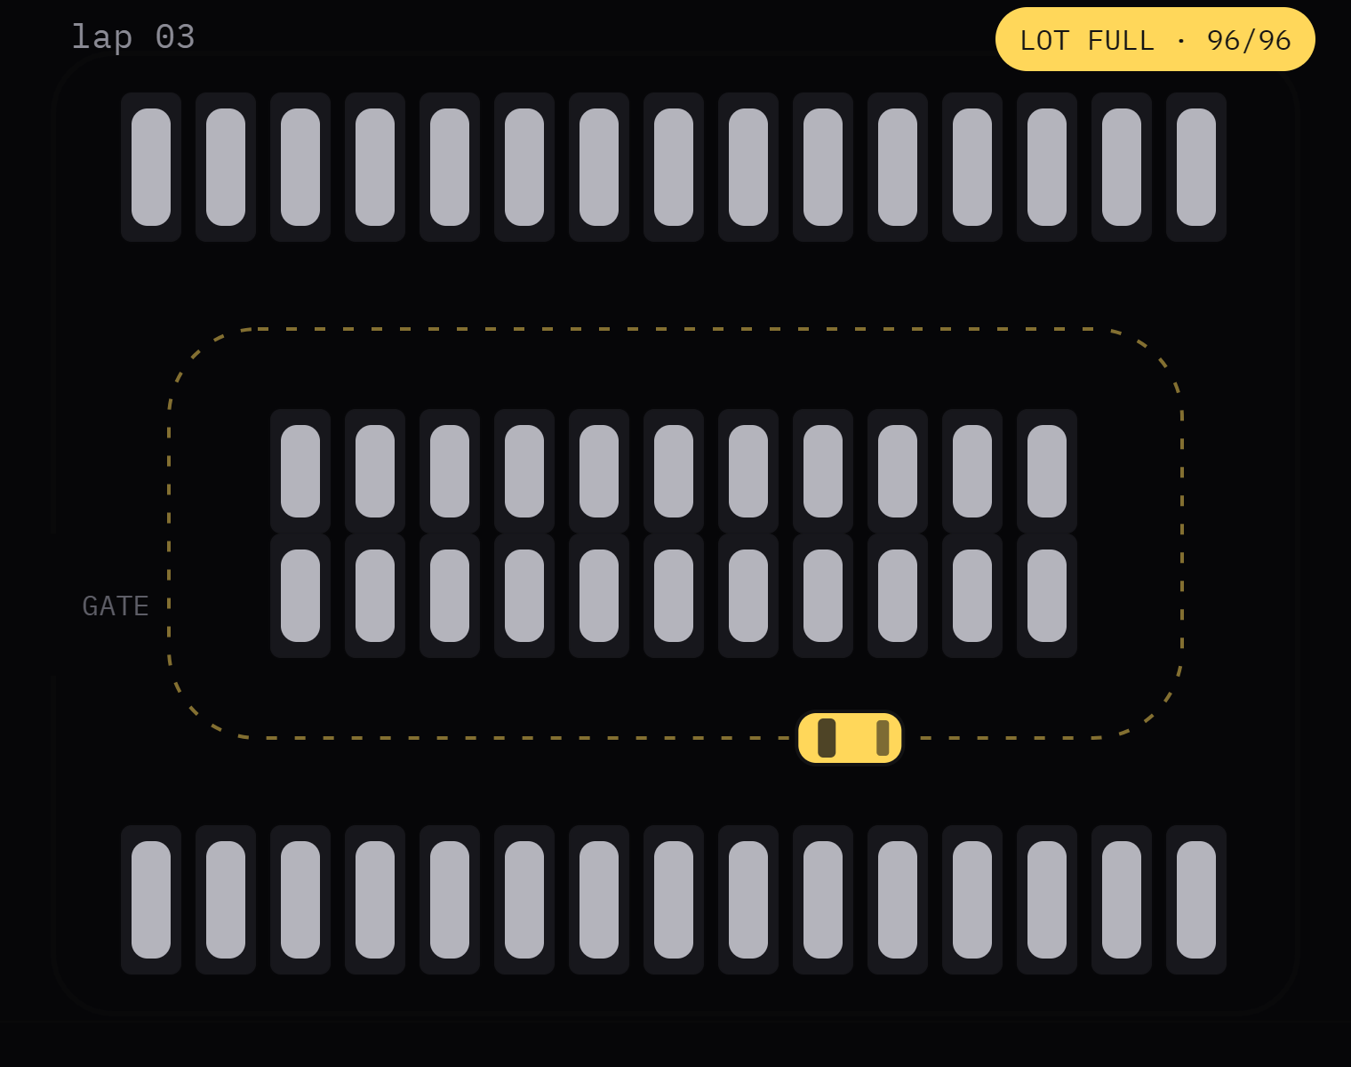
Why it was made · Where it started
03 / 15
01 —— Where it started
Lectures start at 10:00. At 9:58 the lot looks full.
From the gate you can't tell which of the 96 bays is empty. So you drive in and circle: row A, row C, back past the gate, while the car behind you does the same lap. Most mornings a few bays were free the whole time. Nobody could see them.
we were the car on lap 3.
30%
17 h
96
of traffic in busy city centres is drivers cruising for a parking space.
a year the average driver spends looking for parking.
bays in the KIET main lot, and no way to see a free one before you drive in.
Shoup, "Cruising for parking", 2006
INRIX parking study, 2017
our survey of the lot
Notes:
This is where it started. Lectures at KIET start at ten. At 9:58 the main lot looks full from the gate, so everyone drives in and circles. The frustrating part: there were usually free bays, we just couldn't see them. And it's not just us: studies find about 30% of traffic in busy centres is people looking for parking, and INRIX measured 17 hours a year per driver.

Slide 4
Circling isn't just annoying.
Why it was made · What circling costs
04 / 15
02 —— What circling costs
01
02
03
04
TIME
FUEL & AIR
SAFETY
SPACE
Late for the 10:00 lecture
Burning fuel to go nowhere
Eyes on gaps, not on people
Free bays nobody finds
Every extra lap is minutes you don't get back, and attendance is taken at the door.
A car crawling around the lot in first gear burns fuel and puts out exhaust right next to the classrooms.
A driver hunting for a bay is watching for gaps, not for the students walking to class.
The lot often isn't full at all. It only looks full from where you're standing.
Notes:
What circling actually costs: time (you're late for class), fuel and pollution (a car crawling in first gear right next to the buildings), safety (a driver looking for a gap isn't looking for people), and space (bays sit empty because nobody can see them).

Slide 5
What exists today stops one step short.
Why it was made · Why nothing fixed it
05 / 15
03 —— Why nothing fixed it
OPTION
WHAT IT DOES
WHERE IT FALLS SHORT
Map apps
Show that a parking lot exists and roughly how busy the area is.
Can't tell you which bay is free, and can't hold one for you.
Sensor systems
Put a sensor in every bay, or a camera over the lot, to count free spaces.
Need hardware and wiring in every bay. Costly to put into a college lot.
A guard + a register
Someone at the gate keeps an eye on the lot and notes down cars.
No way to book ahead. You still find out only when you reach the gate.
Leave home earlier
Beat the rush by getting to campus at 9:30.
Spends half an hour every day to save a few minutes of circling.
Notes:
We looked at what already exists. Map apps tell you a lot exists, not which bay is free. Sensor systems can count free bays, but they need hardware in every single bay, which is expensive for a campus. A guard and a register can't take bookings. And leaving home early just trades circling for waiting. Every option stops one step short of what a driver actually needs: one exact bay, held for them.

Slide 6
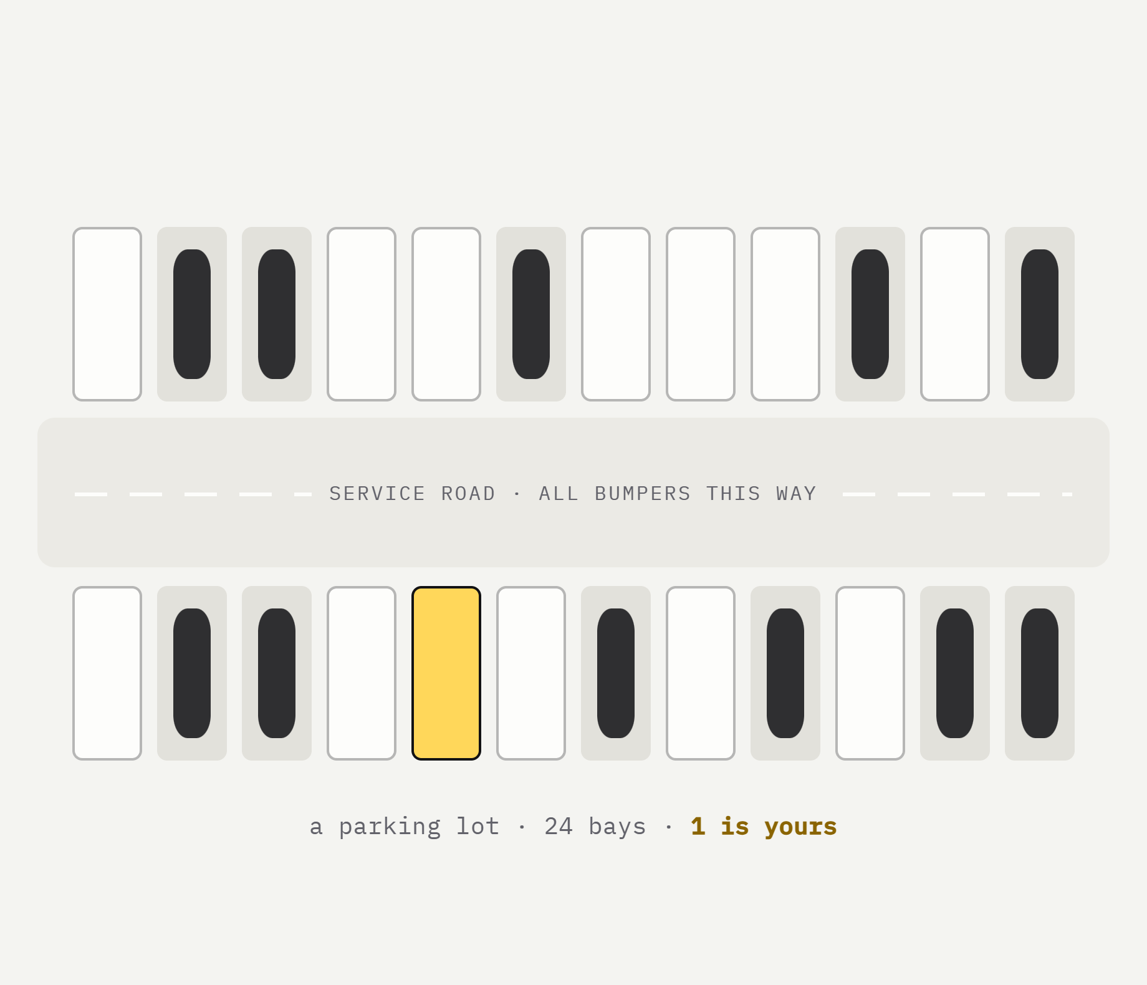
Why not book a bay like a seat?
Why it was made · The spark
06 / 15
04 —— The spark
Ticket apps already taught everyone how this works. You see the whole hall, taken seats are grey, you tap a free one and it's held in your name. A parking lot is really just a hall of seats for cars. So Arrivo is a seat map for parking: every bay on a live plan, pick one, pick your hours, and it's yours when you arrive.
Seat F12 → Bay A-14
Show time → Arrival time
Ticket → Bay pass
a cinema hall, but for cars.
Notes:
The spark was simple. Everyone already knows how to book a seat for a film: you see the hall, grey seats are taken, you tap a free one. We asked why parking can't work the same way. A lot is just a hall of seats for cars. So: seat F12 becomes bay A-14, the show time becomes your arrival time, and the ticket becomes a bay pass.

Slide 7
Five promises we built it around.
Why it was made · What we set out to build
07 / 15
05 —— What we set out to build
01
02
03
04
05
See every bay
Book a window
No double bookings
No hardware
Any phone
All 96 bays on one live plan, each one coloured by what it is doing right now.
Choose when you arrive and how long you stay, not just a spot.
One bay, one booking, one time window. The server makes sure of it.
No sensors, no cameras, no wiring dug into the lot.
It's a website, not an app. Open the link and book.
Notes:
From that we set five goals: show every bay live, let you book a time window, make double booking impossible, need no hardware in the lot, and work on any phone without an app. Every feature in Arrivo comes from one of these five.

Slide 8
08 / 15
Part 02 —— What makes it unique
What makes it unique.
01
A real lot, drawn bay by bay
02
The X-ray lens
03
Book a time, not just a spot
04
Live, no double-booking
Lots of apps help you find parking. These are the five things Arrivo does that they don't.
05
No hardware, any phone
Notes:
Part two: what makes it unique. There are five things, and the next slides take them one at a time.

Slide 9
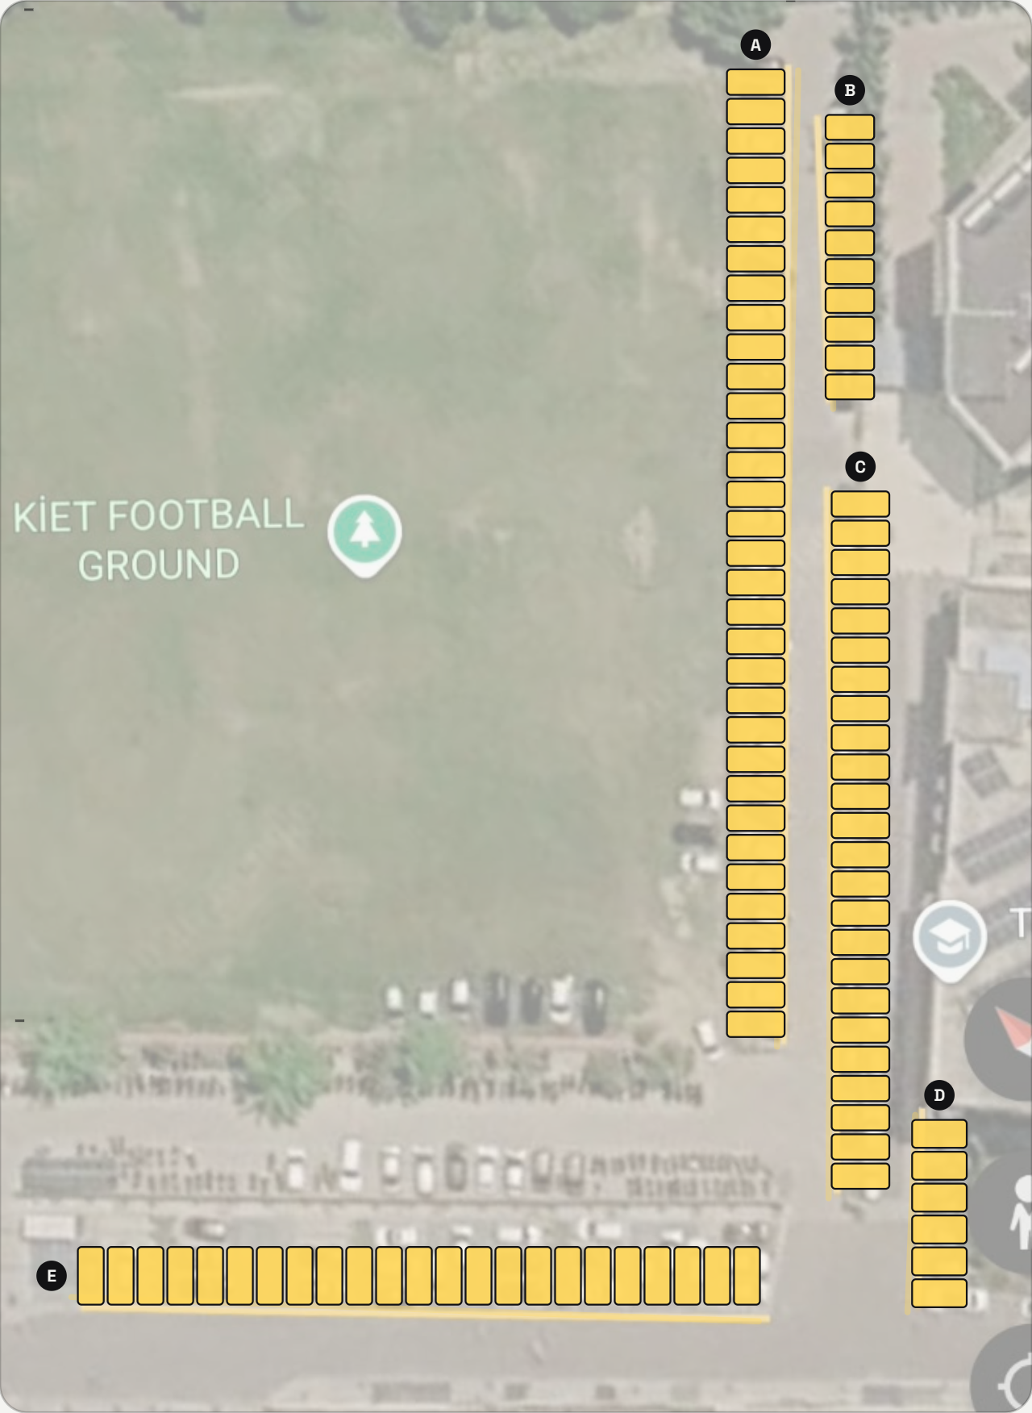
Not a pin on a map. Every bay.
Unique feature · 01 · A real lot
09 / 15
01 —— A real lot, bay by bay
We traced the KIET main lot from a satellite photo at true scale: 50 m on the photo is 385 pixels, so every bay is drawn where it really is. Each of the 96 bays has its own name (A-01 to E-23), a row and a type: standard, compact, EV or step‑free.
96
5
2.5 × 5 m
bays, each with a name
rows, A to E
per bay, drawn to scale
traced, not guessed.
Notes:
First unique thing: it's the real lot. Other apps show a pin on a map. We traced the KIET main lot from a satellite photo at true scale, so all 96 bays are where they really are, in five rows, each about 2.5 by 5 metres, each with its own name and type. When you book A-14, you know exactly where A-14 is.

Slide 10
Pick up a magnifier.
See what every bay is doing.
Unique feature · 02 · The X-ray lens
10 / 15
02 —— The X-ray lens
ROW A · LIVE
01
Hold and drag
Press the lens and sweep it across the plan, on a laptop or a phone.
02
Every bay explains itself
Under the glass, bays light up by status (free, booked, ending soon, reserved) over the real satellite photo.
A-05 ● Yours
Free
Booked
Ending soon
03
Let go to open
till 16:00 · Standard · ₹20/h
Drop the lens on a bay and its details and booking form open right there.
Reserved
Yours
IN THE LENS
1 free · 1 yours · 1 ending
let go to open A-05
Notes:
Second: the X-ray lens. It's a magnifier you pick up and drag over the plan. Under the glass every bay lights up by its status (free, booked, ending soon, reserved) on top of the real satellite photo, and a small card tells you exactly what the bay under the crosshair is doing. Let go on a bay and it opens. We haven't seen this in any parking app.

Slide 11
You pick the hours, not just the bay.
Unique feature · 03 · Book a time
11 / 15
03 —— Book a time, not just a spot
TODAY · BAY A-07
08:00 – 20:00
taken
yours · 13:00–15:00
taken
08:00
10:00
12:00
14:00
16:00
18:00
20:00
✕ 10:30–12:30 clashes
01
02
03
Clashes are crossed out
15 minutes' grace
A pass with a code
Times that overlap someone else's booking can't even be picked.
Running late? Your bay waits 15 minutes past your arrival time.
Show it at the gate. It survives a refresh and opens in any tab.
Notes:
Third: you book a time, not just a spot. Pick when you arrive and how long you stay; the strip shows the whole day, and any window that would overlap someone else's booking is crossed out so you can't pick it. If you're late, the bay waits 15 minutes. You get a bay pass with a code to show at the gate.

Slide 12
Two people tap one bay. Only one gets it.
Unique feature · 04 · Live and fair
12 / 15
04 —— Live, no double-booking
You tap A-14
✓ A-14 is held for you
10:01:02.4
THE SERVER
Checks both in one locked step. The database itself refuses two bookings that overlap.
Someone taps A-14
✕ Just taken. Try A-15?
10:01:02.7
EVERY OPEN SCREEN UPDATES WITHIN A SECOND
Free
Booked
Ending ≤ 20 min
Reserved
Yours
Notes:
Fourth: it's live and it's fair. If two people tap the same bay at the same moment, the server checks both inside one locked step and the database refuses overlapping bookings, so exactly one person gets it and the other is told straight away. And every open screen, on any phone, updates within about a second, so everyone sees the same lot.

Slide 13
Nothing to install, anywhere.
Unique feature · 05 · No hardware
13 / 15
05 —— No hardware, any phone
0
1
Any
sensors or cameras
Python file
phone browser
Nothing gets dug into the lot. The plan and the bookings do the work.
The whole server is one file with nothing to install. It runs on a laptop.
No app download and no sign-up. Open the link and pick a bay.
AND A FEW THINGS YOU NOTICE
3D view of the campus
Dark mode
Other people's plates masked
No sign-up
Live on every screen
Notes:
Fifth: there's nothing to install. No sensors or cameras in the lot, so a campus can start tomorrow. The server is a single Python file. And for drivers it's just a website: no app, no sign-up. On top of that there's a 3D view of the campus, dark mode, and privacy by default: other people's number plates are masked.

Slide 14
How Arrivo compares.
Unique feature · Side by side
14 / 15
06 —— Side by side
 | Arrivo | Map apps | Sensor systems | Guard + register
Shows which exact bay is free | ✓ | ✕ | ✓ | ✕
Book a bay before you leave | ✓ | ✕ | ✕ | ✕
Pick arrival time and how long you stay | ✓ | ✕ | ✕ | ✕
Two people can never get the same bay | ✓ | — | — | ✕
No hardware in the lot | ✓ | ✓ | ✕ | ✓
Works in any phone browser | ✓ | ✓ | ✕ | ✕
— means it doesn’t take bookings, so it can’t double-book either.
Notes:
Side by side. Map apps don't know about individual bays. Sensor systems can tell you a bay is free, but you can't book it and they need hardware everywhere. A guard can't take bookings. Arrivo is the only one that ticks every row: exact bay, book ahead, choose your hours, no double booking, no hardware, any phone.

Slide 15
15 / 15
07 —— In one line
We built Arrivo because 9:58 kept happening.
It's different because you can see, book and hold one exact bay, before you even leave home.
SDG 11 · Sustainable cities
SDG 13 · Less idling, less fuel
Ready for any lot
thank you. ask us anything.
arrivo
Team Arrivo · INNOTECH'26 · Category 6
Notes:
To sum up: we built Arrivo because the 9:58 scramble kept happening to us. What makes it unique is that you can see, book and hold one exact bay before you leave home, with no hardware in the lot. It supports SDG 11 (sustainable cities) and SDG 13 (less idling and fuel). Thank you, happy to take questions.

