Slide 1
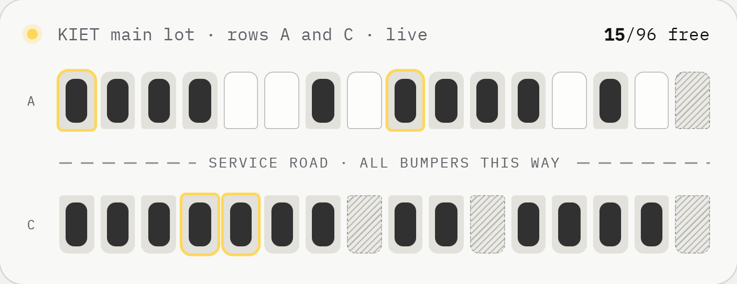
01 / 18
INNOTECH'26 · 30 October 2026
Category 6 · Gen Z Budding Project Solutions
Dept. of IT & CSE (Cyber Security), KIET Deemed to be University
Team Arrivo
Krish Singh · Kritika Sakhuja
Prisha Soam · Vaibhav Kumar
arrivo
Park like you booked a seat.
Notes:
Hi, we are Team Arrivo. This is Arrivo: you book a parking bay before you leave, the way you pick a seat for a film. The card on the left is the KIET main lot, rows A and C.

Slide 2
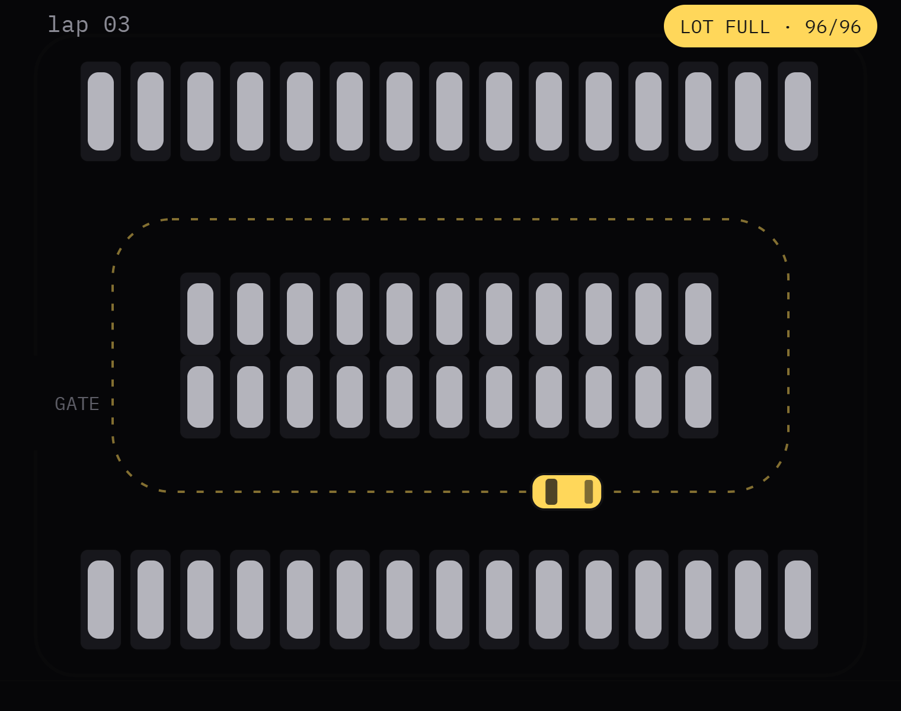
Concept & Originality · Understanding of the problem
02 / 18
01 —— Every weekday morning
09:58
The lot is full. You just don't know it yet.
So you circle. Row A, row C, back past the gate. The lecture starts without you, and the car behind you is doing the same lap.
30%
17 h
0
of traffic in busy city centres is drivers cruising for a parking space.
a year the average driver spends hunting for parking.
ways to know which of the 96 bays at KIET is free before you drive in. Until now.
Shoup, "Cruising for parking", 2006
INRIX parking study, 2017
our count of the KIET main lot
Notes:
Understanding the problem. Studies of city traffic find about 30% of drivers in busy centres are just looking for parking (Shoup, 2006). INRIX measured 17 hours a year per driver. On our own campus there is no way to see a free bay before you drive in, so everyone circles.

Slide 3




First come, first guessed.
Concept & Originality · Understanding of the problem
03 / 18
02 —— Why it keeps happening
The problem isn't too few bays. It's that nobody can see them, book them, or plan them.
01
02
03
04
No visibility
No booking
Blind operators
Wasted minutes
From the gate you can't tell which of 96 bays is empty, so you go and look.
Seats, trains and tables can all be booked. A 2.5 × 5 m bay still can't.
Nobody knows which rows fill first, or when, so nothing gets planned.
Every lap burns fuel and time, for you and for the queue behind you.
Notes:
Four root causes: drivers can't see free bays, they can't book one, the people running the lot have no data, and all of that turns into circling, which wastes time and fuel.

Slide 4
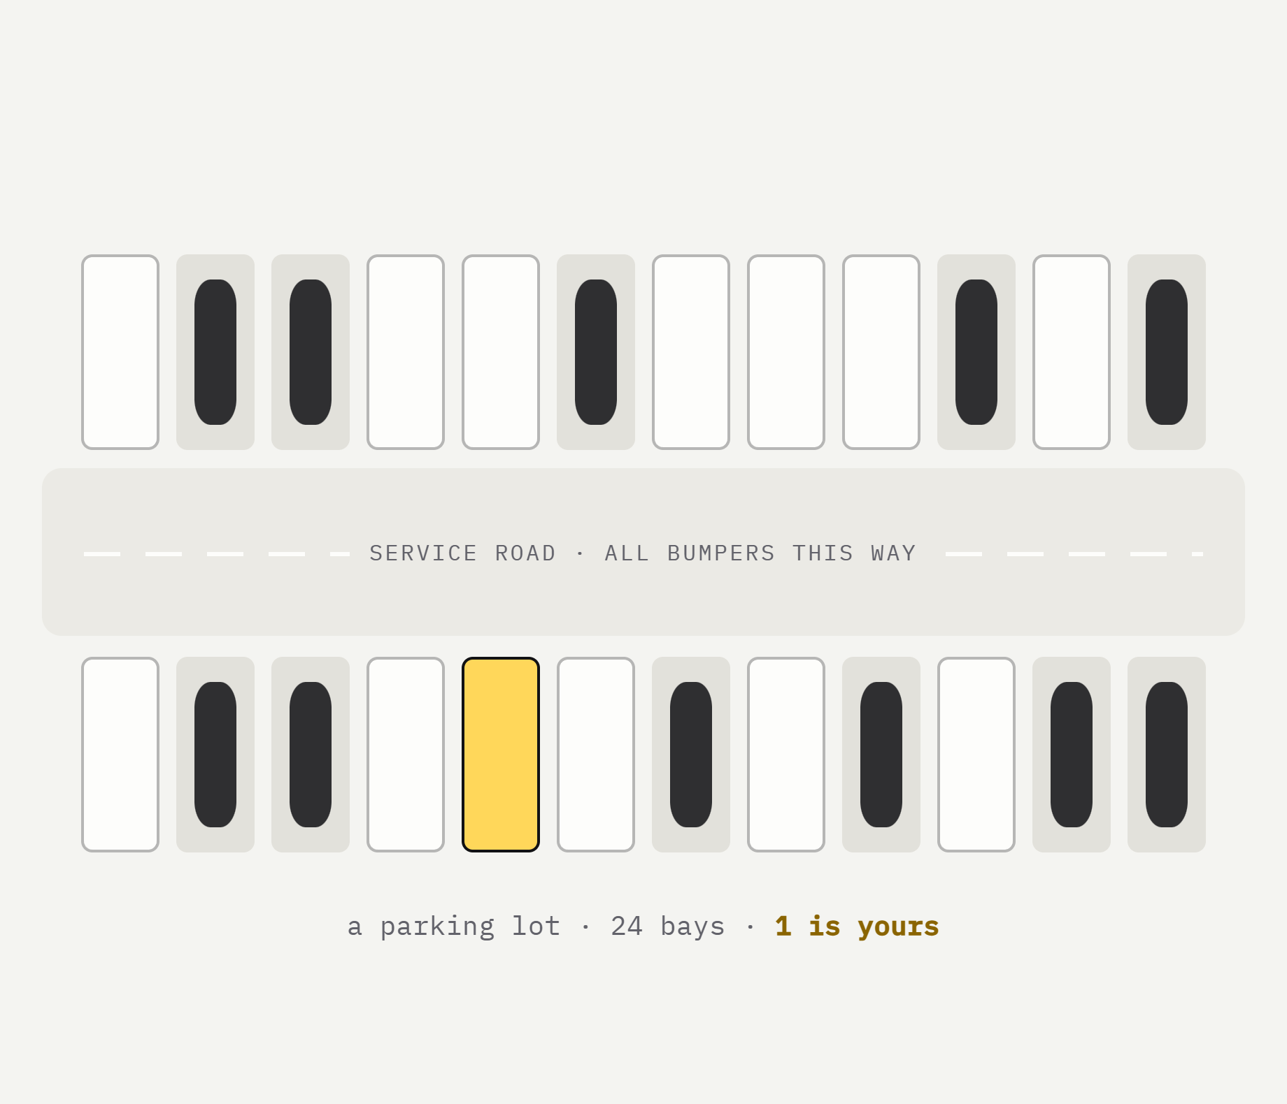
Book a bay the way you book a seat.
Concept & Originality · Originality of idea
04 / 18
03 —— The idea
Ticket apps made picking your exact seat feel normal: you see the hall, you pick the empty one, it's held for you. Arrivo brings that to parking. You see every bay on a live plan, pick a free one, choose your hours, and it's yours when you arrive.
same idea, new place.
Notes:
Originality. Everybody already understands seat maps from booking films. We asked: why not a seat map for parking bays? A cinema hall becomes a parking lot. That one idea is the whole product.

Slide 5
Before and after.
Concept & Originality · Originality of idea
05 / 18
04 —— What changes
WITHOUT ARRIVO
WITH ARRIVO
Finding a bay
✕
Drive in, circle, look
✓
Tap a free bay on a live plan
Knowing it'll be free
✕
Hope
✓
Held for your hours
Running late
✕
Someone else took it
✓
15-minute grace window
Two cars, one bay
✕
An argument at the gate
✓
Impossible: the database refuses it
The lot's owner
✕
Guesses how it's used
✓
Every booking is data
What's new here
Bay-level booking
X-ray lens over a live plan
A lot traced from its satellite photo
Live for every viewer at once
Notes:
Same problem, side by side. Left is today, right is Arrivo. The last row matters: the person running the lot finally gets data. What's new: booking an exact bay, on a plan of the real lot, live for everyone.

Slide 6
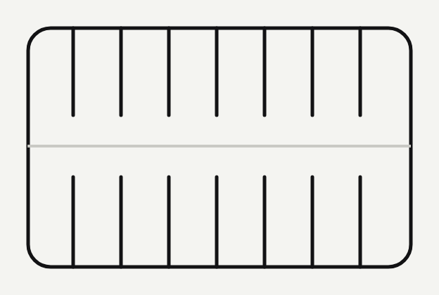
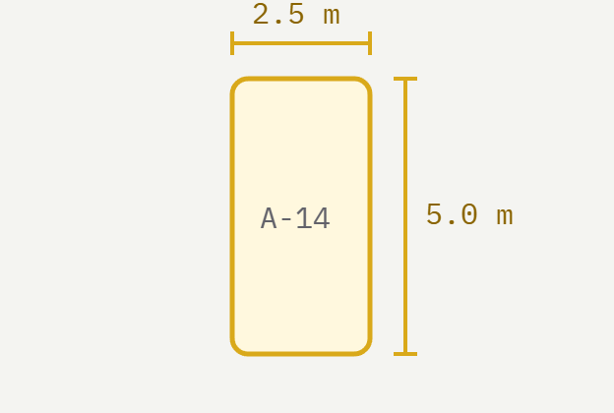
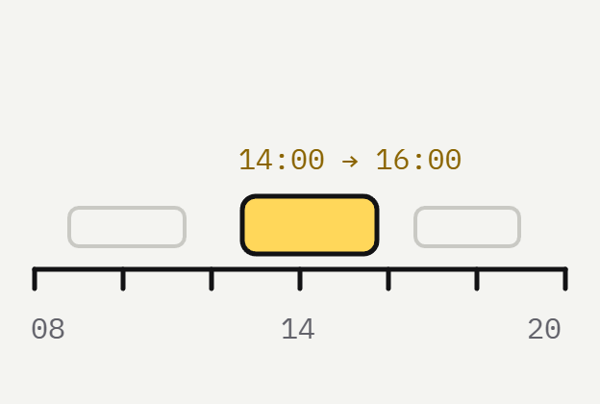
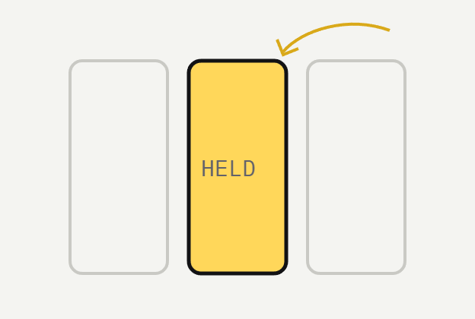

Five steps, lot to parked.
Working prototype · How it works
06 / 18
05 —— How a booking works
01
02
03
04
05
A lot.
A bay.
A window.
A hold.
You arrive.
Each lot is drawn once, row by row, from its satellite photo.
Every bay has a name, a size and a type: standard, compact, EV or step-free.
Pick when you arrive and how long you stay. Taken hours show grey.
Confirm, and the bay is held in your name with a bay pass and a code.
Drive straight to your bay. Nobody else could book it.
Notes:
Walk through the five steps. Point at step four: the hold is what makes it different from just showing free space.

Slide 7
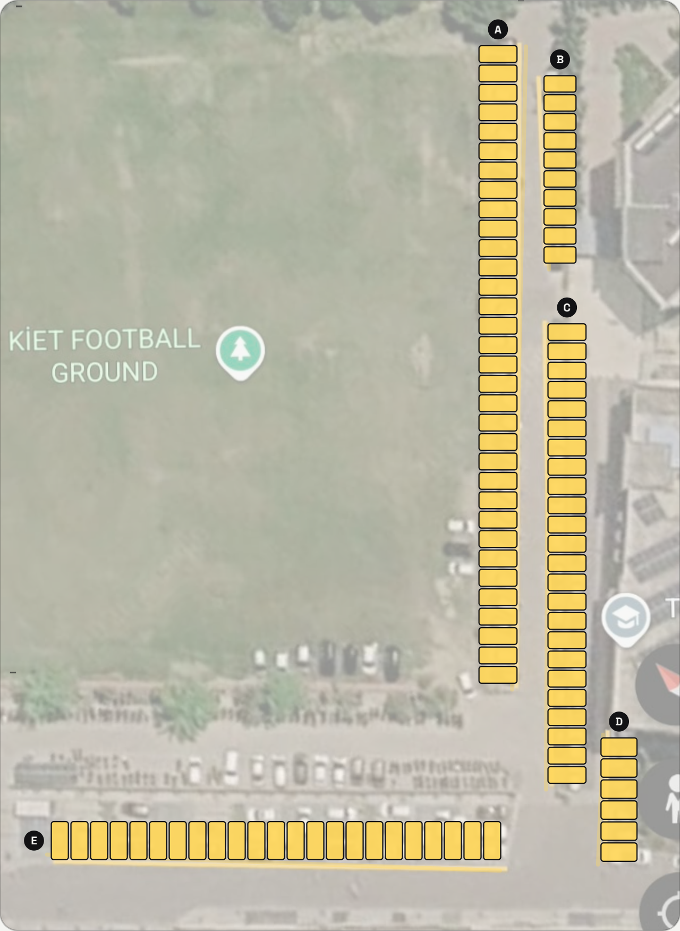
Drawn from the real KIET lot.
Working prototype · Functionality of prototype
07 / 18
06 —— Built on the real lot
We traced the lot beside the KIET football ground from its satellite photo. Every bay sits on the photo's own pixels.
96
5
bays, all bookable
rows, A to E
2.5 × 4.9 m
7.7 px/m
a standard bay
50 m on the photo's scale bar = 385 px
Source: Google Earth capture of KIET, Ghaziabad. Imagery © Google.
Notes:
This is not a made-up layout. We took the satellite photo, marked the five rows in yellow, measured 50 metres on its scale bar and placed every bay on those pixels. That's why the map on our site lines up with the real lot.

Slide 8
Tap it, tilt it, or pick up the lens.
Working prototype · Functionality of prototype
08 / 18
07 —— The live plan
Three ways to read the same live lot. Every view updates the moment anyone books.
A-30
A-31
A-30 ● Free
free till 20:45
IN THE LENS ●4 ●2
FREE
BOOKED
light
dark
01
02
03
X-ray lens
3D view
Dark mode
Hold it and drag. Bays light up as free, booked, ending or reserved over the real satellite photo. Let go to open one.
Tilt the plan and the campus buildings rise out of it, so you know where you are. Plain CSS 3D, no 3D library.
One switch turns the whole site dark, plan included. It remembers your choice and follows your phone's setting.
Notes:
Three ways to read the lot. The lens: hold it and drag, and every bay under it lights up as free, booked, ending soon or reserved, with the bay's details in a card. The 3D view lifts the buildings. And there's a dark mode.

Slide 9
Pick your hours.
Get a pass.
Working prototype · Functionality of prototype
09 / 18
08 —— Booking
TODAY · BAY A-07
08:00 – 20:00
✕ clashes
✓ 13:00–15:00 · yours
08
10
12
14
16
18
20
taken
Choose when you arrive and how long you stay, add your number plate, and hold the bay. About a minute, start to finish.
your window
clash · can't pick
ARRIVO · BAY PASS
KIET MAIN LOT
A-07
01
Clashes are crossed out
Times that overlap someone else's booking can't be picked.
02
A pass with a code
ARRIVE
LEAVE
VEHICLE
PS-7KQ2M
13:00
15:00
UP14 AB 1234
Show it at the gate. Refresh, and it's still there.
ROW A
DATE
PAID
show at the gate
Ground Edge
30 Oct
₹45
03
Late? 15 minutes' grace
After that the bay opens up for someone else.
nobody else can take it.
Notes:
Top right is one bay's day: grey hours are taken, yellow is the window you're picking, and a window that clashes with someone else can't be picked. Below is the pass you get, with the code you show at the gate. If two people try the same slot, the second one is refused, which we'll show in the demo.

Slide 10
Now, live.
Working prototype · Demonstration
10 / 18
09 —— Demonstration
What we'll show on the real site, running on this laptop.
Tap a free bay
01
VAIBHAV
Straight from the live plan of the KIET lot.
02
Hold it, get a pass
VAIBHAV
$ cd backend
$ python server.py
→ http://localhost:8787
96 bays · live updates on
Hours, number plate and total, then the bay pass and its code.
03
Sweep the lens
KRITIKA
X-ray the lot, then let go to open the bay under it.
04
Tilt it to 3D
KRITIKA
localhost:8787 · live
The campus buildings rise out of the plan.
05
Book it twice
PRISHA
one laptop, the real lot.
Same bay, same time, from a second window: refused (409).
Notes:
Switch to the browser for the live demo. Vaibhav: tap a free bay, book it, get the pass. Kritika: pick up the lens and drag it, then switch to 3D. Prisha: try booking the same bay from a second (private) window to show it gets refused. If the server is off, start it with: cd backend, python server.py.

Slide 11
What it's built with.
Working prototype · Effort & build quality
11 / 18
10 —— Tech stack
Languages
JavaScript
Python
HTML
CSS
SQL
7,400
Frontend
React 19 · live map & panel
Vite 8 · build
Motion · animation
lines of frontend code
Lenis · smooth scroll
SVG · the plan, by hand
Python 3 · standard library only
http.server
sqlite3
threading
1,121
Backend
Server-Sent Events · live push
lines of Python, in one file
Design
Bricolage Grotesque
Space Grotesk
IBM Plex Mono
Caveat
paper · ink · one yellow
0
Tools
Google Earth · lot capture
Cloudflare Tunnel · share link
Vite dev server
pip installs for the backend
oxlint
Notes:
Effort and build quality. The frontend is plain HTML, CSS and JavaScript, with React only for the live map and the booking panel. The backend is one Python file using only the standard library: no pip install, it just runs.

Slide 12
How a booking travels.
Working prototype · Effort & build quality
12 / 18
11 —— Architecture
Browser
server.py
parkseat.db
Your phone
POST /api/bookings
Python server
INSERT · locked step
SQLite
Live plan, lens, panel. Taps a free bay and books it.
Checks the rules, saves the booking, tells every open page. Also runs demo cars so the lot looks alive.
Bookings and the live feed. A trigger refuses any two bookings that overlap on one bay.
live push (SSE)
Browser
A friend's laptop
same push, every viewer
Sees that bay turn booked the moment it happens.
1 tap a bay → 2 POST the booking → 3 save, or refuse a clash (409) → 4 push to every screen
Notes:
One booking, start to end. The phone sends the booking to our Python server. The server checks for a clash and saves it in SQLite in one locked step. Then it pushes the change to every open page over Server-Sent Events, so a friend's screen updates without refreshing.

Slide 13
Four rules that keep it honest.
Working prototype · Effort & build quality
13 / 18
12 —— Under the hood
01 · no double booking
02 · status from time
Two cars can never get one bay.
# two windows overlap when
if a.start < b.end and b.start < a.end:
raise ApiError(409, "overlap")
Every bay knows what it is.
free nothing booked now
booked a car is in it
ending due out in ≤ 20 min
reserved due in within 30 min
yours booked from this device
Checked inside a locked transaction, and again by a database trigger.
Worked out from the clock and the day's bookings, never typed in by hand.
03 · live without refresh
04 · private by default
Every screen updates at once.
Content-Type: text/event-stream
event: change
data: {"booking": {"bayId": "A-07", …}}
No sign-up. No plates on show.
owner = sha256(device_id)
# other people's plates
"UP14 AB 4821" → "UP14 •• 4821"
One open connection per page. If it drops, the page reconnects and catches up.
A random device ID marks your bookings, and only its hash is stored.
Notes:
Four engineering decisions. One: double booking is impossible, checked twice, in the code and in the database. Two: a bay's status is computed from time, so it's always right. Three: Server-Sent Events push changes to every screen. Four: no accounts, and other people's number plates are masked.

Slide 14
Less circling, cleaner air.
Impact value · Relevance to society, environment & SDGs
14 / 18
13 —— Impact
11 SDG
13 SDG
9 SDG
Sustainable cities and communities
Climate action
Industry, innovation and infrastructure
Less traffic crawling round the lot and the gate, and a fair, first-booked system instead of first-lucky.
Every lap you don't drive is fuel you don't burn. A booked bay means one straight drive in.
Gets more out of the lot that already exists: no new concrete, just a better way to use it.
500
engine-minutes saved a day, on one lot, if 100 drivers each skip 5 minutes of circling.
illustrative estimate
Notes:
Impact. Three SDGs: 11, 13 and 9. The number at the bottom is an illustration, not a measurement: if 100 drivers a day each save five minutes of circling, that's 500 minutes of engines not idling, on just one lot. Step-free bays are also marked, so people who need them can book them.

Slide 15
One lot today. Every lot after.
Impact value · Potential to inspire change
15 / 18
14 —— Where it goes next
Same method, any lot
How it pays for itself
Roadmap
Trace it once, book it every day.
Small fees, real data.
What we build next.
Adding a lot means drawing its rows on a satellite photo, like we did for KIET.
8%
Now
Live plan, booking, pass, lens and 3D on the KIET main lot.
commission on each booking
Campuses
Hospitals
Malls
Partners
Next
UPI payments, QR check-in at the gate, more KIET lots.
Metro stations
Offices
campuses and parking providers
Events
Later
Plans
Cameras or sensors for occupancy, and demand forecasts so lots can plan ahead.
subscriptions for lot operators
Notes:
Potential to inspire change. The method works for any lot: trace it once and it's bookable. It can pay for itself with a small commission and operator plans. Next is UPI and QR check-in; later, sensors and demand forecasting.

Slide 16
Who built what.
Presentation & teamwork · Team coordination
16 / 18
15 —— Team Arrivo
each of us can demo it.
KS
KS
PS
VK
Krish Singh
Kritika Sakhuja
Prisha Soam
Vaibhav Kumar
Idea & research
Lot plan & lens
Backend
Design & frontend
explains
explains
explains
explains
The problem, the survey of the lot and the SDG impact.
How the plan was traced from the satellite photo, the lens and 3D view.
server.py, the database rule against double booking and live updates.
The site, the booking flow, dark mode and the bay pass.
Notes:
Each member says one line about their part. This is where the judges see that everyone can explain a piece of it.

Slide 17
Query addressing · Answers to judges' questions
17 / 18
go on, ask us anything.
Book a bay
↗
Button · 308 × 92
16 —— Thank you
Your turn.
arrivo
Team Arrivo · INNOTECH'26 · Category 6
Notes:
Thank the judges and open for questions. If they ask for a demo, switch to the browser.

Slide 18
Questions we expect.
Query addressing · Answers to judges' questions
18 / 18
A —— Appendix
Q1
What if someone books and never comes?
Q5
Why not just use Google Maps?
The bay waits 15 minutes past their arrival time, then opens up for anyone.
Maps tells you a lot exists. Arrivo tells you which bay is free, and holds it for you.
Q2
How do you know a bay is really empty?
Q6
How does it make money?
Today, from bookings. Next, a QR check-in at the gate; later, cameras or sensors.
A small commission per booking, plus subscription plans for lot operators.
Q3
Can two people book the same bay?
Q7
Do I need to install an app?
No. The server checks inside a locked step, and the database has a rule that refuses overlaps.
No. It's a website that works in any phone browser. The server is one Python file.
Q4
What about privacy?
Q8
What did you find hardest?
No sign-up. A random device ID, stored only as a hash, and other people's plates are masked.
Making the plan match the real lot, and keeping every screen in sync without refreshing.
Notes:
Backup slide for the Q&A round. Don't present it; jump here if a question comes up.

