Slide 1

BE KIND HEARTED

Slide 2
Unclaimed Corpses GUI for KARMA N.G.O.
A Mini Project By:-
Vaibhav Praskash
Yash Narendra Bhuse

Slide 3
WHAT ARE UNCLAIMED CORPSES?
“It’s sad that you spend a whole life on this planet and no one comes to your funeral.”
This is the exact saying that describes the people who die alone and have no one to fulfill their last death rites. And hence they are termed as unclaimed corpses.

Slide 4
WHAT IS THE PURPOSE OF N.G.O.?
The irony of today’s world is that there are people who do business of dead human bodies through illegal smuggling of organs and various body parts. Hence, to curb these illegal activities, there is an N.G.O. Karma that conducts the last rites of these bodies when found and reported.
The N.G.O. GUI keeps the data of the unclaimed corpses and the volunteers who found the body.

Slide 5
FEATURES OF THE PROJECT

Slide 6
TECHNOLOGY USED
PYTHON3
Kivy – lib
Sqlite3

Slide 7
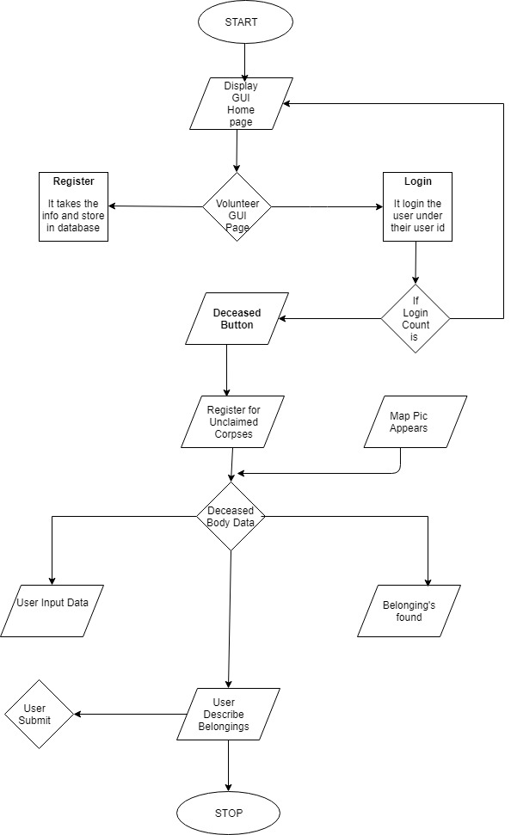
FLOWCHART

Slide 8
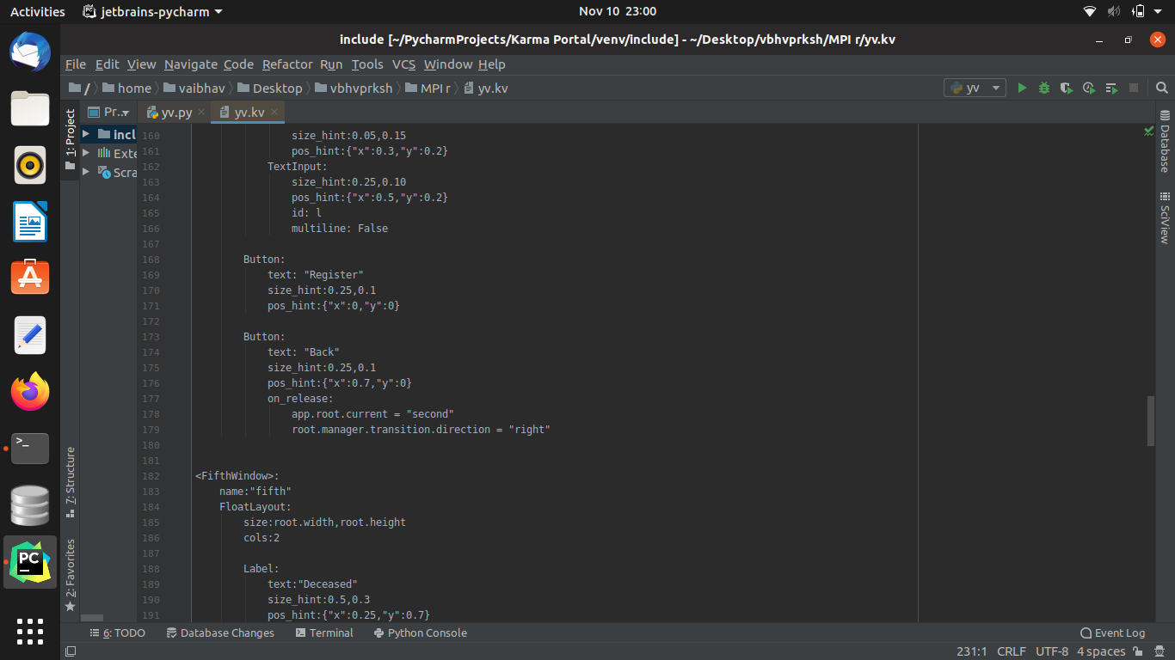
SOURCE CODE

Slide 9
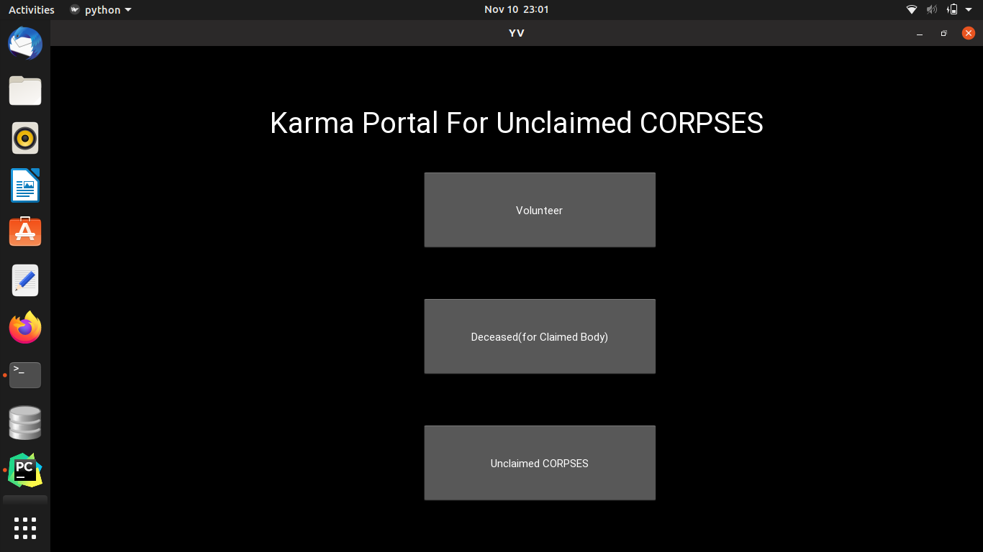
GUI

Slide 10
CONCLUSION
From this GUI the N.G.O. can look into the details of the unclaimed corpses and check the information of the volunteers who found the body.

Slide 11
FUTURE ENHANCEMENT

Slide 12
THANK YOU
Reference:
https://indianexpress.com/article/cities/delhi/what-happens-to-delhis-unclaimed-bodies-an-inside-look-3064888/
https://geeksforgeeks/python/kivy

