Slide 1
DevOps Task
Vladyslav Biletskiy

Slide 2
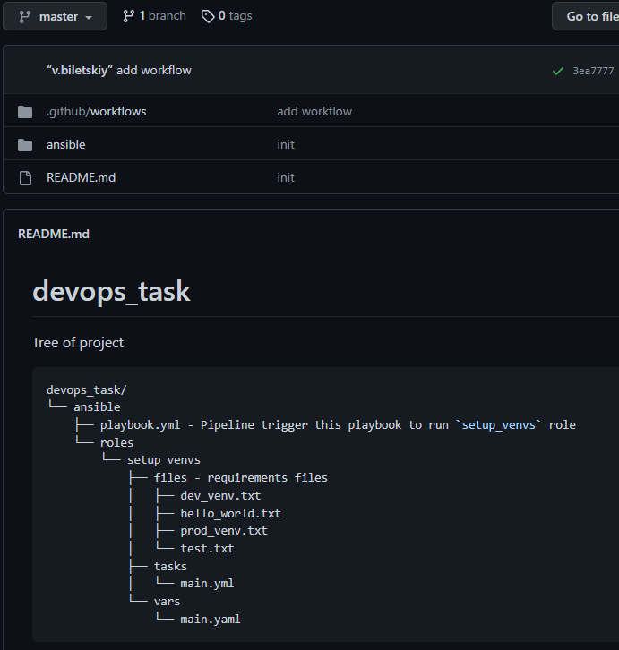
Structure
.github/workflows – GitHub Actions workflow
ansible – directory with roles, playbooks and requirements files
README.md file containing the project tree

Slide 3
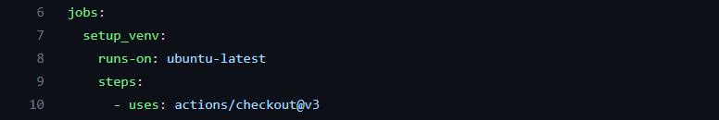
GitHub Actions workflow file
1) Run CI when the master branch commits changes to the repository
2) Checkout code

Slide 4
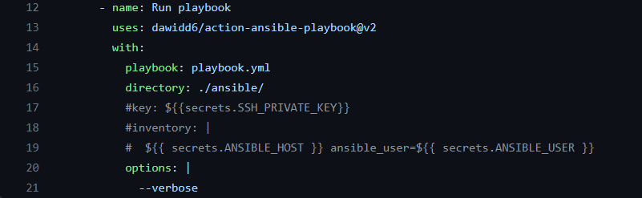
GitHub Actions workflow file
3) Run playbook job: Run playbook.yml with

Slide 5
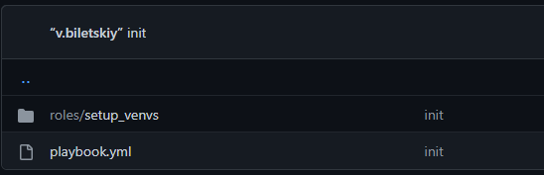
Structure of ansible folder
roles – folder with role “setup_venvs”
playbook.yml – ansible playbook

Slide 6
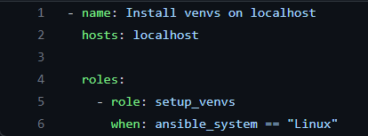
Ansible playbook
A playbook contains a host and a single role that runs on when system is Linux

Slide 7
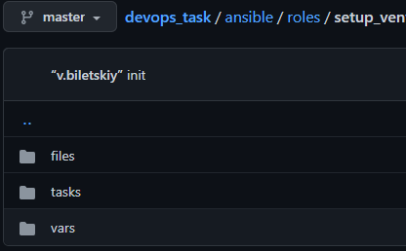
Ansible role
files – folder with requirements files
tasks – folder with task for Ansible
vars – folder with needed variables

Slide 8
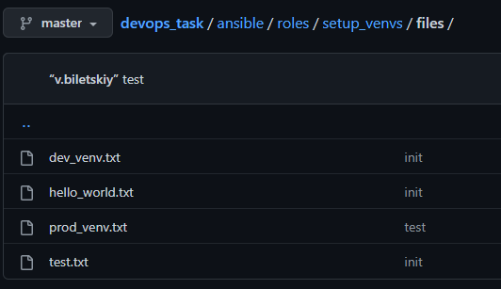
Environments
Here we have 4 txt files with requirements to install in the environment

Slide 9
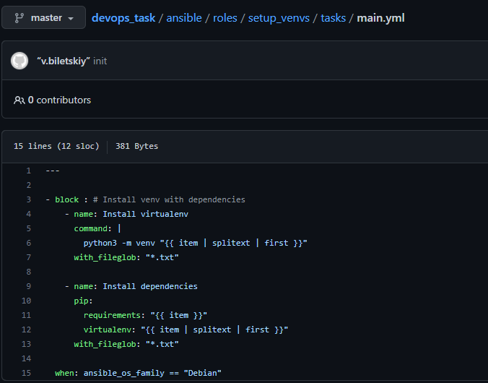
Ansible tasks that executed by the role
Install virtualenv – python3 creates environments called like requirements files
Install dependencies – pip installing the project’s dependencies inside an active virtual environment
* This block works, only when host is on Debian operating system (15 row)

Slide 10
Thank you!
For Your Attention

