Slide 1
Model Compression for DNN
Pruning, Quantization, Binary Networks, Knowledge Distillation, etc.
Bipin

Slide 2
Overview
This document gives an overview of model compression schemes
Pruning and Quantization techniques are explored in detail
Example papers are discussed and accuracy comparisons given
Other ideas are listed for completion, but not elaborated
References are given as footnotes in each slide

Slide 3
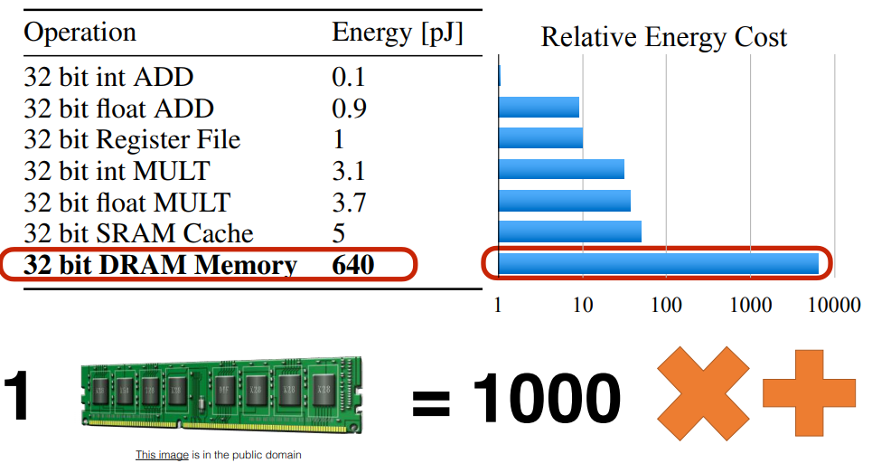
Why Model Compression
DNN models have lot of parameters (Alexnet 60 Million)
Difficult to deploy on embedded devices
Needs more memory to store
Takes more computation during inference
Drains battery power
Takes more time to train
Model compression is used to reduce the number of parameters of a model without reducing the test accuracy
Where to optimize?
Notes:
Image from Song Han : https://arxiv.org/pdf/1506.02626.pdf (Learning both Weights and Connections for Efficient Neural Networks)
45 nm CMOS process

Slide 4
Four types of Model Compression schemes
Parameter pruning and sharing
Explore the redundancy in model parameters and remove uncritical ones
Pruning, Quantization, Binary networks, Weight Sharing
Knowledge distillation
Learn a distilled model and train a more compact NN to reproduce the output of a larger network
Transferred/compact convolutional filters
Special structural convolutional filters
Low-rank factorization
Matrix decomposition to estimate the informative parameters
Notes:
Ref: A survey of Model compression and Acceleration for DNN
https://arxiv.org/pdf/1710.09282
A list of papers: https://github.com/memoiry/Awesome-model-compression-and-acceleration

Slide 5
Pruning

Slide 6
Pruning
Pruning redundant, non-informative weights in a previously trained network reduces the size of the network
Can prune weights(synapses) or activations (whole neurons or filters)
Theory available from 1989 (Optimal Brain damage, LeCun, et al.)
Revisited by Song Han in 2015 with good results for DNN
There is evidence that mammalian brain does pruning. First few months of a child’s development is followed by gradual pruning of little used connections
Notes:
Papers:
Z. Lin, M. Courbariaux, R. Memisevic, and Y. Bengio, “Neural networks
with few multiplications,” CoRR, vol. abs/1510.03009, 2015.
Hanson, S.J., Pratt, L.Y.: Comparing biases for minimal network construction with backpropagation.
In: Advances in neural information processing systems. (1989) 177–185 3
LeCun, Y., Denker, J.S., Solla, S.A., Howard, R.E., Jackel, L.D.: Optimal brain damage. In:
NIPs. Volume 89. (1989) 3
Hassibi, B., Stork, D.G.: Second order derivatives for network pruning: Optimal brain surgeon.
Morgan Kaufmann (1993) 3
S. Han, J. Pool, J. Tran, and W. J. Dally, “Learning both weights and
connections for efficient neural networks,” in Proceedings of the 28th
International Conference on Neural Information Processing Systems, ser.
NIPS’15, 2015.
https://www.scientificamerican.com/article/why-is-synaptic-pruning-important-for-the-developing-brain/

Slide 7
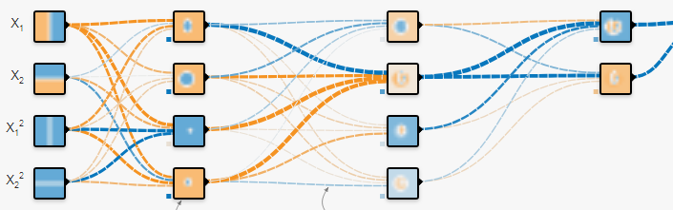
Which weights to prune?
Weights are ranked according to importance. How to define an important weight?
Changing each weight and measuring accuracy is very slow
One idea is to prune the weights below a threshold value
The ranking methods are not good enough until now. Active area of research
Notes:
Image cut from https://playground.tensorflow.org/
In the image the thick lines are weights with a higher numerical value. Blue is positive. Orange is negative.
We may want to prune the thin lines, ie, weights with low values.
Ref: https://jacobgil.github.io/deeplearning/pruning-deep-learning

Slide 8
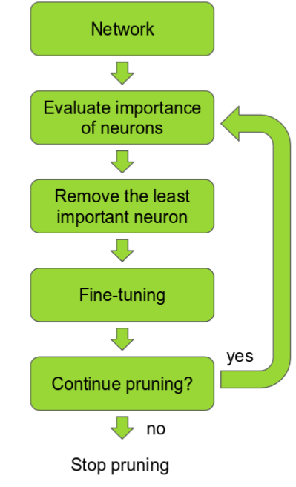
Incremental Pruning
Incremental pruning.
Train the network to learn which connections are important
Prune the unimportant connections
Retrain the network to fine tune the weights of the remaining connections
Repeat
This converts a dense layer to a sparse layer
Notes:
Image from : https://jacobgil.github.io/deeplearning/pruning-deep-learning
Original image from: https://arxiv.org/pdf/1611.06440.pdf

Slide 9
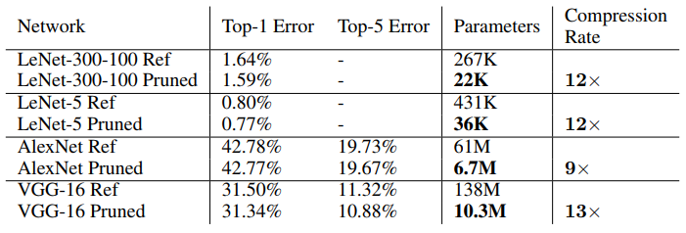
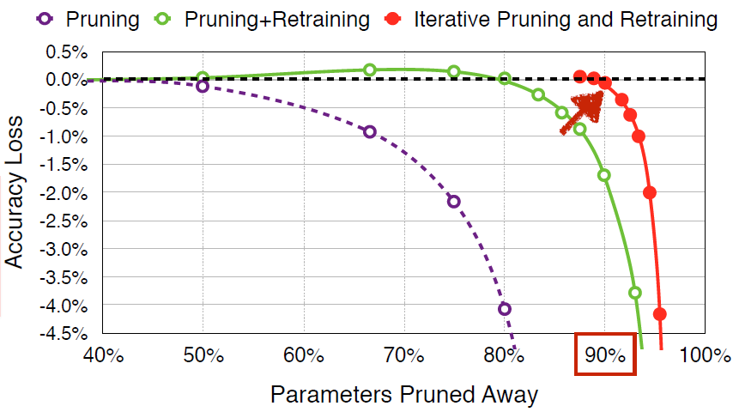
Pruning Results – Song Han
MNIST
ImageNet
Save 9x to 13x
No drop in accuracy
Notes:
From : https://arxiv.org/pdf/1506.02626.pdf (S. Han, J. Pool, J. Tran, and W. J. Dally, “Learning both weights and
connections for efficient neural networks,”)
We implemented network pruning in Caffe [26]. Caffe was modified to add a mask which disregards pruned parameters during network operation for each weight tensor. The pruning threshold is chosen as a quality parameter multiplied by the standard deviation of a layer’s weights. We carried out the experiments on Nvidia TitanX and GTX980 GPUs. We pruned four representative networks: Lenet-300-100 and Lenet-5 on MNIST, together with AlexNet and VGG-16 on ImageNet. The network parameters and accuracy 1 before and after pruning are shown in Table 1.
https://jacobgil.github.io/deeplearning/pruning-deep-learning

Slide 10
Quantization

Slide 11
Quantization
Reduce the number of bits required to represent each weight
1 bit per weight representation in binary NN
NN cope very well with high levels of noise in their inputs. NN treat low-precision calculations as just another source of noise, and still produce accurate results
Weights are usually normally distributed
Notes:
About normally distributed weights (Check out in detail later -Bipin):
https://www.reddit.com/r/MachineLearning/comments/5ufh0m/d_distribution_of_weights_of_trained_neural/
https://www.reddit.com/r/MachineLearning/comments/5u7h3l/r_compressing_nn_with_shannons_blessing/

Slide 12
Quantization in TensorFlow
TensorFlow has production-grade support for eight-bit calculations built in
produce a new model that runs the same operations as the original, but with eight bit calculations internally, and all weights quantized as well
implemented quantization by writing equivalent eight-bit versions of operations that are commonly used during inference (convolution, matrix multiplication, activation functions, pooling operations and concatenation)
Notes:
https://www.tensorflow.org/performance/quantization
https://petewarden.com/2016/05/03/how-to-quantize-neural-networks-with-tensorflow/
Inter nervana Neon supports only 16bits https://github.com/NervanaSystems/neon
DSP is a good candidate for 8bit ( Movidius’ Myriad )
For example, here's how you can translate the latest GoogLeNet model into a version that uses eight-bit computations:
curl -L "https://storage.googleapis.com/download.tensorflow.org/models/inception_v3_2016_08_28_frozen.pb.tar.gz" | tar -C tensorflow/examples/label_image/data -xz bazel build tensorflow/tools/graph_transforms:transform_graph bazel-bin/tensorflow/tools/graph_transforms/transform_graph \ --in_graph=tensorflow/examples/label_image/data/inception_v3_2016_08_28_frozen.pb \ --out_graph=/tmp/quantized_graph.pb \ --inputs=input \ --outputs=InceptionV3/Predictions/Reshape_1 \ --transforms='add_default_attributes strip_unused_nodes(type=float, shape="1,299,299,3") remove_nodes(op=Identity, op=CheckNumerics) fold_constants(ignore_errors=true) fold_batch_norms fold_old_batch_norms quantize_weights quantize_nodes strip_unused_nodes sort_by_execution_order'

Slide 13
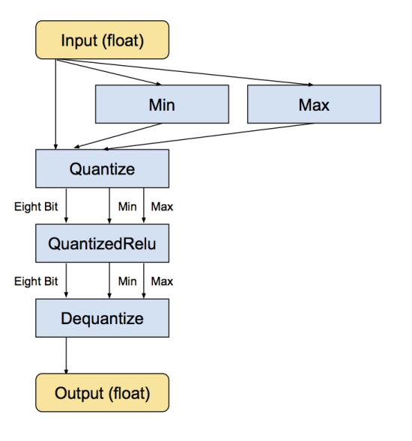
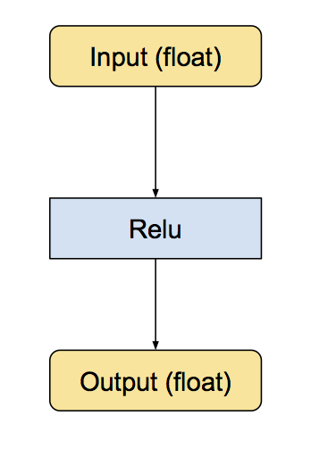
TensorFlow RELU quantization
This is the equivalent converted subgraph, still with float inputs and outputs, but with internal conversions so the calculations are done in eight bit.
original Relu operation, with float inputs and outputs
Notes:
Ref: https://petewarden.com/2016/05/03/how-to-quantize-neural-networks-with-tensorflow/
framework tf use to optimize matrix multiplications at: https://github.com/google/gemmlowp

Slide 14
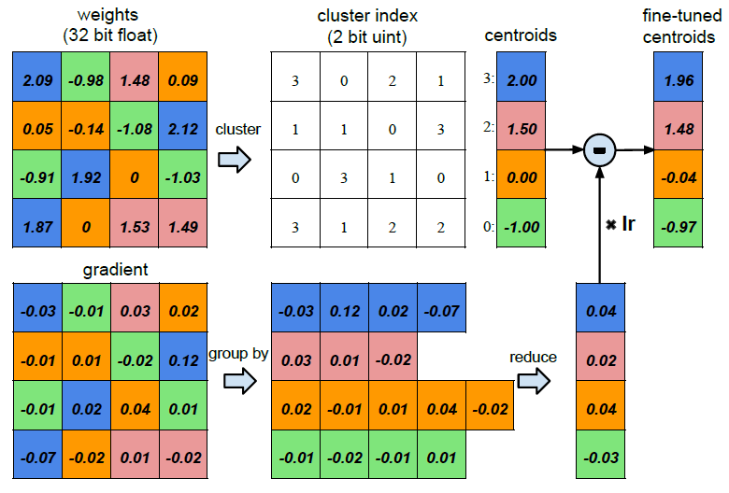
Trained Quantization
Cluster similar weights and use one value
From Deep Compression Paper by Han et al.
8 bits for CONV layers, 5 bits for FC layers
Notes:
https://arxiv.org/abs/1510.00149
A more recent approach : https://arxiv.org/pdf/1712.01048.pdf
Note: (Bipin)
Deep compression paper says “8 bits for CONV layers, 5 bits for FC layers” (page 3, with quantization)
With pruning and quantization “4 bits for CONV, 2 bits for FC (page 8)

Slide 15
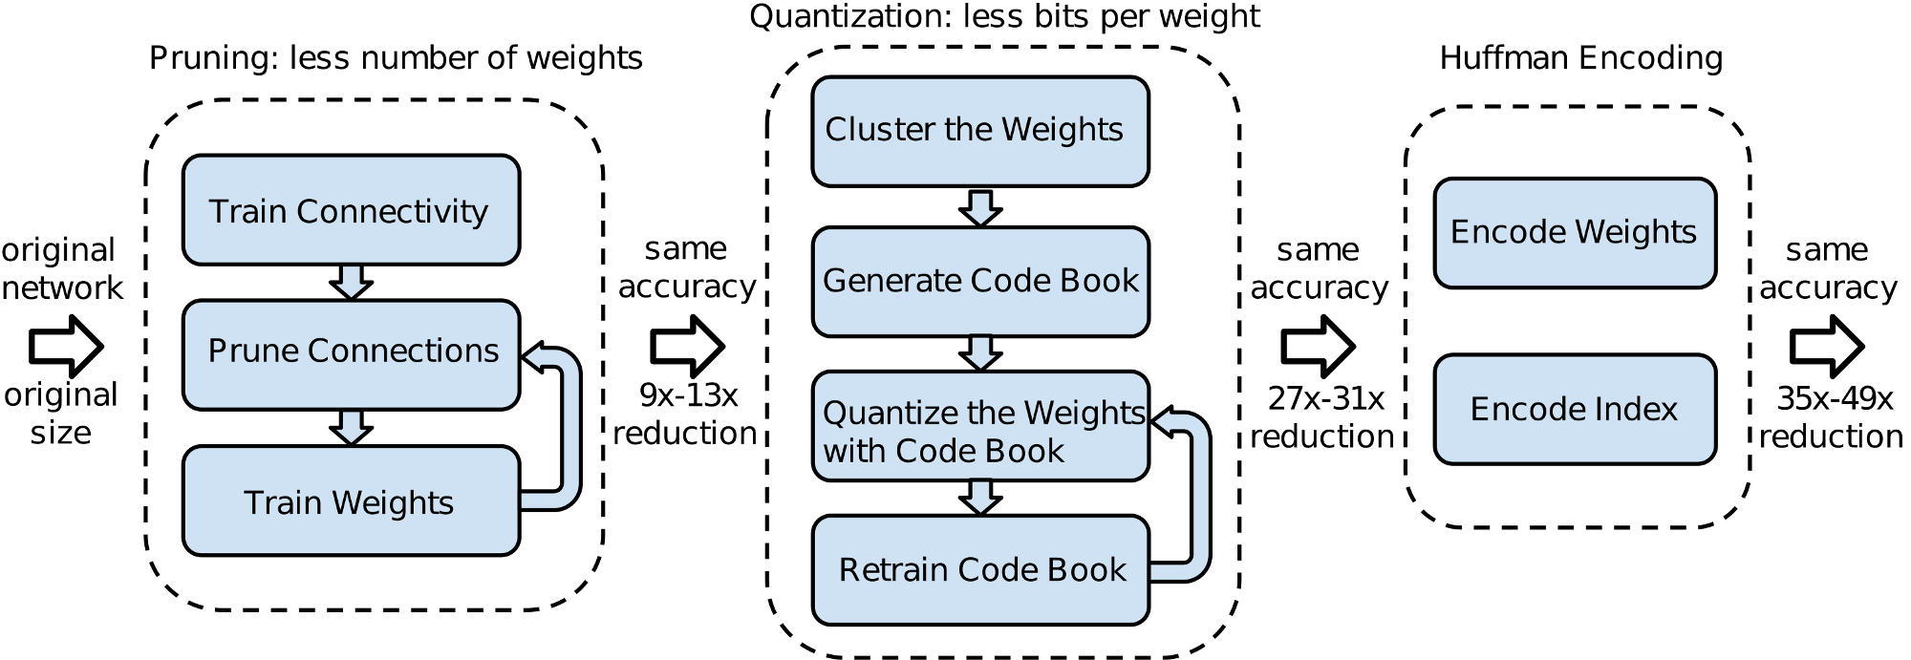
Deep Compression – Song Han
Pruning and quantization can be combined as shown in Deep Compression paper
Can reduce to 3% of original model
Notes:
https://arxiv.org/abs/1510.00149

Slide 16
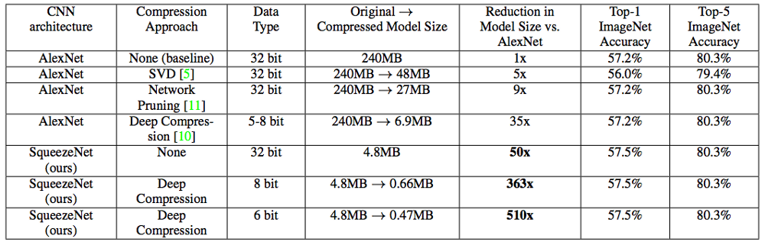
Squeeze Net with deep compression
Already small networks like SqueezeNet can also be pruned and quantized
No accuracy lost
Notes:
SqueezeNet: AlexNet-level accuracy with 50x fewer parameters and <0.5MB model size
Squeeze Net : https://arxiv.org/pdf/1602.07360.pdf
available for download here: https://github.com/DeepScale/SqueezeNet

Slide 17
Binary Networks

Slide 18
Binary Networks
Quantization to 1 bit weights and activations
Binary Connect
Weights { -1, +1 }
Binary Net, Courbariaux, et al.
Weights { -1, +1 }, Activations { -1, +1 }
Simple binarization; binary = sign( real ) ie -1 if r < 0; +1 if r >= 0
Notes:
[12] M. Courbariaux, Y. Bengio, and J. David, “Binaryconnect: Training deep
neural networks with binary weights during propagations,” in Advances
in Neural Information Processing Systems 28: Annual Conference on
Neural Information Processing Systems 2015, December 7-12, 2015,
Montreal, Quebec, Canada, 2015, pp. 3123–3131.
[13] M. Courbariaux and Y. Bengio, “Binarynet: Training deep neural networks
with weights and activations constrained to +1 or -1,” CoRR, vol.
abs/1602.02830, 2016.
[14] M. Rastegari, V. Ordonez, J. Redmon, and A. Farhadi, “Xnor-net:
Imagenet classification using binary convolutional neural networks,” in
ECCV, 2016.
[15] P. Merolla, R. Appuswamy, J. V. Arthur, S. K. Esser, and D. S. Modha,
“Deep neural networks are robust to weight binarization and other nonlinear
distortions,” CoRR, vol. abs/1606.01981, 2016.
[16] L. Hou, Q. Yao, and J. T. Kwok, “Loss-aware binarization of deep
networks,” CoRR, vol. abs/1611.01600, 2016.
[17] Z. Lin, M. Courbariaux, R. Memisevic, and Y. Bengio, “Neural networks
with few multiplications,” CoRR, vol. abs/1510.03009, 2015.

Slide 19
Binary net – Easy for hardware
Very power efficient forward pass
Most arithmetic operations are replaced with bit-wise operations
Can exploit binarized CNN filter redundancy
Requires 32x small memory
32bit MAC is replaced by 1bit XNOR-count ( Can use dedicated hardware)
Notes:
http://minjekim.com/papers/icml2015_mkim.pdf
Demo of XNOR mul
https://sushscience.wordpress.com/2017/10/01/understanding-binary-neural-networks/
http://minjekim.com/demo_bnn.html
XNOR multiply
https://developer.apple.com/documentation/metalperformanceshaders/mpscnnbinaryconvolution

Slide 20
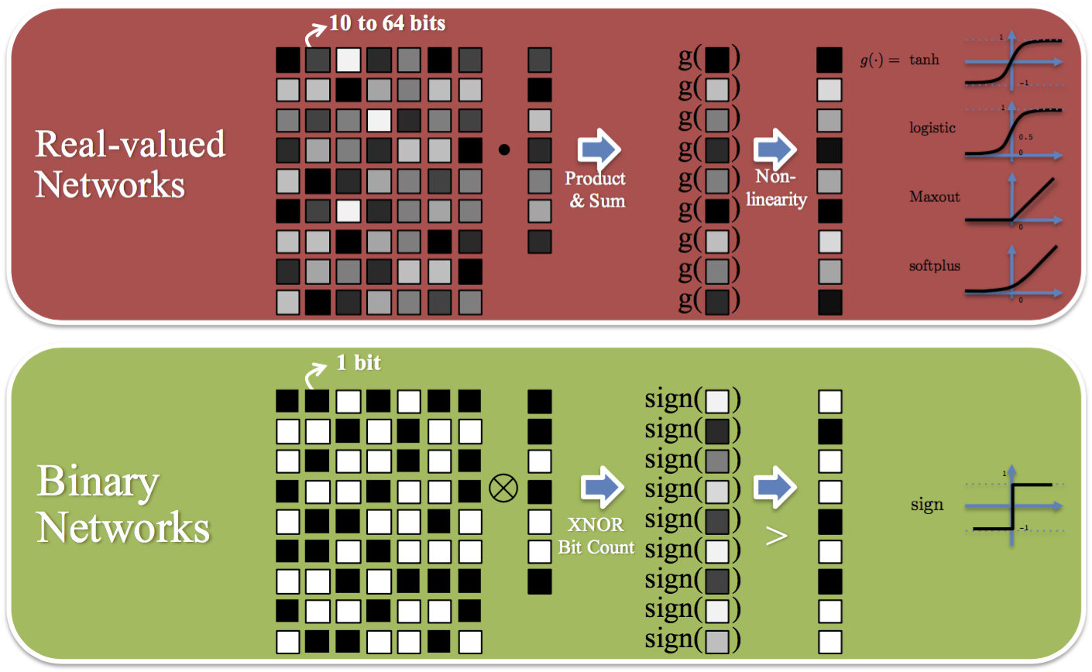
Binary Net – XNOR + Count
Real valued
Activation = g(W.x)
G is the non-liniarity
+1 == 1 and -1 == 0, N = 7
First row of weight matrix
w = [ 0, 0, 1, 0, 1, 0, 0 ]
Input vector
x = [ 0, 0, 1, 0, 1, 1, 0 ]
count(XNOR( w, x ) )
count([1, 1, 1, 1, 1, 0, 1])
= 6
Z = 2*count – N
= 2 * 6 – 7
= 5
Activation = sign( z )
= +1
Notes:
Image from : http://minjekim.com/demo_bnn.html
Calculation by Bipin
Ref: Bitwise neural networks ( Minje Kim )

Slide 21
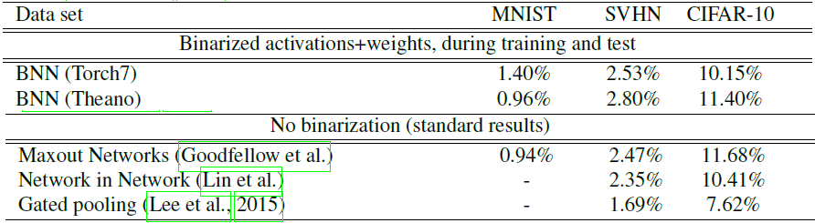
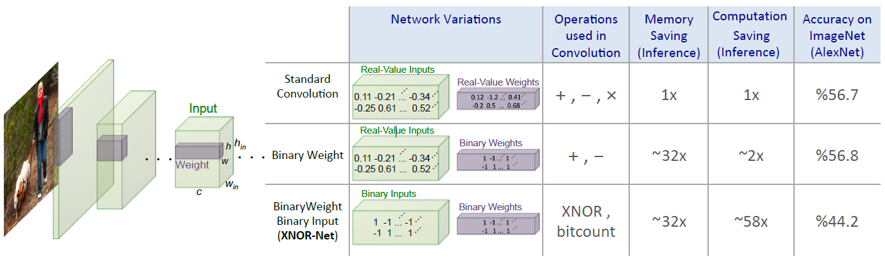
Binary Network Accuracy
Notes:
First Image taken from the Binary Net paper
Second image from XNOR-Net paper
Ref: Xnor-net: Imagenet classification using binary convolutional neural networks
Code: http://allenai.org/plato/xnornet
Classification test error rates of DNNs trained on MNIST (MLP architecture without unsupervised pretraining), CIFAR-10 (without data augmentation) and SVHN.
http://digitalcommons.mtu.edu/cgi/viewcontent.cgi?article=1578&context=etdr

Slide 22
Knowledge Distillation

Slide 23
Knowledge Distillation
Distilling the Knowledge in a Neural Network
Student teacher paradigm
Compress Ensemble of networks (teacher) to a student network of similar depth
Student is trained to predict the output of the teacher as well as the true labels
Notes:
G. E. Hinton, O. Vinyals, and J. Dean, “Distilling the knowledge in a
neural network,” CoRR, vol. abs/1503.02531, 2015.
Implemenation ( not from author) : https://github.com/tejasgodambe/knowledge-distillation
Distilling a Neural Network Into a Soft Decision Tree
https://arxiv.org/abs/1711.09784
Pytorch implementation ( not from author) : https://github.com/kimhc6028/soft-decision-tree
A. Romero, N. Ballas, S. E. Kahou, A. Chassang, C. Gatta, and
Y. Bengio, “Fitnets: Hints for thin deep nets,” CoRR, vol. abs/1412.6550,
2014.
recent work: https://arxiv.org/abs/1803.10750
J. Ba and R. Caruana, “Do deep nets really need to be deep?” in
Advances in Neural Information Processing Systems 27: Annual Conference
on Neural Information Processing Systems 2014, December 8-13
2014, Montreal, Quebec, Canada, 2014, pp. 2654–2662.

Slide 24
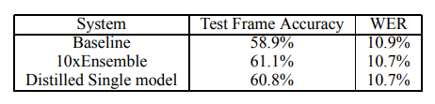
Distilling Knowledge in a NN Hinton, et al.
First train a bigger ensemble of models
Then do a different kind of training (distillation) to transfer the knowledge to a small model
use the class probabilities produced by the cumbersome model as “soft targets” for training the small model
general solution, called “distillation”, is to raise the temperature of the final softmax until the cumbersome model produces a suitably soft set of targets
8 hidden layers of 2560 and softmax layer with 14000 labels
Notes:
Ref: https://arxiv.org/pdf/1503.02531.pdf
From
We use an architecture with 8 hidden layers each containing 2560 rectified linear units and a final softmax layer with 14,000 labels (HMM targets ht). The input is 26 frames of 40 Mel-scaled filterbank coefficients with a 10ms advance per frame and we predict the HMM state of 21st frame. The total number of parameters is about 85M. This is a slightly outdated version of the acoustic model used by Android voice search, and should be considered as a very strong baseline. To train the DNN acoustic model we use about 2000 hours of spoken English data, which yields about 700M training examples. This system achieves a frame accuracy of 58.9%, and a Word Error Rate (WER) of 10.9% on our development set.

Slide 25
Compact Convolution Filters, Low Rank Factorization

Slide 26
Transferred/Compact Convolution Filters
Many methods utilizing translation invariant property and weight sharing
G-CNN Group Equivariant Convolutional Networks
DCNN maintains groups of filters where filters within each group are translated versions of each other
New effective activation scheme called concatenated ReLU (CReLU)
Multi-Bias Non-linear Activation
Exploiting Cyclic Symmetry in Convolutional Neural Networks
SqueezeDet, SqueezeDet+
<Need further study to understand this-Bipin>
Notes:
T. S. Cohen and M. Welling, “Group equivariant convolutional networks,”
arXiv preprint arXiv:1602.07576, 2016.
S. Zhai, Y. Cheng, and Z. M. Zhang, “Doubly convolutional neural
networks,” in Advances In Neural Information Processing Systems, 2016,
pp. 1082–1090.
W. Shang, K. Sohn, D. Almeida, and H. Lee, “Understanding and
improving convolutional neural networks via concatenated rectified
linear units,” arXiv preprint arXiv:1603.05201, 2016.
H. Li, W. Ouyang, and X. Wang, “Multi-bias non-linear activation in
deep neural networks,” arXiv preprint arXiv:1604.00676, 2016.
C. Szegedy, S. Ioffe, and V. Vanhoucke, “Inception-v4, inception-resnet
and the impact of residual connections on learning.” CoRR, vol.
abs/1602.07261, 2016. [Online]. Available: http://dblp.uni-trier.de/db/
journals/corr/corr1602.html#SzegedyIV16
B. Wu, F. N. Iandola, P. H. Jin, and K. Keutzer, “Squeezedet: Unified,
small, low power fully convolutional neural networks for real-time object
detection for autonomous driving,” CoRR, vol. abs/1612.01051, 2016.

Slide 27
Low Rank Factorization
Ideas based on tensor decomposition to low rank to reduce computation complexity
Some papers (see notes below)
Learning separable filters, Rigamonti et al.
Exploiting linear structure within convolutional networks for efficient evaluation, Denton et al.
Speeding up convolutional neural networks with low rank expansions, Jaderberg et al.
Speeding-up convolutional neural networks using fine-tuned cpdecomposition, Lebedev et al.
Convolutional neural networks with low-rank regularization, Tai et al.
<Need further study to understand this-Bipin>
Notes:
R. Rigamonti, A. Sironi, V. Lepetit, and P. Fua, “Learning separable
filters,” in 2013 IEEE Conference on Computer Vision and Pattern
Recognition, Portland, OR, USA, June 23-28, 2013, 2013, pp. 2754–
2761.
E. L. Denton, W. Zaremba, J. Bruna, Y. LeCun, and R. Fergus,
“Exploiting linear structure within convolutional networks for efficient
evaluation,” in Advances in Neural Information Processing Systems 27,
Z. Ghahramani, M. Welling, C. Cortes, N. D. Lawrence, and K. Q.
Weinberger, Eds. Curran Associates, Inc., 2014, pp. 1269–1277.
M. Jaderberg, A. Vedaldi, and A. Zisserman, “Speeding up convolutional
neural networks with low rank expansions,” in Proceedings of the British
Machine Vision Conference. BMVA Press, 2014.
V. Lebedev, Y. Ganin, M. Rakhuba, I. V. Oseledets, and V. S. Lempitsky,
“Speeding-up convolutional neural networks using fine-tuned cpdecomposition,”
CoRR, vol. abs/1412.6553, 2014.
C. Tai, T. Xiao, X. Wang, and W. E, “Convolutional neural networks
with low-rank regularization,” vol. abs/1511.06067, 2015.
M. Denil, B. Shakibi, L. Dinh, M. Ranzato, and N. D. Freitas,
“Predicting parameters in deep learning,” in Advances in Neural
Information Processing Systems 26, C. Burges, L. Bottou, M. Welling,
Z. Ghahramani, and K. Weinberger, Eds., 2013, pp. 2148–2156.
[Online]. Available: http://media.nips.cc/nipsbooks/nipspapers/paper
files/nips26/1053.pdf
T. N. Sainath, B. Kingsbury, V. Sindhwani, E. Arisoy, and B. Ramabhadran,
“Low-rank matrix factorization for deep neural network training
with high-dimensional output targets,” in in Proc. IEEE Int. Conf. on
Acoustics, Speech and Signal Processing, 2013.

Slide 28
Structural Matrix
Only for fully connected layers
Find a reduced weight matrix
Paper: Deep Fried Convnets (https://arxiv.org/abs/1412.7149)
For a fully connected layer with d inputs and n outputs it reduces the storage and the computational costs from O(nd) to O(n) and from O(nd) to O(n log d),respectively
<Need further study to understand this-Bipin>

Slide 29
Thanks
Questions
Bipin
References
All references given as notes along with slides

