Slide 1
Algorithms in AI
Breadth First Search and A*
Path Planning with python 101
Bipin Vijayasenan

Slide 2
Introduction
Uninformed Search
Breadth First Search
Depth First Search
Informed search (Using heuristics)
Greedy
A*

Slide 3
Workshop
Python knowledge expected from you
basic operations
list, dict, tuples
functions
We will code most of the algorithms and supporting functions
If you are stuck, please let me know. A solutions.py is provided.
Rough schedule
BFS/DFS - 1hr
Greedy/A* - 1hr
Debugging and experimentation - 1hr

Slide 4
Applications for coding
Metro map (a simple subset of shanghai metro)
Path finding in a grid world
Solving 8Puzzle

Slide 5
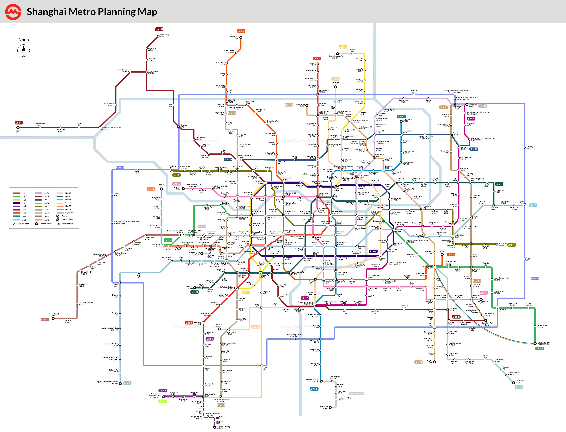
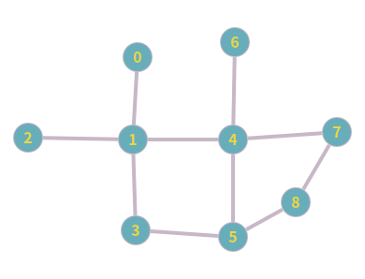
Metro graph – Problem Introduction
https://www.travelchinaguide.com/images/map/shanghai/shanghai-subway.gif

Slide 6
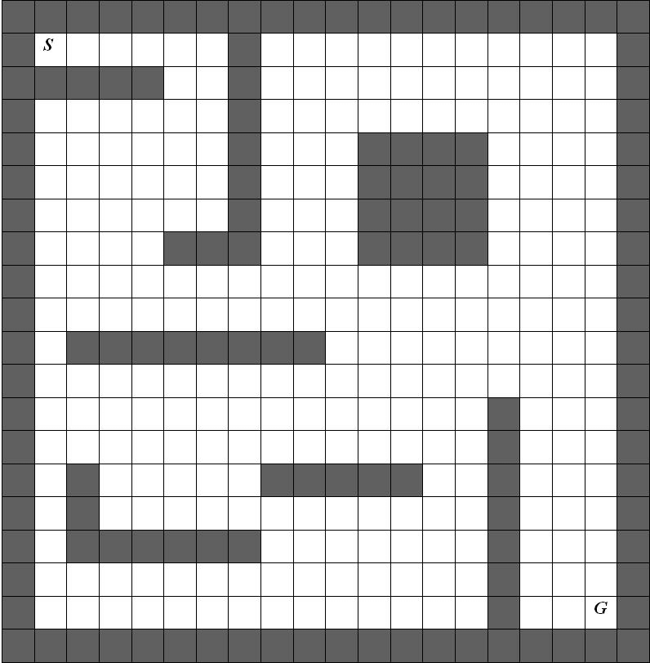
Grid World
https://www.researchgate.net/figure/The-example-is-a-gridworld-environment-with-cell-to-cell-actions-up-down-left-and_fig6_23249669

Slide 7
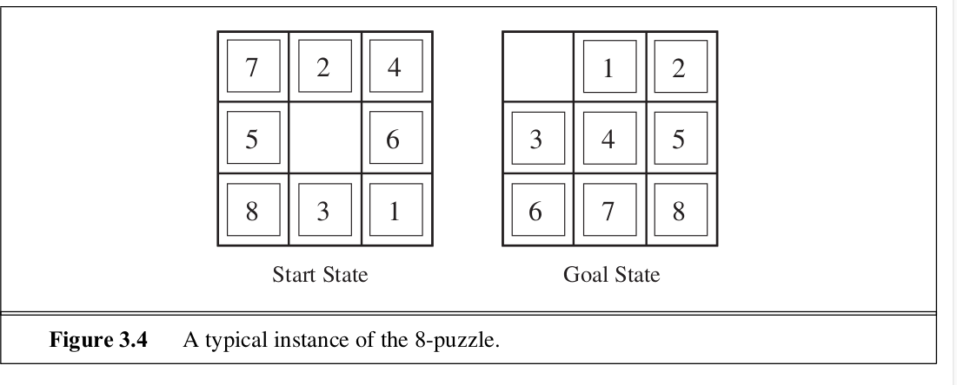
8Puzzle
A tile adjacent to the blank space can slide into the space. The object is to reach a specified goal state.

Slide 8
Example Real World Applications
Route finding
Games
Robotics
Web Crawling
Social Networking
Garbage collection in programming languages
VLSI Layout

Slide 9
Elements
States
Actions
Successors (Next states)
Start State, Goal State and Goal Test
Path (Shortest path, Any path )
Edges and edge weights (For this workshop we assume edge weight as 1 always)

Slide 10
Breadth First Search
Explain algorithm
Code using the metro graph (with/without path)
Trace the algorithm
Introduce the Depth First Search change

Slide 11
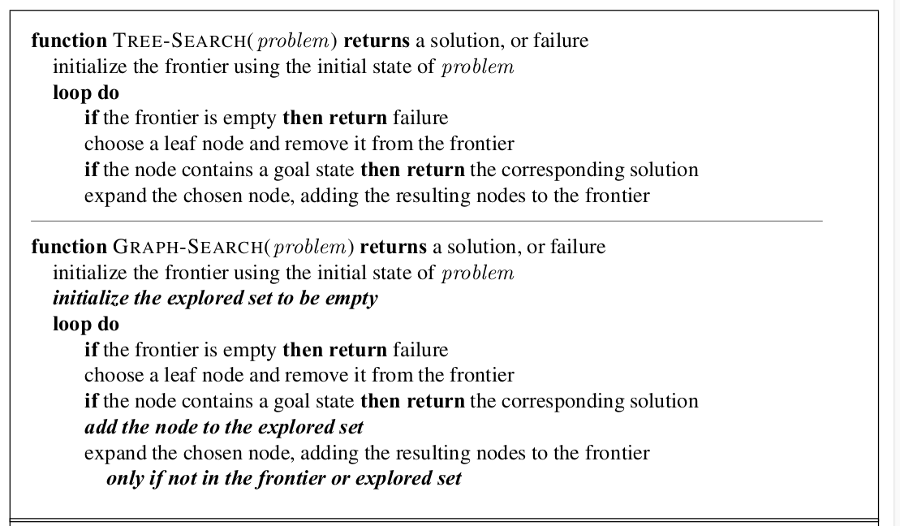
Pseudocode - Search

Slide 12
Grid World
Explain Grid World
Move the BFS code to GridWorld and check
Show visited list in prints
Bigger worlds?

Slide 13
Limitations of Uninformed Search
Idea of heuristics
Idea of priority queues
Code a simple/stupid priority queue
Greedy and A* algorithms

Slide 14
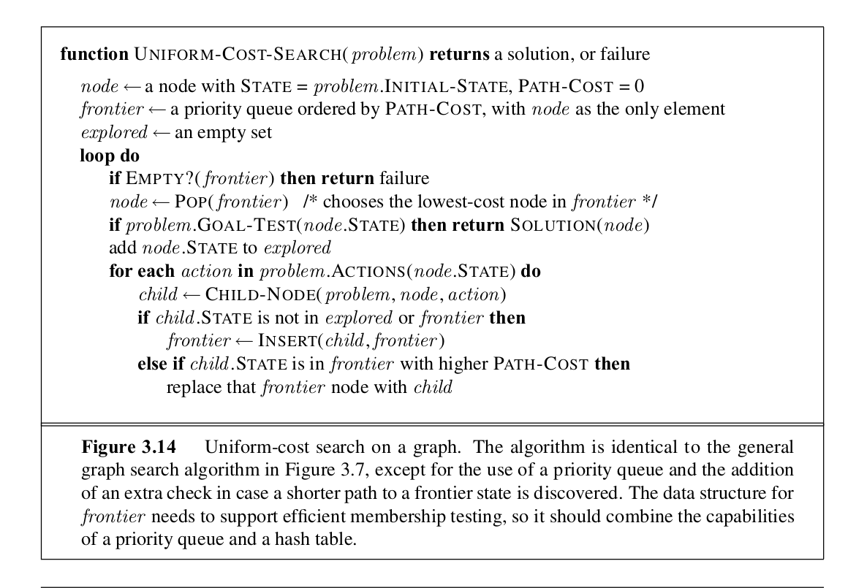
Uniform Cost Search

Slide 15
8Puzzle
Move the code to 8Puzzle environment
Check path length by bfs and astar (length should be identical – paths can differ)
Web UI?

Slide 16
Reference
Artificial Intelligence A Modern Approach (Russel & Norvig)
CS188 Berkeley – Lectures 2 & 3 (http://ai.berkeley.edu/home.html)
Algorithms (Sedgewick & Wayne) (https://algs4.cs.princeton.edu/home/)
Introduction to Algorithms MIT OCW (https://ocw.mit.edu/courses/electrical-engineering-and-computer-science/6-006-introduction-to-algorithms-fall-2011/)

