Slide 1
Attention Mechanism in NMT models
Seq2Seq models, Attention mechanisms, Neural Machine Translation

Slide 2
Introduction
Introduce Sequence to Sequence model
Limitations of basic seq2seq models
Attention is introduced to improve the models
Attention mechanism and different types
Advanced attention papers are not included in this presentation. ( I will try to list some of them for ref )

Slide 3
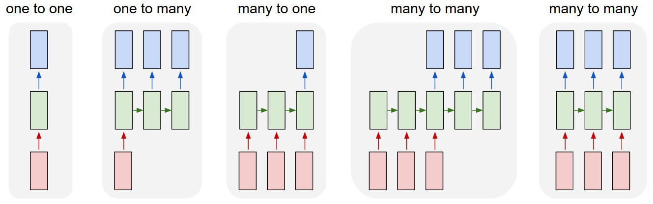
Sequence to Sequence model
Input to the model is a sequence and output is also a sequence
The input and output sequence lengths are variable
Usually the models use RNN architecture
(1) without RNN, from fixed-sized input to fixed-sized output : image classification
(2) Sequence output: image captioning takes an image and outputs a sentence of words.
(3) Sequence input: sentiment analysis where a given sentence is classified as expressing positive or negative sentiment.
These are Sequence to Sequence Models
(4) Sequence input and sequence output
Machine Translation: an RNN reads a sentence in English and then outputs a sentence in French.
(5) Synced sequence input and output
video classification where we wish to label each frame of the video
Notes:
From :
http://karpathy.github.io/2015/05/21/rnn-effectiveness/
Each rectangle is a vector and arrows represent functions (e.g. matrix multiply). Input vectors are in red, output vectors are in blue and green vectors hold the RNN's state

Slide 4
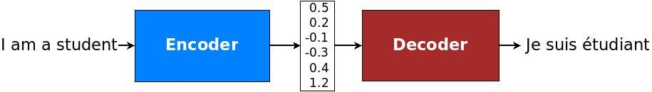
Neural Machine Translation
Encoder Decoder model
Reads the source sentence using an encoder
Build a “thought vector”, a sequence of numbers that represents the sentence’s meaning
A decoder, then, processes the sentence vector to emit a translation
Notes:
https://ai.googleblog.com/2016/09/a-neural-network-for-machine.html
Google's Neural Machine Translation System: Bridging the Gap between Human and Machine Translation
https://arxiv.org/abs/1609.08144
Open NMT
http://opennmt.net/

Slide 5
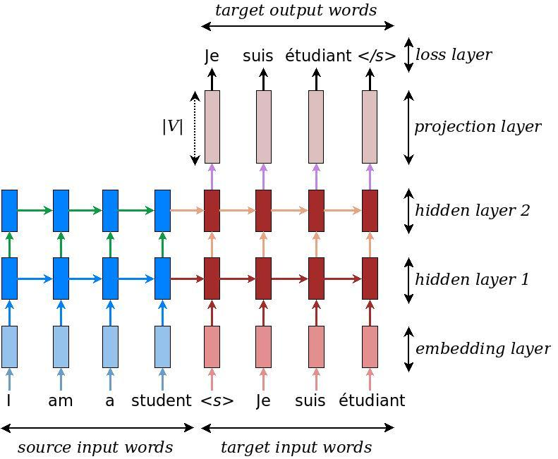
Encoder/Decoder Architecture
RNN is used for both the encoder and decoder
unidirectional or bidirectional
single or multi-layer
often either a vanilla RNN, a Long Short-term Memory (LSTM), or a gated recurrent unit (GRU)
RNN Encoder/Decoder
Multi Layer RNN Encoder/Decoder
Notes:
Google's Neural Machine Translation System: Bridging the Gap between Human and Machine Translation
https://arxiv.org/abs/1609.08144
First pic:
https://towardsdatascience.com/sequence-to-sequence-model-introduction-and-concepts-44d9b41cd42d

Slide 6
Encode/Decoder Limitations
Neural network needs to be able to compress all the necessary information of a source sentence into a fixed-length vector ( context )
Performance of a basic encoder–decoder deteriorates rapidly as the length of an input sentence increases
Notes:
Pic from : https://pytorch.org/tutorials/intermediate/seq2seq_translation_tutorial.html

Slide 7
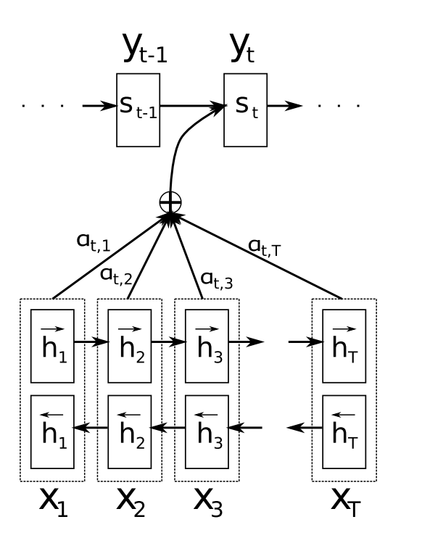
Attention
Does not attempt to encode a whole input sentence into a single fixed-length vector
Attention mechanism encodes the input sentence into a sequence of vectors and chooses a subset of these vectors adaptively while decoding the translation
This allows a model to cope better with long sentences
Decoder
Notes:
https://medium.com/syncedreview/a-brief-overview-of-attention-mechanism-13c578ba9129
https://ai.googleblog.com/2016/09/a-neural-network-for-machine.html
Attn: Neural Machine Translation by Jointly Learning to Align and Translate
https://arxiv.org/abs/1409.0473
Stanford NLP
https://nlp.stanford.edu/pubs/emnlp15_attn.pdf
https://arxiv.org/abs/1508.04025
https://github.com/spro/practical-pytorch/blob/master/seq2seq-translation/seq2seq-translation.ipynb
https://pytorch.org/tutorials/intermediate/seq2seq_translation_tutorial.html

Slide 8
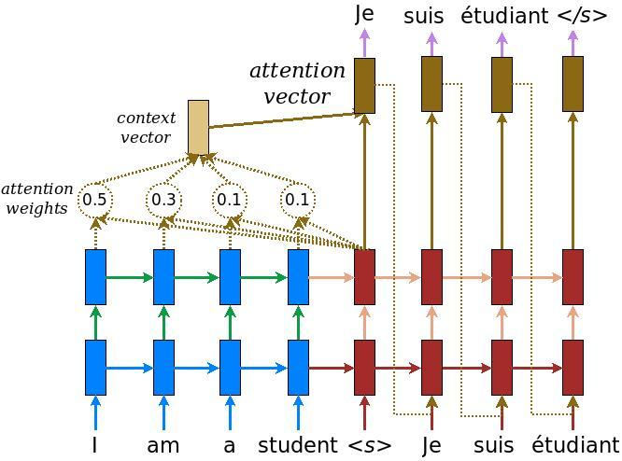
Attention Mechanism
Notes:
Pic from: https://www.tensorflow.org/tutorials/seq2seq
https://medium.com/syncedreview/a-brief-overview-of-attention-mechanism-13c578ba9129

Slide 9
Attention Mechanism
Global Attention Model
From paper “Effective Approaches to Attention-based Neural Machine Translation”, Minh-Thang et al, Stanford
Context vector c(t) is computed as the weighted
Average, according to a(t), over all the source states
Notes:
Stanford NLP
Effective Approaches to Attention-based Neural Machine Translation”, Minh-Thang et al, Stanford
https://nlp.stanford.edu/pubs/emnlp15_attn.pdf
https://arxiv.org/abs/1508.04025

Slide 10
Global Attention Limitations
The global attention has a drawback that it has to attend to all words on the source side
expensive and can potentially render it impractical to translate longer sequences
Can we attend to a subset of the source vectors?
Yes, Local Attention (see next slide)

Slide 11
Local Attention
Local Attention Model
First predicts a single aligned position pt for the current target word
A window centered around the source position pt is then used to compute a context vector ct
To favor alignment points near pt, a Gaussian distribution centered around pt is placed.
S is the length of source sequence.
pt ranges from [0-S], is a real number.
Notes:
Stanford NLP
Effective Approaches to Attention-based Neural Machine Translation”, Minh-Thang et al, Stanford
https://nlp.stanford.edu/pubs/emnlp15_attn.pdf
https://arxiv.org/abs/1508.04025

Slide 12
Some interesting papers
Listen, Attend and Spell
https://arxiv.org/abs/1508.01211
Attention Is All You Need
https://arxiv.org/abs/1706.03762
STATE-OF-THE-ART SPEECH RECOGNITION WITH SEQUENCE-TO-SEQUENCE MODELS
https://ai.google/research/pubs/pub46687
QANet
https://arxiv.org/abs/1804.09541
https://arxiv.org/abs/1711.00106
Transformer for video
https://arxiv.org/pdf/1804.00819.pdf)

Slide 13
CVPR 2017 papers related to Attention Model
https://github.com/ArcherFMY/Paper_Reading_List/tree/master/CVPR2017-Attention-model

Slide 14
References
References are in the slide notes
Questions to Bipin ( bipin.vijayasenan@unisoc.com )

