Slide 1


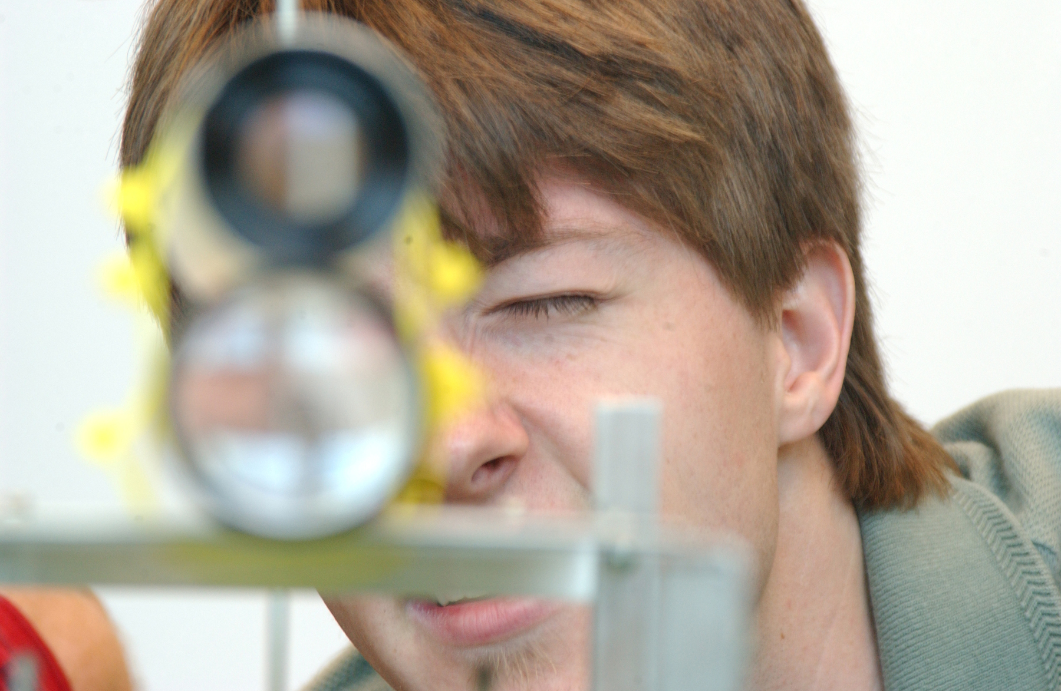

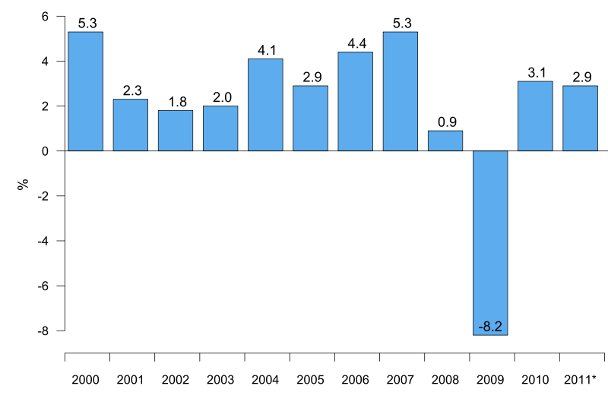
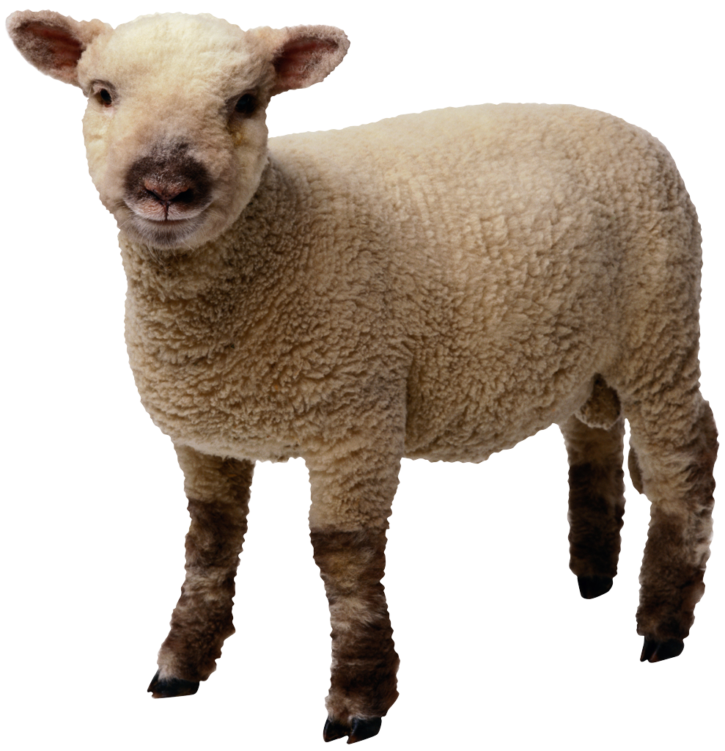
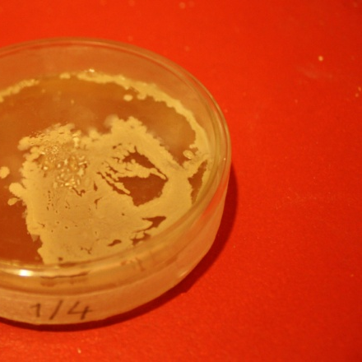
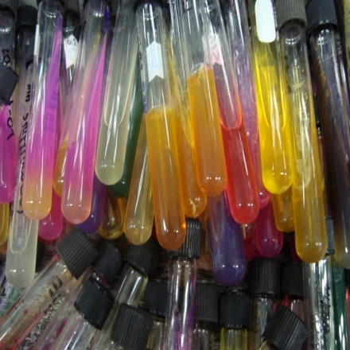
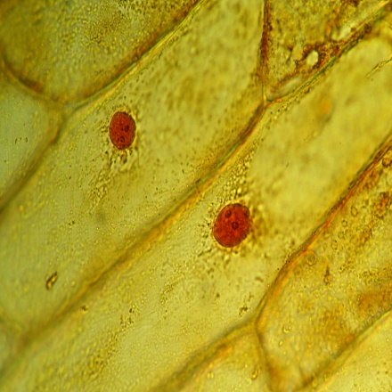
This is the Area Where You Place the Title of Your Poster
Full name, ECT
University of North Florida, College Jacksonville, FL USA 32224
INTRODUCTION
MATERIALS & METHODS
CONCLUSIONS
Whether it be in a work environment, personal research, or every-day life, many users find themselves having potentially tens of tabs open all at the same time. Keeping tabs organized and managed without having them constantly be opened, crowding your browser, and eating at your memory, is what Tab Ultra is being developed for. Tab Ultra is a Google Chrome-based browser extension that allows users to save, group, and manage tabs for specific use-cases so that any and all tabs can be quickly re-opened for user convenience.
Tab Ultra makes heavy use of JavaScript and CSS for back-end implementation and relies on HTML for displaying all front-end GUI elements. What makes the saving of tabs and groups across multiple Google Chrome instances is Chrome’s Storage API. This allows for data to be stored locally and then synced across any Chrome browser that the user is logged in to across any
device. Tab Ultra features a tab view and a group view. The tab view allows tabs to be selected from open tabs or added manually and saved into either a new group or an existing group. The group view displays all saved groups, allows the user to select and open any or all tabs in each group, and view group metadata (date created, last used, etc.).
Sustie dolorero dignim quat eum dunt aliqui eui blaorperit volor iriuscip et nit doluptatis dunt ut nos euiscin henim zzrit erit lam. Nullum nibh et luptat wisis estrud exer sum quam qui bla faccummy niat augue mod duis nonsequ ismodio nsenibh eu feu faccum zzrit nosto dolore digna feu feui te commy nis autpat iustinc iliquis euguerostrud molorer suscincilla feuisl ullaortinis er si. Im il ulla cor sim
acin euguerosto commolore tate
vel delit atie tat lut vel iril do er
ipit ilisl dolortie tat, ver irit nums
andre dio odolore vendre facipit
ulputatio conse volum dolore tat.
Sustie dolorero dignim quat eum
dunt aliqui eui blaorperit volor.
OBJECTIVES
Nostie dignisisim iuscip erillaore magnismod dio commy nulla feummy non velese dipit lutat. Nostie dignisisim iuscip erillaore magnismod dio commy nulla.
The goal of Tab Ultra is to maximize convenience and ease-of-use when it comes to managing tabs. Tab Ultra will allow a user to select and store any opened tabs into a group which they can then name, save, and manage in multiple different ways. Each group can then be accessed, and user-selected tabs can be re-opened instead of having to manually open each potential bookmark the user may have created. Unlike similar extensions, Tab Ultra aims to be as non-intrusive as possible by having all functionality be confined to a pop-up window within the currently open tab. The act of being taken to a separate page to manage groups and tabs is what Tab Ultra intends to avoid.
Nostie dignisisim iuscip erillaore magnismod dio commy nulla feummy non velese dipit lutat. Nostie dignisisim iuscip erillaore magnismod dio commy nulla. Nostie dignisisim iuscip erillaore magnismod dio commy nulla feummy non velese dipit lutat. Nostie dignisisim iuscip erillaore magnismod dio commy nulla.
REFERENCES
Sustie dolorero dignim quat eum dunt aliqui eui blaorperit volor iriuscip et nit doluptatis dunt ut nos euiscin henim zzrit erit lam. Nullum nibh et luptat wisis estrud exer sum quam qui bla faccummy niat augue mod duis nonsequ ismodio nsenibh eu feu faccum zzrit nosto dolore digna feu feui te commy nis autpat iustinc iliquis euguerostrud molorer suscincilla feuisl ullaortinis er si. Im il ulla cor sim acin euguerosto commolore tate vel delit atie tat lut vel iril do er ipit ilisl dolortie tat, ver irit numsandre dio odolore vendre facipit ulputatio conse volum dolore tat. Sustie dolorero dignim quat eum dunt aliqu.
RESULTS
Sustie dolorero dignim quat eum dunt aliqui eui blaorperit volor iriuscip et nit doluptatis dunt ut nos euiscin henim zzrit erit lam. Nullum nibh et luptat wisis estrud exer sum quam qui bla faccummy niat augue mod duis nonsequ ismodio nsenibh eu feu faccum zzrit nosto dolore digna feu feui te commy nis autpat iustinc iliquis euguerostrud molorer suscincilla feuisl ullaortinis er si. Im il ulla cor sim acin euguerosto commolore tate vel
Nostie dignisisim iuscip erillaore magnismod dio commy nulla feummy non velese dipit lutat. Nostie dignisisim iuscip erillaore magnismod dio commy nulla.
ACKNOWLEDGEMENTS
Sustie dolorero dignim quat eum dunt aliqui eui blaorperit volor iriuscip et nit doluptatis dunt ut nos euiscin henim zzrit erit lam. Nullum nibh et luptat wisis estrud exer sum quam qui bla faccummy niat augue mod duis nonsequ ismodio nsenibh eu feu faccum zzrit nosto dolore digna feu feui te commy nis autpat iustinc iliquis euguerostrud molorer suscincilla feuisl ullaortinis er si. Im il ull.
Nostie dignisisim iuscip erillaore magnismod dio commy nulla feummy non velese dipit lutat. Nostie dignisisim iuscip erillaore magnismod dio commy nulla. Nostie dignisisim iuscip erillaore magnismod dio commy nulla feummy non velese dipit lutat. Nostie dignisisim iuscip erillaore magnismod dio commy nulla.
Nostie dignisisim iuscip erillaore magnismod dio commy nulla feummy non velese dipit lutat. Nostie dignisisim iuscip erillaore magnismod dio commy nulla. Nostie dignisisim iuscip erillaore magnismod dio commy nulla feummy non velese dipit lutat. Nostie dignisisim iuscip erillaore magnismod dio commy nulla.

