Slide 1
Model-Context-Protocol A brief overview
Industrial AI, 2026S
Kristóf Varga-Balázs
12516697

Slide 2
Agenda
What is MCP?
Why is MCP relevant?
Technical overview
Live demo
Notes:
“Today I’ll introduce the Model Context Protocol, or MCP. We’ll start with a short overview of what it is, then look at why it actually matters using concrete examples. After that, I’ll walk through how it works technically, and finally I’ll show a live demo where an AI interacts with a real system using MCP.”

Slide 3
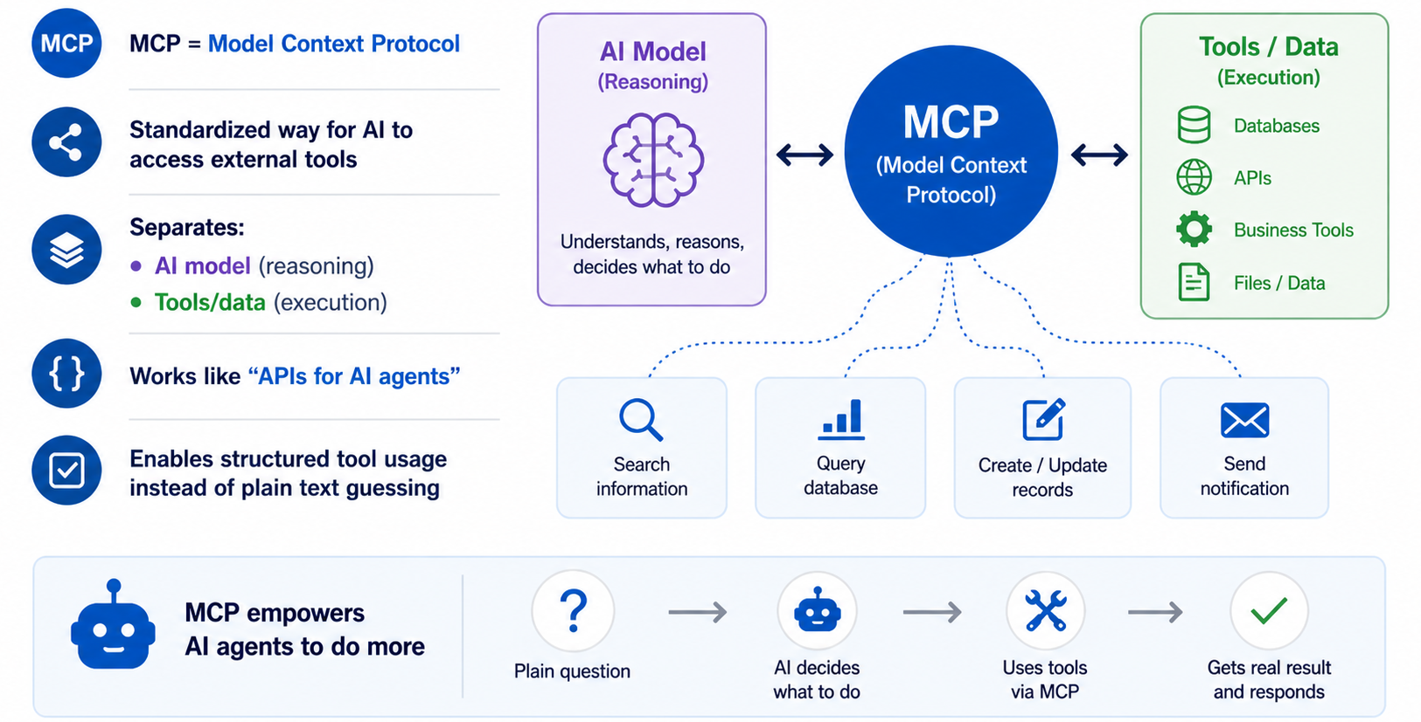
What is MCP?
Notes:
“MCP stands for Model Context Protocol. It’s essentially a standardized way for AI models to interact with external tools and data sources.
Instead of an AI just generating text, it can now call functions, query databases, or trigger actions in systems.
A key idea is separation: the model focuses on reasoning, while external tools handle execution and real data.
You can think of MCP as APIs—but designed specifically for AI agents.”

Slide 4
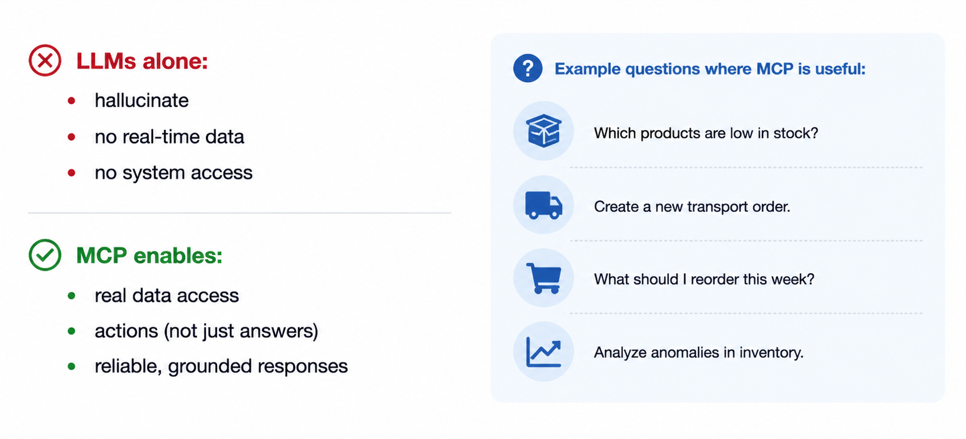
Why is MCP relevant?
LLMs alone:
hallucinate
no real-time data
no system access
MCP enables:
real data access
actions (not just answers)
reliable, grounded responses
Notes:
“Large language models by themselves are limited. They don’t have access to real-time data, they can’t interact with systems, and they may hallucinate.
MCP solves this by connecting the model to real tools.
That means instead of guessing, the AI can:
query your database
trigger actions
and give grounded, reliable answers
For example, instead of asking a model hypothetically about inventory, we can ask: ‘Which products are low in stock?’ —and it actually checks the system.
This transforms AI from a chatbot into a real assistant.”

Slide 5
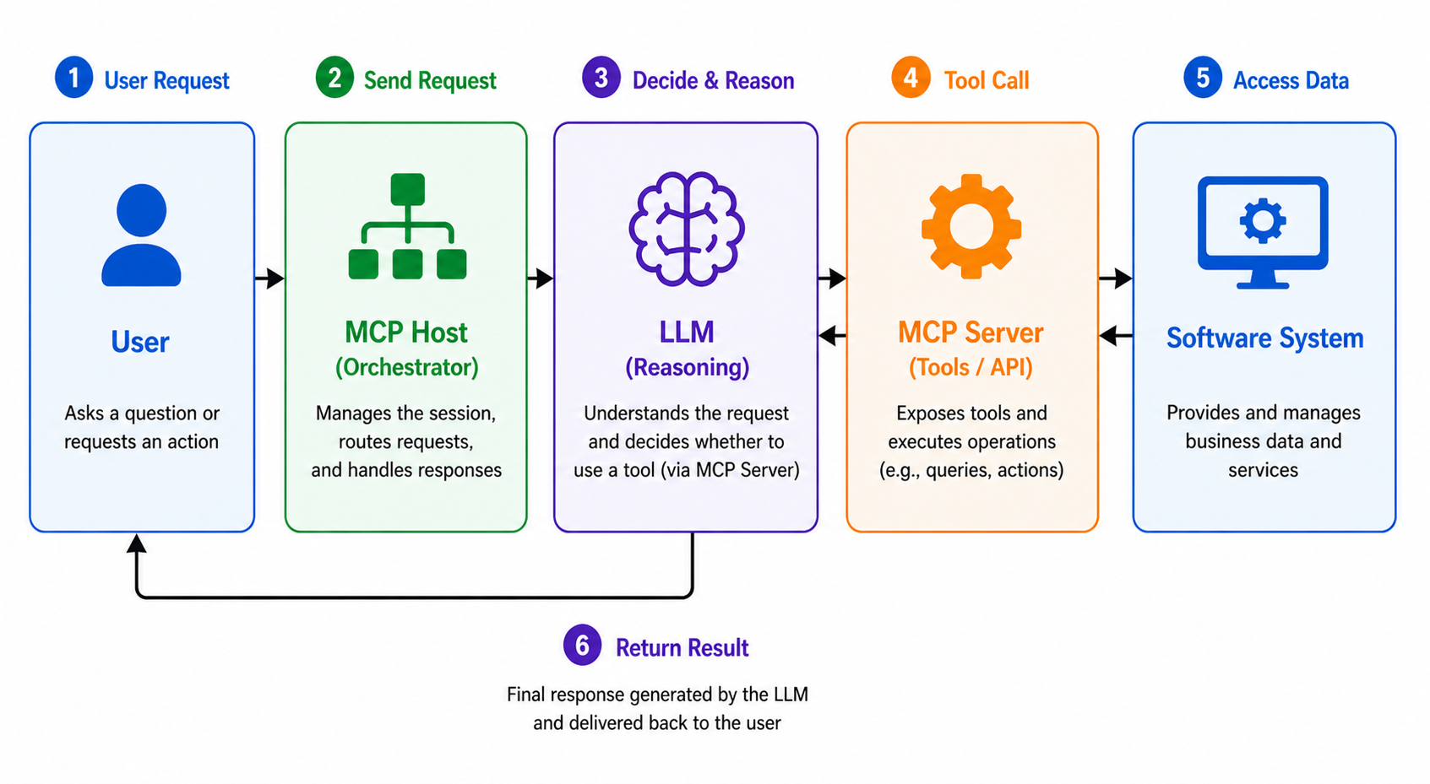
Technical Overview
Notes:
“Technically, MCP consists of three main parts.
First, the MCP server. This exposes tools—for example, database queries or business logic.
Second, the MCP host. This acts as the orchestrator. It connects the model with the tools.
Third, the language model itself, which decides when and how to use those tools.
The flow is the following: A user asks a question. The model decides that it needs data. The MCP host calls the appropriate tool. The tool returns real data. And finally, the model generates an answer based on that data.
So the intelligence stays in the model, while execution happens in the tools.”

Slide 6

Demo

Slide 7


Takeaway
MCP enables a shift from AI that only talks,
to AI that acts within real systems.
Github repository:
Contact me (LinkedIn):

Slide 8
Thank you for your attention!

