Slide 1
Data Analysis and Project Proposal for Olympics Dataset
Karaarslan
June 2020

Slide 2
Potential Audience
Anybody who wants to explore olympics data set is a potential audience for this Project. This Project can help them to understand the processes of how to make an exploratory data analysis and getting some insights of the data.

Slide 3
Why Olympics Dataset
I have chosed the Olympics Dataset. The datasets are in csv format and I am more comfortable reading csv’s to pandas DataFrame. For this reason I selected this dataset.

Slide 4
What has done until now?
I have downloaded the csv files from coursera web page.
I have imported necessery libraries for reading the data set with pd.read_csv() into pandas dataframe
EDA(Exploratory Data Analysis) to understand and get some sense of the data.
Visualization to see the relationship or trends between the columns.

Slide 5
Questions Before Inspecting Data
Which countrey won the most medals in total? How many?
Which country have the highest medal winning ratio(number of medal winners compared with participated atheletes)?
What’s the average participation times of an athelete?
Who have participated the most Olympic games?
How many times have they won?

Slide 6
Hypothesis
I assume that womens were not involved at the very first years of the olympics. I will try to find when was the first year that womens are began to attend to the olympics.
I assume that host country/countries had shown better performance than the years that they were not the host of the games.

Slide 7
Approach
To test my hypothesis, I’ll be using primarily average metrics.
I will separate the data into two to see the difference of male and female participance.
I will count the medals for every country to be able to measure the performance of the countries.
I will try to find the host countries and try to measure their performance for both while hosting and not hosting the olympics.
I will try to find the first participation of female athletes to olympics.

Slide 8
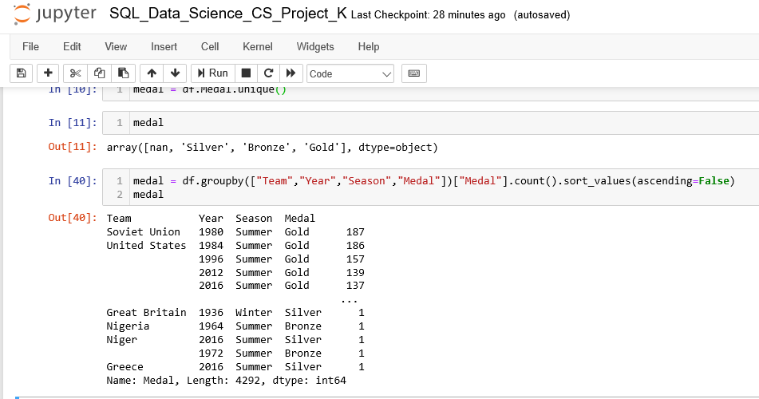
Data Overview

Slide 9
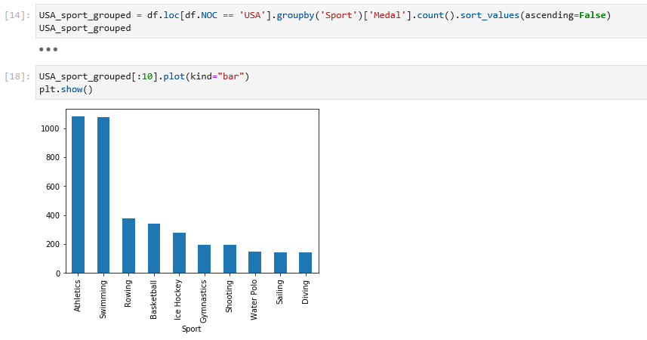
Statistics regarding USA
It is clear that in Athletics and Swimming USA is much better than other branches.

Slide 10
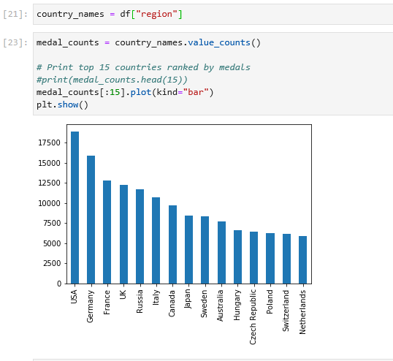
Total Medal Counts
First 15 countries according to their total medal counts

Slide 11
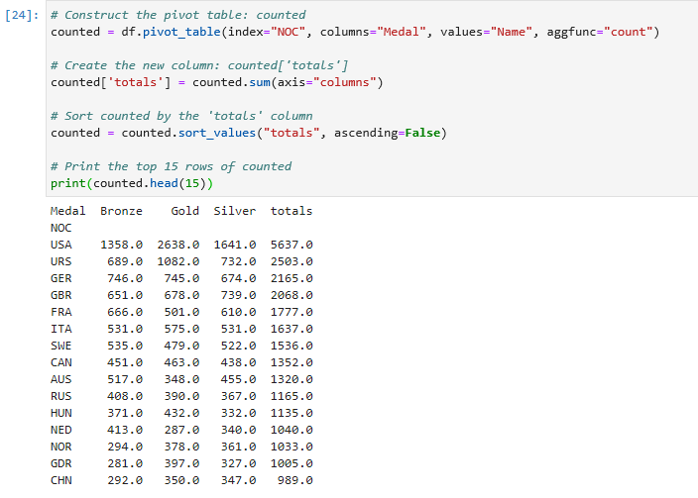
Gold-Silver-Bronze Totals
Countries by Medal counts.
Last Column is the total number of other three columns.

Slide 12
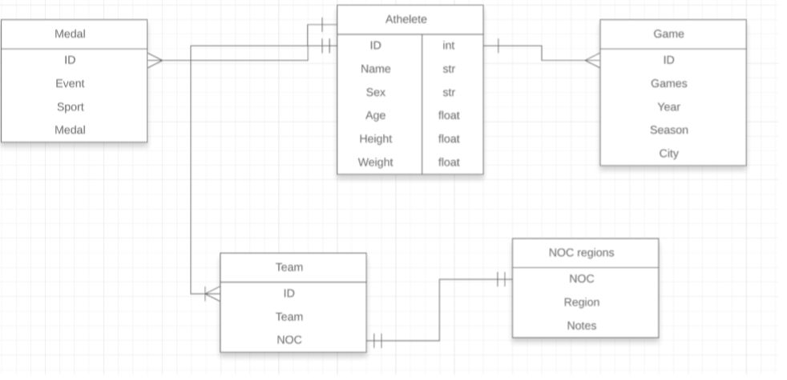
ERD of the Data

Slide 13
New Metrics
I would like to also find the medal counts for women of different countries. Which countries were the best as female athletes and is there any relationship between the number of athletes of a country and the success of that country.

Slide 14
New Approachs
I have performed several histograms with the objective of getting the distribution of age, weight and height in the dataset in general, and I also performed the exact same histograms but just for woman and just for man.

Slide 15
Discoveries
It was possible to observe that in the general dataset the most common age is 19, while in the women segment is 17 and in the man is 21. Is also possible to notice that women start to compete earlier than men, but they also drop the competition earliaer.
Also for both men and women, height and weight has increased gradually over the history of the Games.

Slide 16
Results
I have found out that, there is not any female athletes before 2000.
Athletes have won more medals in London.
USA has won the highest number of gold medals when compared to other medals and almost equal percent of silver and bronze medals.

Slide 17
Results(Continued)
There is increase in number of medals won from 1896 Olympics to 2012 Summer olympics.
One of the reasons will definitely be increase in participating countries, more sports and also number of athletes.
One thing clearly stands out is richest and developed countries have won the highest number of medals.
They are still winning majority of the medals.

