Slide 1

Merchant agreements for payment acceptance on the Blockchain
…

Slide 2
Who is AirPlus?
AirPlus International A leading Global provider of Corporate Credit Cards
51,000 corporate customers in 60+ countries € 15 bn issuing volume
1,300 staff owned by Lufthansa HQs in Frankfurt/Main
Payment institution supervised by BaFin Member of UATP, MC, Visa

Slide 3
AirPlus offices around the world
London
Amsterdam
Zurich
Mexico City
Frankfurt
Washington D.C.
Bologna
Prague
Beijing
Vienna
Shenzhen
Budapest
Shanghai
Stockholm
Brussels
Paris
Lisbon
Madrid
Hong Kong
Sydney
Dubai
Singapore
Israel
Johannesburg

Slide 4











Enabling payment guarantees, within the WindingTree eco-system
Business problem: hotel providers only accept approved FoP
BOOK
APPROVE

Slide 5
For the acceptance of payments the merchant enters a contract with a financial institution
Traveller
Merchant
Purchase request
Accomodation offer
Agreement to facilitate Payment
Agreement to facilitate Payment
pre-requisit for payments due to regulatory ristrictions
Financial Institution

Slide 6


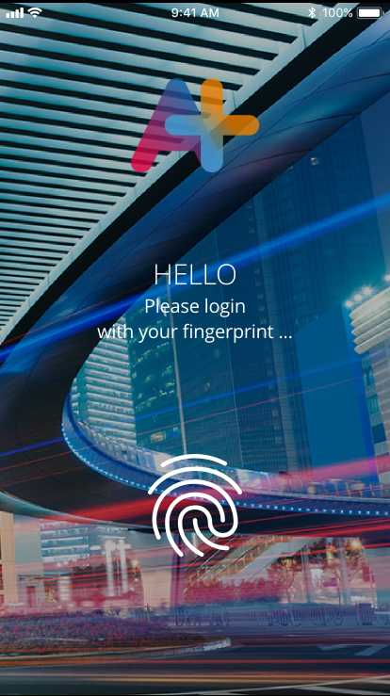
Removing complexity to enable solution adoption by bridging innovative distribution with current payment & billing solutions
Winding Tree index
Booking smart contract
Payment smart contract
Authorization
Authorization
Merchant agreementexists?
Decentralized storage
Data enrichment
Merchant agreement smart contract
Invoicing
Off chain
On chain

Slide 7

Establish relationship between hotel merchant and financial institution to allow for pay-later capability
Write data
Grant access
Read data
In scope
Out of scope
Indices
Register
Merchant Agreement Index
Indices
Merchant agreement smart contract states
Act: Hotel merchant
Act: Financial Inst.
Act: Hotel merchant
Act: Financial Inst.
Act: Hotel merchant
Request Merchant agreement
Request Merchant data
Enable data access
Propose terms
Sign agreement
SWARM

Slide 8
Register → Indices → Smart Contracts
SC=Smart Contract FI= Financial Institution
+
+
Indices
Register
Merchant Agreement Index
Merchant Index
FI Index
?
+Merchant Index
+Merchant Agr Index
+FI Index
+WT Index (Hotel)
+ ? Index
+Merchant Agr SC.addr
+…
+Merchant SC.addr
+…
+FI SC.addr
+…
FI SC
FI SC
FI SC
FI SC
FI SC
FI SC
Merchant Agreement SC
Merchant SC
FI SC
+Merchant SC addr
+FI SC addr
Hotel merchant fee
+Merchant W.addr
+Merchant Name
+Merchant registration #
+FI W.addr
+FI Name
+FI registration #

Slide 9
SC=Smart Contract FI= Financial Institution
Request Merchant agreement
Request Merchant Data
Enable data access
Propose terms
Sign agreement
+Merchant SC addr
+Merchant pub.key
~Payment type: CCR
~Contract state: REQ
+SWARM hash X
In SWARM
Company profile
Beneficial owner
Bank details
Bus. Reg. certificate
+FI SC addr
+FI pub.key
~Contract state: SEL
+SWARM hash Y
In SWARM
Company profile
Bank details
FI License ID
Bus. Reg. certificate
~Contract state: ACC
~Contract state:
Propose
+SWARM hash Z
In SWARM
Hotel merchant fee
Payment terms
~Contract state: SIN

Slide 10



Thank you! Questions?

