Slide 1
A Study on
Robust Quantitative Techniques for Capital Allocation
Student: Vinayak B. Menon
Supervisor: Azam Shamsi, PhD Finance

Slide 2
Introduction
This theoretical framework , now known as Modern Portfolio Theory(MPT) or Mean Variance Analysis, provided great insights on how to obtain optimal portfolios for various levels of risk.
As per MPT, the primary goal of portfolio optimization is to construct a portfolio that provides the highest possible return for a given level of risk.
This type of problem can be mathematically viewed as a ‘convex optimization problem’ with linear equalities, and hence being simple enough to solve through standard optimization procedures.
When we include inequality constraints on the assets, such as when we add ‘no shorting’ constraints, the problem cannot be solved directly through the Lagrangian , and we may need to resort to quadratic solvers to get an approximate solution.
However, the Critical Line Algorithm, introduced by Markowitz, manages to provide an accurate solution to these type of problems as well.

Slide 3
Yet, a major drawback of mean variance optimizers is their sensitivity to input errors
When managing portfolios, this can be a huge issue, as it can lead to a high turnover rate in capital allocation
Given the nature of financial data, we constantly deal with estimates and naturally, a certain level of error is to be expected.
Portfolios that are optimized in-sample fail to outperform or even match the naive weighted allocation of a portfolio out of sample.
Some practitioners have attempted to deal with the covariance structure rather than the mean giving rise to what are commonly known as risk-parity portfolios.
Instabilities due to the covariance matrix can be attributed to two causes:
  Instability due to noise in the covariance matrix
  Instability due to the signal structure

Slide 4

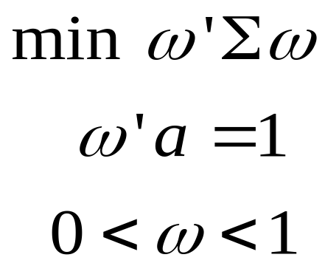



Problem Statement
Consider X to be the return data of N assets over T observations
Expected return:
Covariance of returns:
Constraint characteristic vector:
    Minimum Variance Portfolio:
    Maximum Sharpe Ratio Portfolio:

Slide 5
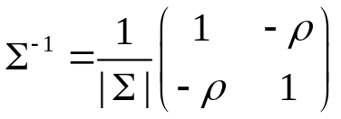
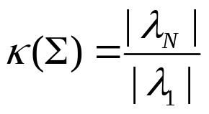
Instability Due to Noise
The non linear relationship between the inverse and determinant can lead to magnification of any errors within the covariance matrix. Such a matrix is said to be ill-conditioned.
Eigen Value Decomposition allows us to partition the covariance matrix as eigen values and eigen vectors.
The condition number is said to be the ratio between the absolute values of the maximal and minimal eigen values. Since the determinant of the covariance is simply the product of the eigen values, a high condition number would lead to ill conditioning

Slide 6
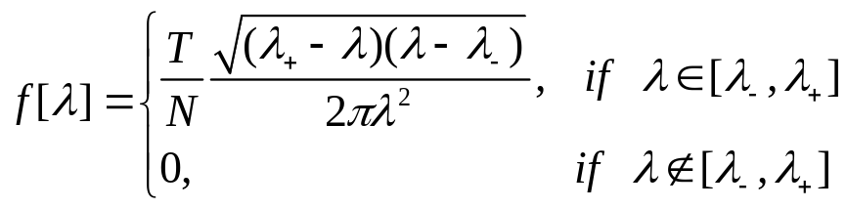
Marcenko-Pastur Theorem
The Marcenko-Pastur Theorem states that, for a collection of IID observations from a given distribution, as the ratio T/N increases, the eigen values of the associated covariance matrix moves towards the distribution below,
In other words, the eigen values associated with randomness follows the above distribution (Marcenko-Pastur distribution).
This allows us to segregate eigen values due to random noise and eigen values due to signal.
Once we can find identify the threshold eigen value, we can specifically treat those eigen values associated with noise., without losing information from the signal.

Slide 7
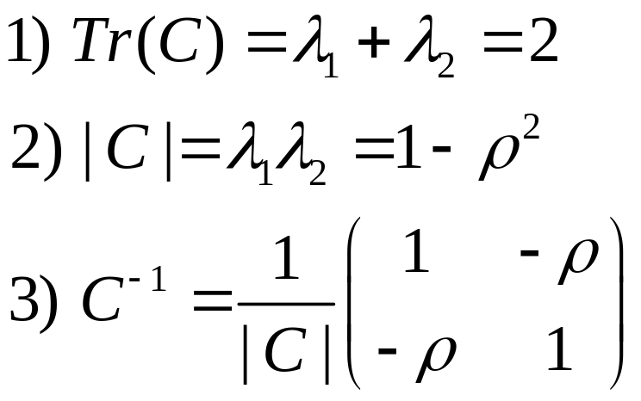
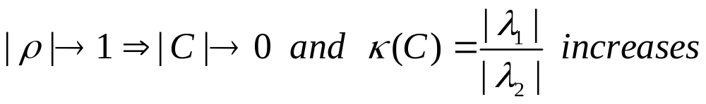
Instability Due to Signal
Consider a correlation matrix C of order 2. Then, the following results can be obtained:
Because of 1) and 2), we can further observe

Slide 8
The above relationships indicate that as the assets under consideration move from zero dependence to perfect dependence, the condition number increases and the inverse of the correlation matrix becomes ill conditioned.
In general, when we consider highly correlated assets, the associated covariance matrix tends to become ill conditioned, leading to extremely unstable allocation results.
This phenomenon is also known as the Markowitz’s curse, because of the implication that the Markowitz solution tends be reliable only when we consider assets with little to no correlation between them.
Resolving this issue is much harder than resolving noise induced instabilities, as the treatment has to be performed in the optimization process itself, rather than on the covariance matrix

Slide 9
Methods to control for
Noise related Instabilities

Slide 10
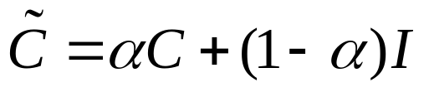
Linear Shrinkage Methods
The Linear Shrinkage Technique is a technique that reduces the condition number of the covariance matrix by shifting the covariance matrix to an associated prior form.
The Ledoit Wolfe shrinkage method is a prominently known method of this class, which shifts the covariance matrix to the identity matrix.
Depending on the value of the parameter, the shrinkage can be adjusted to obtain a matrix between the original matrix and the identity matrix.
A major drawback with this type of shrinkage is that, although it reduces the condition number of the matrix, it does not differentiate between the signal and noise, leading to shrinkage of the signal as well.

Slide 11

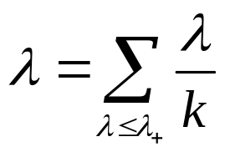
Eigen Value Clipping Method
The Eigen Value Clipping method is a technique that involves adjusting the noise related eigen values of the covariance matrix, while keeping the rest intact.
By doing this, it both reduces the condition number while also leaving the signal intact, leading to better allocation outcomes.
Once we obtain the eigen components upon decomposition, we can find the threshold eigen value by fitting the Marcenko-Pastur distribution, after which we replace the noise related eigen values by their average.
Assuming the number of noise related eigen values is
We choose the replacement as the mean to preserve the trace of the correlation matrix. As long as the Trace does not deviate, any replacement can be performed.
The new correlation matrix can be obtained upon rejoining the eigen components and standardizing the diagonal elements.

Slide 12
Targeted Shrinkage Method
As the name suggests, the Targeted shrinkage method targets the application of shrinkage to the noise related eigen values.
Once the Marcenko-Pastur distribution provides the threshold eigen value, we perform the following:
Similar to the shrinkage method, the choice of the parameter value will produce different levels of shrinkage

Slide 13
Methods to control for
Structure related Instabilities

Slide 14
Critical Line Algorithm (CLA)
The Critical Line Algorithm is unique in that it theoretically obtains accurate solutions to the inequality based mean variance optimization problem while circumventing the restrictions of the KKT conditions
The significant contribution by the CLA algorithm is that it guarantees the exact solution after a known number of iterations.
It uses the notion of free and bounded assets to obtain the entire constrained efficient frontier.
The procedure begins by obtaining the maximum return portfolio with the given constraints, and then calculates all possible values of the lambda parameter to obtain the next portfolio in the efficient frontier.
By repeating this step, we end up with the minimum variance portfolio under the inequality constraints.

Slide 15
Hierarchical Risk Parity (HRP)
The HRP technique is a technique uses a tree-based clustering algorithm to segregate assets, allowing for lower complexity in choice of asset and a useful top down approach to obtaining the optimal allocations.
The HRP method has 3 stages:
Tree Clustering: The hierarchical relationship is established using the notion of a distance metric.
Quasi Diagonalization: The covariance matrix is rearranged to a block diagonal form, where each block represents a cluster
Recursive Bisection: Maintaining the hierarchical relationship through a link structure, we bisect our collection of securities and obtain inverse variance allocations for each collection. Repeating this step on each new partition, we finally end up with the HRP allocation.

Slide 16
Nested Clustered Optimization (NCO)
Financial securities, in particular, would have a high presence of clusters within the correlation matrix due to the presence of hierarchical relationships.
Securities that are contained within a cluster tend to be exposed to a single common eigen vector with an eigen value that explains their variance.
Because of high intracluster correlations, we may obtain an extremely high eigen value that can offset the remaining ones, leading to a high condition number i.e greater the intracluster correlations, greater is the instability.
We can resolve this by optimizing the clusters intracluster, and using the reduced covariance matrix to obtain the intercluster weights. After this a simple dot product will yield our final result.
Note that the only new concept NCO brings to the table is on optimizing the covariance matrix separately based on clusters. The underlying optimization can be one of any known methods

Slide 17
Monte Carlo Optimization Selection (MCOS)
MCOS method is introduced for the sole purpose of estimating the allocation error produced by various methods given a set of input variables, and is thus especially useful to decide which method performs better for a specifc set of inputs.
The procedure can be summarized as follows:
Obtain actual input data and obtain the actual allocation weights
Simulate data based on the actual data a number of times and obtain their respective allocations
Estimate the errors between the actual allocations and the simulated results
The actual inputs can either be generated from stylized results or from real world dataset.

Slide 18
Numerical Experiments

Slide 19
Test 1: Comparison of Denoising techniques
Our goal is to perform the standard constrained optimization via the quadprog solver in Python, with and without the denoising techniques and compare their performance based on the standard deviation of their RMSE.
We further compare the Targeted shrinkage method under various cases of the shrinkage parameter (at 0.1, 0.5 and 0.9) along with the effect of Shrinkage.
We generate the actual expected return and covariance matrix (of size 10 blocks with 10 assets each), with off diagonal elements having correlation 0.5.
We perform the MCOS method, under 10,000 simulations, with the various denoising techniques applied on the base quadprog function in Python.
The test is performed to obtain both Minimum Variance and Maximum Sharpe Ratio Allocations

Slide 20
Test 1: Comparison of Denoising techniques
Table1: Minimum Variance Portfolio
 | No Denoising | EC | TS(0.1) | TS(0.5) | TS(0.9)
No Shrinkage | 1.581 | 1.393 | 1.569 | 1.665 | 1.980
Shrinkage | 1.615 | 1.423 | 1.574 | 1.549 | 1.765
Table 2: Maximum Sharpe Ratio Portfolio
 | No Denoising | EC | TS(0.1) | TS(0.5) | TS(0.9)
No Shrinkage | 1.95 | 1.679 | 1.930 | 2.043 | 2.428
Shrinkage | 1.962 | 1.706 | 1.939 | 2.045 | 2.427

Slide 21
Test 2: Comparison of Optimization Techniques on Simulated Data
We generate the actual expected return and covariance matrix (of size 10 blocks with 10 assets each), with off diagonal elements having correlation 0.5.
Based on the previous result, we perform Eigen clipping as a denoising technique.
We apply each of the optimization methods discussed alongwith the inbuilt numerical solver, using the MCOS method, over 1000 runs.
Comparison is based on the respective RMSE of weights and variation of expected returns

Slide 22
Test 2: Comparison of Optimization Techniques on Simulated Data
Xe-03 | MVO | CLA | HRP | NCO
RMSE | 1.407 | 1.553 | 1.361 | 0.794
Return | 1.11 | 2.49 | 3.46 | 0.59
NCO method shows least variation of results with respect to the CLA allocations,
both in terms of RMSE of the allocations and the difference between returns.
HRP algorithm shows favorable results for RMSE while has relatively poor scores with respect to the difference in returns
The CLA method shows higher variation as compared to the inbuilt quadratic programming solver, indicating the presence of input errors

Slide 23
Test 3: Comparison of Optimization Techniques on Actual Data
We have obtained the mean and covariance inputs from the monthly return data, from 2000-2020, of 50 assets listed in the SP100 index in varying sectors.
The inputs are obtained for each month between 2005-2020 from the return data to the prior 5 years.
We obtain the monthly allocations between this period and compare the performance of these portfolios in the overall duration
We compare the portfolios based on Return, Standard Deviation as volatility, Portfolio Sharpe Ratio and a measure of Portfolio Turnover.

Slide 24
Test 3: Comparison of Optimization Techniques on Actual Data
 | MVO | CLA | HRP | NCO
Return | 0.9936e-02 | 1.0189e-02 | 1.2195e-02 | 1.1210e-02
Stand. Dev. | 2.685e-03 | 2.717e-03 | 4.460e-03 | 5.228e-03
Sharpe Ratio | 3.7 | 3.75 | 2.73 | 2.14
Turnover Ratio | 0.152 | 0.17 | 0.52 | 1.18
The HRP algorithm shows promise in terms of return, followed by NCO
Yet when comparing volatilities, we see that the base method and numerical solver perform better
Because of this, a similar behaviour is witnessed when comparing Sharpe Ratio
When comparing the Turnover ratios, we see that there is higher turnover for the NCO and HRP portfolio allocations.

Slide 25
Conclusion

Slide 26
We can observe that although the methods worked well on simulated data which represents a stylized version of the S&P100, they do not perform as well when presented in the actual dataset
Part of the reason for this could be attributed to the power of the clustering algorithm. Generally, it is useful to remove the market related principal component in order to have the clustering function to perform well.
In short, further preprocessing of the data is required, without which, these methods may not perform as expected.

Slide 27
The End

