Slide 1

Deepfake Detector (Khushi)
FastAPI Backend • React Frontend • Xception ML Model
Instructor:
Team:
Zeshang Chen
John Ademola, Vipul Bodhani, Khushi Patel, Jyotsana

Slide 2
What We Built (Khushi)
Deepfake Detection System
Frontend
Backend
Developed with React 18 + TypeScript + Vite + Tailwind CSS for a responsive UI. GitHub
FastAPI API (backend folder) with JWT authentication for secure operations. GitHub
An end-to-end solution for identifying AI-generated content. GitHub
ML Layer
Core Functionality
Xception model for classification, integrated with OpenCV/MediaPipe for face detection. GitHub
Supports video upload, returns prediction + confidence score, and stores results for history.

Slide 3
User Experience & Interface (Khushi)
1
2
Authentication
Upload & Analysis Screen
Seamless sign-up and login using robust JWT-based authentication for secure user access.
Intuitive file selection or drag-and-drop. Displays loading / progress indicators during backend analysis.
3
4
Results View
Detection History
Clear display of Real / Fake classification, including a confidence score, filename, and analysis timestamp.
Users can easily access and review past uploads and their corresponding results through a comprehensive history table.

Slide 4

System Architecture Overview (. Jojo)
User Browser (React UI)
FastAPI Backend (REST API)
ML Model Service + File Storage
PostgreSQL DB (users, detections)
Frontend Details:
Database Details:
React + TypeScript + Vite + Tailwind UI for a modern and efficient user interface.
PostgreSQL with SQLModel/SQLAlchemy for robust data modeling and queries, managed with Alembic migrations. GitHub
Backend Details:
FastAPI framework, structured with routers for authentication, detection, and history management.

Slide 5
Model Testing Results and Explainability (John)
Fine-tuning Experiment Summary
Initial Fine-tuning (SampleData)
Extended Fine-tuning (CompleteData)
Dataset: 400 sample videos from DFDC
Dataset: Additional 600 videos (200 each from 3 chunks)
Unique identities: ~50 unique faces
Unique identities: 3 unique faces (one per chunk)
Results:
Fine-tuning strategy: Low learning rate (lr_head=1e-5, lr_full=5e-6) to mitigate catastrophic forgetting
Accuracy: 94.13%
Results:
F1 Score: 86.87%
AUC: 98.99%
Accuracy: 93.01%
AP (Fake): 96.68%
F1 Score: 84.63%
wP = 0.8763
AUC: 98.14%
False Positive Rate: ~3.4% (31 FPs out of ~919 real samples)
AP (Fake): 94.67% | wP = 0.8763
False Positive Rate: 0.83% (31 FPs out of 3,734 real samples)

Slide 6
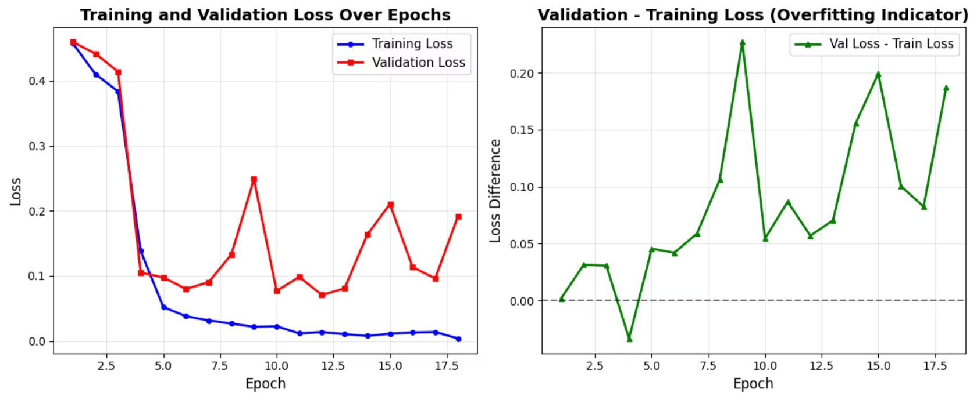
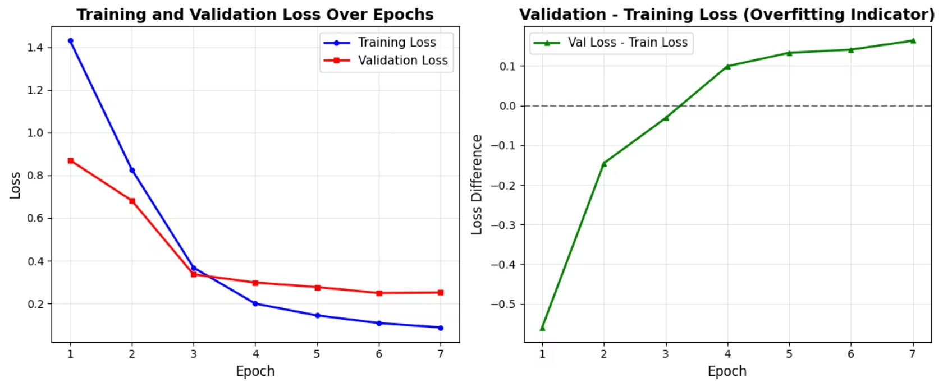
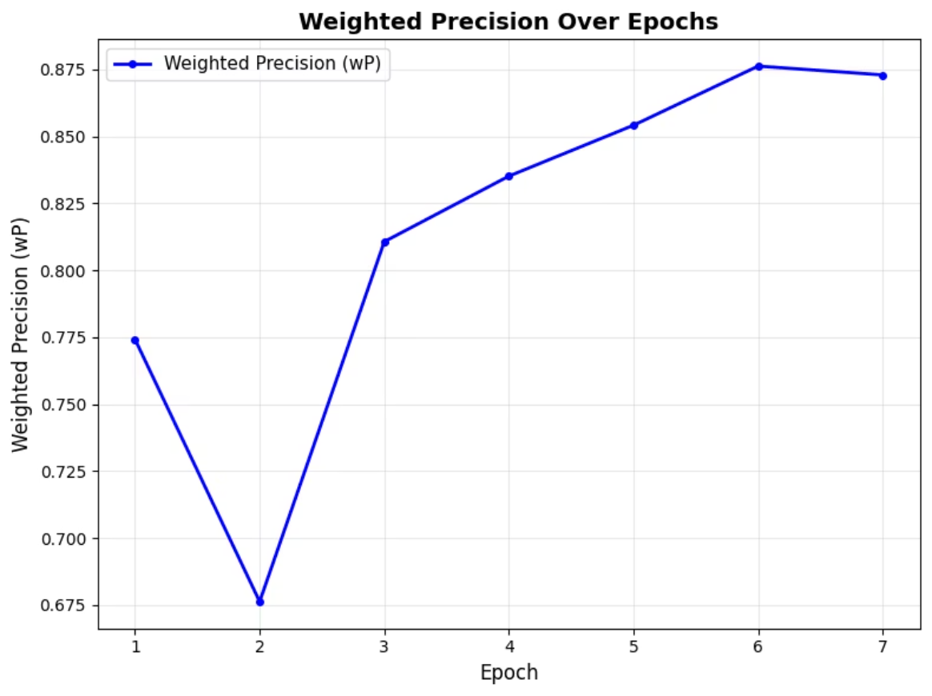
Model Testing Results - Training Metrics (John)

Slide 7
Team Experience — What Went Well & What Didn't (. Jojo)
✅ What Went Well
⚠️ What Didn't Go Well
Equal contribution across all parts — Everyone worked on frontend, backend, and fine-tuning, creating shared ownership and learning.
High pressure during mid-term and final presentations — Preparation felt rushed and stressful.
Insufficient early testing — Some issues surfaced late because we didn't plan enough time for systematic testing.
Consistent communication — Weekly meetings and active WhatsApp coordination kept the project aligned.
Strong project structure — Using the GitHub project board helped us plan, assign tasks, and track progress effectively.
Could integrate earlier — Testing earlier combined components might have reduced last-minute fixes.
Collaborative problem-solving — Team members supported each other quickly when issues came up.

Slide 8
Future Work (. Jojo)
1
2
Train Across All 50 Data Chunks
Publish a Research Paper
Expand fine-tuning to the entire dataset to improve accuracy, generalization, and model robustness.
Document our methodology, experiments, and results to contribute to academic and industry knowledge.
3
4
Deploy the Application to Production
Select an Affordable Hosting Platform
Turn the system into a real, usable tool where users can upload videos and get deepfake detection results.
Evaluate low-cost GPU/CPU cloud services to host the model efficiently (e.g., Paperspace, RunPod, GCP, Azure, AWS).

Slide 9
Sponsors Appreciation (Vipul)
Prof Adolfo CoronadoDr Rohan Ayush (inspired us with his UI/UX designs)

