Slide 1




Informational and Relational Analysis of Biological Data
Università degli Studi di Verona
Informational Analysis
of Biological Data
GTT
ACGT
TCATTCA
Ph.D. Vincenzo Bonnici
University of Verona, Italy
vincenzo.bonnici@univr.it
www.di.univr.it/~bonnici

Slide 2
Informational and Relational Analysis of Biological Data
Informational Analysis of Genomic Sequences
Computational biology and bioinformatics are multidisciplinary fields which involve plenty of sciences, such as biology, biotechnology, mathematics, computer science, physics and chemistry.
In the last decades, bioinformatics approaches, regarding sequence analysis, mainly focused on methodologies based on string alignment algorithms.
  e.g. BLAST Altschul,S.F. et al. (1990) Basic local alignment search tool. J. Mol. Biol., 215, 403–410
An alternative perspective is based on alignment-free methodologies for genome analysis, where global and local properties of genomes are investigated.
  Susana Vinga and Jonas Almeida. Alignment-free sequence comparison - a review. Bioinformatics, 19(4):513–523, 2003.
In this context, we focus the attention on those methodology regarding informational analysis, which also include information theory, probability, statistics, formal languages and linguistic theory.
Information theory was developed by Shannon to study message transmission over communication systems, and it has later been applied to many other fields of research.
  Claude Elwood Shannon. A Mathematical Theory of Communication. The Bell System Technical Journal, 27:379–423,623–656, 1948.
Links between informational analysis and biology are well established, continuously reemerging, and deeply rooted.
  Shannon’s Ph.D. thesis, titled ‘An Algebra for Theoretical Genetics’ (1940), precedes his famous booklet where he notion of information entropy was introduced.
  LL Gatlin. The information content of DNA. Journal of theoretical biology, 10(2):281–300, 1966.
  Lila L Gatlin et al. Information theory and the living system. 1972.
  Edward N Trifonov and Joel L Sussman. The pitch of chromatin DNA is reflected in its nucleotide sequence. Proceedings of the National Academy of Sciences, 77(7):3816–3820, 1980.
  Peak 3-periodicity
    Manfred Eigen and Ruthild Winkler-Oswatitsch. Transfer-RNA, an early gene? Naturwissenschaften, 68(6):282–292, 1981.
    John CW Shepherd. Periodic correlations in DNA sequences and evidence suggesting their evolutionary origin in a comma-less genetic code. Journal of Molecular Evolution, 17(2):94–102, 1981.
    James W Fickett. Recognition of protein coding regions in DNA sequences. Nucleic acids research, 10(17):5303–5318, 1982.

Slide 3
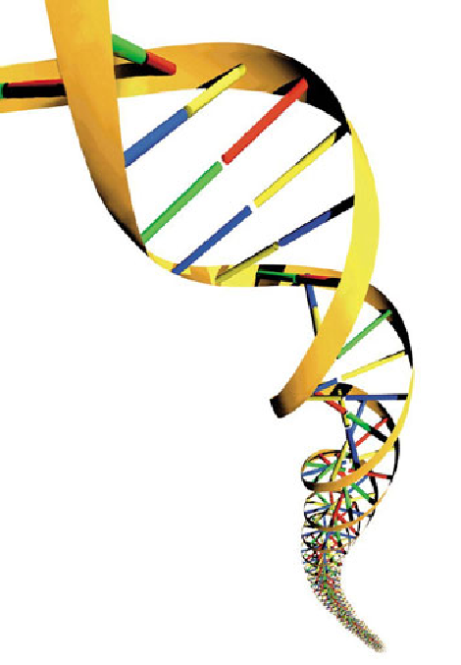
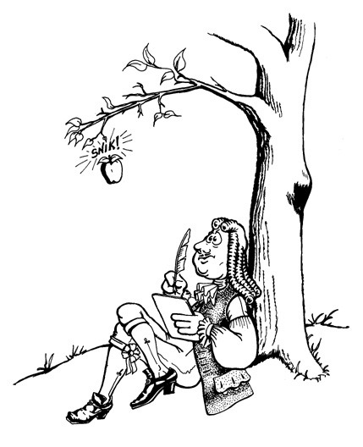
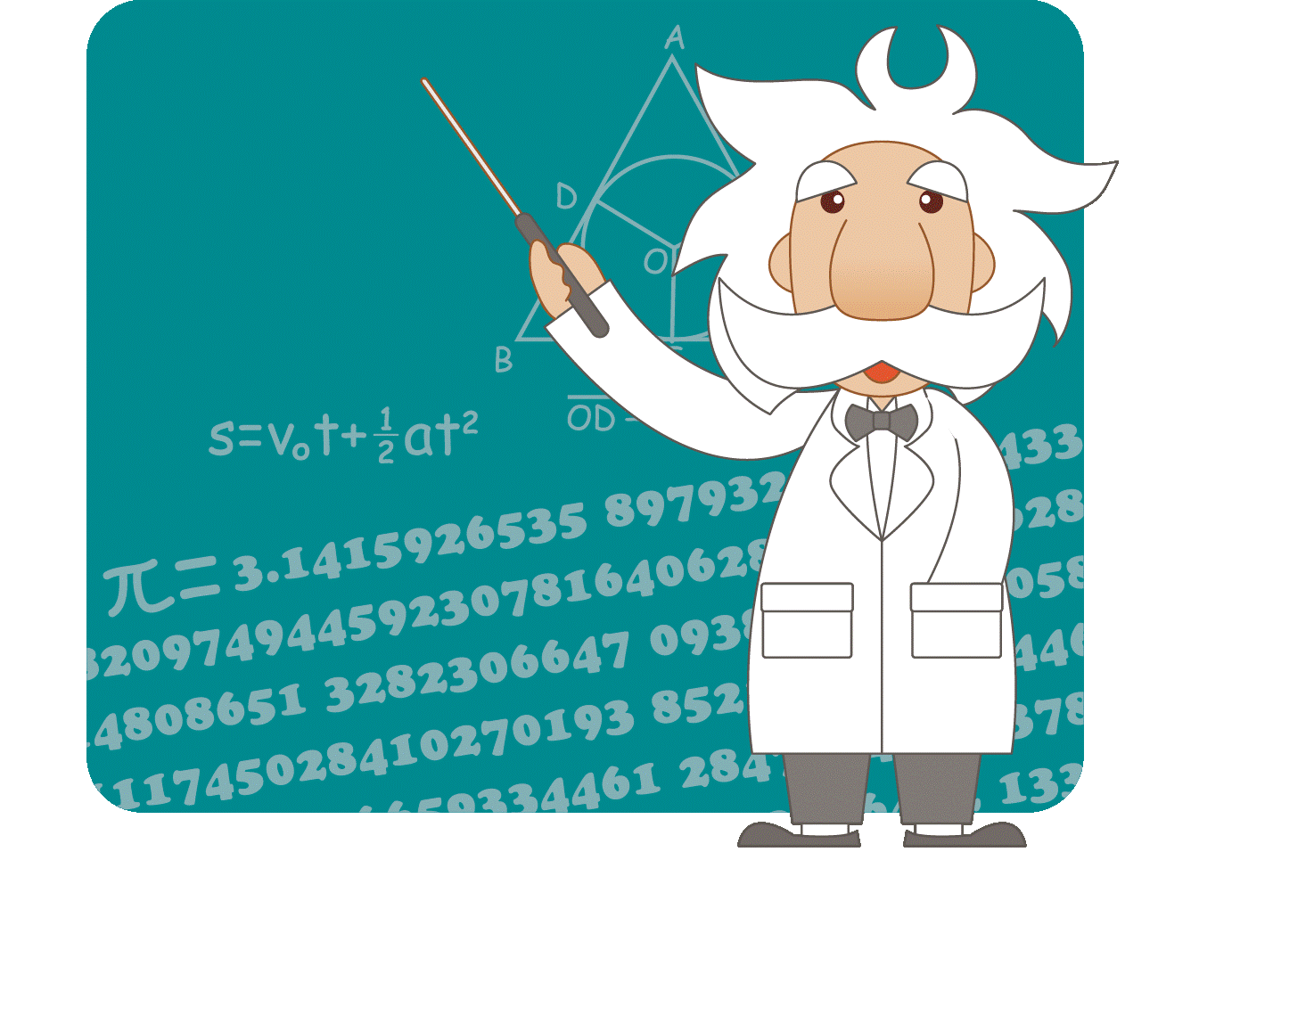

Informational and Relational Analysis of Biological Data
Informational Analysis of Genomic Sequences
InfoGenomics
The InfoGenomics project aims at proving a systematic approach from an informational point of view by making use of informational analysis and well-characterized genomic features: indices, distributions, representations (and visualizations).
The ENCODE project created an encyclopedia of DNA elements by annotating the human genome in terms of bio-chemical function. It provided evidence that 80% of the human genome, first considered junk regions, is covered by functional elements.
This scenario has an informational basis linked to DNA
fragments related to such functional elements.
An integration between biochemical and
informational analysis could provide
new possibilities for interpreting data and to discover
principles of genome organization and functions.
Manca, V.: Infobiotics: information in biotic systems. Springer (2013)
Bonnici, V., Manca, V.: Recurrence Distance Distributions in Computational Genomics. AJBCB (2015)
Bonnici, V., Manca, V.: Infogenomics Tools: A Computational Suite for Informational Analyses of Genomes. JBPR (2015).
Castellini, A., Franco, G., Manca, V.: A dictionary based informational genome analysis. BMC Genomics, 13, 485 (2012)
The Encode Project Consortium: An integrated encyclopedia of DNA elements in the human genome. Nature 489, 57–72 (2012)
Maths in action
e = m c²
?
f = m a

Slide 4
Informational and Relational Analysis of Biological Data
GGAGTGAGACGTTACTCATTCATGGGAGAGTT
InfoGenomics
Notation and Definitions
  DNA alphabet Γ = {A,C,G,T}
  Extended alphabet Γ = {A,C,G,T,N}
  Γ^{k} the set of words of length k over Γ
  k-mer a word in Γ^{k}
  Given a string G = a₁a₂ … a_{n}
  G[i,j], for 1 ≤ i ≤ j ≤n, the substring of G from position i to j
  G[1,j], for 1 ≤ j ≤n, a prefix of G
  G[i,n], for 1 ≤ i ≤n, a suffix of G
  Given a string α, pos(α,G) the set of positions where α occurs in G
  mult(α,G) = |pos(α,G)|, the multiplicity of α in G
  Hapax a word α with mult(α,G) = 1
  Repeat a word α with mult(α,G) > 1
  A dictionary D is a set of words
  Given k > 0, D_{k}(G) the words in Γ^{k} that occur in G
  D_{k} is complete if it contains all the word in Γ^{k}
  T_{k}(G) the multiset of D_{k}(G) (i.e. words and their multiplicities)

Slide 5
Informational Analysis of Genomic Sequences
GGAGTGAGACGTTACTCATTCATGGGAGAGTT
Genomic sequences visualization
A C G T
Color Schema
Sequence
A T G C G C G T A T G C A T G C C C A C
2D Image

Slide 6
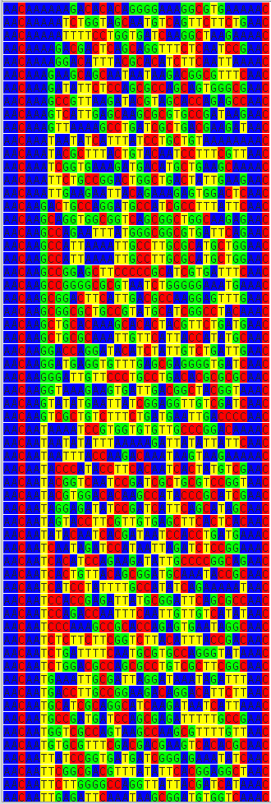
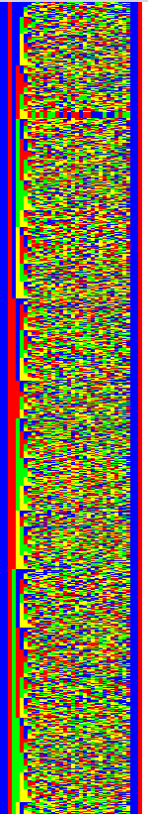
Informational Analysis of Genomic Sequences
GGAGTGAGACGTTACTCATTCATGGGAGAGTT
Genomic sequences visualization
Graphical
Compact
Representation
Colored Text
2D Image
From left to right
One sequence per row
Lexicographically ordered
From top to bottom

Slide 7
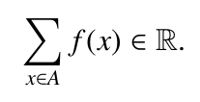
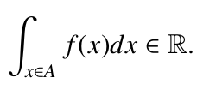
Informational Analysis of Genomic Sequences
Genomic Distributions
GGAGTGAGACGTTACTCATTCATGGGAGAGTT
Genomic Distributions
Definition
The discrete distribution, over a domain A, is a function which assigns to each element of A an element in Â, having the property of finite summability over A.
It is a continuous distribution over A if it is finitely integrable over A.
When the sum or the integral over A is equal to 1, then the distribution (discrete or continuous) is a
probability distribution.

Slide 8
Informational Analysis of Genomic Sequences
Genomic Distributions
GGAGTGAGACGTTACTCATTCATGGGAGAGTT
Genomic Distributions
Definition - Example
There are 10 pencils of different colors
Pencil | Color
1 | blue
2 | red
3 | green
4 | blue
5 | blue
6 | red
7 | blue
8 | red
9 | green
10 | blue

Slide 9
Informational Analysis of Genomic Sequences
Genomic Distributions
GGAGTGAGACGTTACTCATTCATGGGAGAGTT
Genomic Distributions
Definition - Example
There are 10 pencils of different colors
Pencil | Color
1 | blue
2 | red
3 | green
4 | blue
5 | blue
6 | red
7 | blue
8 | red
9 | green
10 | blue
Domain A = set of colors = {blue, red, green}
Distributions
(Assign to each color a related information)
Color | Pencils having that color | Number of pencils having that color (Multiplicity) | Frequency (Probability)
blue | {1, 4, 5, 7, 10} | 5 | 5 / 10
red | {2, 6, 8} | 3 | 3 / 10
green | {3, 9} | 2 | 2 / 10

Slide 10
Informational Analysis of Genomic Sequences
Genomic Distributions
GGAGTGAGACGTTACTCATTCATGGGAGAGTT
Genomic Distributions
Taxonomy
Given a genomic sequence G, we can define the following genomic distributions:
Word position
  This distribution assigns to any word α of D the set of positions of G where it (its first character) occurs, that constitute what is also called the spectrum of α in G. When the spectrum is given for every word of a dictionary that is complete for G, then the whole genome G can be easily reconstructed.
n-Word Count
  This distribution assigns to any value of n < |G| the cardinality of D_{n}(G).
n-Repeat Count
  This distribution assigns to any value of n, from 0 to some maximum value, the cardinality of the set of the repeats of G having length n.
Rank Frequency
  If we order the words, of a complete dictionary for G, according to their frequencies in G (in decreasing order) we say that the most frequent words have rank 1, the most frequent words, after words of rank 1, have rank 2, and so on. Therefore, this distribution assigns to each rank the vale corresponding its frequency. This distribution, also called Zipf distribution, after the scholar who introduced it, was extensively studied in natural languages.

Slide 11
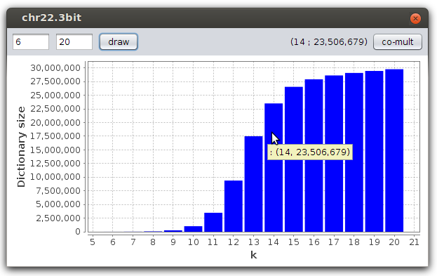
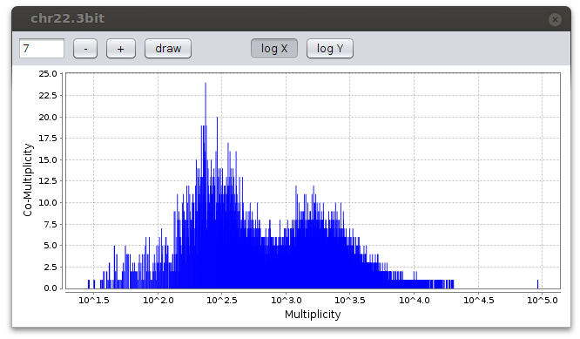
Informational Analysis of Genomic Sequences
Genomic Distributions
GGAGTGAGACGTTACTCATTCATGGGAGAGTT
Genomic Distributions
Examples
n-Word Count Distribution
Chromosome 22 of Homo sapiens
Word Co-multiplicity Distribution

Slide 12
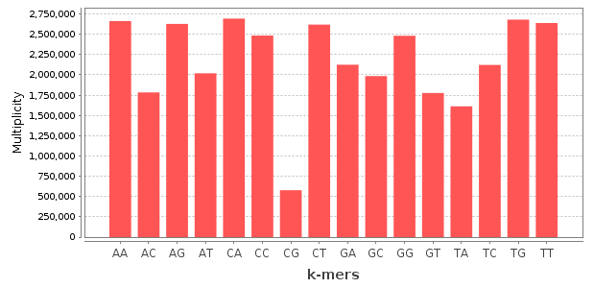
Informational Analysis of Genomic Sequences
Genomic Distributions
GGAGTGAGACGTTACTCATTCATGGGAGAGTT
Genomic Distributions
Examples (cont.)
Word Multiplicity Distribution
Chromosome 22
of Homo sapiens

Slide 13
Informational Analysis of Genomic Sequences
Genomic Distributions
GGAGTGAGACGTTACTCATTCATGGGAGAGTT
Genomic Distributions
Word Multiplicity Distribution and HeatMaps
Word Multiplicity Distribution
Chromosome 22
of Homo sapiens
heatmap
legend

Slide 14
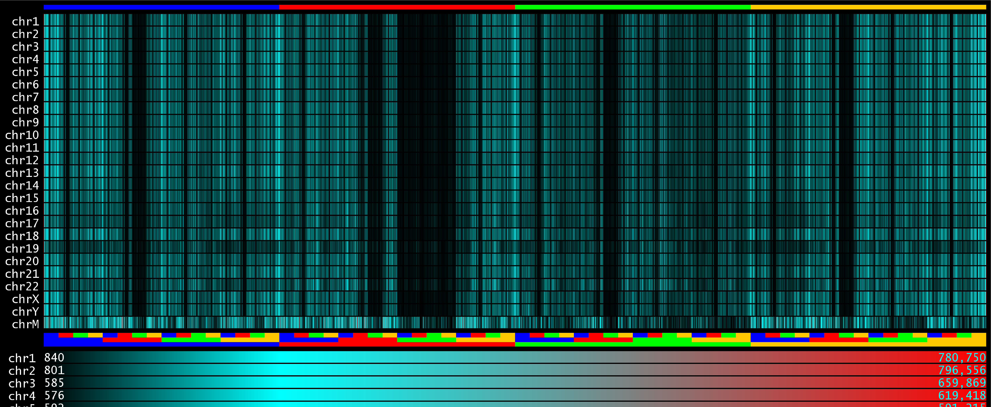
Informational Analysis of Genomic Sequences
Genomic Distributions
GGAGTGAGACGTTACTCATTCATGGGAGAGTT
Genomic Distributions
Word Multiplicity Distribution and HeatMaps
The language similarity among human chromosomes
by their 6-mer multiplicity distributions.

Slide 15
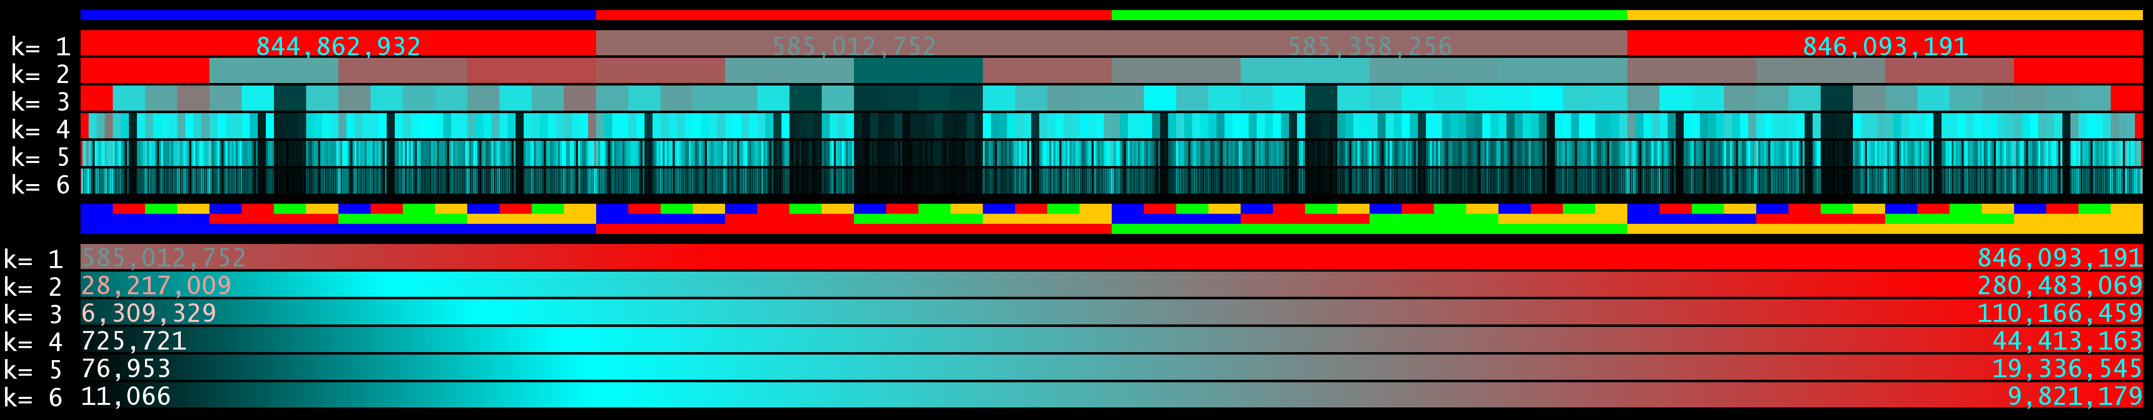
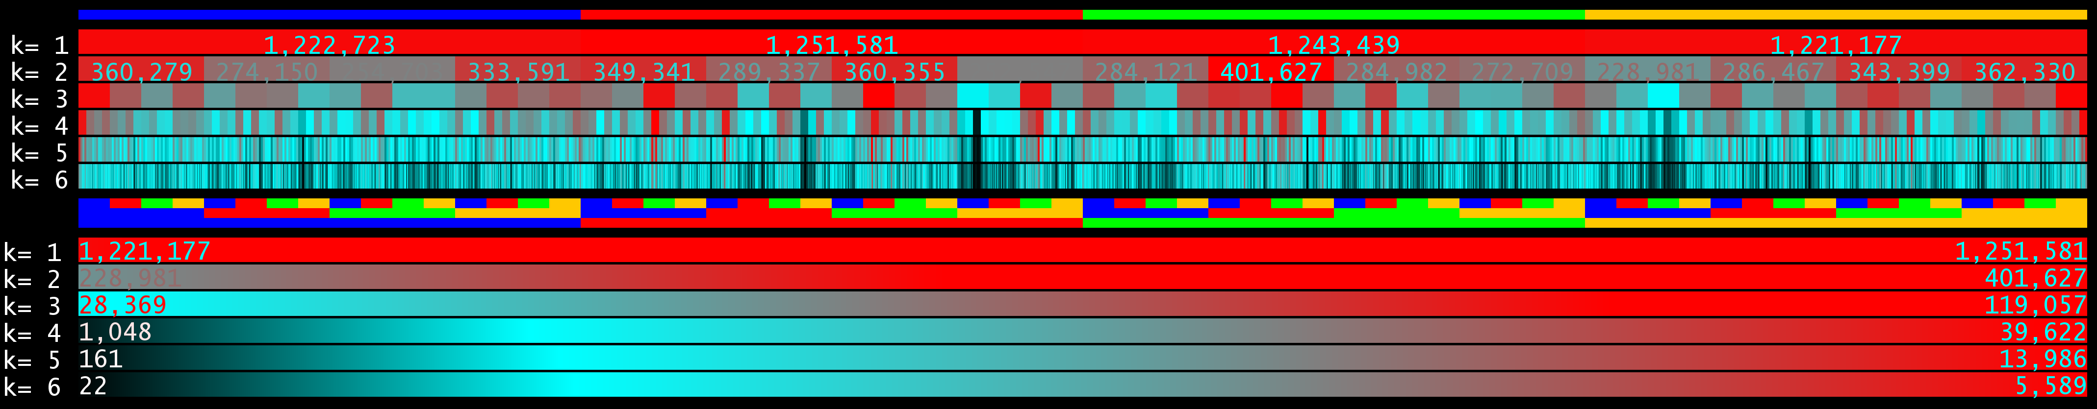
Informational Analysis of Genomic Sequences
Genomic Distributions
GGAGTGAGACGTTACTCATTCATGGGAGAGTT
Genomic Distributions
Word Multiplicity Distribution and HeatMaps
Visualization of species diversity.
Homo sapiens
Escherichia coli

Slide 16
Informational Analysis of Genomic Sequences
Genomic Distributions
GGAGTGAGACGTTACTCATTCATGGGAGAGTT
Genomic Distributions
Recurrence and Recurrence Distance
  Let α ∈ D_{k'}(G), β ∈ D_{k''}(G)
  Global co-occurrence (p₁,p₂)
    p₁ ∈ pos(α,G) AND p₂ ∈ pos(β,G) or vice versa
    p₁ < p₂
  Minimal co-occurrence (p₁,p₂)
    ∄ p' : p₁ < p' < p₂ AND p' ∈{ pos(α,G) ∪ pos(β,G)}
  It is a recurrence if α = β
  The recurrence distance is given by p₂- p₁
p₁
p₂
p₃
G
α
β
β
p₁
p₂
p₃
G
α
β
β
G
α
β
α
α
β

Slide 17
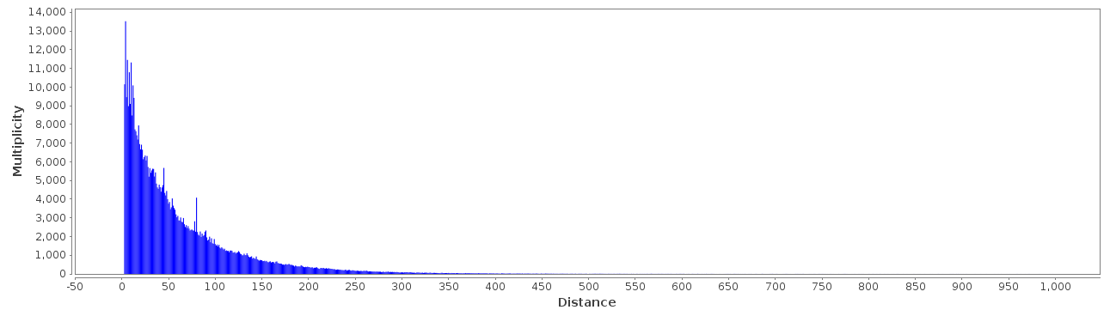

Informational Analysis of Genomic Sequences
Genomic Distributions
GGAGTGAGACGTTACTCATTCATGGGAGAGTT
Genomic Distributions
Recurrence Distance Distribution
Given a word α, this distribution assigns to any distance n, going from 1 to some maximum value, the number of times it occurs at distance n from its previous occurrence.
Given a set of words D, the average recurrence distance assigns to any distance n the value
where |R(G, α, n)| is the number of times α occurs in G at distance n (|D| is the cardinality of D).
Recurrence Distance Distribution of ATG in chromosome 22 of Homo sapiens

Slide 18

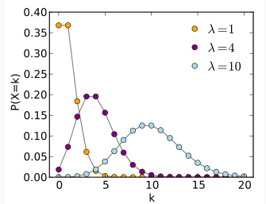
Informational Analysis of Genomic Sequences
Genomic Distributions
GGAGTGAGACGTTACTCATTCATGGGAGAGTT
Genomic Distributions
Word Probability and Waiting Time
The probability, with which words appear in a sequence, follow a specific distribution.
In our case, it is described by the Word Frequency Distribution,
namely the Word Multiplicity Distribution normalized by the total count of word occurrences and ordered by the multiplicity value
For us: number of occurrences = multiplicity = frequency = probability
But in general it can follow such us
    Uniform distribution: all the words have the same multiplicity (frequency, probability of appearance)
    Gaussian distribution: word frequencies can be described by a Gaussian distribution
    Poisson distribution: word frequencies can be described by a Poisson distribution,
    where the probability that a word has a multiplicity equal to k, Pr(X = k), is given by
    where e is the Euler's number
    and λ is the variance (the mean value of the distribution)

Slide 19

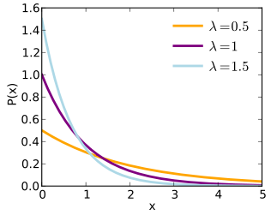
Informational Analysis of Genomic Sequences
Genomic Distributions
GGAGTGAGACGTTACTCATTCATGGGAGAGTT
Genomic Distributions
Word Probability and Waiting Time
The Word Frequency Distribution describes how many times a word occurs.
It does not describe where such occurrences are, neither the distances between them.
The Waiting Time of a Frequency Distribution describes the amount of time we need to attend between two occurrences of an event.
In our case, events are words and the amount of time is given by the number of symbols (characters)
The Waiting Time of a Poisson Distribution is the Exponential Distribution
In our case
  x is the distance between two occurrences
  P(x) is the number of times two occurrences appear at distance x
  It is exactly the Recurrence Distance Distribution !!!

Slide 20


Informational Analysis of Genomic Sequences
Genomic Distributions
GGAGTGAGACGTTACTCATTCATGGGAGAGTT
Genomic Distributions
Recurrence Distance Distribution (RDD)
It is known that some real genomic sequences follow a quasi Poisson Distribution
Then, their Recurrence Distance Distribution must follow a quasi Exponential Distribution
Recurrence Distance Distribution of ATG in chromosome 22 of Homo sapiens
Estimated Exponential Distribution

Slide 21
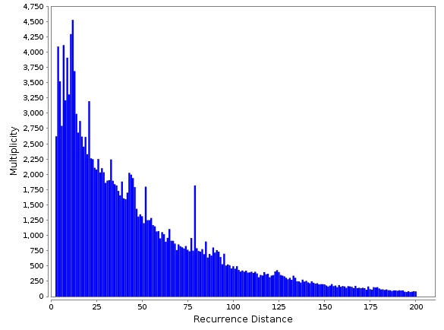
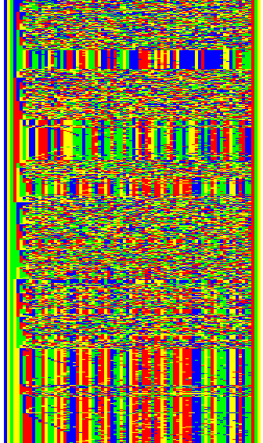
Informational Analysis of Genomic Sequences
Genomic Distributions
GGAGTGAGACGTTACTCATTCATGGGAGAGTT
Genomic Distributions
Peaks in Recurrence Distance Distribution
Peaks in Recurrence Distance Distributions identify repetitive elements
Their quantification can be obtained by subtracting the theoretical distribution.
Recurrence Distance Distribution of ATC
in chromosome 22 of Homo sapiens
Sequences enclosed between the occurrences of ATC ad distance 81

Slide 22
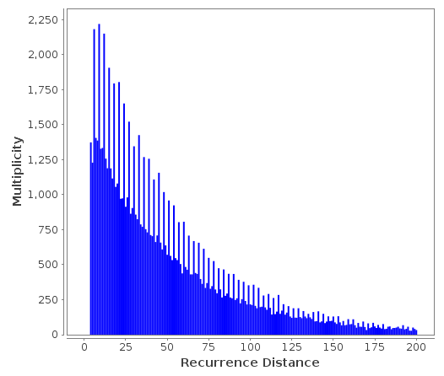
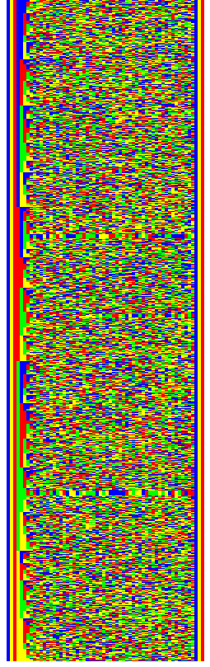
Informational Analysis of Genomic Sequences
Genomic Distributions
GGAGTGAGACGTTACTCATTCATGGGAGAGTT
Genomic Distributions
Peaks in Recurrence Distance Distribution
The Escherichia coli case
Peaks are at distances multiples of 3 and they do not represent repetitive elements.
Recurrence Distance Distribution
of ATC in Escherichia coli
Sequences enclosed between the occurrences of ATC ad distance 81

Slide 23
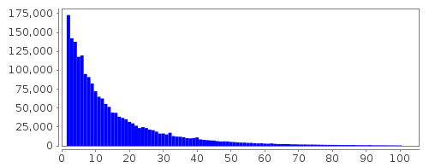

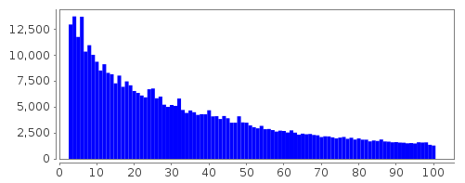
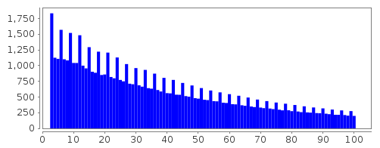
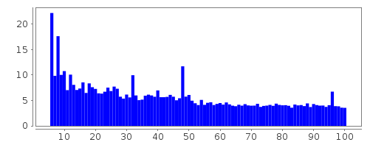
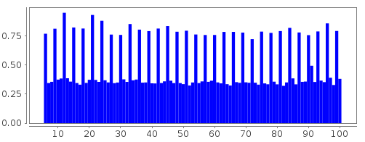
Informational and Relational Analysis of Biological Data
Genomic Distributions
GGAGTGAGACGTTACTCATTCATGGGAGAGTT
Genomic Distributions
RDD: Averages and peak 3-periodicity
Average RDD in whole sequences
Homo sapiens
k = 2
Escherichia coli
k = 2
k = 3
k = 3
k = 6
k = 6

Slide 24
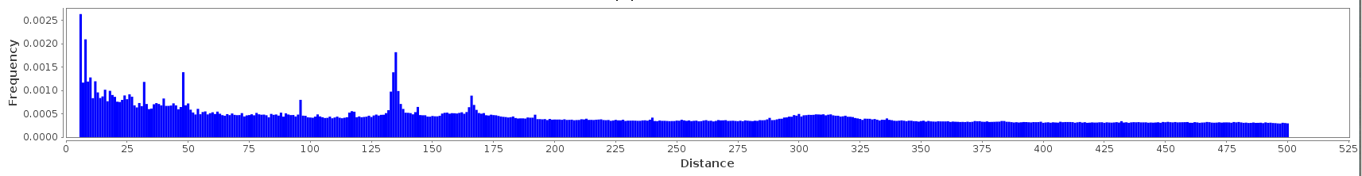
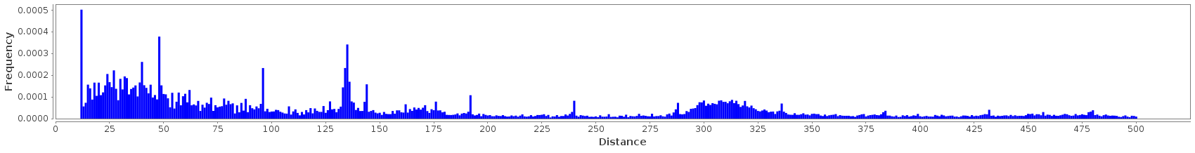
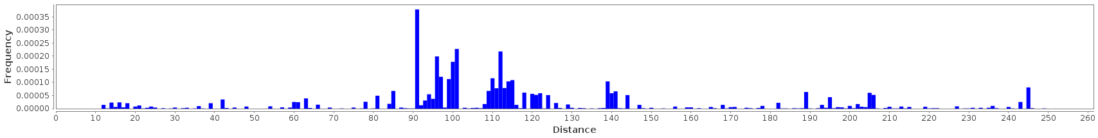
Informational and Relational Analysis of Biological Data
Genomic Distributions
GGAGTGAGACGTTACTCATTCATGGGAGAGTT
Genomic Distributions
ARDD and recurrence distance preference
Homo sapiens, chromosome 22
k = 6
k =12
Escherichia coli
k =12

Slide 25
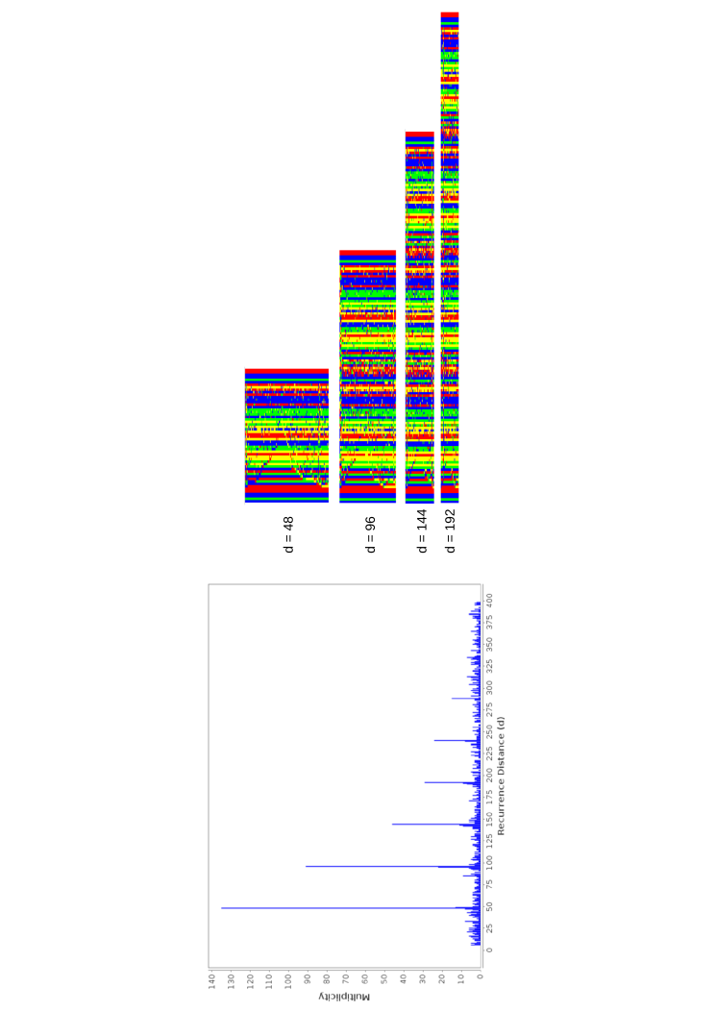
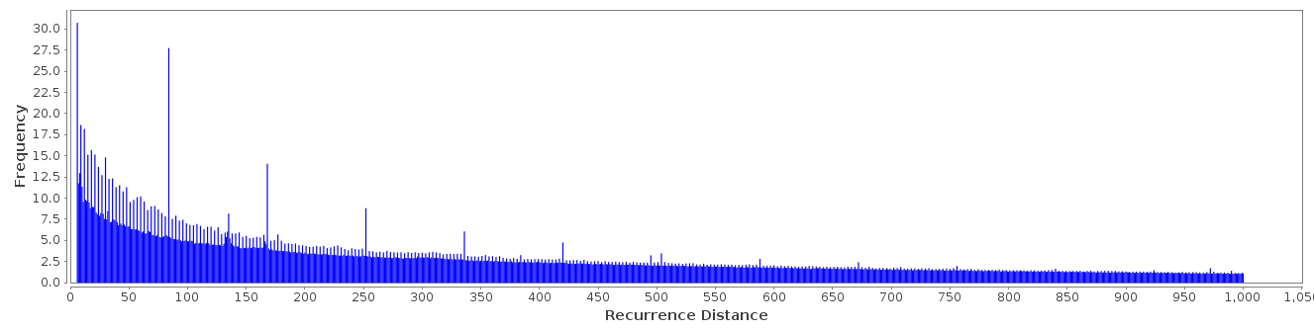
Informational and Relational Analysis of Biological Data
Genomic Distributions
GGAGTGAGACGTTACTCATTCATGGGAGAGTT
Genomic Distributions
Extra peak periodicity in RDD and ARDD
Homo sapiens, chromosome 22,
protein-coding regions of transcripts
k = 6
Peaks at distances multiple of 84
We extracted the enclosed strings of recurrences at distance 84 (of AAAAAC) and searched them in public databases of protein domains.
We found that such strings correspond to the C2H2 zinc finger domain, which often forms tandem sequences.
AGAACC
α
β
α
β
α
β
α
β
α

Slide 26
Informational Analysis of Genomic Sequences
GGAGTGAGACGTTACTCATTCATGGGAGAGTT
Informational Analysis of Genomic Sequences
IGTools (InfoGenomics Tools)
An open-source suite for the informational analysis of genomic sequences.
Goals
  Efficiency: made on top of well-established data structures and algorithms, adapted for real genomic sequences.
  Interactive graphical interfaces and CLI (for batch analyses)
  Also for developers: modular Java API ready to be used and extended
It aims at providing the first framework for informational analysis of genomic sequences.
CLI
Command Line Interface
GUI
Graphical User Interface
Java API
Informational Analysis
Dictionaries
Searching, Enumeration, ..., Set-theoretic Operations
Algorithms and Data structures
NELSA (Extended Suffix Arrays + N)
3bit encoding (ACGTN)
(for nucleotides)
Bonnici, V., Manca, V.: InfoGenomics Tools: a computational suite for informational analysis of genomes. Submitted to Journal of Bioinformatics and Proteomics (2015)

Slide 27
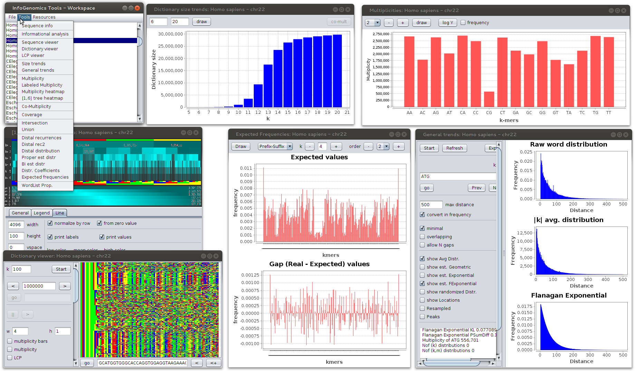
Informational Analysis of Genomic Sequences
IGTools
GGAGTGAGACGTTACTCATTCATGGGAGAGTT
Informational Analysis of Genomic Sequences
IGTools (InfoGenomics Tools)
An open-source suite for the informational analysis of genomic sequences.

Slide 28
Informational Analysis of Genomic Sequences
IGTools
GGAGTGAGACGTTACTCATTCATGGGAGAGTT
IGTools
Sequences
FASTA and Binary Encoding
FASTA format (textual)
  A T G C G
2-bit encoding
  A → 00
  C → 01
  G → 10
  T → 11
00 11 01 10 01
A T G C G
3-bit encoding
  A → 000
  C → 001
  G → 010
  T → 011
  N → 100
000 011 001 010 001 100
A T G C G N

Slide 29
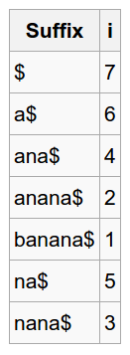
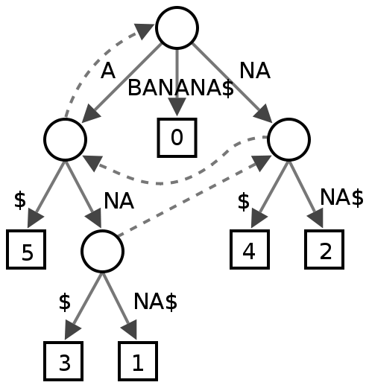
Informational Analysis of Genomic Sequences
IGTools
GGAGTGAGACGTTACTCATTCATGGGAGAGTT
IGTools
Text self-indexing
for genomic sequences
Indexes (data structures) to efficiently solve operations (i.e. pattern search).
Suffix Trees
is a compressed trie containing all
the suffixes of the given text as their keys and positions in the text as their values. Suffix trees allow particularly fast implementations of many important string operations.
Suffix Arrays
is a sorted array of all suffixes of a string. Suffix arrays were introduced by Manber & Myers (1990) as a simple, space efficient alternative to suffix trees.

Slide 30
Informational Analysis of Genomic Sequences
IGTools
GGAGTGAGACGTTACTCATTCATGGGAGAGTT
IGTools
Text self-indexing
for genomic sequences
Suffix Arrays + LCP
Longest Common Prefix.
It allows for efficient enumeration of k-mers.
i | suffix | SA[i] | LCP[i]
1 | $ | 7 | 0
2 | a$ | 6 | 0
3 | ana$ | 4 | 1
4 | anana$ | 2 | 3
5 | banana$ | 1 | 0
6 | na$ | 5 | 0
7 | nana$ | 3 | 2
They do not represents the sequence it self.
They are an index to the suffixes of the sequences, plus other regarding data.
SA + LCP + sequence
Dictionaries

Slide 31
Informational Analysis of Genomic Sequences
IGTools
GGAGTGAGACGTTACTCATTCATGGGAGAGTT
IGTools
SA + LCP + Sequence = Dictionary
S = ATGCGCCGTAT
suffix | SA[i] | LCP[i]
ATGCGCCGTAT$ | 1 | 0
AT$ | 9 | 2
CCGTAT$ | 5 | 0
CGCCGTAT$ | 3 | 1
CGTAT$ | 6 | 2
GCCGTAT$ | 4 | 0
GTAT$ | 7 | 1
TAT$ | 8 | 0
TGCGCCGTAT$ | 2 | 1
T$ | 10 | 1
A
C
G
T
T
A
G
$
T
C
G
C
T
$
GCGCCGTAT$
GTAT$
C
G
CGTAT$
AT$
T$
CGCCGTAT$

Slide 32
Informational Analysis of Genomic Sequences
IGTools
GGAGTGAGACGTTACTCATTCATGGGAGAGTT
IGTools
SA + LCP + Sequence = Dictionary
S = ATGCGCCGTAT
1-mers
suffix | SA[i] | LCP[i]
ATGCGCCGTAT$ | 1 | 0
AT$ | 9 | 2
CCGTAT$ | 5 | 0
CGCCGTAT$ | 3 | 1
CGTAT$ | 6 | 2
GCCGTAT$ | 4 | 0
GTAT$ | 7 | 1
TAT$ | 8 | 0
TGCGCCGTAT$ | 2 | 1
T$ | 10 | 1
T
A
A
C
G
T
A
G
$
T
C
G
C
T
C
$
GCGCCGTAT$
GTAT$
C
G
CGTAT$
AT$
T$
CGCCGTAT$
G
T

Slide 33
Informational Analysis of Genomic Sequences
IGTools
GGAGTGAGACGTTACTCATTCATGGGAGAGTT
IGTools
SA + LCP + Sequence = Dictionary
S = ATGCGCCGTAT
2-mers
suffix | SA[i] | LCP[i]
ATGCGCCGTAT$ | 1 | 0
AT$ | 9 | 2
CCGTAT$ | 5 | 0
CGCCGTAT$ | 3 | 1
CGTAT$ | 6 | 2
GCCGTAT$ | 4 | 0
GTAT$ | 7 | 1
TAT$ | 8 | 0
TGCGCCGTAT$ | 2 | 1
T$ | 10 | 1
T
AT
A
C
G
T
A
G
$
CC
T
C
G
C
T
CG
$
GCGCCGTAT$
GTAT$
C
G
CGTAT$
AT$
T$
CGCCGTAT$
GC
GT
TA
TG

Slide 34
Informational Analysis of Genomic Sequences
IGTools
GGAGTGAGACGTTACTCATTCATGGGAGAGTT
IGTools
The recipe
FASTA
3-bit
NELSA
SA + LPC +
N
ATGCGCGTATGCATGCCCAC
001 011
010 001
010 001
010 011
….
Simple operations
Informational
Analysis
IGTools

Slide 35
Informational Analysis of Genomic Sequences
IGTools
GGAGTGAGACGTTACTCATTCATGGGAGAGTT
IGTools
Dictionary Iterator
Iterator(S,k) → iterate over D_{k}(S) following the lexicographic order
Why?
Because, it provides a simple interface to traverse the index,
indipendently form the value of k.
Iterator(S,k)
suffix | SA[i] | LCP[i]
ATGCGCCGTAT$ | 1 | 0
AT$ | 9 | 2
CCGTAT$ | 5 | 0
CGCCGTAT$ | 3 | 1
CGTAT$ | 6 | 2
GCCGTAT$ | 4 | 0
GTAT$ | 7 | 1
TAT$ | 8 | 0
TGCGCCGTAT$ | 2 | 1
T$ | 10 | 1
AT
AT
NELSA.iterator(k)
while( it.next() ){
…
}
CC
CG
GC
GT
TA
TG
TG

