Slide 1
Developers Tools
Tips & Tricks
Notes:
https://umaar.com/dev-tips/

Slide 2
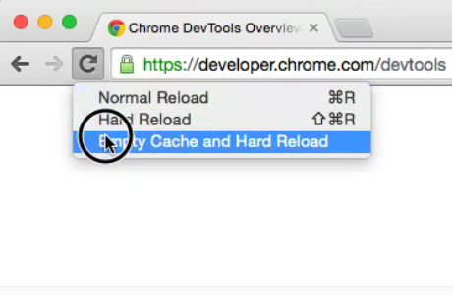
With DevTools opened, click and hold the reload button to see more options.

Slide 3
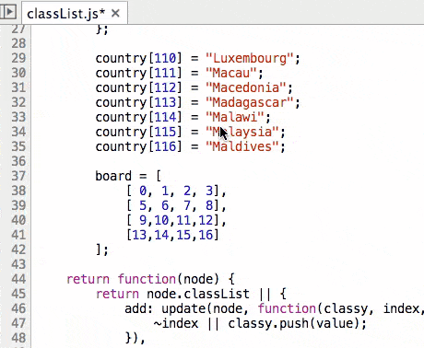
Perform a column selection by dragging
Notes:
You can make a column selection in the Sources Panel editor by holding Alt while dragging the mouse.﻿

Slide 4
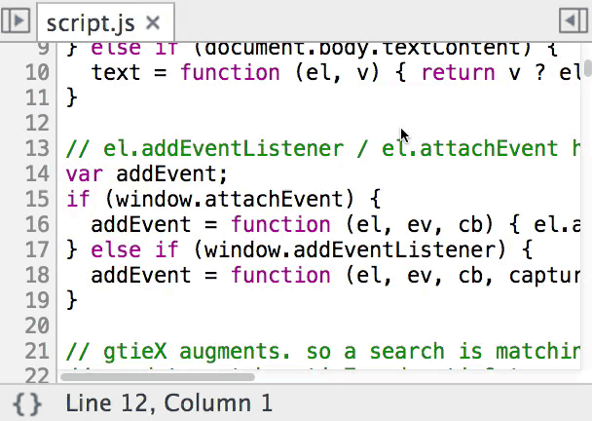
Go to a line number at a specific column
Notes:
GOTO a line number with a specified column using the format :linenumber:columnnumber in the CMD+O dialogue from the Sources panel editor.
Hit CMD + O from the Sources Panel with an open file
Enter :5:9
Notice you are taken to line 5, column 9!
You can even be more productive if hit CTRL + g
Enter 5:9
Notice you are taken to line 5, column 9!

Slide 5
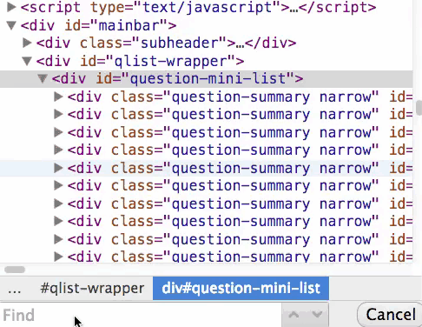
DOM tree search by CSS selector
Notes:
When browsing the DOM with the Elements panel, try searching (CMD+F) for nodes by their CSS selectors.

Slide 6
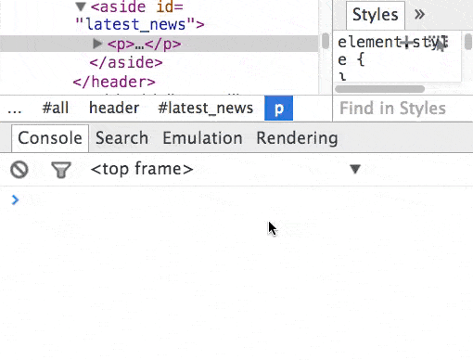
Console shortcut to get the currently selected DOM node
Notes:
When you have a node selected in the Elements panel, use $0 to access it in the Console panel. On this subject, you can also use $_ to access the value of the most recently evaluated expression.﻿

Slide 7
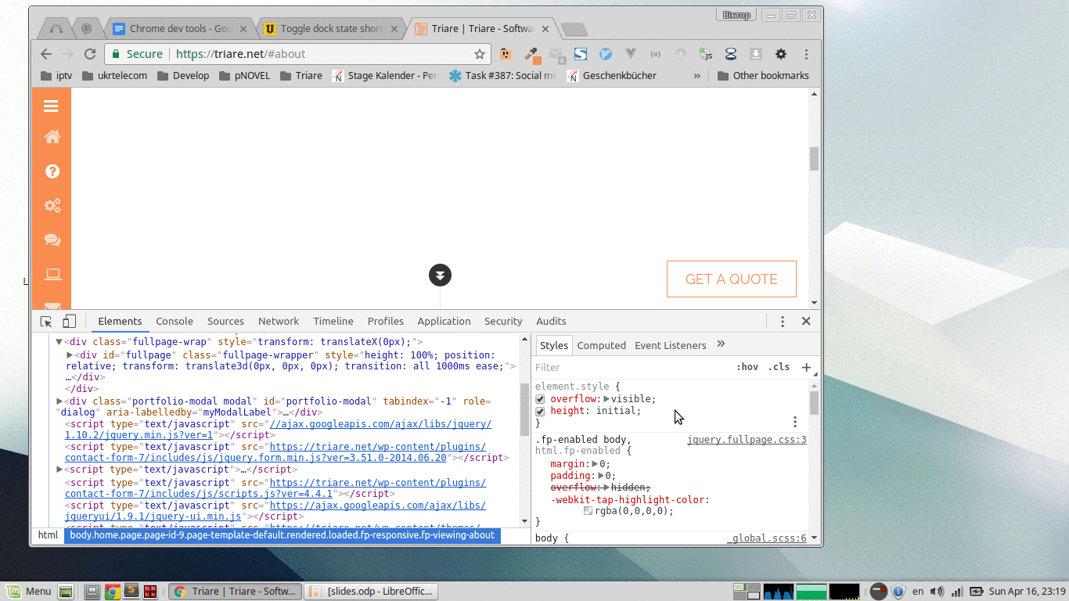
Toggle the DevTools dock state with a keyboard shortcut
Notes:
Use Cmd + Shift + D to toggle the DevTools dock state between the last two recently used states. Dock options are:
Dock to right
Dock to bottom
Undock DevTools

Slide 8
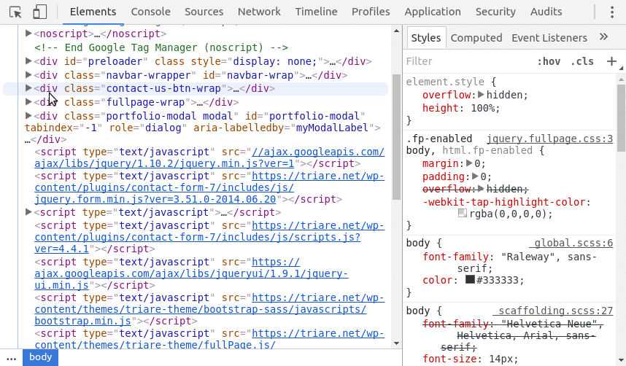
Alt + Click to expand all child nodes
Notes:
You can use Alt + Click in the Elements Panel to expand all child nodes. Just click on the small arrow to the left of the DOM node while holding Alt.

Slide 9
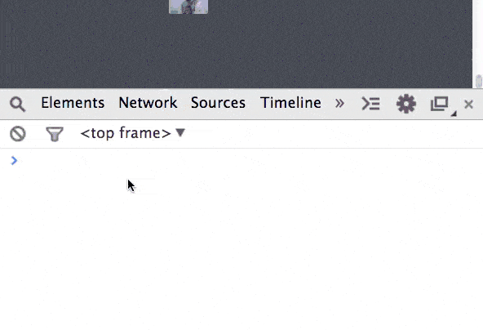
Reveal DOM nodes in the Elements panel from the Console
Notes:
If you console.log out a DOM node, you can right click on it in the Console panel and select Reveal in Elements panel, you are then taken to the DOM node location in the Elements panel.﻿

Slide 10
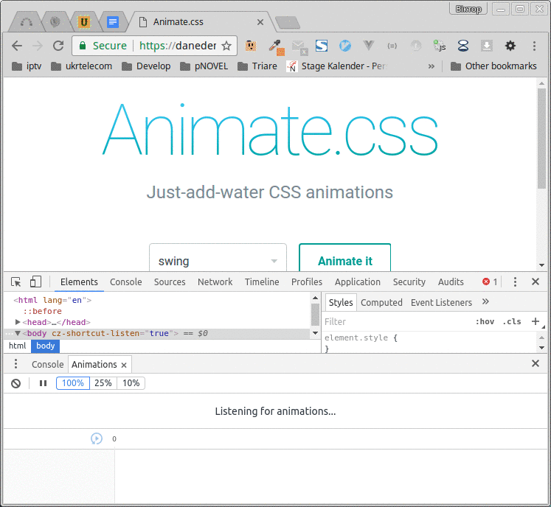
Use the animation inspector to change and modify running animations

Slide 11
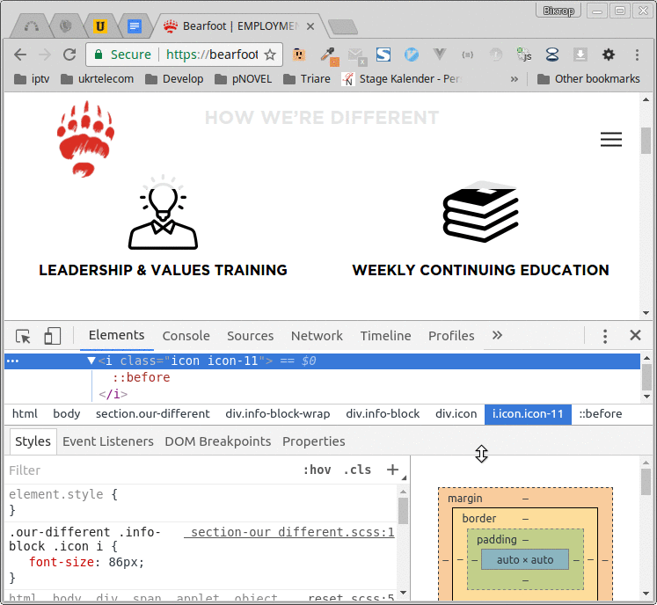
Use the toggle element classes feature for instant visual feedback
Notes:
You can toggle individual element classes (for example .btn, .btn-primary or .text-nowrap) in the DevTools styles pane. Just click the icon labelled .cls.
This can be especially useful when an element has many utility classes applied to it.

Slide 12
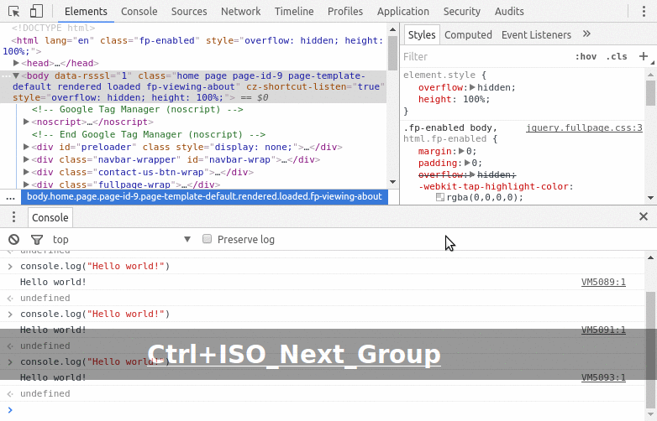
Use the Command Menu to access almost everything in DevTools in a few keystrokes
Notes:
Use Ctrl + Shift + p in DevTools to open up the command menu. You can use the arrow keys or the mouse to make a selection in the menu. The menu consists of commonly used DevTools functions.

