Slide 1
Markov Decision Proces (MDP)
Levin, E., Pieraccini, R., Eckert, W., 2000. A stochastic model of human–machine interaction for learning dialogue strategies. IEEE Transactions on Speech and Audio Processing 8 (1), 11–23.
Many problems can be modeled as MDPs
Robot planning
Travel route planning
Economics
Network routing
…..

Slide 2
SDS based on Markov Decision Process
Speech recognition/understanding: Data is used for estimating model parameters in order to optimize the performance of the system. Usually the more data the system is trained with, the higher the resulting performance on new data is.
Problems with supervised learning in Dialog Models:
The dynamic nature of dialog itself.
The user behavior. (Unexplored situations)
Evaluation
The behavior of the users are not necessary the best.
MDP objetive: To perform the best dialog strategy

Slide 3
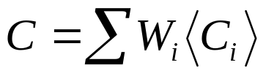
Dialog startegy: Optimization of an objective :
C_{i} : expected costs for different dialog characteristics, reflecting the distance to the achievement of the application goal and the efficiency of the interaction.
W_{i} :weights that determine the tradeoff among the costs. Some of these characteristics are objetives (dialog duration,number of turns, cost of accessing databases…), others can be retated tu user satisfaction. (i.e. PARADISE evaluation framework)
In literature is user the reward term intead of cost.
In this example it is not considered discounting γ.

Slide 4
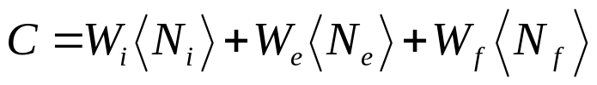
Example: Day-and-Month dialog
The goal is to get the correct day and month values from the user through the shortest possible interaction.
The objective function can de described as the sum of three terms:
- The first term is the expected duration of the dialog (the number of interactions).
- The second term corresponds to the expected number of errors in the obtained values (ranging from zero to two);
- The third term measures the expected distance from achieving our application goal (this distance is zero for a complete date, one if either day or month value is missing, and two if both are incomplete).

Slide 5
A dialog system is described it as a sequential decision process in terms of its action set, state space, and strategy.
Action set:
- a question asking for the value of the day (A_{d});
- a question asking for the value of the month (A_{m} );
- A question asking for the value of the date (day and month) (A_{dm} );
- A final action, closing the dialog and submitting the form (A_{f} ).
State space:
The state of a dialog system includes the values of all the relevant internal variables that determine the next action that the system executes. Given the same external conditions (i.e.,user responses, database results, etc.) the system future behavior is uniquely determined by the current state.
In the example, the state description include two integer variables that describe the day and the month, whose values can be either zero or assigned to the answer provided by the user
Dialog strategy:
It specifies, for each state reached, what is the next action to be invoked.

Slide 6
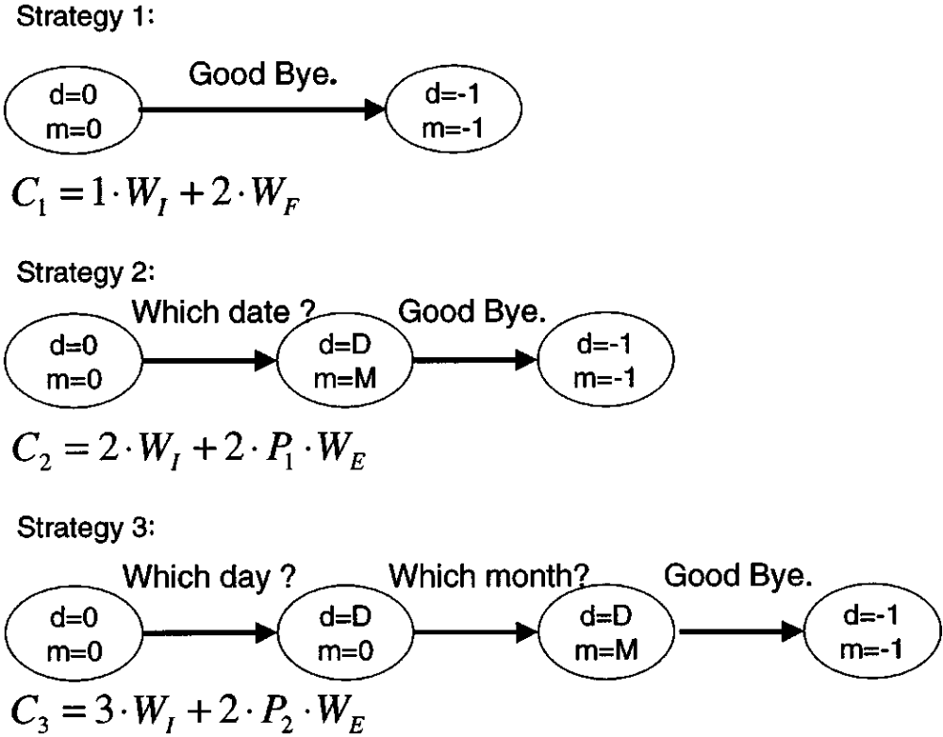
Three different strategies
The optimal strategy is the strategy that minimizes the objective function.
P₁: probability of making an error in the recognition of the month or day value
P₂: error probability of the speech recognizer when specific questions about month and day are asked

Slide 7
- Exponential number of strategies.
Dialog system as an MDP for which techniques exist for finding the optimal strategy.
Two assumptions
The first assumption concerns assigning a probabilistic model to state transitions, that is, when an action a_{t} is taken at time t while in state s_{t}, the MDP state changes to s_{t+1} according to transition probabilities with the following Markovian property:
- The second assumption concerns stochastic modeling costs. When action is executed while in state the system receives a feedback cost distributed according to

Slide 8

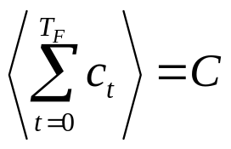
We define the session cost as a sum of all the costs experienced by the system during a dialog session (a path in the state space starting in the initial state, and ending in the final state),
The objective function for MDP is the expected session cost.(undiscounted MDP)
Were T_{F} is the time step at which the S_{F} is reached

Slide 9
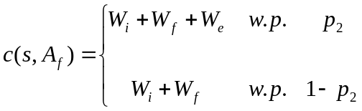
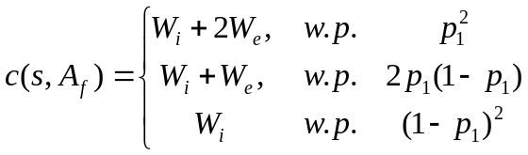
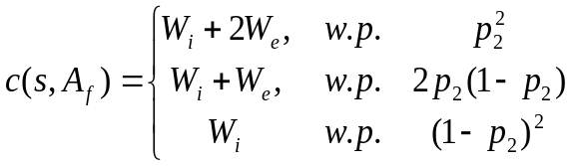
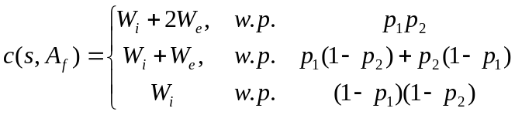
Example: Model definition
Actions asking about day or month, A_{d}, A_{m}, A_{dm},: Cost W_{i}, with probability 1
When the dialog is closed A_{f},: Cost W_{i}+N_{e}W_{e}+N_{f}W_{f}
N_{e}:number of errors
N_{f}:number unasigned variables
Let p₂ the error rate for recognition of the month or day values for simple question
Let p₁ the error rate for recognition for composite quesions question
Initial state:
States with a variable asigned by simple question
States with both variables asigned by composite question
States with both variables asignad by simple question.
States with both variables asignad one by simple and other by composite question.
C(s_{I},A_{f})=W_{i}+2W_{f}
The State Space, the Action Set, theTransition probabilities, the cost function defines the MDP.

Slide 10


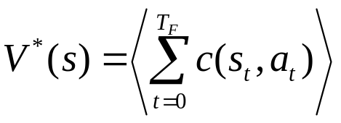

Finding optimal startegy
An optimal strategy is a policy , which is a mapping between states and actions.
Dynamic programming techniques exist for computing the optimal strategy given the model parameters.
These techniques rely on the following definition.
The optimal value V*(s) of a state is the expected sum of costs incurred from state s and following the optimal strategy until the final state S_{F} is reached:
where

Slide 11
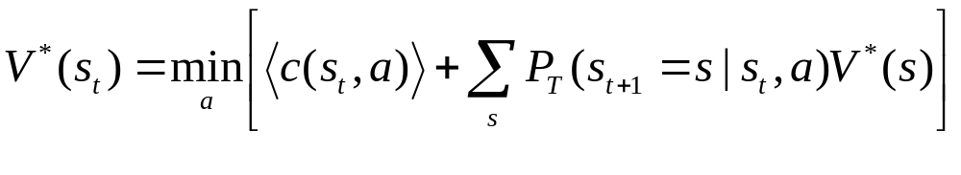
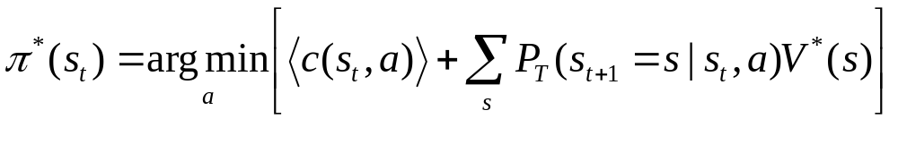
The optimal value function can be computed as:
The optimal strategy can be computed as
Value iteration, or policy iteration techniques can be used to compute optimal value or startegy.

Slide 12
k | V^{k}(s₁) | V^{k} (s₂) | V^{k} (s₃) | V^{k} (s₄) | V^{k} (s₅)
1 | x | x | x | x | x
2 | x | x | x | x | x
3 | x | x | x | x | x
4 | x | x | x | x | x
V_{k}(s₁): maximum reward starting in s₁ and given k time steps.

Slide 13

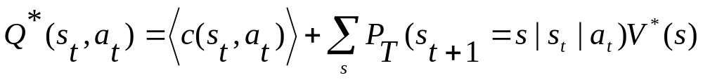
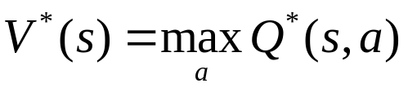
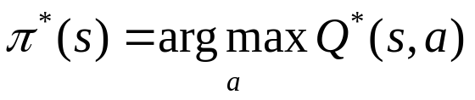

Reinforcement Learning
The goal is to estimate the optimal state-action value function defined as the expected cost of a dialog starting in state s_{t}, taking an action a_{t} and thereafter proceeding according the optimal startegy until the final state is reached.
This algorithm (like many other reinforcement algorithms) is an iterative procedure beginning with an initial guess of and successively improving it at each iteration k,
Q-learning

Slide 14
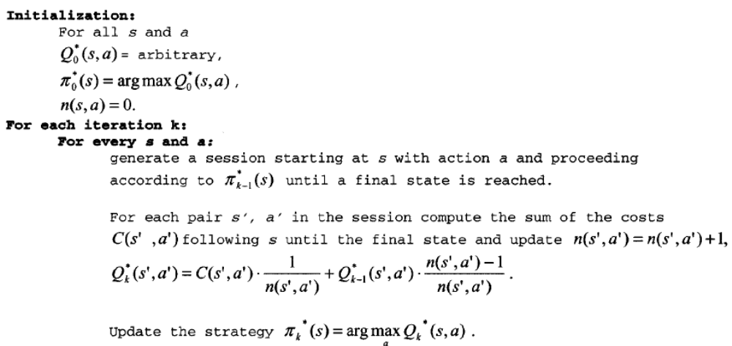
Algorithm for Reinforcement Learning
At each state

Slide 15




Example ATIS Task
1) Objective Function
is the expected number of turns
is the expected number of tuples retrieved
is the data presentation cost function with N₀ being the number of records that are presented to the user
is an overall task success measure

Slide 16
2) Actions
Interactions with the user:
Greeting: it is an open ended question like How may I help you?
Constraining: this includes a set of actions each requesting a particular attribute from the user, as follows
Constrain airline: e.g., Please specify your favorite airline.
Constrain origin: e.g., Where are you leaving from?
Constrain destination: e.g., Where do you want to go?
Constrain departure time: e.g., When do you want to leave?
Relaxing: this includes a set of actions each requesting the user to relax a particular constraint that was specified earlier.
Relax airline: e.g., Do you mind considering other airlines?
Relax origin: e.g., Do you mind leaving from somewhere else?
Relax destination: e.g. Do you mind going somewher else?
Relax departure time: e.g., Do you mind leaving at a different time?
Output: e.g., Here are the 25 flights that match your request
Closing: closing the dialog, e.g., Thanks, good bye.
Interaction with the database:
Retrieval: forming a database query from the information included in the current state and getting the corresponding data.

Slide 17
3) States
A state included three templates (a template is a set of keyword-value pairs).
User template: represents the meaning of the user request interpreted in context.
Data template: describes the data retrieved from the database according to the query based on the user template.
System template: represents some history of system actions during the interaction.

Slide 18
4) Costs
c(s,a)=W_{i} for all s when a is an action involving interaction with the user
c(s,a)=W_{r}N_{r} when a is a retrivel action with N_{r} tuples received
c(s,a)= W_{o}f₀ (N₀) when a is the data output action, where N₀ is the number of tuples presented to de user.
c(s,a)= W_{s}F_{s} (s)+ W_{i} for the closing action
5) State transitions and the simulated user
The set of probabilities that describe the state transitions that result from the user response is called the simulated user. For this experiment, the simulated user is a generative stochastic model
The simulated user was parametrizad in the following way.
Response to Greeting: Includes the probability P(n) where n is the number of attributes specified by the user in a single utterance.
Response to Cnstraining Questions: Parameterized by P(k_{R}|k_{g}), i.e., the probability of the user specifying a valuefor attribute k_{R} when asked for the value of attribute k_{g}.
Response to a Relaxation Prompt: Parameterized by P(yes|k_{G})=1- P(no|k_{G}), i.e., the probability of accepting (or rejecting) the proposed relaxation of attribute .

Slide 19
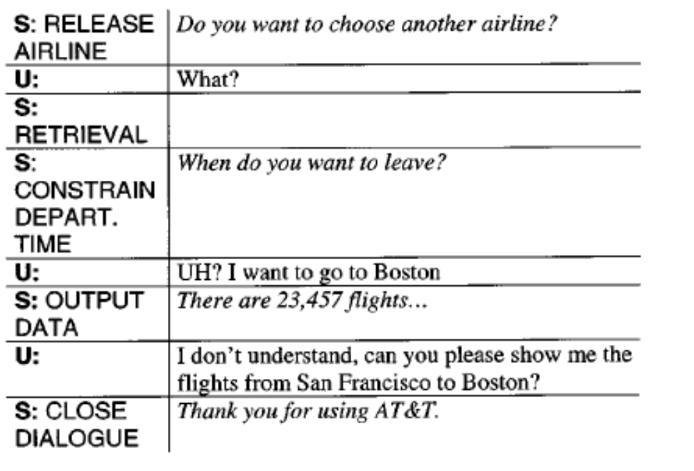
Example of dialog with an untrained system

Slide 20
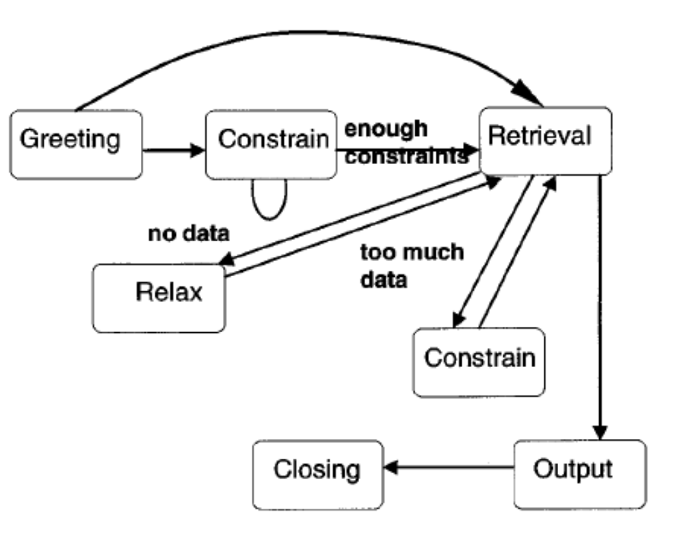
Optimal startegy

Slide 21
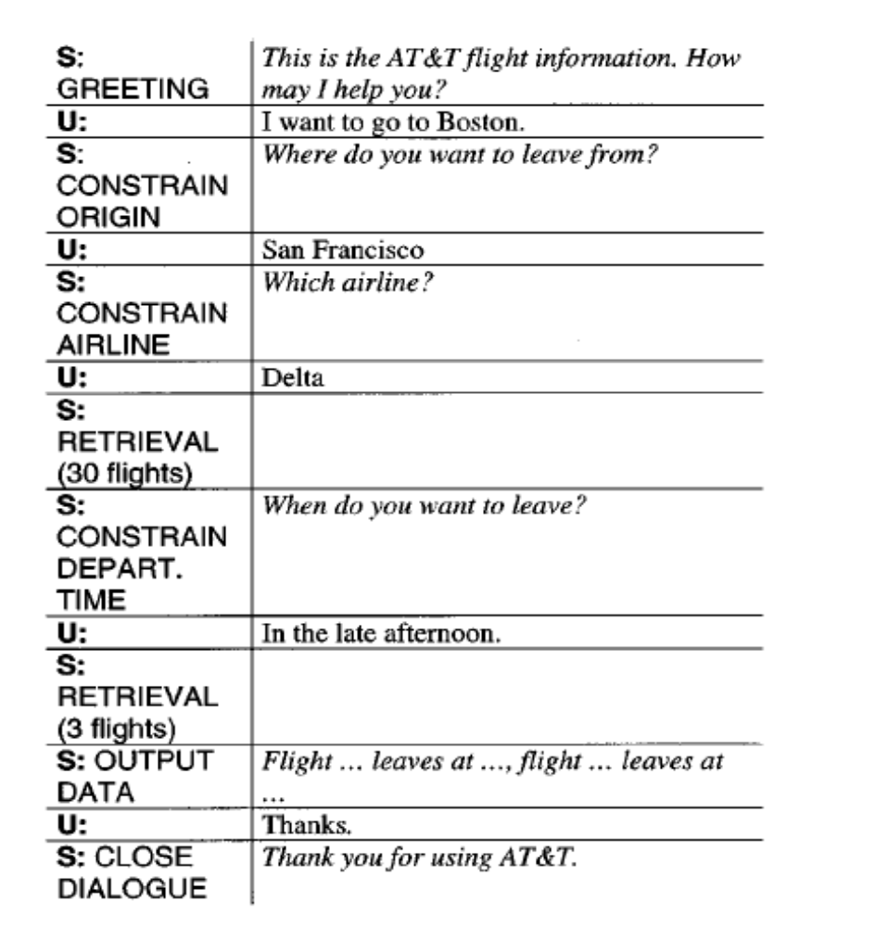
Example of dialog with a trained system

Slide 22
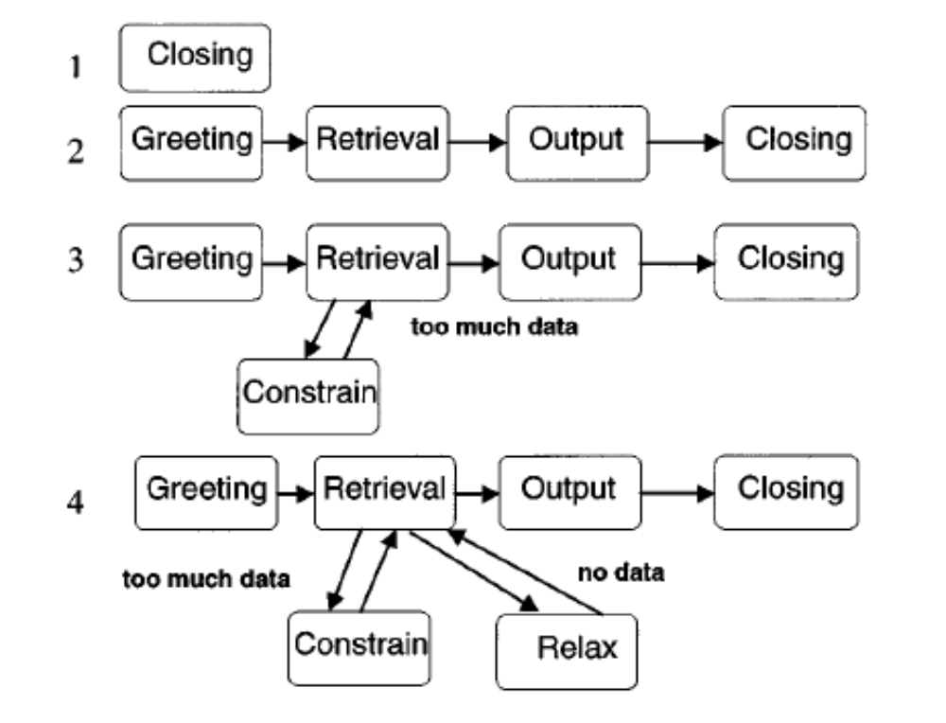
Evolution of the strategy

Slide 23
Partially Observable Markov Decision Process
J. Williams and S. Young (2007). "Partially Observable Markov Decision Processes for Spoken Dialog Systems." Computer Speech and Language 21(2): 231-422.

Slide 24

Structure of a Spoken Dialog System
Conventional
Probabilistic
s_{d}
~
s_{d}
~
Speech
Understanding
ã_{u}
State
Estimator
Belief
Estimator
a_{u}
~
User
s_{u}
~
~
b(s_{m})
s_{m}
Speech
Generation
Dialog
Policy
a_{m}
Dialog
Policy
a_{m}
ã_{m}
If n-best are accepted

Slide 25
- MDP assume that the entiere state is observable
To take into account the uncertainty in the user sate, the dialog history, or in the user’s dialog act, POMDP maintains a distribution across all states (belief state) rather than a point-estimate of the most likely state.
The dialog manager traks all possible dialog paths rather than just the most likely path.
The dialog decision is based on the distribution over all dialog states. (This simplifies error recovery, since the DM can shift its attention to alternative hipothesys rather that train to repair the existing one).
Problem: The state space is very large and it would be intractable.
A POMDP policy is a mapping form partitions in n-dimensional belief space to actions.

Slide 26
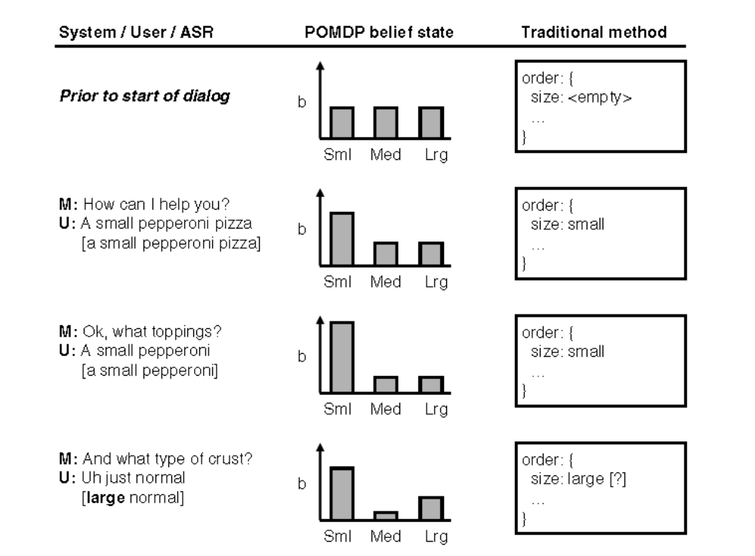
Benefits of parallel state hypothesis

Slide 27
POMDP
POMDP is a tuple {S,A,T,R,O,Z,k,b₀}
where
S is a set of states describing the agent’s world;
A is a set of actions that an agent may take;
T defines a transition probability P(s’|s,a);
R defines the expected (immediate, real-valued) reward r(s,a);
O is a set of observations the agent can receive about the world;
Z defines an observation probability, P(o’ |s’,a);
λ is a geometric discount factor
0 ≤ λ ≤ 1;
b₀ is an initial belief state b₀ (s).

Slide 28
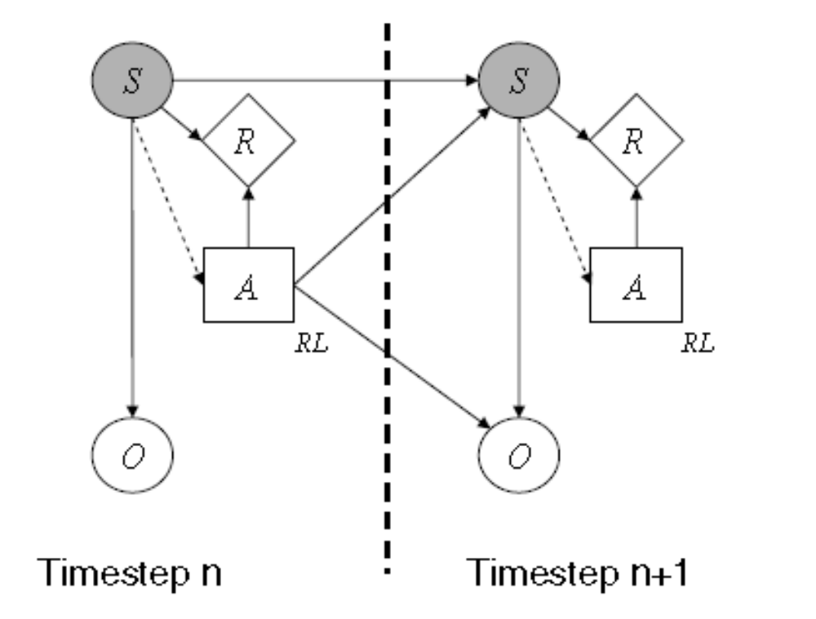

POMDP
At each time step the world is in a unobserved state s.
State s is not know exactly → a distribution over sates (“belief state” b) is maintained.
Based on b the machine selects an action a A, receives a reward r(s,a), and transites to unobserved state s’.
The machine recieves an ovservation o’ which is dependet on s’ and a.

Slide 29
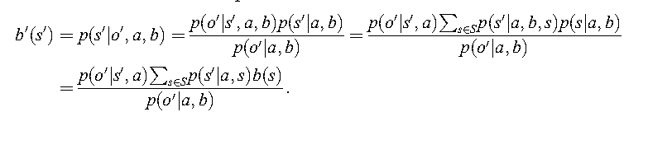
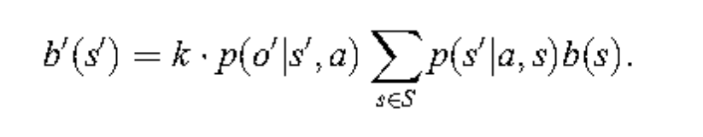
At each tine step the belief state is updated
b is Markovian with respect to b₀ and {a₁,o₁,a₂,o₂, . . .}. Thus, in effect, the update expressed in previous equation is considering all possible (hidden) state transition histories when computing a new belief state. Planning algorithms need only consider b when choosing actions.

Slide 30
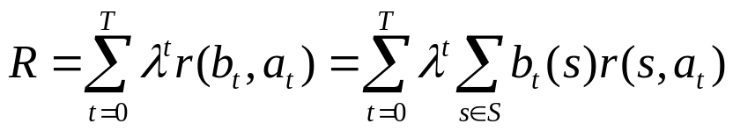


As mentioned above, at each time-step, the agent receives reward r_{t}. The cumulative, infinite-horizon, discounted reward is called the return:
The goal is to choose actions to maximize the expected return E[R]. To do that it must be found a policy which indicates the actions to take at each turn.
A policy is a mapping from the belief state to action
An optimal policy is a policy that maximizes E[R].

Slide 31

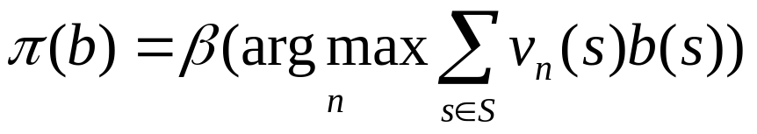
Example of evolution of belief state based onpoit-based the value iteration
Recursive process that leads to estimate V*(b), that is, the value function corresponding to the optimal policy *.
A collection of n vectors vn(s) and an array of corresponding actions is generated. Each vector v_{n}(s) indicates the (long-term) value of taking an action in state s. A policy can be produced from v_{n}(s) and b(n)
Value iteration provides:
A partitioning of belief space into regions corresponding to optimal actions.
expected retur for that actions.

Slide 32
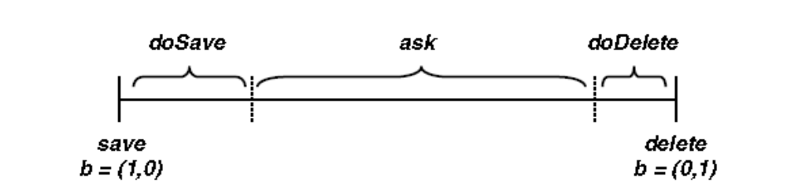
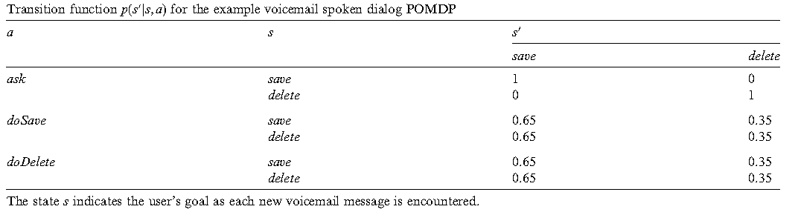
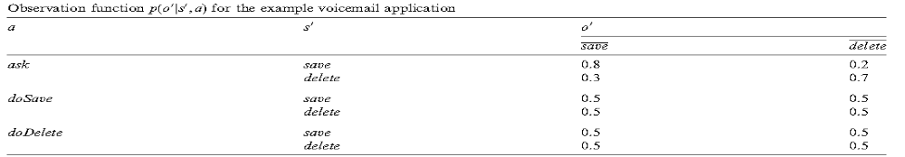
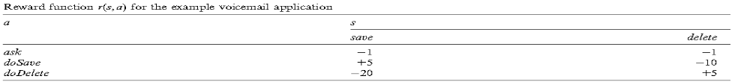

Slide 33
Fig shows an example conversation between the user and a machine executing the optimal policy.
At each time-step, the machine action and the observation are used to update the belief state as in Eq. are selected depending on the partition which contains the current belief state.
The first response is misrecognized as delete, moving the belief state towards the delete corner. However, since belief remains in the central region where uncertainty is high, the machine continues to ask the user what to do.
After two successive(correct) save observations, the belief state moves into the doSave region, the message is saved and the belief state transitions back to the prior state.

Slide 34
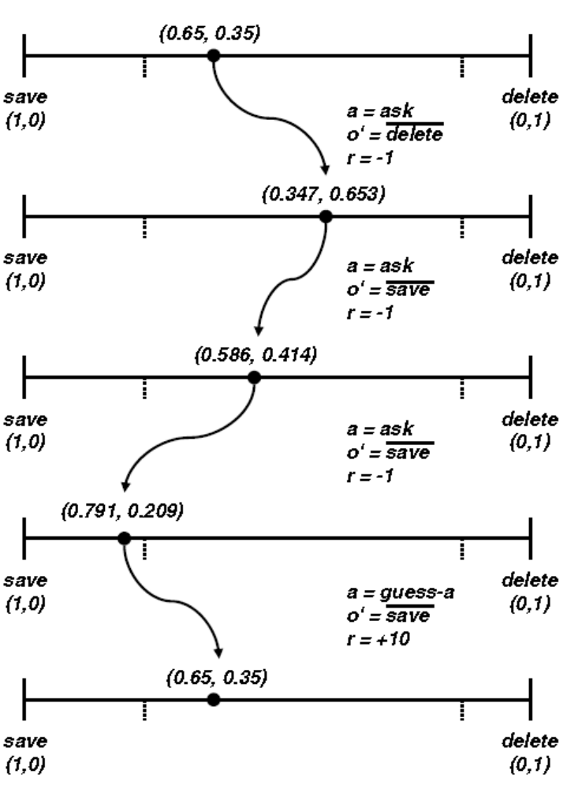

Slide 35
POMDP applied to SDS
S=(s_{u}, a_{u}, s_{d})
s_{u}:user goal
a_{u}:user action
s_{d}:dialog history
The syste state is the belief state
s_{m}=b(s)=b(s_{u}, a_{u}, s_{d})
The observation O takes into account the noisy recognition results and the confidence score
O=(ã_{u},c)

Slide 36
In this case the transitions probability function is:
P(s’|s,a)=p( s’_{u}, s’_{d}, a’_{u}| s_{u}, s_{d}, a_{u}, a_{m},)
P(s’|s,a)=p( s’_{u}| s_{u}, s_{d}, a_{u}, a_{m}) p( a’_{u}| s’_{u}, s_{u}, s_{d}, a_{u}, a_{m}) p(s’_{d}| a’_{u}, s’_{u}, s_{u}, s_{d}, a_{m})
User goal
User action model
Dialog history model
Independence asumptions:
User goal: p( s’_{u}| s_{u}, s_{d}, a_{u}, a_{m}) = p( s’_{u}| s_{u},a_{m})
User action model: p( a’_{u}| s’_{u}, s_{u}, s_{d}, a_{u}, a_{m}) = p( a’_{u}| s’_{u},a_{m})
Dialog history: p(s’_{d}| a’_{u}, s’_{u}, s_{u}, s_{d}, a_{m})= p(s’_{d}| a’_{u}, s’_{u},s_{d}, a_{m})
The transition function becomes:
P(s’|s,a)= p( s’_{u}| s_{u},a_{m}) p( a’_{u}| s’_{u},a_{m}) p(s’_{d}| a’_{u}, s’_{u},s_{d}, a_{m})
Te observation function:
P(o’|s’,a)=p(ã’_{u} ,c’|a’_{u})

Slide 37
The user goal and the user action model can be estimated from a corpus of annotated interactions.
The dialog history can be estimated from data or by a deterministic funtion representing rules.
Thus, this model enables both probabilities estimated from corpora and handcrafted heuristics to be incorporated.
The observation function can be estimated from a corpus
The reward function depends on the design objectives of the target system.
Given the previous definitions, the belief state can be updated each time-step by:

Slide 38
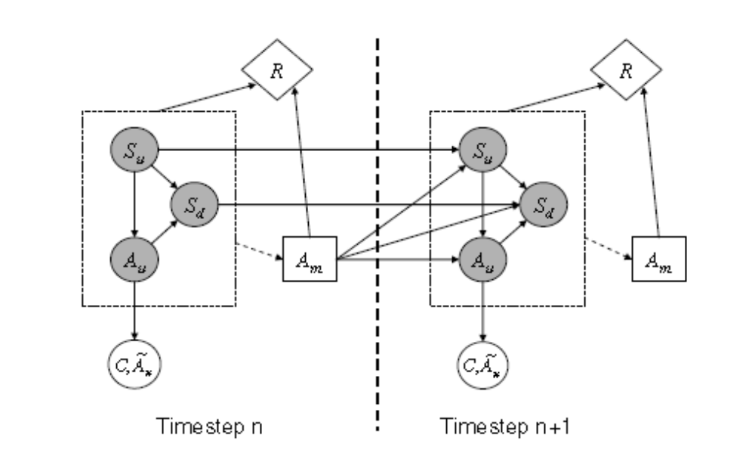
Representation of the SDS-POMDP

Slide 39
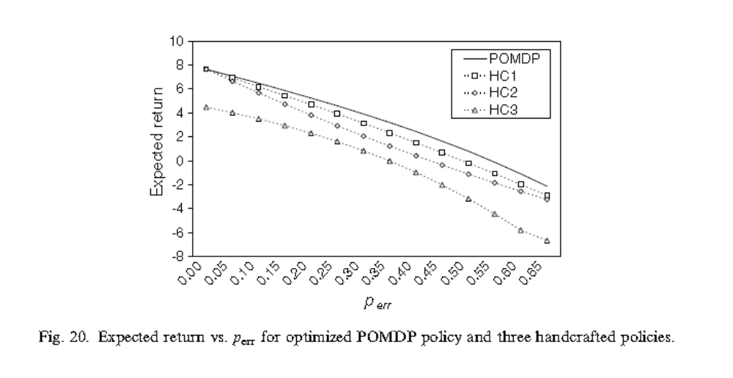
Example of behavior of a Dialog System with different policies

Slide 40
Q-learning
Temporal difference learning. Comparing the actual one-step reward with the reward predicted by the Q-function. (ocassionally the dialog can be deviated from the optimal policy in order to explore many reasonable combinations of (s,a).
In the case of POMDP starting from an initial policy the system interacts with the user. Each new belief point encountred in the space is compared with all existing belief points and if it is suficiently different it is retained. Associated to each belief point b_{i} there is a Q-function Q(b_{i},a_{m}) whose value is the expected total reward obtained choosing the action a_{m}. Goal: to find the Q-values.
User simulation technique are typically used.

Slide 41
References
J. Williams and S. Young (2007). "Partially Observable Markov Decision Processes for Spoken Dialog Systems." Computer Speech and Language 21(2): 231-422.
Williams, J.D., Young, S.J., 2005. Scaling up POMDPs for dialog management: the ‘‘Summary POMDP’’ method. In: Proc. IEEE Workshop on Automatic Speech Recognition and Understanding (ASRU), San Juan, Puerto Rico.
Levin, E., Pieraccini, R., 1997. A stochastic model of computer–human interaction for leaning dialog strategies. In: Proc. Eurospeech, Rhodes, Greece.
Levin, E., Pieraccini, R., Eckert, W., 1998. Using Markov decision process for learning dialogue strategies. In: Proc. Int. Conf. On Acoustics, Speech, and Signal Processing (ICASSP), Seattle, pp. 201–204.
Levin, E., Pieraccini, R., Eckert, W., 2000. A stochastic model of human–machine interaction for learning dialogue strategies. IEEE Transactions on Speech and Audio Processing 8 (1), 11–23.

