Slide 1
Spoken Language Understanding
Emilio Sanchis
Universidad Politécnica Valencia

Slide 2
Outline
Introduction
Corpus
Semantic representation in dialog systems
Grammatical Models
Statistical Models
5.1 Hidden Markov Models
5.2 Finite State Automata Models
5.2 Hidden Understanding Models
5.3 Vector State Models
6) Conditional Random Fields.
7) Active learning
8) Confidence measures.
9) Evaluation measures

Slide 3
1) Introduction

Slide 4
Speech Understanding
Understanding: Obtaining the meaning of a sequence of signs
Natural Language Understanding: Obtaining a conceptual representation of a sentence.
Spoken Language Understanding: Obtaining the meaning of a speech signal.
Input sequence X
Understanding
Output representation Y

Slide 5
Spoken Language Understanding
Problems:
Incorrect syntax of spoken sentences: hesitations, ungrammatical constructions, repetitions,..
Errors in the Speech Recognition process
The ASR don’t generate structure information (puntuations, sentence boundaries…)
Ambiguous semantic sentences. Need of context for desmbiguation.

Slide 6
Milestones in Human Machine Interactions Research
Small & Medium Vocabulary, Acoustic-Phonetics &Template-based
Large Vocabulary; Syntax, Semantics,
Very Large Vocabulary; Semantics; Multimodal Dialog
Large Vocabulary, Statistical-based
Isolated Words; Connected Digits;
Connected Words; Continuous Speech
Spontaneous Language Understanding
Mixed Initiative dialog; Multiple modalities
DARPA RM
DARPA ATIS
DARPA Communicator
Filter-bank analysis; Time-normalization;Dynamic programming
Pattern recognition; LPC analysis; Clustering algorithms; Level building;
Hidden Markov models;
Stochastic language modeling.
Stochastic language understanding;
Learning dialog strategy from Interactions
1962 1967 1972 1977 1982 1987 1992 1997 2002
Year
Notes:
Historical perspective and the role of DARPA projects and benchmarking in the evolution of the field.
diagram shows pivotal advancements with he introduction of statistical modeling to different components of MMI system. I will not argue here about the chicken and egg problem of who to attribute this success to, but just want to mention the great contribution of US ARPA agency that thorough a series of multi year projects with standardized labeled data, and test data and objective testing criterion challenged the community to come up with adequate solutions:
In the 70-s hMM’s replaced the previous heuristical methods especially after proving it s superiority on the ARPA RM task of continuous speech recognition.
The RM project in the 80-s moved the field away from template –driven methods to allow robust and efficient continuous speech recognition.
ATIS project in the 90-s was concerned with spoken language understanding.
It was built around Air Travel information system,. As an example of a a very complex task familiar to many users. It was the first time that an objective and standardized evaluation of this component of the system was carried. After the last evaluation in 1995 the participating cites were encourages to create mixed initiative dialog systems for this task
In the late 90 –up to 2002 the communicator project was created. It was concerned with software architecture for spoken and them multi-modal dialog systems that will allow for rapid application development, software reusability, etc., but also with objective evaluation
Of different dialog system -> lead to the development of modeling dialog as an MDP
1950s – various research labs tried to exploit the fundamental of acoustic/phonetic to ASR. Isolated digits recognition experiments were reported by Bell Labs for a single speaker relying heavily on measuring spectral resonance during the vowel regions of digits.
1960s – three key research developments in ASR; (a) RCA labs developed solutions for dealing with non-uniformity of time scales in speech events, (2) Vintsyuk (Russia) proposed dynamic programming (only became popular in the West in the 70s and 80s); (3) dynamic tracking of phonemes at CMU.
1970s – use of pattern recognition for ASR was developed Itakura applied the idea of LPC in ASR (already established in coding). IBM demonstrated simple dictation systems (Tangora). AT&T bagan series of efforts for making ASR truly speaker independent.
1980s – connected word recognition was further developed with the creation of level building dynamic programming methods. This decade was characterized by a shift from template-based methods to statistical modeling methods. Essentially the use of HMMs. DARPA invested into LVASR (e.g., SPHINX/CMU, BYPLOS/BBN).
1990s – emphasis on natural language with ASR being increasingly used for telephone networks and enhance operator services.
VRCP - automation of 0+ calls (AT&T Labs invented a new wordspotting technique, which made this service viable). Saves AT&T $200M-$300M. (deployed in 5ESS/OSPS)
800 Voice Recognition - automation of AT&T’s Call Prompter service using voice commands (e.g., “Press or say 1 for information”). Deployed in 4ESS/Isaic.
DA Call Completion - allows AT&T to complete a call made to AT&T’s DA. An ASR system listens to the digits played out by RBOC operators
VRCP 2.0 - added connected digit recognition to allow for more automation of calling card and third-number billed phone calls
AT&T VoiceLine - gave customers voice dialing by name and number. Speaker verification was also deployed to give added security but it was not ‘turned on’. Only a couple of thousand users subscribed.
Universal Card - connected digit recognition is used by customers to enter their account number in order to access UCS’s customer care line.
Voice Touch - deployed in AWS network pre-AT&T/McCaw merge. It provides voice dialing from cell phones (uses non-AT&T speech technology)
AT&T Direct - ASR is used to automate international calls made back to the US through the AT&T Direct service.
00 - automation - when AT&T customers dial “00” to get to an operator, they hit a speech-controlled user interface
SDN/NRA - connected digit recognition is used to allow SDN/NRA subscribers to do voice-dialing.
Infoworx - AT&T Solutions uses Infoworx to deploy IVR and voice-enabled services for its customers.
CALL ATT R2.0 - provide voice control of the CALL AT&T service. This was developed and deployment started. Then it was halted.
ATPS - this was an BMD/Infoworx play. Advanced voice-enabled service such as hotel or car rent services could not be developed. The was fully developed, but not deployed.
Universal VoiceLine - provided voice-dialing to consumers. It was access via 8YY number, with auto login from AT&T cell phones.
HMIHY - provides very advanced automation of 00- customer care using a sophisticated voice interface. This uses large vocab. ASR, language understanding and dialog management
OneReach - used TTS to provide customers with information over the phone
VoiceTone - see earlier viewgraphs
AT&T Mail Center - initial will use TTS to read e-mail messages over the phone. In 2000, Natoce has asked for adding ASR to provide full voice control of messaging.
800 Gold - provided simple voice dialing of 3 words (home, office, voicemail). Developed. Deployment on hold. (uses non- AT&T speech technology)

Slide 7
Historic review
Years 70, 80:
Syntactic analysis of the best sequence of words generated by the ASR
Problems: Determinstic rules, not compatibles with input errors
Years 90:
Probabilistic finite-state models and grammars. Dealing with ambiguities and errors.
- Possibility of integrating ASR and SLU processes.

Slide 8
Constratints vs. Coverage (in Language Models and in Semantic Models)
Grammars: More constraints, long term relations, difficulties to tackle with errors, less coverage, deeper analysis, more capability to extract complex meaning from the sentences
Statistical models: Less constraints, short distance relations, more robust with noise input, more coverage, shallow analysis. Less capability to extract complex meaning from the sentences.
Knowledge-based approach: TINA (MIT), Phoenix (CMU)
Statistical approach: CHRONUS (AT&T), BBN

Slide 9
Types of SLU systems
Speech mining applications: Information extraction, named entity recognition, themes, opinions
A simple representation is enough: Atribute-value pair, or semantic tag.
Dialog systems: More complex task. Deeper semantic representation and analysis.

Slide 10
MIT examples
Example sentences
I WOULD LIKE TO FLY FROM SAINT PAUL TO SAN JOSE
MONDAY MORNING FROM SAN JOSE TO HOUSTON
TUESDAY MORNING AND FROM HOUSTON TO SAINT PAUL
ON WEDNESDAY MORNING
[UM] I WOULD LIKE TO FIND OUT WHAT FLIGHTS THERE
ARE ON FRIDAY JUNE ELEVENTH FROM SAINT
PETERSBURG <TO> M- TO M- MILWAUKEE AND THEN
FROM MILWAUKEE TO TACOMA THANK YOU
Difficult sentences
I would like to find a flight from Pittsburgh to Boston on Wednesday and I have to be in Boston by one so I would like a flight out of here no later than 11 a.m.
I'll repeat what I said before on scenario 3 I would like a 727 flight from Washington DC to Atlanta Georgia I would like it during the hours of from 9 a.m. till 2 p.m. if I can get a flight within that time frame and I would like it for Friday
Some database I'm inquiring about a first class flight originating city Atlanta destination city Boston any class fare will be all right

Slide 11
2) Corpus

Slide 12
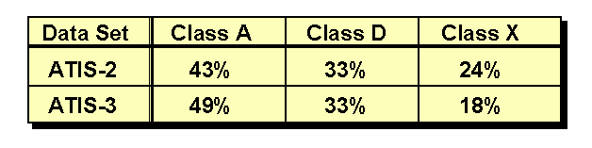
ATIS
Over 25,000 utterances were collected (from AT&T, BBN,CMU, MIT, NIST, and SRI)
About 80% of the collected data (speech and transcriptions) were distributed for system development and training
Over 11,000 of training utterances were annotated with database “reference” answer
About 40% of the data from ATIS-3 (more cities)
A: Context-independent queries
D: Context-dependent queries
X: Un-answerable queries
Example: flights from boston to philadelphia
  FRAME: FLIGHT
  DEPARTURE.CITY = boston
  ARRIVAL.CITY = philadelphia

Slide 13
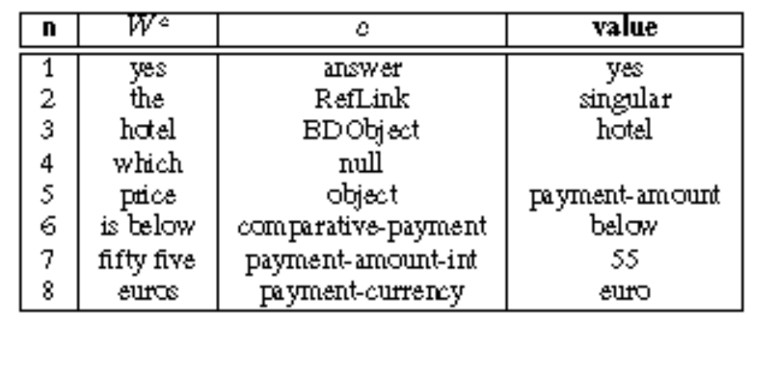
MEDIA
A 1250 French dialogue corpus has been recorded by ELDA following a Wizard of Oz protocol: 250 speakers have followed each 5 hotel reservation scenarios. This corpus has been manually transcribed, then conceptually annotated according to a semantic representation defined within the project.
Example of message with concept+value information.
The original French transcription is: “oui l’hôtel dont le prix est
inférieur à cinquante cinq euros”

Slide 14
ARISE (LIMSI)
10.000 dialogs
14.582 sentences extracted and manually labelled
Average words per sentence: 5
Vocabulary size: 1800 words including 500 station names
Number of concepts: 64
Example:
Utterance: “Dans la matinée et c’est pas Croisic c’est Roissy”
Recognized: “Dans la matinée pas Croisic Roissy”
Concept sequence:
(+/range-dep) (+/null) (-/m:mode)(-/place)(+/place)
Normalized values matin Croisic Roissy
Frame (+/range-dep) matin
(-/place) Croisic
(+/place) Roissy

Slide 15
DIHANA
DIHANA project: Development of a dialog system to provide information in natural language about train services, schedules, and fares in Spanish.
A set of 900 dialogs was acquired in the DIHANA project.
Three types of scenarios were defined.
This corpus was acquired using:
  A Wizard of Oz technique (WO), a complete dialog system.
225 (75)
4 (3)
6280 (3528)
7
7.74
823 (637)
10.8
225 (75)
4 (3)
6280 (3528)
7
7.74
823 (637)
10.8
Number of users
Number of dialogs/user
Number of user turns
Average number of user turns/dialog
Average number of words/user turn
Vocabulary
Duration of the recording (hours)
225 (75)
4 (3)
6280 (3528)
7
7.74
823 (637)
10.8
Number of users
Number of dialogs/user
Number of user turns
Average number of user turns/dialog
Average number of words/user turn
Vocabulary
Duration of the recording (hours)
Number of users
Number of dialogs/user
Number of user turns
Average number of user turns/dialog
Average number of words/user turn
Vocabulary
Duration of the recording (hours)
(..) BASURDE
corpus
Notes:
desarrollar páginas web controlables mediante la voz: prompts y entradas de voz.

Slide 16
DIHANA
Corpus labeling:
  USER TURNS: Frame representation of the meaning of the utterance.
    Task-dependent concepts: Hour, Price, Train-Type, Trip-Time, and Services.
    Task-independent concepts: Affirmation, Negation, and Not-Understood.
    Attributes: Origin, Destination, Departure-Date, Arrival-Date, Departure-Hour, Arrival-Hour, Class, Train-Type, Order-Number, and Services.
Yes, I would like to know the timetables and the prices leaving from Valencia.
(Affirmation)
(Hour)
Origin: Valencia
(Price)
Origin: Valencia
Notes:
desarrollar páginas web controlables mediante la voz: prompts y entradas de voz.

Slide 17
3) Semantic represntationin dialog systems

Slide 18
Scheme of a Dialog system
Dialog
History
DataBase
Acoustic
Models
Language
Model
Semantic
Model
Word
sequence
Query BD
speech
Frames
ASR
Semanic
Analyzer
Dialog Manager
Query
Output speech
Answer generator
Rules
TTS
Word
sequence

Slide 19
Language Understanding for dialog systems
Need of complex SLU. Example in Project LUNA three levels of complexity (also in DIHANA project, but not explicitely):
From words to basic conceptual constituents
Semantic composition on basic constituents
Context sensitive analysis

Slide 20
Typical Discourse Phenomena in Conversational Systems
• Deictic (verbal pointing) and anaphoric (e.g., pronominal)
reference:
1. Show me the restaurants in Cambridge.
2. What is the phone number of the third one?
3. How do I get there from the nearest subway stop?
• Ellipsis:
1. When does flight twenty two arrive in Dallas?
2. What is the departure time ()?
• Fragments:
1. What is the weather today in Denver?
2. How about Salt Lake City?
• Semantic ambiguity:
Not to Denver, to Chicago
Not, to Denver

Slide 21
Meaning representation
Example: The customer accepts the contract
First order logic: accept (customer, contract)
Frames: Structures represented by a name and a set of role-values pairs (slots)
{Accept
is_a: verb
agent [human,…]
theme [……………]
……….
}
Role
Constraints for the values
Many instances of this frame can be obtained: values are associated to roles. For each role some restrictions can be associated, and specific procedures can be defined to find the values. Hierarchical structures are permitted.

Slide 22
4) Grammatical models

Slide 23
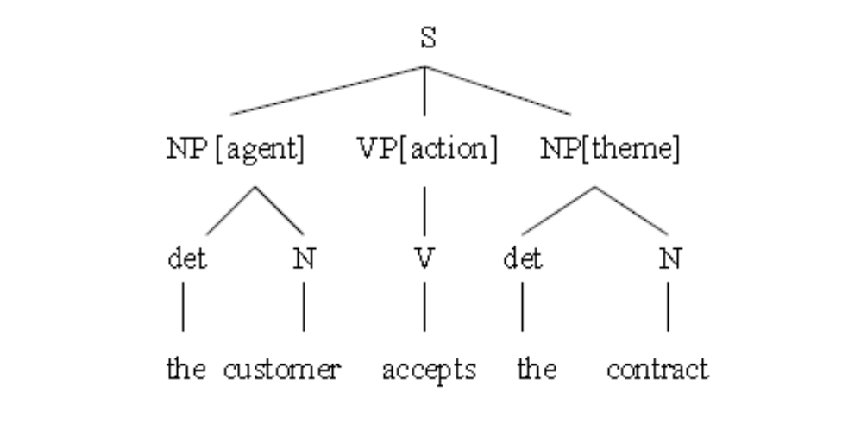
Semantic interpretation
Semantic and syntactic analysis.
Syntactic and semantic anaysis y performed by a parser which produces a parse tree.
Example: The costumer accepts the contract
Internal nodes have associated semantic labels.

Slide 24
Hand-crafting grammars
ASR
Decisions about type of grammar required
  Chomsky hierarchy
  Flat v hierarchical representations
Processing issues (parsing)
  Dealing with ambiguity
  Efficiency
n-best list, word lattice, …
Parsing
parse tree
Frame
Generation
semantic frame
Discourse
Processing
frame in context
DB
Query
SQL query

Slide 25
Context Free Grammar in which the Left Side of rules is a semantic category:
Example:
  LIST -> show me | I want | can I see|…
  DEPARTTIME -> (after|around|before) HOUR | morning | afternoon | evening
  HOUR -> one|two|three…|twelve (am|pm)
  FLIGHTS -> (a) flight|flights
  ORIGIN -> from CITY
  DESTINATION -> to CITY
  CITY -> Boston | San Francisco | Denver | Washington

Slide 26
Deeper semantic analysis
Contextual information can be used.
Example: Can remove the people by helicopter?
A request to change the plan.
A question about feasibility.
Example:
System: Do you want to go to Trento?
User: Not, to Milano.
Example:
“ What is the arrival time of the first one?”

Slide 27
TINA (MIT, Seneff, 1989)
The linguistic analyzer TINA, (MIT, Seneff, 1989), has a grammar written as a set of probabilistic context free rewrite rules with constraints.
The grammar is converted automatically at run-time to a network form in which each node represents a syntactic or semantic category.
The probabilities associated with rules are calculated from training data, and serve to constrain search during recognition (without them, all possible parses would have to be considered).

Slide 28
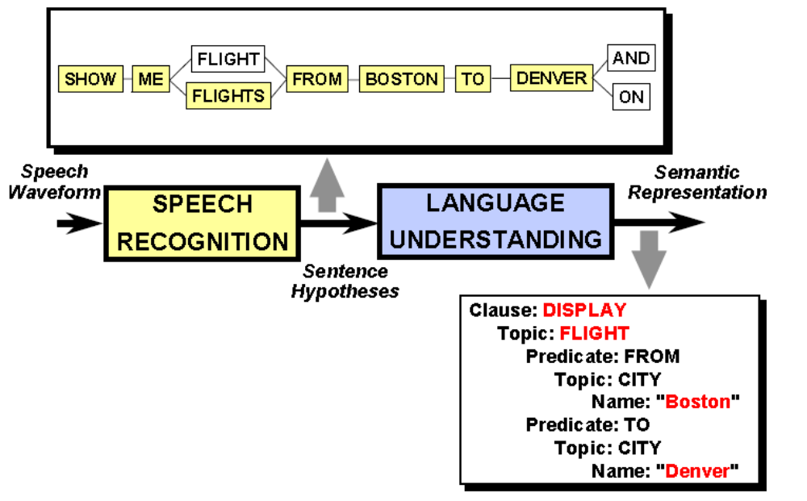
TINA (MIT)

Slide 29
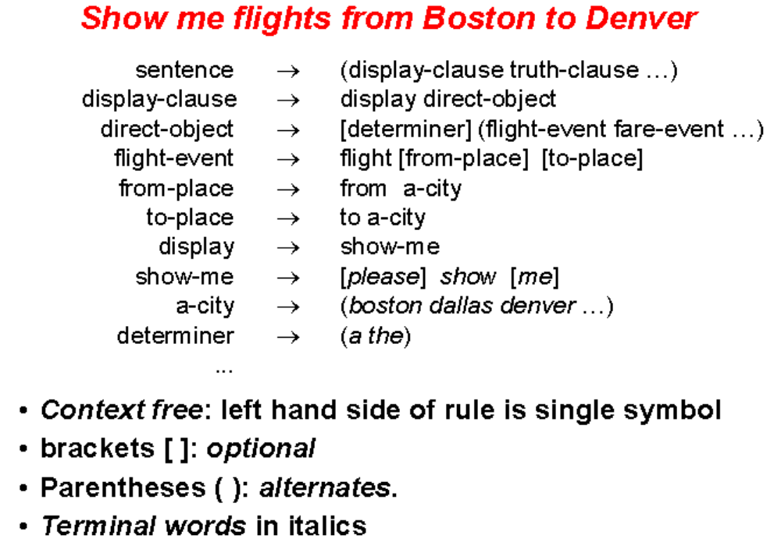
TINA (MIT)

Slide 30
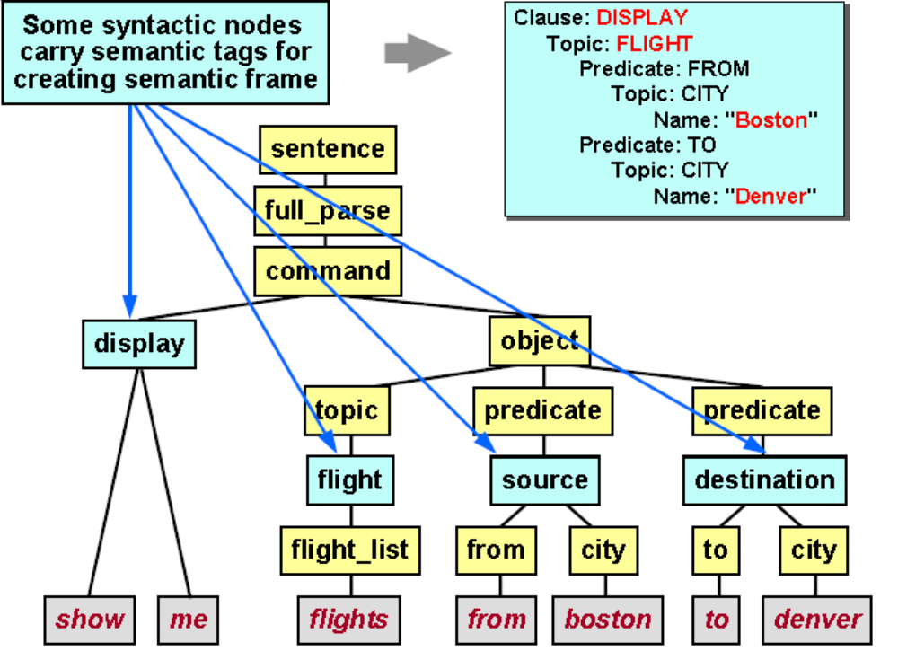
TINA (MIT)

Slide 31
Combined strategies: TINA (MIT)
Grammar rules include mix of syntactic and semantic categories
Context free grammar using probabilities trained from user utterances to estimate likelihood of a parse
Parse tree converted to a semantic frame that encapsulates the meaning
Robust parsing strategy
TINA enhances its coverage through a robust parsing strategy.
Sentences that fail to parse are subjected to a fragment parse strategy
Sentences that fail to parse are parsed using fragments that are combined into a full semantic frame
Fragments are combined into a full semantic frame
When all things fail, word spotting is used

Slide 32
PHOENIX (CMU)
  The grammar is a semantic grammar, non-terminals are semantic concepts.
  The grammar is also written so that phrases can stand alone (be recognized by a net) as well as being embedded in a sentence.
  The grammar is compiled into a set of finite-state networks. Networks can "call" other networks, thereby significantly reducing the overall size of the system.
ASR
word string
Semantic
Parser
meaning
representation

Slide 33
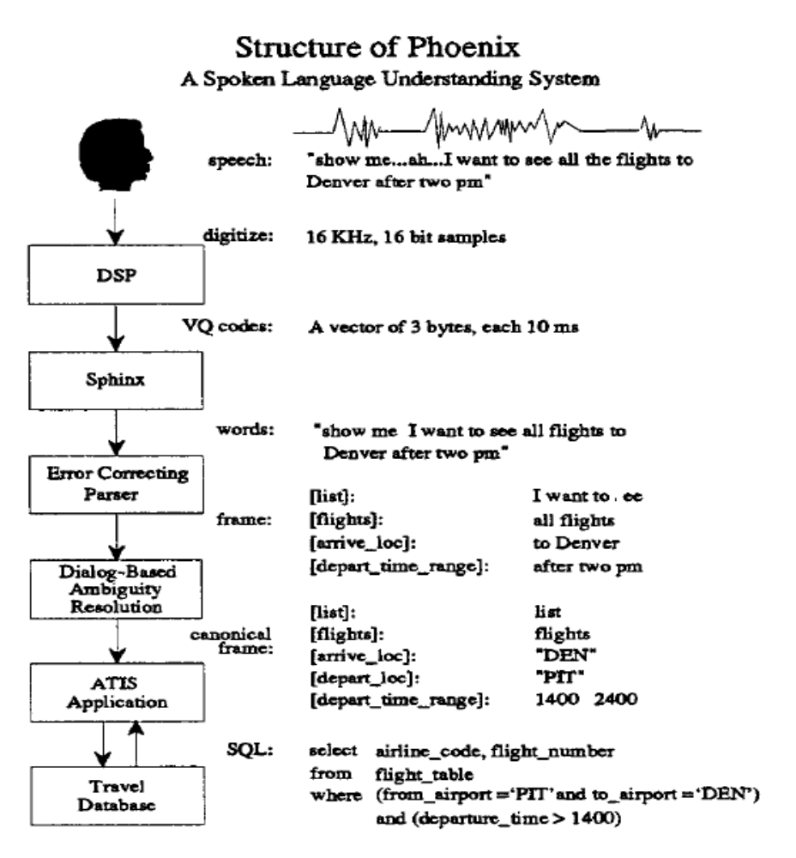
Phoenix (Ward)

Slide 34
Deriving Meaning directly from ASR output: VoiceXML
Uses finite state grammars as language models for recognition and semantic tags in the grammars for semantic parsing
ASR
meaning
representation
I would like a coca cola and three large pizzas with pepperoni and mushrooms
{
drink: "coke",
pizza: {
number: "3",
size: "large",
topping: [
"pepperoni",
"mushrooms"
]
}
}

Slide 35
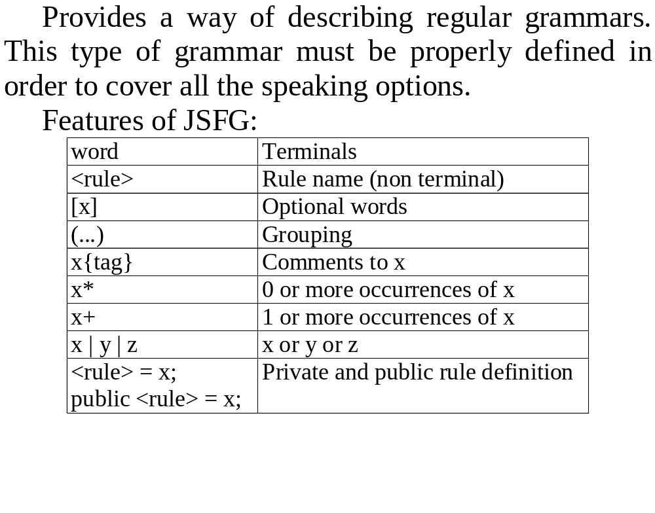
Java Speech Grammar Format

Slide 36
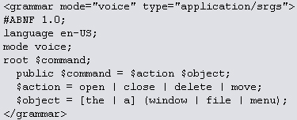
Example of grammars VoiceXML
#JSGF V1.0;
grammar confirma;
public <confirma> = <si> | <no>;
<si>= si | vale | "es correcto" | bien | correcto;
<no>= no | mal | "está mal" | incorrecto;

Slide 37
VOICEXML Example.
#JSGF V1.0;
grammar centralita;
public <centralita> ="por favor" <peticion> | <peticion> ["por favor"];
<nombremasc> = pepe | juan | josé | luis | víctor | andrés | guillermo | paulo | antonio | pablo | raul | germán | david | miguel | carlos | mario | felipe | manuel | manolo | mariano | nacho | ignacio | jorge;
<nombrefem> = maría | ana | luisa | isabel | paz | antonia | lidón | lledó;
<nombre> = (<nombremasc> | <nombrefem>);
<apellido> = martínez | lópez | jímenez | marzal | vilá | peris | castellanos | aibar | prat | castaño | valls | amengual | montoliu | sanz | gómez | aliaga | fabregat | porcar | varó | pelayo | toledo | lobo | climent | ventura | garcía | ibáñez | palomar | llorens | vilar | zarco | yagüe | llopis | espósito | badenas | monfort | granada | vizcaíno | iborra;
<persona> = ([el señor] (<nombremasc> [<apellido>] | [<nombremasc>] <apellido>)) | ([la señora] (<nombrefem> [<apellido>] | [<nombrefem>] <apellido>));
<digito> = cero | uno | dos | tres | cuatro | cinco | seis | siete | ocho | nueve;
<numero> = <digito> [<digito> [<digito> [<digito>]]];
<extension> = ( el número | la extensión | el | el teléfono ) <numero>;
<pedirhablar> = (deseo | desaría | me gustaría | quisiera | quiero | quería) hablar;
<pedirpasar> = póngame | me pone | me pasa | páseme | puede ponerme | puede pasarme | me pasaría;
<pedir> = <pedirhablar> | <pedirpasar>;
<pedirextension> = <pedir> con <extension>;
<pedirpersona> = <pedir> con <persona> | se puede poner <persona> | <pedir> con el secretario de <persona> | <pedir> con la secretaria de <persona> | <pedir> con el jefe de <persona> | <pedir> con la jefa de <persona> | <pedir> con el despacho de <persona> | <pedirpasar> con la extensión de <persona>;
<peticion> = <pedirextension> | <pedirpersona>;

Slide 38
Problems with hand-crafted approaches
Hand-crafted grammars are
  not robust to spoken language input
  require linguistic and engineering expertise to develop if grammar is to have good coverage and optimised performance
  time consuming to develop
  error prone
  difficult to maintain

Slide 39
5) Statistical models

Slide 40
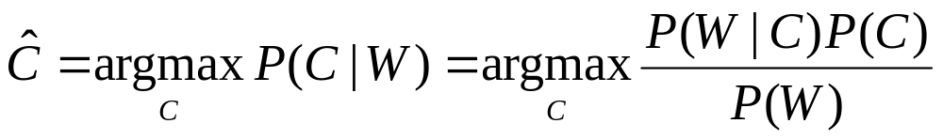
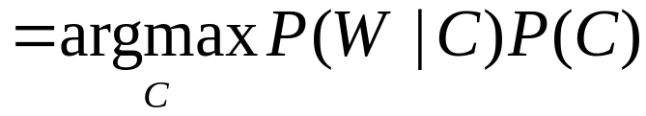
Statistical modelling for SLU
Given word sequence W, find semantic representation of meaning C that has maximum a posteriori probability P(C|W)
P(C): semantic model
P(W|C): Probability of word sequence W given C

Slide 41

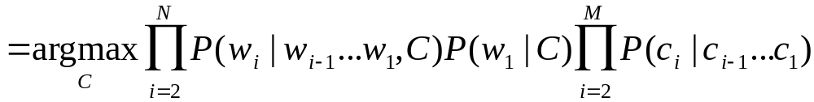
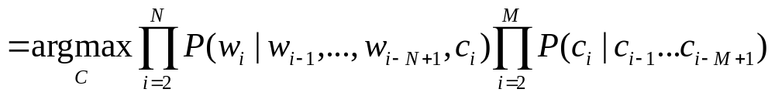

Assuming:

Slide 42
Early Examples
CHRONUS (AT&T: Pieraccini et al, 1992; Levin & Pieraccini, 1995)
  Finite state semantic tagger
  ‘Flat-concept’ model: simple to train but does not represent hierarchical structure
HUM (Hidden Understanding Model) (BBN: Miller et al, 1995)
  Probabilistic CFG using tree structured meaning representations
  Grammatical constraints represented in networks rather than rules
    Ordering of constituents unconstrained - increases robustness
    Transition probabilities constrain over-generation
  Requires fully annotated treebank data for training

Slide 43
5.1) Hidden Markov Models

Slide 44
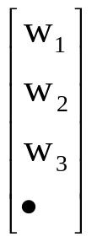

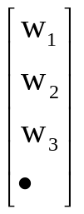
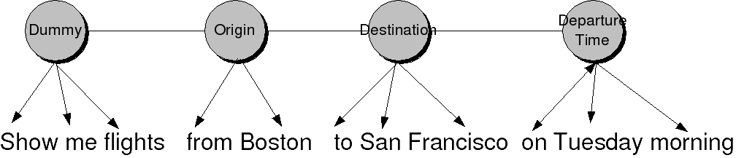
Hidden Markov Models
C2
P(C4|C2)
C1
C4
C3

Slide 45
Learning: Pairs of sequences of words/sequendes of concepts. It is necessary a set of manually labeled sentences
Recognizer: Viterbi algorithm
It can’t modelize long term constraints nor other more complex constraints. Good results in a flat semantic representation.

Slide 46
5.2) Finite State Automat Models

Slide 47
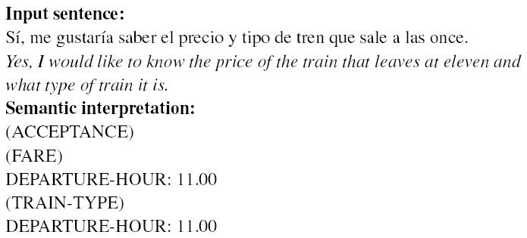
Speech Understanding: A two level approach
The semantic representation chosen for the task is based on the concept of frame.
SU: takes the sentence supplied by the recognition process as input and generates one or more frames.
Notes:
desarrollar páginas web controlables mediante la voz: prompts y entradas de voz.

Slide 48
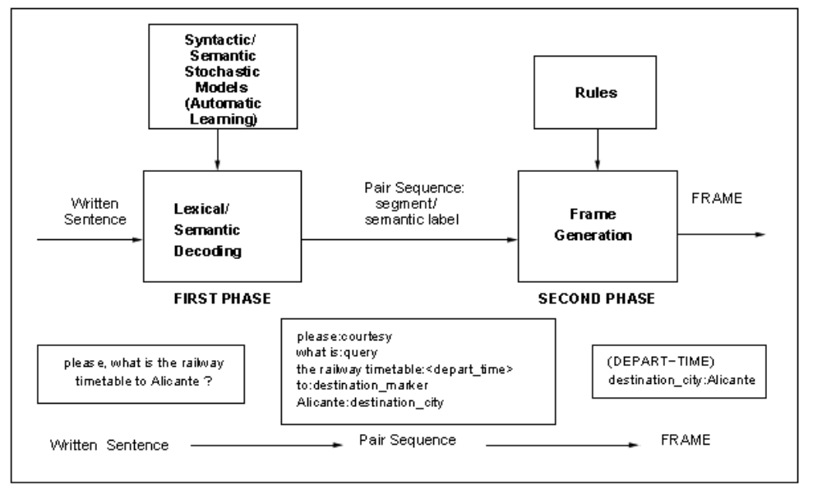

Slide 49
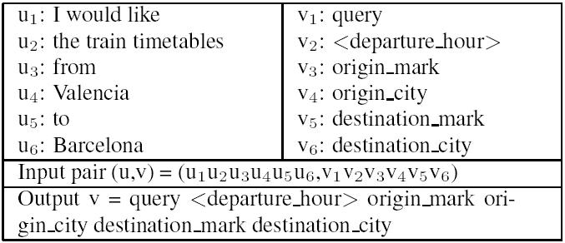
Speech Understanding module (SU)
The understanding process is done in two phases:
  First phase → translates the input sentence into a semantic sequence defined in an intermediate language (ISL).
Notes:
desarrollar páginas web controlables mediante la voz: prompts y entradas de voz.

Slide 50
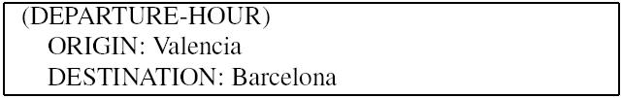
Speech Understanding module (SU)
  Second phase → translates this semantic sequence into its corresponding frame.
In this task, we identified 8 concepts (DEPARTURE-HOUR, ARRIVAL-HOUR, FARE, etc).
Each concept has a set of attributes associated to it (ORIGIN, DESTINATION, DEPARTURE-HOUR, ARRIVAL-HOUR, TRAIN-TYPE, etc).
Notes:
desarrollar páginas web controlables mediante la voz: prompts y entradas de voz.

Slide 51
Learning samples
query <dept_time> dest_m dest_city
Correct_value_mark time date
.
.
Learning samples
query
I would like
Please tell me
I want to know
´.
Learning samples
Destination_m
to
destination to
for going to
.
.
Semantic Units models
Semantic model
Integrated Model

Slide 52
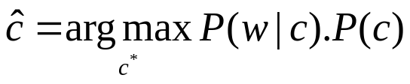
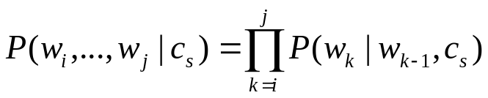
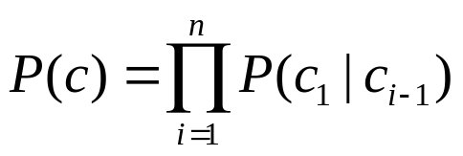
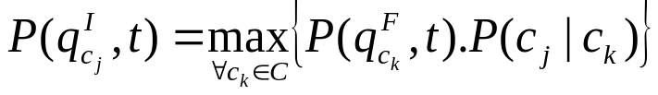
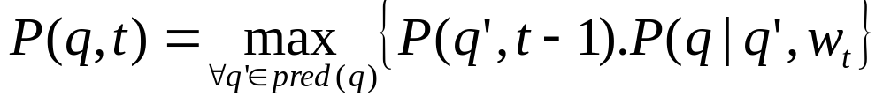


Understanding algorithm
where
Recognition algorithm over the integrated automaton
Where and are respectiveley the initial and final states of the nerwork associated to the concept c_{k}.
- Acoustic models can be also integrated in the network allowing for an integrated recognition/understanding process, considering semantic constraints
- Other ways to associate probabilies of observing segments of words in concepts states can be defined.

Slide 53
5.3) Hidden Understanding Models

Slide 54
Hidden Understanding Model (HUM) (Miller et al., 1996).
TREE STRUCTURED MEANING REPRESENTATIONS
Individual concepts appear as nodes in a tree, with component concepts appearing as nodes attached directly below
them.
Example: the concept of aflight in the ATIS domain has component concepts including airline,flight number, origin, and destination.
These could then form part of the representation for the phrase:
United flight 203 from Dallas to Atlanta.
The representation of the phrase flight 203 to Atlanta from Dallas on
United includes the same nodes.
The meaning of a tree structured representation is invariant with respect to the left-to-fight order of the component concept nodes.

Slide 55
Hidden understanding models: generative models
Two component statistical process.
The first component: the meaning (what to say). Semantic language model
The second component: the word sequences (how to say) lexical
realization model
Both can be considered as stochastic processes
Semantic language model
Meaning structures
Word sequences
Lexical realization model

Slide 56
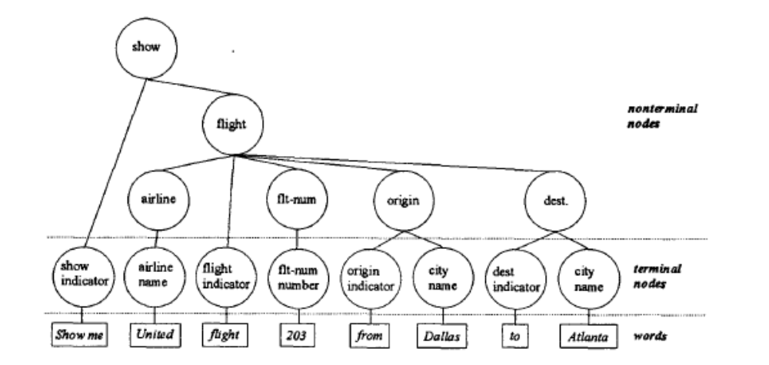

Slide 57
Semantic Language Model.
Each abstract concept corresponds to a Probabilistic State Transition Network.
All such networks are then combined into a single Probabilistic Recursive Transition Network, forming the entire Semantic Language Model.
P(State_{n}IState_{n-1},Context), is the probability of taking a transition from one state to another within a particular context.
For example, the arc from origin to dest has probability P(dest I origin,flight), meaning the probability of entering dest from origin, within the context of the flight network.
Lexical Realization Model
Just as in the semantic language model, terminal nodes correspond to networks in the lexical realization model. The difference is that semantic language networks specify transition probabilities between states, while lexical realization networks specify transition probabilities between words.
P( word_{n} l word_{n-1} ,context ) , which is the probability of taking a transition from one word to another given a particular context.
For example, P(showlplease, show-indicator ) is the probability that the
word show follows the word please within the context of a show indicator phrase.

Slide 58
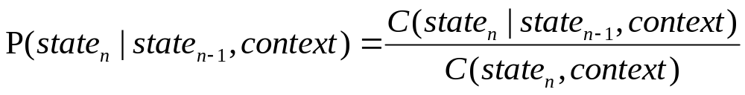
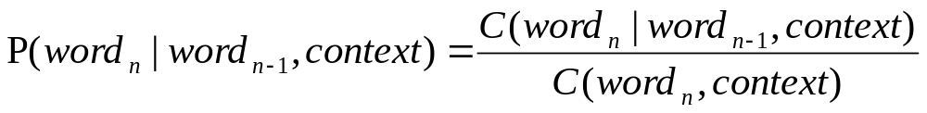
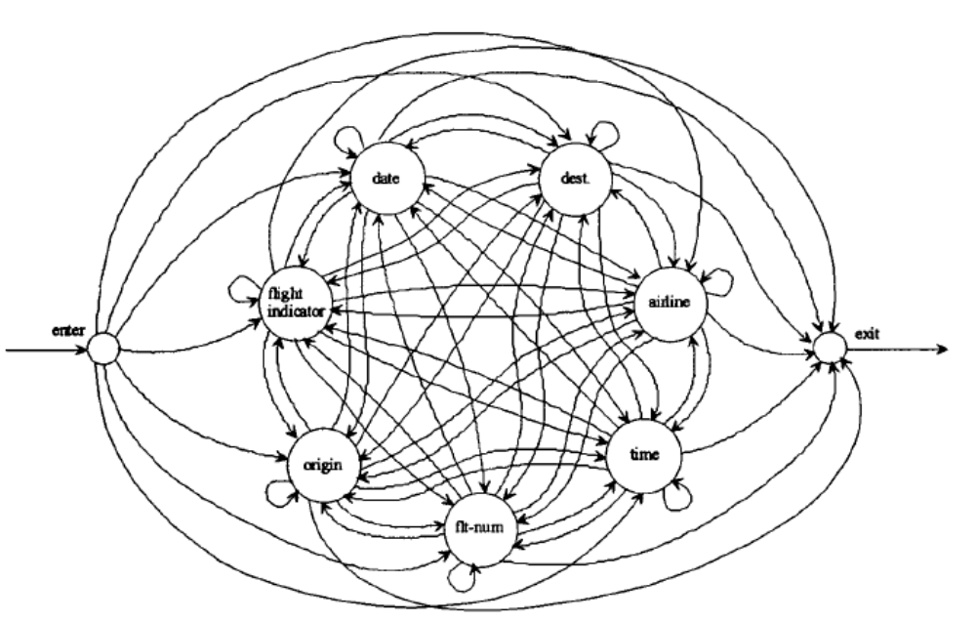
Training
Flight concept network

Slide 59
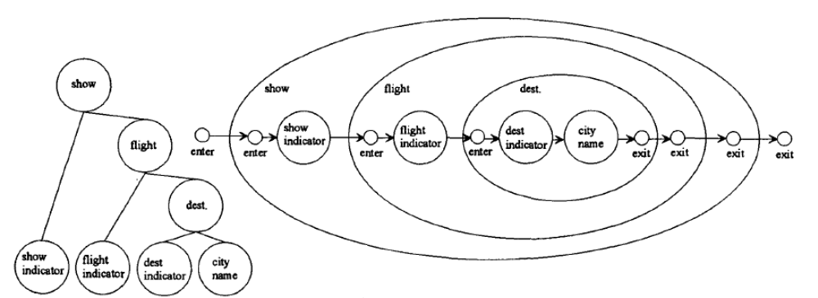
Understanding process.
The problem of understanding is to find the highest probability path among all possible paths.

Slide 60
5.4) Hidden Vector State models

Slide 61
Hidden Vector State (He & Young)
Extends ‘flat-concept’ HMM model
Represents hierarchical structure (right-branching) using hidden state vectors
  Each state expanded to encode stack of a push down automaton
  Avoids computational tractability issues associated with hierarchical HMMs
Can be trained using lightly annotated data

Slide 62
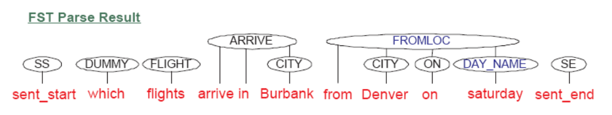
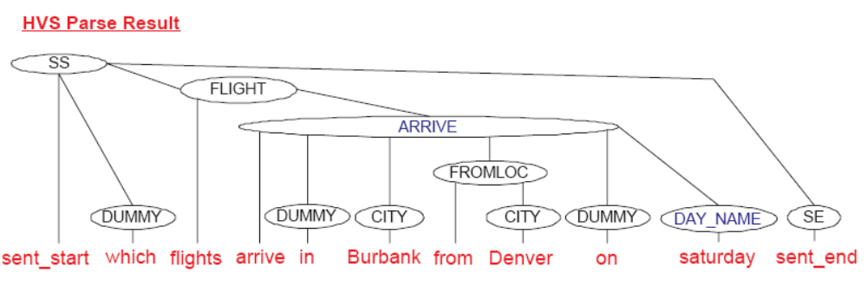
Which flights arrive in Burbank from Denver on Saturday?
Problem with long-distance dependency between ‘Saturday’ and ‘arrive’
‘Saturday’ associated with ‘FROMLOC’
Hierarchical model allows ‘Saturday’ to be associated with ‘ARRIVE’
Also: more expressive, allows sharing of sub-structures

Slide 63
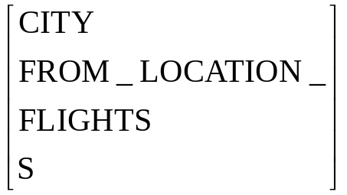
Hidden Vector state model
Each vector state is viewed as a hidden variable and represents the state of a push-down automaton. Such a vector is the result of pushing non-terminal symbols starting from the root symbol and ending with the pre-terminal symbol. Non-terminal symbols correspond to semantic compositions like FLIGHTS while pre-terminal symbols correspond to semantic constituents like CITY.
An example of state vector representing a path for a composition to the start symbol S is:

Slide 64
The HVS model can be seen as a constrained version of the HHMM in which the hidden state is a vector representing the stack of a push down automaton, constrained to produce only right-branching parses.
The HVS language model aims to dynamically learn hierarchical clusters and model long-range dependencies among words or more pop operations followed by a single push operation. Thus, the basic HVS model is a regular HMM in which each state encodes history in a fixed dimension stack-like structure.

Slide 65
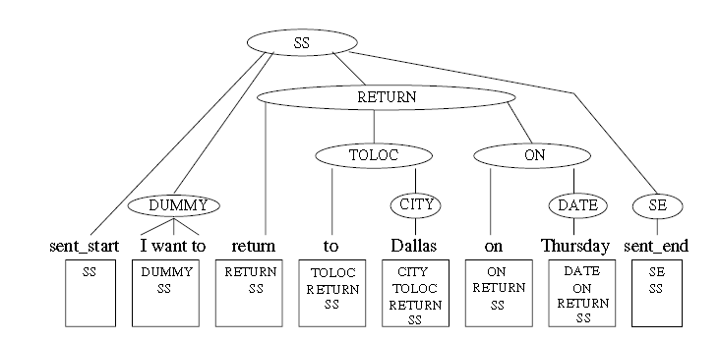
If the semantic concept labels are stored as a single vector, then the parse tree can be transformed into a sequence of vector states. Viewing each vector state as a hidden variable, the whole parse tree can be converted into a first order vector state Markov model, this is the HVS model

Slide 66
Indeed, given some maximum depth of the parse tree, any PCFG formalism can be converted to a first-order vector state Markov model. If we view each vector state as a stack, then state transitionsmay be factored into a stack shift by n positions followed by a push of one or more new preterminal semantic concepts relating to the next input word

Slide 67
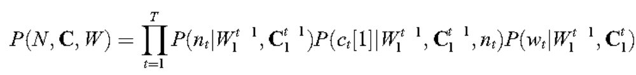


The HVS description
The joint probability P(N,C,W) of a series of stack shift operations N, a concept vector sequence C, and a word sequence W can be decomposed as follows:
Where denotes a sequence of vector states c₁,c₂ . . c_{t}
For example c_{t} can be [CiTY,TOLOC,RETURN,SS]
- denotes the previous semantic parse, up to position t -1,
n_{t} is the vector stack shift operation and takes values in the range 0. . D_{t-1}.
c_{t}[1]=c_{wt} is the new preterminal semantic tag assigned to word w_{t} at word position t.
Each move has now been factored into three terms:
choice of how many elements to pop from the stack,
the new concept label to push onto the stack
- and the word to generate given the new vector state.

Slide 68
Training
The semantic representation RETURN(TOLOC(CITY(Dallas))ON(DATE(Thursday)))
corresponding to the utterance
‘‘I want to return on Thursday to Dallas’’
would be expanded to the flattened concept sequence
RETURN RETURN+TOLOC RETURN+TOLOC+CITY(Dallas) RETURN+ON RETURN+ON+DATE(Thursday)

Slide 69
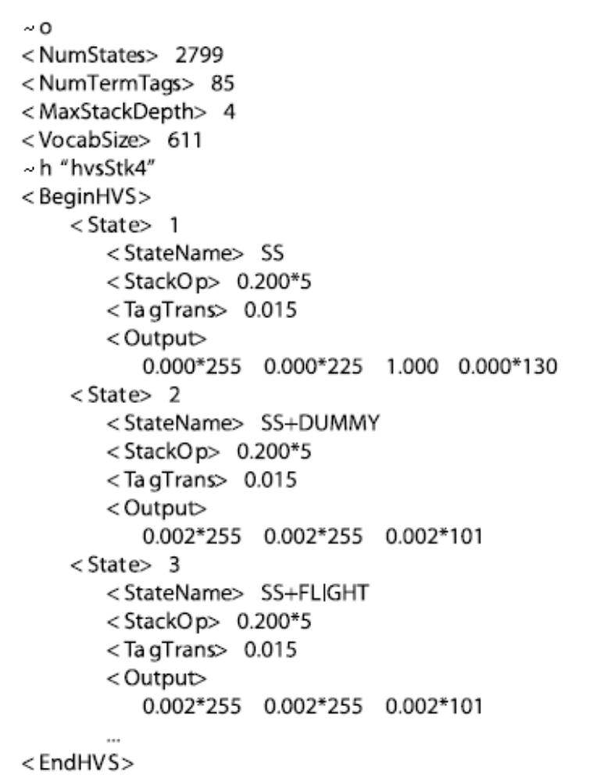
Example of the definition of a HVS model

Slide 70
6) Conditional Randon Fields

Slide 71
Conditional
Random Fields (CRF).
Previous approaches to SLU have modeled concept relations as stochastic semantic networks ranging from generative approach to discriminative. As spoken dialog systems complexity increases, SLU needs to perform understanding based on a richer set of features ranging from a-priori knowledge, long dependency, dialog history, system belief, etc.
Nevertheless discriminative approach, like sequential classification approach, or CRF, can handle many correlated features which would be difficult to integrate into generative models.

Slide 72
Classifier-based sequence labeling
The sequential classification views the labeling problem as a sequence
of classification problems.
Once, SVMs are binary classifiers, SVMs can be extended
to K-class classifiers using pairwise classification.
K ∗ (K − 1)/2 classifiers considering all pairs of classes.
It can also to apply bynary classifiers using a threshold to decide is a sample belongs to a class.

Slide 73
Conditional Random Fields
A CRF has a single exponential model for the joint probability of the entire sequence of labels given the observation sequence.
CRFs bring together the best of generative and classification
models. Like classification models, they accommodate many
statistically correlated features of the inputs and train them discriminatively.
Like generative models, they trade off decisions
at different sequence positions, however it is not so easy to integrate
them in the early stages of the speech recognition or with
word lattices.

Slide 74
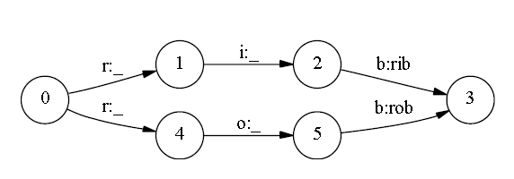
The Label Bias Problem
Figure represents a simple finite-state model designed to distinguish between the two words rib and rob.
Suppose that the observation sequence is r i b. In the first time step, r matches both transitions from the start state. Next we observe i. Both states 1 and 4 have only one outgoing transition. Thus, states with a single outgoing transition effectively ignore their observations.
States with low-entropy next state distributions will take little notice of observations.
If one of the two words is slightly more common in the training set, the transitions out of the start state will slightly prefer its corresponding transition, and that word’s state sequence will always win.

Slide 75
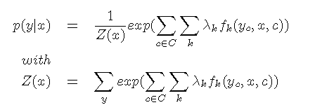
A conditional random field is defined by a dependency
graph G and a set of features fk to which are associated weights
λ_{k}. The conditional probability of an annotation given an observation
is given by:
These features take in parameter the values taken by the random variables (y_{c}) of the clique (c) to which they apply, and also the whole observation x. The weights λ_{k} associated to each features are the parameters of the model. Learning a CRF is to compute the weights λ_{k}.
There is an open source implementation of Conditional Random Fields.
T. Kudo, “Crf++.” [
Available: http://chasen.org/~taku/software/CRF++/

Slide 76
7) Active learning

Slide 77
Active learning (AT&T) (Gupta et al 2006)
Existing
model
Selective
sampled
data
Pooled data
Active
learning
Human
labeling
Labeling
Error
Detection
Labeled
data
Unlabeled
data
Model
training
Model
training
New
model

Slide 78
Active learning: to select and label only thos data items that improve the system performance the most. This minimizes the human labeling effort.
Only those examples for wich the confidence values output by the current model are below acertain threshold are selected. In this way new “situations” are included in the model.
The rest of examples, for which the current model outputs relatively higher confidence values are used in usupervised manner.
Active learning has the capability of to adapt to nonstationary events by means of a feedback mechanism. New request or significant changes are automatically identified and submitted for manual labeling.

Slide 79
Algorithm
1) Given some amount of human-labeled training data S_{t}, and a larger amount of unabeled data in the pool S_{p}={s₁,..,s_{n}}
2) While (labelers/utterances are available) do
2.1 Train a classifier using the current training data S_{t}.
2.2 Classify the utterances in S_{p} using this classifier, and compute
the confidence scores CS(s_{i}), i=1..,n
2.3 Label the set S_{k}={s_{i}: CS(s_{i})<th} manually
2.4 S_{t} = S_{t} ∪S_{k} and S_{u} =S_{u} ∪( S_{p} \ S_{k})
2.5 Aument the classifier with the machine-labekled data S_{u}.
2.6 Get the unlabeled data into the pool.

Slide 80
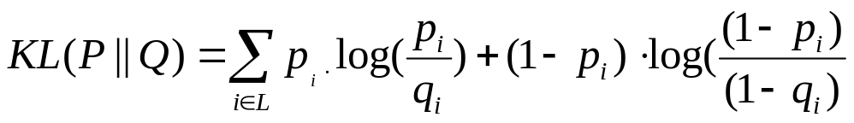
Labeling error detection
To identify the labeled data that is believed to be erroneous or inconsistent.
Confidence values obtained in the previuosly trained classifier are considered, and compare with the first pass
They use Kullback-Leibler (KL) divergence between the first pass of labeler asignad labels P and the outputs of the clasifier Q
Where q_{i} is the probability of the i^{th} call-type obtained by the classifier, and p_{i} is is the probability assigned by the labelers in the first pass {0 or 1}

Slide 81
8) Confidence measures

Slide 82
Confidence scores
Word Level: in this level, confidence measures provide an
idea about the accuracy of each recognized word. For this level we will use decoder and Language Model (LM) features.
Utterance Level: here, the target is the detection of out of
domain utterances. In this level we will use acoustic, LM and
parsing features.
Concept Level: The end-to-end system performance does not
change in cases where the phrases in a sentence that belong
to concepts are correctly recognized while the “filler” words
or phrases are not correctly recognized. In this level, we
focus on parts of phrases that are meaningful to the task.
Decoder, LM and parsing features will be used to tag the
concepts with the confidence measures.

Slide 83
WORDLEVEL
Normalized Score: acoustic score of the word divided by the
number of frames that it spans.
Count in the Nbest: percentage of times the word appears in
the 100-best hypotheses in similar position.
Lattice Density: number of altemative paths to the word
considered in the word-graph generated in the second pass of
the recognizer.
Phone Perplexity: average number of phones searched along
the frames where the recognized word has been active in the
decoding process.
Language Model Back-Off Behavior: back-off behavior of
an N-gram language model.
Language Model Score; the log-probability for each word in
a sequence as computed from a back-off language model.
.
.

Slide 84
UTTERANCE LEVEL
- Average Word Confidence: The average score per
word from all models for the top-choice hypothesis
- Top-Choice Total N-gram Score: The total score of
the N-gram model for the top-choice hypothesis.
-Top-Choice Average N-gram Score: The average
score per word of the N-gram model for the top-choice
hypothesis.
- Top-Choice Average Acoustic Score: The average
acoustic score per acoustic observation for the topchoice
hypothesis.
- Lexical Score Drop: The drop in the total N-gram
score between the top hypothesis and the second hypothesis
in the N-best list.
.
.
.

Slide 85
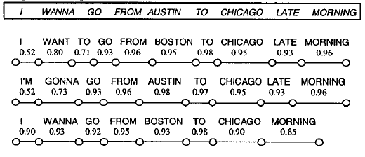
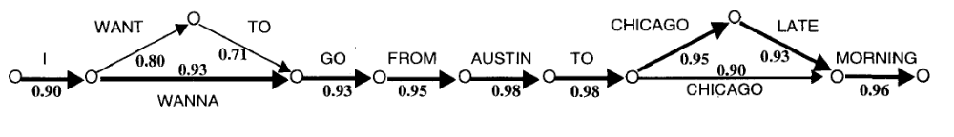

Slide 86
CONCEPT LEVEL
- Average word confidence in the words belonging to the rule
used to get the concept.
- Average word confidence for the value of the concept:
average word confidence for the words that can be
considered as the value of the concept. Considering the
sentence: “I wanna go to Chicago.”: the phrase “go to
Chicago” contain the words belonging to the rule applied to
get the concept: [Arrival City], and “Chicago” is the value for
ths concept.
- Concept count in the 100-Best: Each hypothesis in the 100-
best are parsed and the percentage of times that a concept
appears in the hypotheses are counted.
- Concepts and value count in the 100-Best: in this case we
consider the number of times that a concept appears with the
same value along the 100-best hypotheses.
- Language Model Back-Off Behavior: back-off behavior of
an N-gram language model.
- Language Model Score: the log-probability for each concept
in a sequence as computed from a back-off language model.

Slide 87
Evaluation of confidence measures
Note that the main problems in Understanding in Dialog systems are Insertions, and Substitutions. Therefore the criteria to accept/reject hypothesis must be based in this principle.

Slide 88
Evaluation of Confidence measures (Curve ROC)
100
Correct Aceptance
0
False Aceptance

Slide 89
9) Evaluation

Slide 90
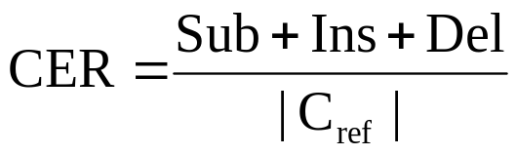
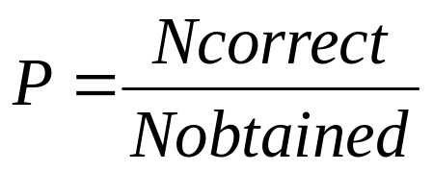
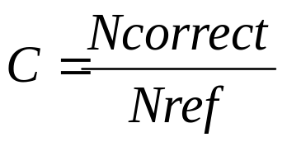
Evaluation
Concept error rate
- Sequence of concepts.
- Frame slots (attribute/value pairs)
Precision
Coverage

Slide 91
References
R. De Mori, “Spoken dialogues with computers” Academic Press, 1998
Jurafsky, D. & Martin, J. (2000) Speech and Language Processing, Prentice-Hall
Bangalore, S., Hakkani-Tür, D., Tur, G. (eds), (2006) Special Issue on Spoken Language Understanding in Conversational Systems. Speech Communication 48.
Gupta, N., Tur, G., Hakkani-Tür, D., Bangalore, S., Riccardi, G., Gilbert, M. (2006) The AT&T Spoken Language Understanding System. IEEE Transactions on Speech and Audio Processing 14:1, 213-222.
Miller, S., Stallard, D., Bobraw, R., Schwartz, R, "A Fully Statistical Approach to Natural Language Interfaces,“ Proceedings of the ACL, June, 1996.
Yulan He, Steve Young “Semantic processing using the Hidden Vector State model” Computer Speech and Language 19 (2005) 85–106
Christian Raymond, Giuseppe Riccardi “Generative and Discriminative Algorithms for Spoken Language Understanding” Interpeech2007
Ruhi Sarikaya, Yuqing Gao, Michael Picheny, Fellow, and Hakan Erdogan “Semantic Confidence Measurement for Spoken Dialog Systems” IEEE TRANSACTIONS ON SPEECH AND AUDIO PROCESSING, VOL. 13, NO. 4, JULY 2005

Slide 92
D Hakkani-Tur , G. Riccardi, and G. Tur, “An Active Approach to spoken Language Processing'', ACM Trans. on Speech and Language Processing, 3(3): 1-31, 2006.
T.J. Hazen and S. Seneff and J. Polifroni, “Recognition confidence scoring and its use in speech understanding systems,” Computer Speech and Language, 2002, vol 16, pp. 49-68.
Y. He and S. Young, “Spoken language understanding using the Hidden Vector State Model”,Speech Communication vol. 48, pp.262–275, 2006.
R. Pieraccini, E. Levin and C.H.Lee, “Stochastic Representation of Conceptual Structure in the ATIS Task.” Proc. Speech and Natural Language workshop, 121-124, Los Altos, 1991.
S. Seneff, “TINA: A Probabilistic Syntactic Parser for Speech Understanding Systems.” IEEE ICASSP, vol. 2, pp. 711-714. Glasgow, UK., 1989.
Christian Raymond and Giuseppe Riccardi,"Generative and Discriminative Algorithms for Spoken Language Understanding" Interspeech, Antwerp, Belgium, August 2007
Rub& San-Segundo’, Bryan Pellom, Kadri Hacioglu, Wayne Ward “Confidence measures for spoken dialogue systems” IEEE TRANSACTIONS ON SPEECH AND AUDIO PROCESSING, VOL. 13, NO. 4, JULY 2005
J. D. Lafferty, A. Mccallum, and F. C. N. Pereira, “Conditional random fields: Probabilistic models for segmenting and labeling sequence data,” in ICML, 2001, pp. 282–289.

