Slide 1
DEEP MURMUR : AI DRIVEN PHONOCARDIOGRAM ANALYSIS FOR DETECTING HEART MURMUR
MENTOR : Dr. Y. NANCY JANE
TEAM A25 :
SANTHOSH S (2022503042)
RAMANATH PRABHU V B (2022503550)
SURESH KUMAR K (2022503708)

Slide 2
PROBLEM STATEMENT
Develop an AI-driven system for automated heart murmur detection using phonocardiogram (PCG) signals with minimal human intervention.
Leverage time-series analysis with Multi head self attention transformer and PatchTST for accurate and early murmur classification.
Enhance noise robustness to mitigate background disturbances and recording variations for reliable detection.
Utilize ensemble learning and time-series anomaly detection to differentiate normal and abnormal heart sounds effectively.

Slide 3
LITERATURE SURVEY
Title | Author & Year of Publication | Methodology (Including Dataset) | Results/Inferences
Beyond Heart Murmur Detection: Automatic Murmur Grading from Phonocardiogram [1] | A. Elola et al. IEEE Journal of Biomedical and Health Informatics, vol. 27, no. 8, pp. 3856-3866, Aug. 2023 | Develop a CNN-based deep learning algorithm for multi-class murmur detection and grading using pediatric heart sound recordings.(CirCor DigiScope phonocardiogram dataset) | The CNN-based model accurately graded heart murmurs, with uncertainty estimation improving reliability and misclassification detection.
Heart Murmur Severity Stages Classification Using Multikernel Residual CNN [2] | S. Das and S. Dandapat IEEE Sensors Journal, vol. 24, no. 8, pp. 13019-13027, 15 April 2024 | Develop an MK-RCNN model for automatic heart murmur severity classification using PCG signals. (CirCor DigiScope, HSM, and CICC 2016 databases) | The model effectively classifies murmur severity directly from raw PCG signals, demonstrating robustness. real-time processing efficiency and adaptability to unseen noise.
Precision Diagnosis:An Automated Method for Detecting Congenital Heart Diseases in Children From Phonocardiogram Signals Employing Deep Neural Network [3] | H. K. Alkahtani et al. IEEE Access, vol. 12, pp. 76053-76064, 2024 | Used 1D CNN for binary classification of congenital heart diseases (Local dataset from hospitals, University of Michigan dataset). | The model demonstrated high accuracy and reliability in distinguishing normal and abnormal heart sounds.

Slide 4
LITERATURE SURVEY
Title | Author & Year of Publication | Methodology (Including Dataset) | Results/Inferences
Classification of Phonocardiogram Signals Using Wavelet Scattering Transform and Equilibrium Optimization [4] | A. Q. Aldhahab, M. R. Ismael, and H. J. Abd IEEE Access, vol. 12, pp. 191231-191242, 2024 | Applied wavelet scattering and equilibrium optimization with KNN for PCG classification (CirCor DigiScope dataset). | The proposed model effectively distinguishes normal and abnormal PCG signals, outperforming conventional methods. But the computational cost of wavelet-based transformations may impact real-time processing feasibility.
Identification of Congenital Valvular Murmurs in Young Patients Using Deep Learning-Based Attention Transformers and phonocardiograms. [5] | M. Alkhodari, L. J. Hadjileontiadis, and A. H. Khandoker IEEE Journal of Biomedical and Health Informatics, April 2024 | Develop a attention transformer model for early detection of congenital heart disease (CHD) by analyzing phonocardiogram (PCG) recordings. (CirCor DigiSCope database). | Deep learning-based PCG analysis enables accurate murmur classification, minimizing reliance on expert assessment and costly diagnostics.
An RNN-Bi LSTM Based Multi Decision GAN Approach for the Recognition of Cardiovascular Disease (CVD) From Heart Beat Sound: A Feature Optimization Process [6] | N. A. Vinay et al. IEEE Access, vol. 12, pp. 65482-65502, 2024. | Implement Bi-LSTM with GANs to detect cardiovascular diseases from PCG signals.(PASCAL Database). | The RNN-Bi LSTM based Multi Decision GAN achieves remarkable accuracy, sensitivity, and specificity in CVD recognition, making it a valuable tool for early detection of the disease.

Slide 5
LITERATURE SURVEY
Title | Author & Year of Publication | Methodology (Including Dataset) | Results/Inferences
Automated Detection of Heart Valve Diseases Using Stationary Wavelet Transform and Attention-Based Hierarchical LSTM Network [7] | S. Das, D. Jyotishi, and S. Dandapat IEEE Transactions on Instrumentation and Measurement, vol. 72, pp. 1-10, 2023. | A hierarchical LSTM model with a stationary wavelet transform (SWT) and attention mechanism was used to classify heart valve diseases. (CinC 2016 Database and HSM Database). | The proposed method is reliable for supporting clinicians in preliminary healthcare checkups but requires further validation for large-scale clinical deployment.
Automated Heart Sound Activity Detection Using Time–Frequency-Domain Deep Neural Network [8] | S. K. Ghosh et al. IEEE Transactions on Instrumentation and Measurement, vol. 71, pp. 1-10, 2022 | A deep neural network (DNN) using stacked autoencoders and time-frequency domain analysis was applied for heart sound segmentation. (Michigan Heart Sound and Murmur Database (MHSDB) and PhysioNet CinC 2016 dataset). | The proposed approach effectively identifies fundamental heart sound (FHS) components from PCG signals using a modified Gaussian window-based Stockwell transform and autoencoder-based deep neural network.

Slide 6
LITERATURE SURVEY
Title | Author & Year of Publication | Methodology (Including Dataset) | Results/Inferences
Deep Learning Based Heart Murmur Detection Using Frequency-time Domain Features of Heartbeat Sounds [9] | JJ. Lee et al.,(2022 Computing in Cardiology (CinC)) | The model extracts 2D frequency-time features from phonocardiogram (PCG) signals using log-mel spectrogram, STFT, and CQT. These features are fed into Convolutional Neural Networks (CNN) and Light CNN (LCNN) for heart murmur detection. The system was trained and evaluated using PhysioNet 2022 dataset. | The proposed model effectively identified heart murmurs and clinical outcomes using log-mel spectrograms and Light CNN.
Heart Murmur Detection from Phonocardiogram Recordings using Deep Learning Techniques.[10] | N. S. Bathe and V. Ingale 2022 International Conference on Futuristic Technologies (INCOFT), Belgaum, India, 2022 | The system takes PCG audio signals as input and extracts relevant features for analysis. Machine learning models like SVM and CNN are trained on labeled PCG data to classify the signals as normal or murmur. | The proposed system successfully detects and classifies different types of heart murmurs from PCG recordings. It supports accurate and efficient diagnosis, helping in the early identification of cardiac abnormalities.
Table 1: Literature Survey

Slide 7
LIMITATIONS
Traditional ML models require handcrafted features, which may not capture complex murmur patterns effectively.
Background noise and variations in stethoscope placement significantly impact the accuracy of existing detection methods.
Many models fail to leverage the sequential nature of phonocardiogram (PCG) signals effectively.
Limited robustness in detecting low-intensity murmurs, leading to false negatives.

Slide 8
OBJECTIVES
To enhance noise robustness to minimize the impact of background interference.
To capture long-term dependencies and temporal patterns in PCG signals for improved murmur classification.
To develop an ensemble learning framework combining Multi head self attention transformer and PatchTST models to enhance classification accuracy and robustness across diverse datasets.
To improve model generalization across different recording conditions.
To ensure computational efficiency for real-time classification.

Slide 9
DATASET DESCRIPTION
The CirCor DigiScope Phonocardiogram Dataset.
Total number of patients : 56549184 samples (164 patients)
Number of patients with present murmur : 24998528 samples (77 patients)
Number of patients with absent murmur : 31550656 samples (87 patients)
Sampling rate of .wav files : 4000 Hz
Number of recordings per patient : 4 valve recordings

Slide 10
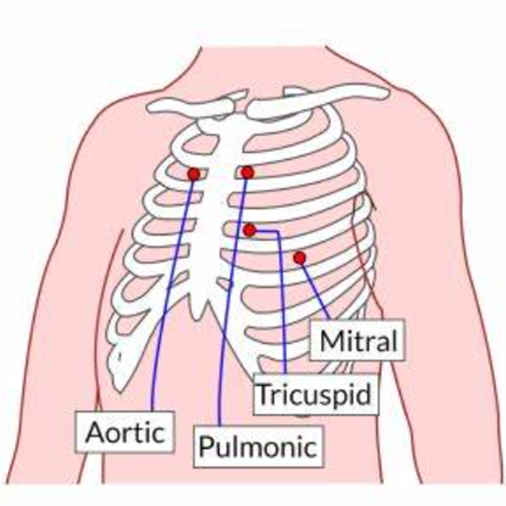
DATASET DESCRIPTION
Heart Valves and their location
Aortic - 2nd right intercostal space in right sternal border.
Pulmonary - 2nd left intercostal space in left sternal border
Tricuspid - 4th left intercostal space in left sternal border
Mitral - 5th left intercostal space in midclavicular line.
Fig 1: Locations of valves in human heart
https://upload.wikimedia.org/wikipedia/commons/1/14/Cardiac_Auscultation_PNG.png?20200422054236

Slide 11
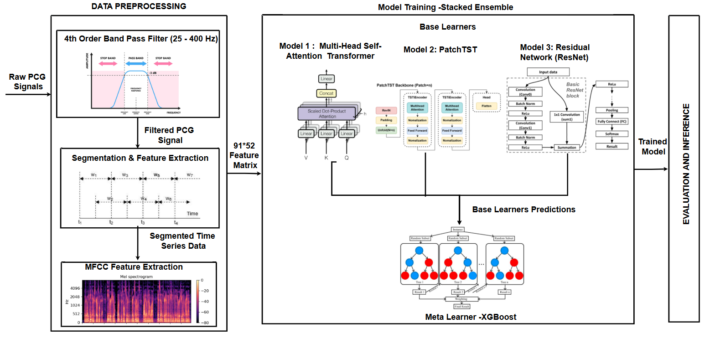
BLOCK DIAGRAM
Fig 2: Architecture Diagram

Slide 12
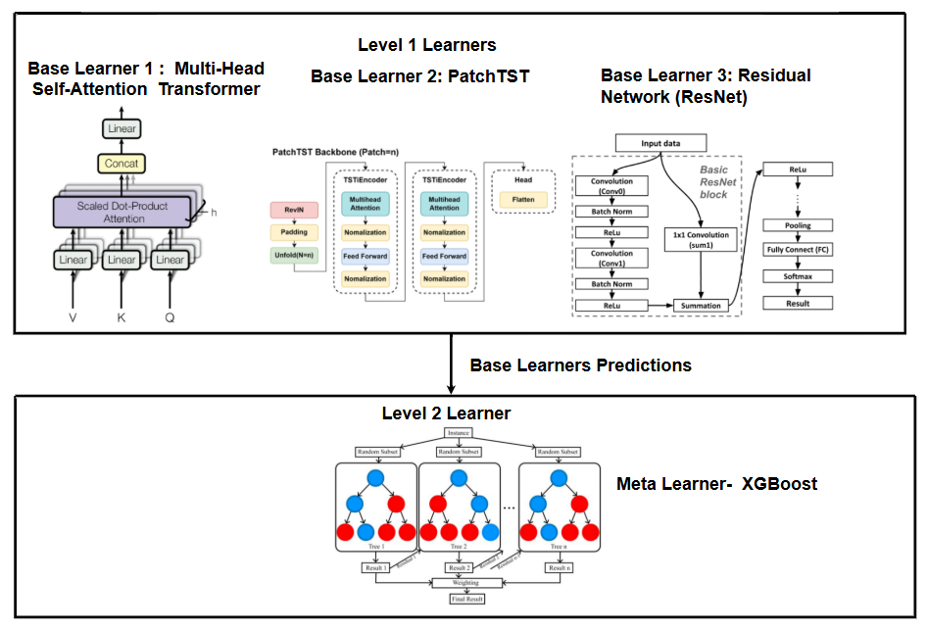
NETWORK DIAGRAM
Fig 3: Network Diagram

Slide 13
MODULES DESCRIPTION
MODULE | KEY ACTIVITIES
Data Preprocessing and Feature Extraction | Applied a 4th order bandpass filter (25 to 400 Hz) for noise reduction. Segmented heart sounds (S1, S2, murmurs) for better feature representation. Extracted Mel Frequency Cepstral Coefficients (MFCCs) from PCG signals.
Model Training | Trained a Multi-Head Self-Attention Transformer for time-series classification. Implemented and trained a PatchTST model from Hugging Face. Trained a resent model for classification. Used stacked ensemble (XGBoost ) model to improve accuracy.
Evaluation and Inference | Calculate accuracy to measure the overall correctness of predictions. Generate a confusion matrix to analyze true positives, false positives, true negatives, and false negatives.
Table 2: Modules Description

Slide 14
PCG_FILTERING ALGORITHM
Algorithm: PCG_Filtering(X,Sr,LowCut,HighCut,Order):
//Input: Raw PCG Signal (X) ,Sampling rate (Sr), Lower Cutoff Frequency(LowCut), Higher Cutoff Frequency(HighCut),Order of Bandpass Filter(Order).
//Output: Filtered PCG signal.
For each sample in PCG_data do
Compute normalized cutoff frequencies:
low=lowcut/(0.5×Sr)
high=highcut/(0.5×Sr)
Apply a Butterworth bandpass filter of 4th order;
Store the filtered sample in Filtered_Signal
End for

Slide 15
FEATURE_EXTRACTOR ALGORITHM
Algorithm: Feature_Extractor(X, Sr, Window_Size, Overlap, N_MFCC):
//Input: Filtered PCG Signal (X), Sampling rate (Sr), Size of the sliding window(Window_Size), Overlap of the window(Overlap), Number of MFCC coefficients (N_MFCC).
//Output: Extracted MFCC features.
Compute segmentation parameters:
step_size = (Window_Size − Overlap) × Sr
window_length = Window_Size × Sr

Slide 16
FEATURE_EXTRACTOR ALGORITHM
For each segment in X with step size step_size:
Extract segment of length window_length.
Compute MFCC features:
MFCC = librosa.feature.mfcc(y=segment, sr=Sr, n_mfcc=N_MFCC)
Compute mean across time axis:
MFCC_features = mean(MFCC, axis=1)
Append MFCC_Features to the output list
Return the extracted MFCC features.
End For

Slide 17
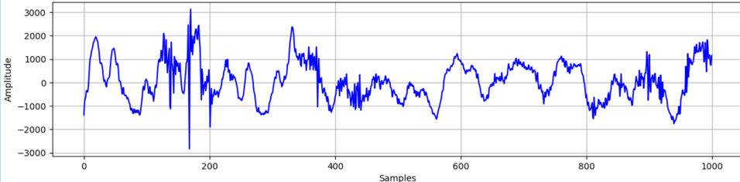
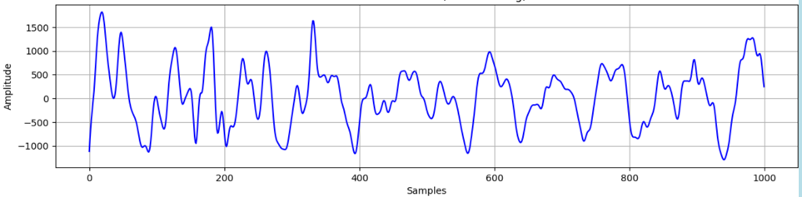
EXECUTION RESULT
Fig 4: Raw PCG data before filtering
Fig 5: Filtered PCG Signal

Slide 18
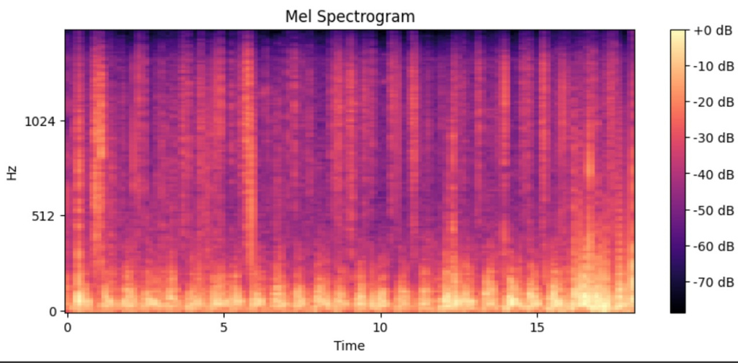
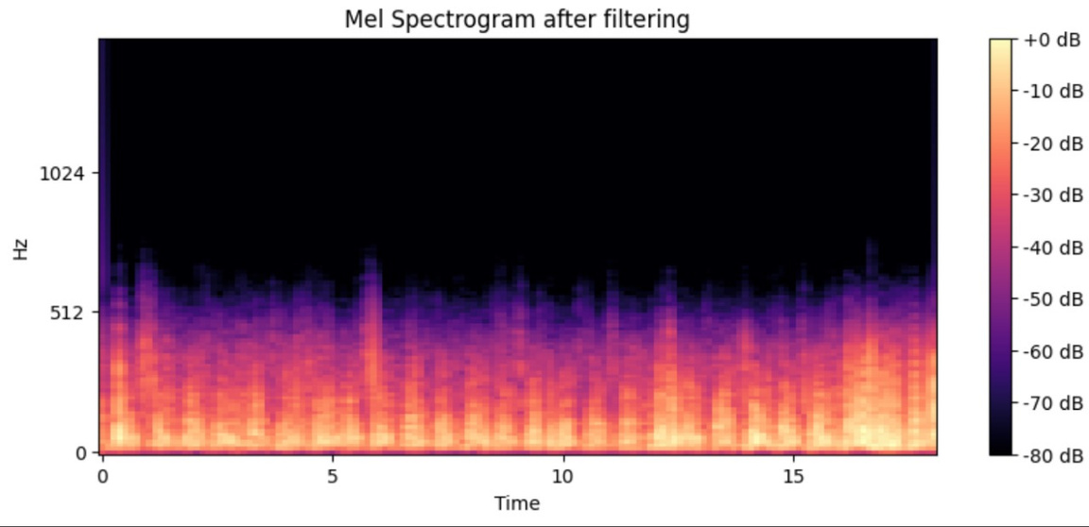
EXECUTION RESULT
Fig 6: Before Filtering (Raw PCG Signal)
Fig 7:After Filtering (PCG Signal)

Slide 19
HMT ALGORITHM
BASE LEARNER 1 –MULTI HEAD SELF ATTENTION TRANSFORMER
ALGORITHM:HMT(Feature_Matrix, Segments, MFCC_Features, Num_Heads, Num_Layers,Epochs,Batch_Size,Optimizer):
//Input:
Feature_Matrix- MFCC feature matrix of shape Segments * MFCC_Features
Segments = 91 (Number of windowed segments from the PCG signal)
MFCC_Features = 52 (Extracted MFCC coefficients across 4 heart valves).
Num_Heads = 4 (Number of attention heads).
Num_Layers = 6 (Number of Transformer encoder layers).
Epochs = 50, Batch_Size = 41, Optimizer = Adam.
//OUTPUT:
Binary classification of murmur(0: Absent, 1: Present).

Slide 20
HMT ALGORITHM
Project Feature _Matrix into a 128-dimensional space using a dense layer.
Add sinusoidal positional encoding for sequence retention.
For each of the 6 Transformer encoder layers:
Apply 4-head self-attention, add residual connections, normalize, and pass through a 2-layer feed-forward network.
Aggregate features using Global Average Pooling (GAP).
For each epoch:
Optimize using Adam with binary cross-entropy loss.
Update weights with a batch size of 41.
Validate performance after each epoch.
Classify using a sigmoid-activated dense layer for binary output.

Slide 21
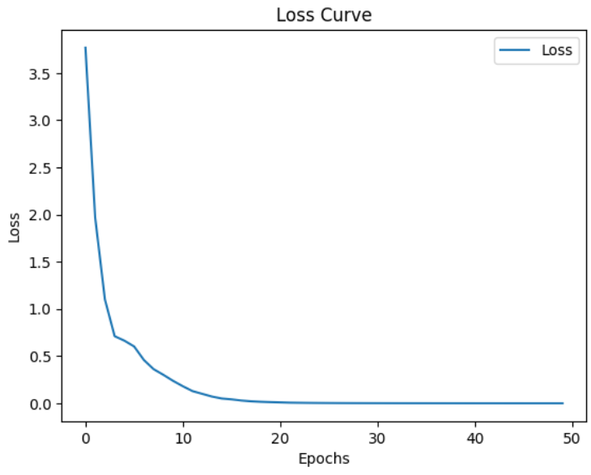
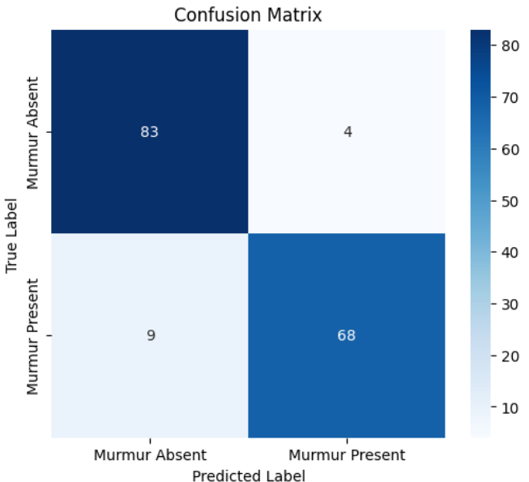
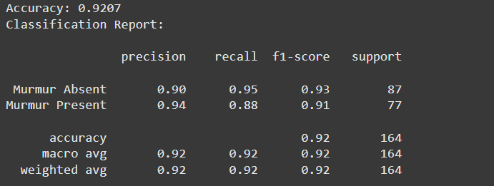
EXECUTION RESULT
Fig 8: Execution result of Multi Head Self Attention Transformer

Slide 22
P_TST ALGORITHM
BASE LEARNER 2 –Patch TST
ALGORITHM:P_TST(Feature_Matrix, config, epochs, batch_size, lr, weight_decay):
//Input:
Feature_Matrix X(91×52)
PatchTST configuration (config),
Training parameters: epochs, batch_size, lr, weight_decay.
//Output:
Binary classification of murmur(0: Absent, 1: Present).

Slide 23
P_TST ALGORITHM
Initialize PatchTST with 52 input channels, 91 context length, 12 patch length, 0.5 dropout, and CLS token.
Normalize Feature_Matrix and split into train-test sets, and load with batch size 16.
Train for 200 epochs using CrossEntropyLoss and Adam optimizer (lr = 1e-4, weight_decay = 1e-3).
For each epochs:
Perform a forward pass and compute the loss.
Backpropagate the error and update the weights.
Track the average loss across all batches.
Compute average loss and log progress.
End For

Slide 24
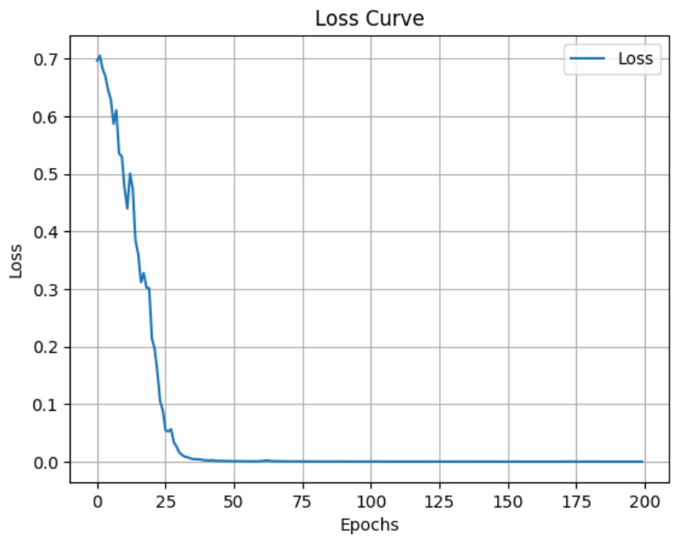
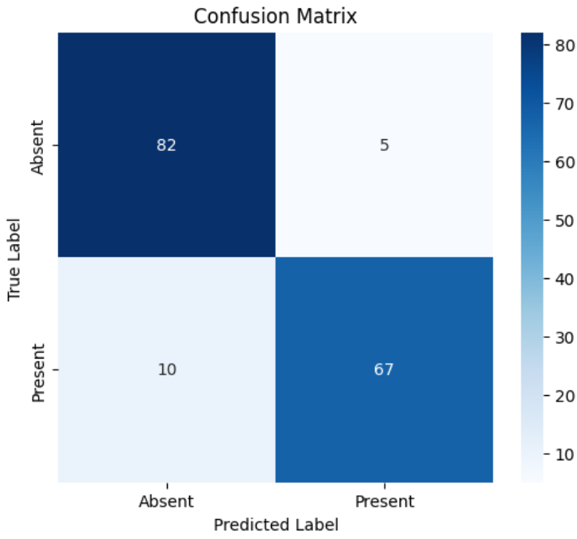
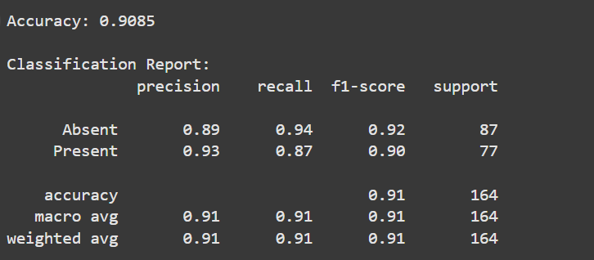
EXECUTION RESULT
Fig 9: Execution result of PatchTST

Slide 25
RESNET18 ALGORITHM
BASE LEARNER 3 –Resnet18 (Residual Neural Network)
ALGORITHM:Resnet18(Feature_Matrix, epochs, batch_size, optimizer,loss function):
//Input:
Feature_Matrix: A NumPy array of shape (91, 52) containing MFCC features for 91 time segments, each with 52 extracted MFCC coefficients.
Epochs: 150 epochs for training.
Batch_Size: 16 for each training and validation batch.
Optimizer: Adam with learning rate of 0.001.
Loss Function: CrossEntropyLoss with label smoothing (0.1).
//Output:
Binary classification of murmur(0: Absent, 1: Present).

Slide 26
RESNET18 ALGORITHM
Initialize ResNet18 model with 2 output classes for binary classification.
Load the extracted MFCC features from CSV files.
Split data into training and validation sets.
Create MFCC Dataset and use Data Loader to load batches.
For each epoch:For each batch:
Perform forward pass and calculate loss using Cross Entropy Loss.
Backpropagate and update weights.
Track average training loss.
Save the trained model to a .pkl file after training.

Slide 27
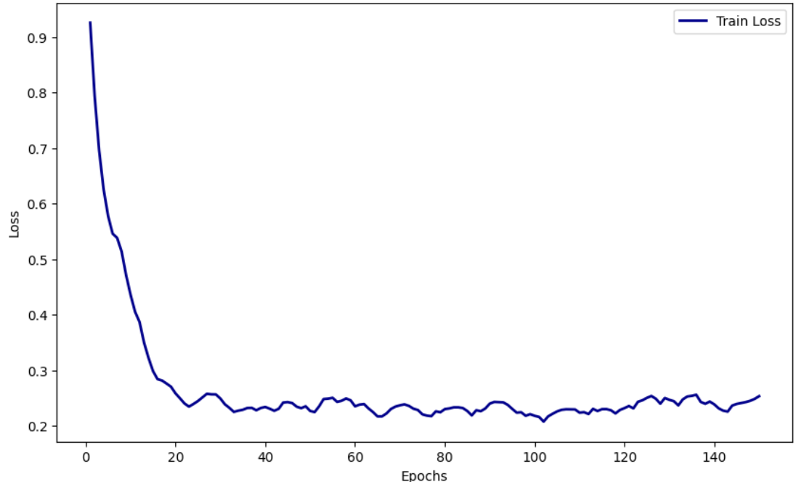
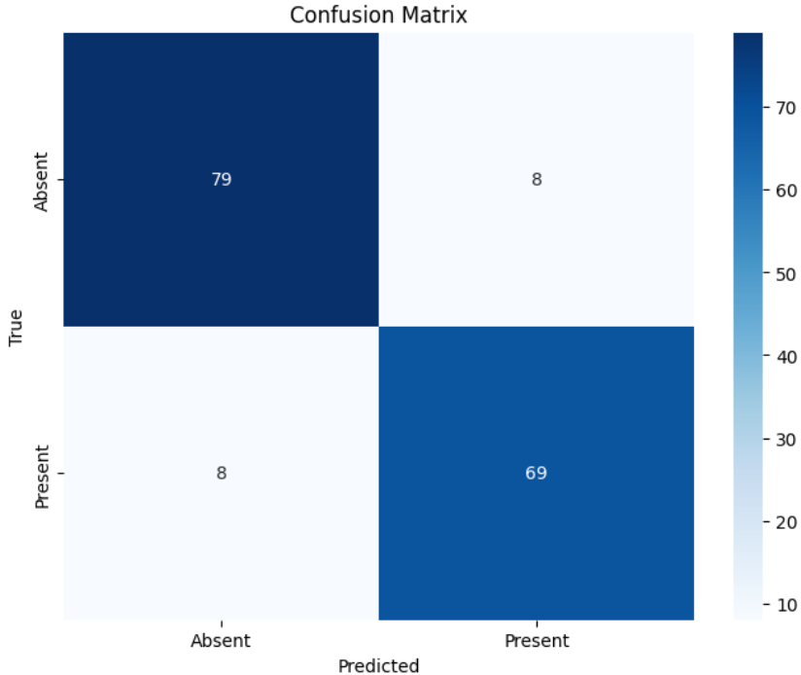
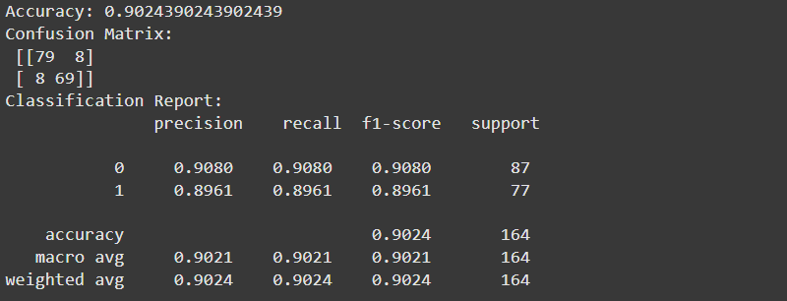
EXECUTION RESULT
Fig 10: Execution result of Resnet18

Slide 28
XGBOOST ALGORITHM
META LEARNER – XGBoost ALGORITHM:
XGBoost_Ensemble(Pred1, Pred2, Pred3, y_true, k=5)
// Input:
Predictions from three base learners.
Ground truth labels (y_true).
Number of folds for cross-validation (k=5).
// Output:
Final binary murmur classification (0: Absent, 1: Present).

Slide 29
XGBOOST ALGORITHM
Load prediction files and true labels from saved directory.
Stack predictions to form input features for XGBoost.
Perform 5-fold Stratified Cross-Validation.
Train XGBoost on 4 folds, evaluate on 1 fold.
Track predictions, accuracy, and log loss.
Plot training loss (log loss) for all folds.
Generate average accuracy, classification report, and confusion matrix.
Print model summary and estimate total FLOPs.

Slide 30
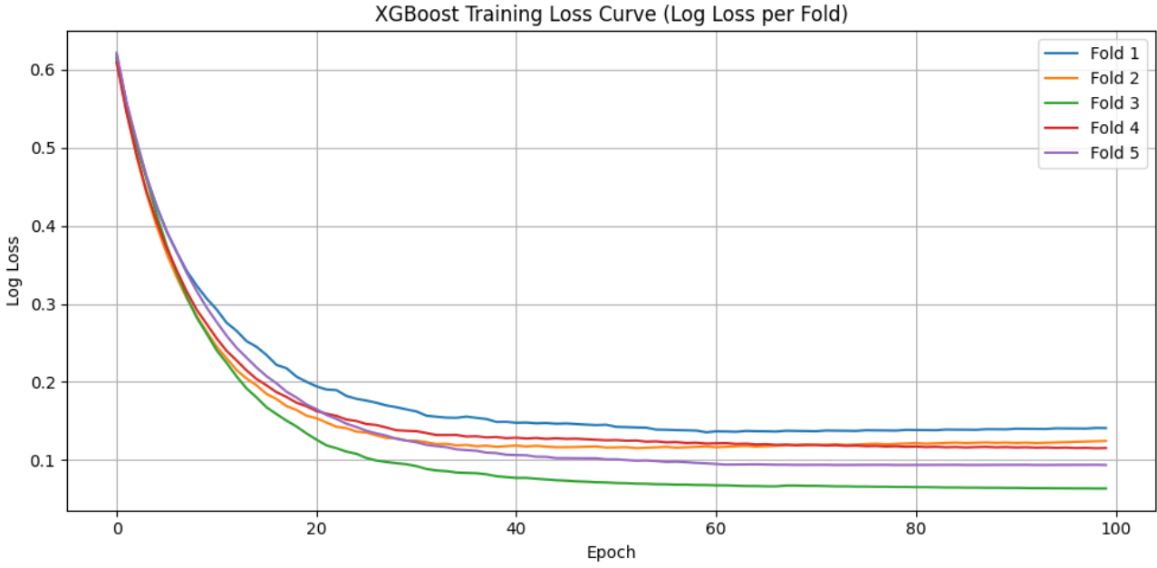
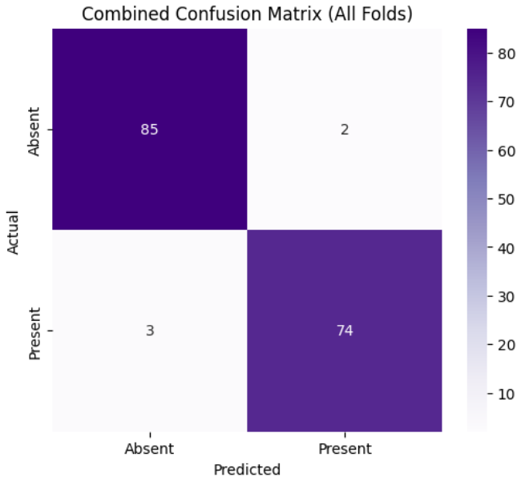
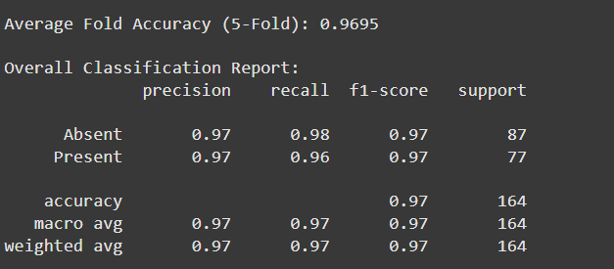
EXECUTION RESULT
Fig 11: Execution result of XGBoost

Slide 31
COMPARATIVE ANALYSIS
MODELS | ACCURACY
Base Learners -Multi Head Self Attention Transformer & Patch TST Meta Learner –XGBoost | 91.52
Base Learners - Multi Head Self Attention Transformer & Resnet Meta Learner –XGBoost | 90.91
Base Learners -Patch TST & Resnet Meta Learner –XGBoost | 88.43
Base Learners - Multi Head Self Attention Transformer,Patch TST & Resnet Meta Learner- Random Forest Classifier | 91.52
Base Learners -Multi Head Self Attention Transformer,Patch TST & Resnet Meta Learner- XGBoost | 96.95
Table 3: Comparative Analysis

Slide 32
REFERENCES
A. Elola et al., "Beyond Heart Murmur Detection: Automatic Murmur Grading From Phonocardiogram," in IEEE Journal of Biomedical and Health Informatics, vol. 27, no. 8, pp. 3856-3866, Aug. 2023, doi: 10.1109/JBHI.2023.3275039.
S. Das and S. Dandapat, "Heart Murmur Severity Stages Classification Using Multikernel Residual CNN," in IEEE Sensors Journal, vol. 24, no. 8, pp. 13019-13027, 15 April15, 2024, doi: 10.1109/JSEN.2024.3373226
H. K. Alkahtani, I. U. Haq, Y. Y. Ghadi, N. Innab, M. Alajmi and M. Nurbapa, "Precision Diagnosis: An Automated Method for Detecting Congenital Heart Diseases in Children From Phonocardiogram Signals Employing Deep Neural Network," in IEEE Access, vol. 12, pp. 76053-76064, 2024, doi: 10.1109/ACCESS.2024.3395389.
A. Q. Aldhahab, M. R. Ismael and H. J. Abd, "Classification of Phonocardiogram Signals Using the Wavelet Scattering Transform and Equilibrium Optimization Approach," in IEEE Access, vol. 12, pp. 191231-191242, 2024, doi: 10.1109/ACCESS.2024.3518635.
M. Alkhodari, L. J. Hadjileontiadis and A. H. Khandoker, "Identification of Congenital Valvular Murmurs in Young Patients Using Deep Learning-Based Attention Transformers and Phonocardiograms," in IEEE Journal of Biomedical and Health Informatics, vol. 28, no. 4, pp. 1803-1814, April 2024, doi: 10.1109/JBHI.2024.3357506.

Slide 33
REFERENCES
N. A. Vinay, K. N. Vidyasagar, S. Rohith, D. Pruthviraja, S. Supreeth and S. H. Bharathi, "An RNN-Bi LSTM Based Multi Decision GAN Approach for the Recognition of Cardiovascular Disease (CVD) From Heart Beat Sound: A Feature Optimization Process," in IEEE Access, vol. 12, pp. 65482-65502, 2024, doi: 10.1109/ACCESS.2024.3397574.
S. Das, D. Jyotishi and S. Dandapat, "Automated Detection of Heart Valve Diseases Using Stationary Wavelet Transform and Attention-Based Hierarchical LSTM Network," in IEEE Transactions on Instrumentation and Measurement, vol. 72, pp. 1-10, 2023, Art no. 4005110, doi: 10.1109/TIM.2023.3270974.
S. K. Ghosh, R. N. Ponnalagu, R. K. Tripathy, G. Panda and R. B. Pachori, "Automated Heart Sound Activity Detection From PCG Signal Using Time–Frequency-Domain Deep Neural Network," in IEEE Transactions on Instrumentation and Measurement, vol. 71, pp. 1-10, 2022, Art no. 4006710, doi: 10.1109/TIM.2022.3192257.
J. Lee et al., "Deep Learning Based Heart Murmur Detection Using Frequency-time Domain Features of Heartbeat Sounds," 2022 Computing in Cardiology (CinC), Tampere, Finland, 2022, pp. 1-4, doi: 10.22489/CinC.2022.071. keywords: {Heart;Deep learning;Time-frequency analysis;Heart beat;Feature extraction;Frequency conversion;Recording},

Slide 34
REFERENCES
B. Walker, F. Krones, I. Kiskin, G. Parsons, T. Lyons and A. Mahdi, "Dual Bayesian ResNet: A Deep Learning Approach to Heart Murmur Detection," 2022 Computing in Cardiology (CinC), Tampere, Finland, 2022, pp. 1-4, doi: 10.22489/CinC.2022.355. keywords: {Heart;Training;Deep learning;Costs;Data models;Bayes methods;Recording},
N. S. Bathe and V. Ingale, "Heart Murmur Detection from Phonocardiogram Recordings using Deep Learning Techniques," 2022 International Conference on Futuristic Technologies (INCOFT), Belgaum, India, 2022, pp. 1-4, doi: 10.1109/INCOFT55651.2022.10094334. keywords: {Heart;Support vector machines;Machine learning algorithms;Feature extraction;Valves;Prediction algorithms;Recording;Machine Learning;Phonocardiogram (PCG) signals;CNN;SVM;MURMUR},
Navin, K.S. et al. ‘A Classification Framework Using Filter–wrapper Based Feature Selection Approach for the Diagnosis of Congenital Heart Failure’. 1 Jan. 2023 : 6183 – 6218

Slide 35
Thank You

