Slide 1

DEEP MURMUR : AI- DRIVEN PHONOCARDIOGRAM
ANALYSIS FOR HEART MURMUR DETECTION
MENTOR : Dr. NANCY JANE Y
TEAM 35 :
SANTHOSH S (2022503042)
RAMANATH PRABHU V B (2022503550)
SURESH KUMAR K (2022503708)

Slide 2
INTRODUCTION
Heart murmurs are abnormal heart sounds caused by turbulent blood flow, often indicating cardiovascular diseases.
They can be classified as innocent or pathological, with pathological murmurs requiring medical attention.
Early detection is crucial for preventing complications and ensuring timely medical intervention.
Traditional diagnosis relies on auscultation by expert cardiologists, which can be subjective.

Slide 3
PROBLEM STATEMENT
Develop an automated system capable of detecting heart murmurs with minimal human intervention.
To leverage AI-driven time series analysis and LLM-based neural networks for accurate and early detection of heart murmurs using phonocardiogram (PCG) signals.
Enhance noise robustness to minimize the impact of background disturbances and recording variations.
Use time-series anomaly detection techniques to differentiate normal and abnormal heart sounds effectively.

Slide 4
LITERATURE SURVEY
TITLE | AUTHOR & YEAR | METHODOLOGY | RESULT (OR) INFERENCE
Beyond Heart Murmur Detection: Automatic Murmur Grading From Phonocardiogram [1] | A. Elola et al. (2023) | Develop a CNN-based deep learning algorithm for multi-class murmur detection and grading using pediatric heart sound recordings.(CirCor DigiScope phonocardiogram dataset) | The CNN-based model accurately graded heart murmurs, with uncertainty estimation improving reliability and misclassification detection.
Heart Murmur Severity Stages Classification Using Multikernel Residual CNN [2] | S. Das & S. Dandapat (2024) | Develop an MK-RCNN model for automatic heart murmur severity classification using PCG signals. (CirCor DigiScope, HSM, and CICC 2016 databases) | The model effectively classifies murmur severity directly from raw PCG signals, demonstrating robustness. real-time processing efficiency and adaptability to unseen noise variations need further evaluation.
Precision Diagnosis: An Automated Method for Detecting Congenital Heart Diseases in Children From Phonocardiogram Signals Employing Deep Neural Network [3] | H. K. Alkahtani et al. (2024) | Used 1D CNN for binary classification of congenital heart diseases (Local dataset from hospitals, University of Michigan dataset). | The model demonstrated high accuracy and reliability in distinguishing normal and abnormal heart sounds.

Slide 5
LITERATURE SURVEY
TITLE | AUTHOR & YEAR | METHODOLOGY | RESULT (OR) INFERENCE
Classification of Phonocardiogram Signals Using the Wavelet Scattering Transform and Equilibrium Optimization Approach [4] | A. Q. Aldhahab et al. (2024) | Applied wavelet scattering and equilibrium optimization with KNN for PCG classification (CirCor DigiScope dataset). | The proposed model effectively distinguishes normal and abnormal PCG signals, outperforming conventional methods. But the computational cost of wavelet-based transformations may impact real-time processing feasibility.
Identification of Congenital Valvular Murmurs in Young Patients Using Deep Learning-Based Attention Transformers and Phonocardiograms [5] | M. Alkhodari, L. J. Hadjileontiadis and A. H. Khandoker (2024) | Develop a attention transformer model for early detection of congenital heart disease (CHD) by analyzing phonocardiogram (PCG) recordings. (CirCor DigiSCope database). | Deep learning-based PCG analysis enables accurate murmur classification, minimizing reliance on expert assessment and costly diagnostics.
An RNN-Bi LSTM Based Multi Decision GAN Approach for the Recognition of Cardiovascular Disease (CVD) From Heart Beat Sound: A Feature Optimization Process [6] | N. A. Vinay et al. (2024) | Implement Bi-LSTM with GANs to detect cardiovascular diseases from PCG signals (PASCAL Database). | The RNN-Bi LSTM based Multi Decision GAN achieves remarkable accuracy, sensitivity, and specificity in CVD recognition, making it a valuable tool for early detection of the disease.

Slide 6
LITERATURE SURVEY
TITLE | AUTHOR & YEAR | METHODOLOGY | RESULT (OR) INFERENCE
Automated Detection of Heart Valve Diseases Using Stationary Wavelet Transform and Attention-Based Hierarchical LSTM Network [7] | S. Das, D. Jyotishi, and S. Dandapat (2023) | A hierarchical LSTM model with a stationary wavelet transform (SWT) and attention mechanism was used to classify heart valve diseases. (CinC 2016 Database and HSM Database). | The proposed method is reliable for supporting clinicians in preliminary healthcare checkups but requires further validation for large scale clinical deployment.
Automated Heart Sound Activity Detection Using Time–Frequency-Domain Deep Neural Network [8] | S. K. Ghosh et al. (2022) | A deep neural network (DNN) using stacked autoencoders and time-frequency domain analysis was applied for heart sound segmentation. (Michigan Heart Sound and Murmur Database (MHSDB) and PhysioNet CinC 2016 dataset). | The proposed approach effectively identifies fundamental heart sound (FHS) components from PCG signals using a modified Gaussian window-based Stockwell transform and autoencoder-based deep neural network.

Slide 7
LIMITATIONS OF EXISTING WORKS
Traditional ML models require handcrafted features, which may not capture complex murmur patterns effectively.
Background noise and variations in stethoscope placement significantly impact the accuracy of existing detection methods.
Many models fail to leverage the sequential nature of phonocardiogram (PCG) signals effectively.
Limited robustness in detecting low-intensity murmurs, leading to false negatives.
Deep learning models, especially CNNs and LSTMs, require extensive computational resources, limiting real-time applications.

Slide 8
OBJECTIVES
Utilize LLM-based time series models to effectively analyze phonocardiogram (PCG) signals.
Enhance noise robustness to minimize the impact of background interference.
Improve model generalization across different recording conditions.
Effectively capture long-term dependencies and temporal patterns in PCG signals for improved murmur classification.

Slide 9
DATASET DESCRIPTION
The CirCor DigiScope Phonocardiogram Dataset.
There are four data file types in this dataset (per subject):
A wave recording file (binary .wav format) per auscultation location for each subject, which contains the heart sound data.
A header file (.hea format) describing the .wav file.
A segmentation data file (.tsv format) per auscultation location for all subjects, which contains segmentation information regarding the start and end points of the fundamental heart sounds S1 and S2.
A subject description text file (.txt format) per subject that contains demographic data such as weight, height, sex, age group and pregnancy status.

Slide 10
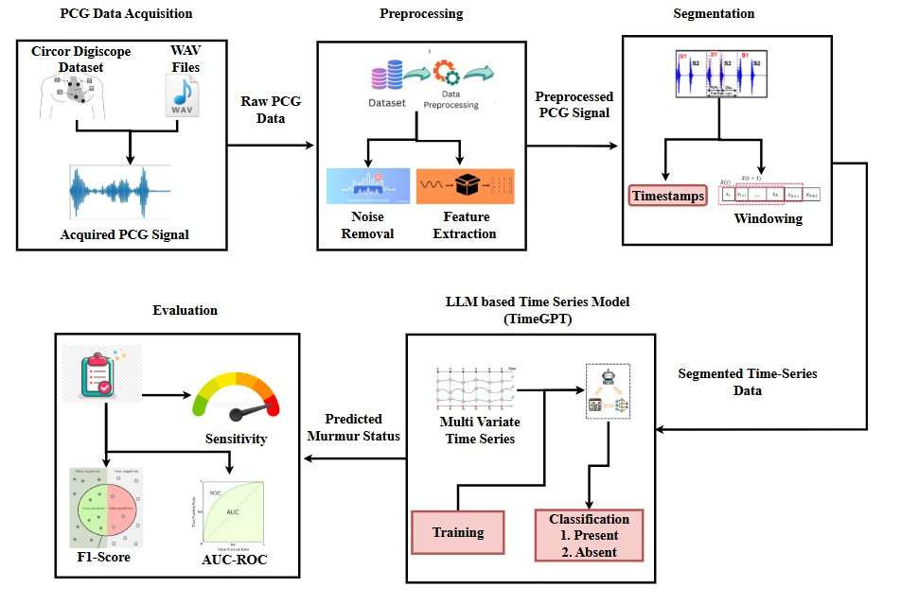
BLOCK DIAGRAM

Slide 11
MODULES
1. Data Preprocessing Module:
Load PCG signals from the CirCor DigiScope dataset.
Apply noise filtering (bandpass filters, wavelet denoising) to remove background noise.
Segment heart cycles using S1, S2, systole, and diastole timestamps.
2. Time Series Preparation Module:
Covert PCG signals into a structured time series format.
Apply windowing or chunking to segment meaningful heart cycles.
Ensure that the data is timestamped and formatted correctly for Time GPT input.

Slide 12
MODULES
3. Time Series Classification Module:
Feed the structures time series PCG data into TimeGPT.
Utilize attention mechanisms to identify murmur patterns across time.
Classify the PCG signal into Murmur Present / Murmur Absent.
4. Model Evaluation Module:
Evaluate performance using Accuracy, Precision, Recall, and F1-score.
Compare performance with traditional ML models (CNN, LSTM, SVM) to highlight improvements.
Analyze false positives and false negatives to refine murmur classification accuracy.

Slide 13
REFERENCES
1) A. Elola et al., "Beyond Heart Murmur Detection: Automatic Murmur Grading From Phonocardiogram," in IEEE Journal of Biomedical and Health Informatics, vol. 27, no. 8, pp. 3856-3866, Aug. 2023, doi: 10.1109/JBHI.2023.3275039.
2) S. Das and S. Dandapat, "Heart Murmur Severity Stages Classification Using Multikernel Residual CNN," in IEEE Sensors Journal, vol. 24, no. 8, pp. 13019-13027, 15 April15, 2024, doi: 10.1109/JSEN.2024.3373226
3) H. K. Alkahtani, I. U. Haq, Y. Y. Ghadi, N. Innab, M. Alajmi and M. Nurbapa, "Precision Diagnosis: An Automated Method for Detecting Congenital Heart Diseases in Children From Phonocardiogram Signals Employing Deep Neural Network," in IEEE Access, vol. 12, pp. 76053-76064, 2024, doi: 10.1109/ACCESS.2024.3395389.
4) A. Q. Aldhahab, M. R. Ismael and H. J. Abd, "Classification of Phonocardiogram Signals Using the Wavelet Scattering Transform and Equilibrium Optimization Approach," in IEEE Access, vol. 12, pp. 191231-191242, 2024, doi: 10.1109/ACCESS.2024.3518635.

Slide 14
REFERENCES
5) M. Alkhodari, L. J. Hadjileontiadis and A. H. Khandoker, "Identification of Congenital Valvular Murmurs in Young Patients Using Deep Learning-Based Attention Transformers and Phonocardiograms," in IEEE Journal of Biomedical and Health Informatics, vol. 28, no. 4, pp. 1803-1814, April 2024, doi: 10.1109/JBHI.2024.3357506.
6) N. A. Vinay, K. N. Vidyasagar, S. Rohith, D. Pruthviraja, S. Supreeth and S. H. Bharathi, "An RNN-Bi LSTM Based Multi Decision GAN Approach for the Recognition of Cardiovascular Disease (CVD) From Heart Beat Sound: A Feature Optimization Process," in IEEE Access, vol. 12, pp. 65482-65502, 2024, doi: 10.1109/ACCESS.2024.3397574.
7) 7. S. Das, D. Jyotishi and S. Dandapat, "Automated Detection of Heart Valve Diseases Using Stationary Wavelet Transform and Attention-Based Hierarchical LSTM Network," in IEEE Transactions on Instrumentation and Measurement, vol. 72, pp. 1-10, 2023, Art no. 4005110, doi: 10.1109/TIM.2023.3270974.
8) 8. S. K. Ghosh, R. N. Ponnalagu, R. K. Tripathy, G. Panda and R. B. Pachori, "Automated Heart Sound Activity Detection From PCG Signal Using Time–Frequency-Domain Deep Neural Network," in IEEE Transactions on Instrumentation and Measurement, vol. 71, pp. 1-10, 2022, Art no. 4006710, doi: 10.1109/TIM.2022.3192257.

Slide 15
THANK YOU

