Slide 1
MINI PROJECT

Slide 2


MATRIMONY
If you don’t find one ,we’ll give you variety of choices to find one

Slide 3
PROBLEM STATEMENT :
Most of the candidates (nearly 50 % of population) choose their life with the wrong one which leads to fight and in some cases its ends with getting divorced.
It’s difficult to find the apt canditate for you in this entire world.

Slide 4
OBJECTIVE :
the main objective of matrimony is to establish a legally recognized union between two individuals, typically with the intent of forming a long-term, committed relationship.
The main objective of our idea is to find a perfect life partner for a candidate…

Slide 5
CHALLENGES IDENTIFIED :
If the candidate of the matrimony user gets married with someone, the candidates ID still exist . The user has to delete the account manually. It’s a major problem.
The user may enter wrong details such as their income and even age.
To avoid this, proper documents can be uploaded signed by government officials.
As the size of the database grows, it can become difficult to manage and maintain. Adding new tables or fields can also be a challenge, as it may require modifying existing applications.
As the amount of data stored in the database increases, queries can become slower and less efficient. Indexing and optimizing queries can help improve performance, but it requires expertise and resources.

Slide 6
REFERENCES:
W3Schools : www.w3schools.com
Python- mysql : www.realpython.com
Geeks for geeks : www.geeksforgeeks.org

Slide 7
DISPLAY NO
END
NO
IS DATABASE CONNECTED
AGE RANGE,
SALARY RANGE, RELIGION
FORMAT THE QUERY
EXECUTE THE QUERY
DISPLAY THE QUERY
START
CONNECT DATABASE IN MYSQL
END
YES
NO
DISPLAY ALL DATAS
YES
EXECUTE QUERY

Slide 8
ALGORITHM :
Start
Create a database.
Enter the values into the database table.
Connect to MySQL database.
If database is connected to the program, proceed to next step or else end the program.
Ask the users whether to display every data.
If yes execute the required query and display or else go to next step.
ask the user for age range, salary range and religion and store it.
Format the data given with the query.
Execute the query.
Display the information stored one by one.
End

Slide 9
DESCRIPTION:
The below program is used to display all the data or filter the data to the user's requirements from the sql database and display the data.
The database consists of data from various users which gets stored in the form of tables containing rows and columns.
This Python program uses sql commands which are present in the built-in module “sqlite3” .

Slide 10
PROGRAM :
import sqlite3
connection=sqlite3.connect("Matrimony.db")
connection.execute("""DROP TABLE users;""")
sql_command="""CREATE TABLE users(id INTEGER PRIMARY KEY,name VARCHAR(20),age INTEGER(2),gender CHAR(1),DOB DATE,religion VARCHAR(15),salary INTEGER,occupation VARCHAR(20),email VARCHAR(20));""“
connection.execute(sql_command)
connection.commit()
connection.execute("INSERT INTO users(id,name,age,gender ,DOB,religion ,salary,occupation,email) VALUES(?,?,?,?,?,?,?,?,?)",(1,"JAI",20,'M',"2002-08-09","HINDU",20000,"VENDOR","john@gmail.com"))
connection.execute("INSERT INTO users (id, name, age, gender ,DOB ,religion, salary,occupation,email)VALUES(?,?,?,?,?,?,?,?,?)",(2,"TOM",25,'M',"1997-12-14“ ,"CHRISTIAN“ ,50000, "ENGINEER", "tom@gmail.com"))

Slide 11
connection.execute("INSERT INTO users(id,name,age,gender,DOB,religion, salary,occupation,email)VALUES(?,?,?,?,?,?,?,?,?)",(3,"KELLY",23,'F',"1999-10-22","CHRISTIAN",35000,"NURSE","kelly@gmail.com"))
connection.execute("INSERT INTO users(id,name,age,gender,DOB,religion,salary ,occupation,email)VALUES(?,?,?,?,?,?,?,?,?)",(4,"BABAR",26,'M',"1996-05-13“ ,"MUSLIM",45000,"VENDOR","babar@gmail.com"))
connection.execute("INSERT INTO users(id,name,age,gender,DOB, religion,salary,occupation,email)VALUES(?,?,?,?,?,?,?,?,?)",(5,"PRIYA",24,'F',"1998-05-06","HINDU",80000,"DOCTOR","priya@gmail.com"))
connection.execute("INSERT INTO users(id,name,age,gender,DOB ,religion, salary,occupation,email)VALUES(?,?,?,?,?,?,?,?,?)",(6,"SMITH",29,'M',"1993-11-13","CHRISTIAN",60000,"TEACHER","smith@gmail.com"))
connection.execute("INSERT INTO users(id,name,age,gender,DOB,religion, salary,occupation,email)VALUES(?,?,?,?,?,?,?,?,?)",(7,"ROSE",34,'F',"1988-02-04","CHRISTIAN",0,"NONE","rose@gmail.com"))
connection.execute("INSERT INTO users(id,name,age,gender,DOB, religion, salary,occupation,email)VALUES(?,?,?,?,?,?,?,?,?)",(8,"MITHUN",22,'M',"2000-05-12","HINDU",65000,"ENGINEER","mithun@gmail.com"))

Slide 12
connection.execute("INSERT INTO users(id,name,age,gender,DOB , religion,salary,occupation,email)VALUES(?,?,?,?,?,?,?,?,?)",(9,"NISHA",26,'F',"1996-11-07","HINDU",20000,"CLERK","nisha@gmail.com"))
connection.execute("INSERT INTO users(id,name,age,gender,DOB ,religion,salary,occupation,email)VALUES(?,?,?,?,?,?,?,?,?)",(10,"FAHEEMA",19,'F',"2003-09-08","MUSLIM",70000,"ENGINEER","faheema2gmail.com"))
connection.commit()
cursor=connection.execute("SELECT id,name,age,gender,DOB , religion,salary,occupation,email FROM users")
print("id,name,age,gender,DOB,religion,salary,occupation,email\n")
for row in cursor: print(row[0],row[1],row[2],row[3],row[4],row[5],row[6],row[7],row[8])
connection.close()

Slide 13
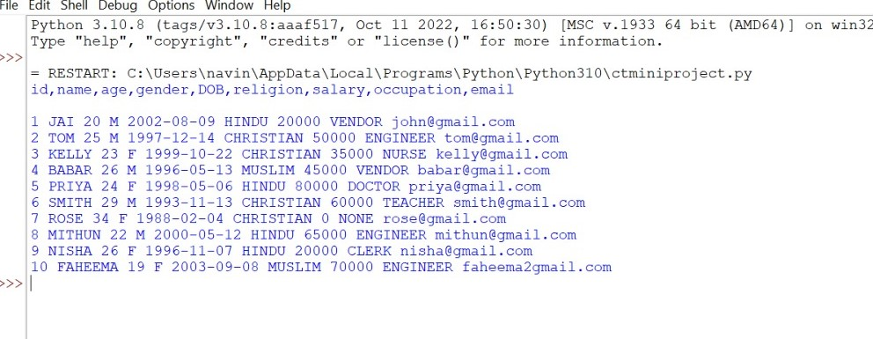

Slide 14
import sqlite3
connection=sqlite3.connect("Matrimony.db")
cursor=connection.cursor()
req=[]
print("Enter the age range:")
for i in range(0,2):
a=int(input("Enter the age:"))
req.append(a)
print("Enter salary range:")
for i in range(0,2):
a=int(input("Enter the salary:"))
req.append(a)
s=input("Enter the religion of spouse:")
req.append(s)
cursor. execute("SELECT * FROM users WHERE (age BETWEEN {} AND {})AND(salary BETWEEN {} AND {})AND(religion='{}')".format(req[0],req[1],req[2],req[3],req[4]))
data=cursor.fetchall()
print("id,name,age,gender,DOB,religion,salary,occupation,email\n")
for row in data:
print(row[0],row[1],row[2],row[3],row[4],row[5],row[6],row[7],row[8])
connection. close()
SEARCHING IN THE DATABASE

Slide 15
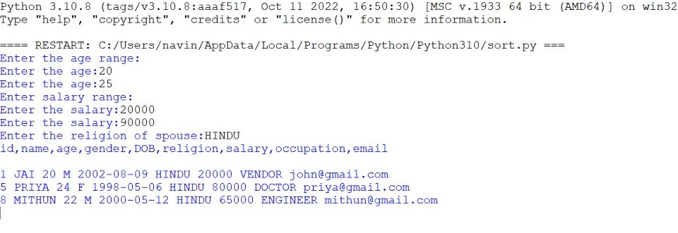

Slide 16
import time
import sqlite3
connection=sqlite3.connect("Matrimony.db")
cursor=connection.cursor()
req=[]
print("Enter the age range:")
for i in range(0,2):
a=int(input("Enter the age:"))
req.append(a)
print("Enter salary range:")
for i in range(0,2):
a=int(input("Enter the salary:"))
req.append(a)
s=input("Enter the religion of spouse:")
req.append(s)
start=time. time()
cursor.execute("SELECT * FROM users WHERE (age BETWEEN {} AND {})AND(salary BETWEEN {} AND {})AND(religion='{}')".format(req[0],req[1],req[2],req[3],req[4]))

Slide 17
data=cursor.fetchall()
print("id,name,age,gender,DOB,religion,salary,occupation,email\n")
for row in data: print(row[0],row[1],row[2],row[3],row[4],row[5],row[6],row[7],row[8])
end=time.time()
elapsed=end-start
print(start,end,elapsed)
connection. close()

Slide 18
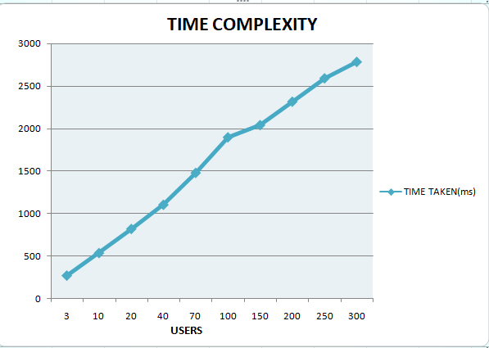

Slide 19
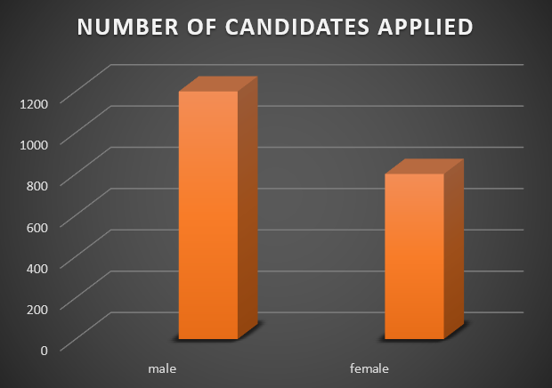
STATISTICS

Slide 20
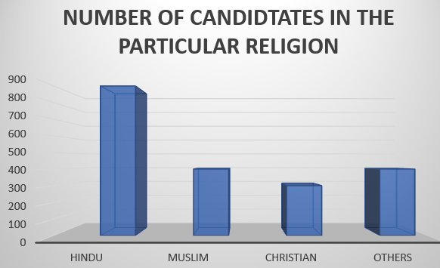

Slide 21
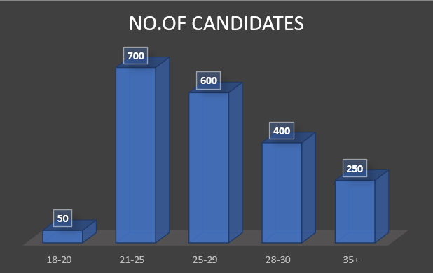
AGE

Slide 22
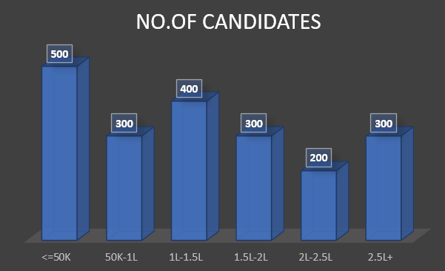
SALARY

Slide 23
-BY Team mr nj 2022503062 2022503550 2022503516 2022503518
THANK YOU

