Slide 1
Securities

Slide 2
Agenda
Start | End | Item
 |  | Securities Summary
 |  | Securities Technical Trading Indicator- SMA
 |  | Securities Technical Trading Indicator- MACD
 |  | Securities Technical Trading Indicator- RSI
Next Class |  | Financial Risk Modeling
 |  | Non-Traditional Markets w/Daniel Chang

Slide 3
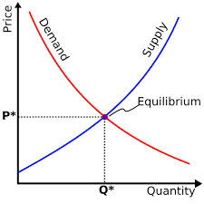
What is a Market?
Traditional Markets
Stock Markets
Bond Markets
Housing/Mortgages
Commodities – gold/silver etc
Crop Futures – corn/soybean
Consumer Credit
…
A market is one of the many varieties of systems, institutions, procedures, social relations and infrastructures whereby parties engage in exchange. Traditional markets are often regulated, have defined trading norms/rules, and have been in existence for some time.

Slide 4
Securities Trading can be distilled into 4 categories*
Belief Based – some intrinsic value of the company is appealing and triggers a buy/selling action.
“I like Netflix movies, so I bought Netflix.”
“I don’t agree with tobacco sales so I avoid those stocks.”
Warren Buffet “Buy companies you understand.”
Fundamental Trading - traditional financial indicator triggers an action regardless of sector, or company product.
“I reviewed Berkshire’s annual report and decided to buy based on EPS”
Technical Trading – trade based on “indications”. Uses non-financial mathematical indicators to quantify risk/reward, or trigger buy/sell
Momentum – Recognize prices moving up/down at thresholds to trigger action
“Charting” – Chart patterns trigger actions (crossovers, head & shoulders)
High Frequency Trading – Extremely technical trading and complex algorithms that can trigger thousands of actions measured in nano-seconds. “scalping” small profits thousands of times per minute.
* Keep in mind there are nuances & this is not a finance course.
This is my interpretation to make sense of complexity

Slide 5
What type?
Belief Based – some intrinsic value of the company is appealing and triggers a buy/selling action.
Fundamental Trading - traditional financial indicator triggers an action regardless of sector, or company product.
Technical Trading – trade based on “indications”
High Frequency Trading – “scalping” small profits repeatedly
The Stochastic Momentum Indicator (SMI), a formula for measuring momentum, crossed over to positive territory. I think I will buy Google (Alphabet).

Slide 6
What type?
Belief Based – some intrinsic value of the company is appealing and triggers a buy/selling action.
Fundamental Trading - traditional financial indicator triggers an action regardless of sector, or company product.
Technical Trading – trade based on “indications”
High Frequency Trading – “scalping” small profits repeatedly
Our PhD physicist wrote an algorithm that trades apple stock 10,000 per minute.

Slide 7
What type?
Belief Based – some intrinsic value of the company is appealing and triggers a buy/selling action.
Fundamental Trading - traditional financial indicator triggers an action regardless of sector, or company product.
Technical Trading – trade based on “indications”
High Frequency Trading – “scalping” small profits repeatedly
I won’t buy firearm companies.

Slide 8
What type?
Belief Based – some intrinsic value of the company is appealing and triggers a buy/selling action.
Fundamental Trading - traditional financial indicator triggers an action regardless of sector, or company product.
Technical Trading – trade based on “indications”
High Frequency Trading – “scalping” small profits repeatedly
In class we modeled the probability of risk using a decision tree and it looks like a buying a retail stock is a good investment.

Slide 9
What type?
Belief Based – some intrinsic value of the company is appealing and triggers a buy/selling action.
Fundamental Trading - traditional financial indicator triggers an action regardless of sector, or company product.
Technical Trading – trade based on “indications”
High Frequency Trading – “scalping” small profits repeatedly
Google’s quarterly ad revenue is improving, so I am going to buy some shares.

Slide 10
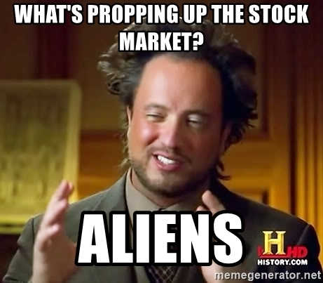
Financial Risk Modeling

Slide 11
Let’s zoom into Technical Trading Rules (TTR)
Our learning goal is to use and understand some of the common technical indicators which affect you as a saver, pension holder, stock trader etc.
Our learning goal is NOT to make you into a trader, or convince you that you are now qualified to be a technical trader.

Slide 12
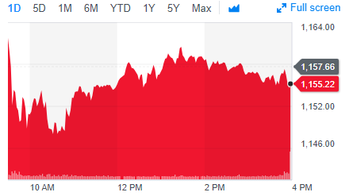
Stock Prices represent a time series
PRICE or Volume
TIME
BUT they are very hard to forecast due to external forces such as macro economic, international politics, sector/competitor actions, weather etc. From a forecasting perspective stock prices are often considered a “random walk” meaning traditional econometric forecasting techniques do not apply.

Slide 13
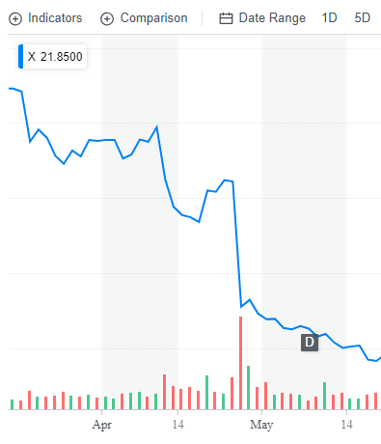
What happened to US Steel?
Daily Chart
4/25/17 Close : $31
4/26/17 Close: $22
4/26/17 Volume spike

Slide 14
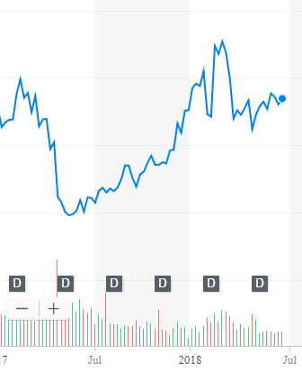
What other forces can impact US Steel?
Weekly Chart
After the disappointing quarter (self-inflicted) the stock rose dramatically. Why?
5/15/17: ~$20
2/26/18: ~$45

Slide 15
What other forces can impact US Steel?
Weekly Chart
After rhetoric of a trade war (international politics) with steel tariffs on their foreign competitors the price retreated and is now in a range. Why?
4/25/17: $31
4/26/17: $22
2/26/18: ~$45
4/16/18: ~$36
6/16/18 ~$36

Slide 16
What other forces can impact US Steel?
Weekly Chart
The trade war shifted towards talk about auto tariffs, coupled with high auto inventory.
4/25/17: $31
4/26/17: $22
2/26/18: ~$45
4/16/18: ~$36
6/16/18 ~$36

Slide 17
So forecasting (pattern recognition) methods won’t work.
Weekly Chart
Some stock movements are self-inflicted (quarterly miss), others political (tariffs) while others are based on out of sector (automotive) performance.

Slide 18



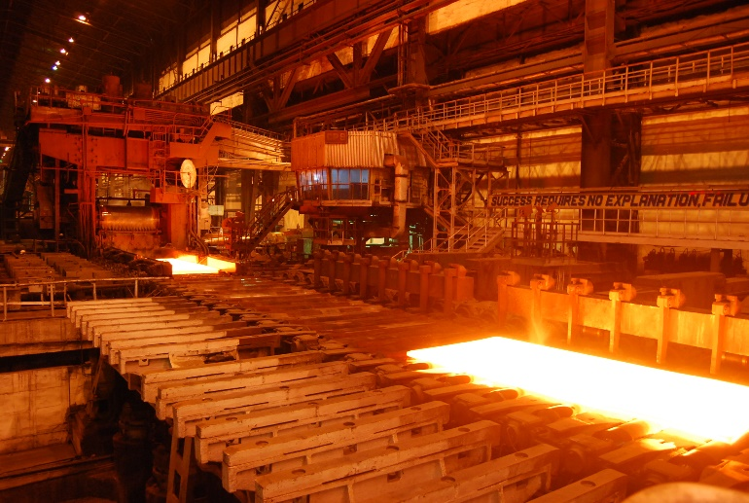
Meanwhile, US Steel was... producing steel.
Coincidentally, a belief investor would not have bought or sold but fundamental, technical and HFT would have been in and out at different times.

Slide 19
Agenda
Start | End | Item
 |  | Securities Summary
 |  | Securities Technical Trading Indicator- SMA
 |  | Securities Technical Trading Indicator- MACD
 |  | Securities Technical Trading Indicator- RSI
Next Class |  | Financial Risk Modeling
 |  | Non-Traditional Markets w/Daniel Chang

Slide 20
So instead of forecasting, can we identify indicators to move into or out of positions?
library(TTR)
SMA() #simple moving average
MACD() #moving avg convergence/divergence
RSI() #Relative Strength Index
For expediency we will cover 3 indicators but there are many more and you could even develop your own.

Slide 21
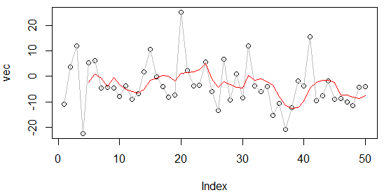
What is a moving average?
A smoothing technique reducing noise in a data series. Takes the average over “n” number of periods.
set.seed(1234)
vec <-rnorm(50,1,10)
plot(vec)
lines(vec, col='grey')
lines(SMA(vec, n=5), col='red')
vec[1:15]
[1,] -11.070657
[2,] 3.774292
[3,] 11.844412
[4,] -22.456977
[5,] 5.291247
[6,] 6.060559
[7,] -4.747400
[8,] -4.466319
[9,] -4.644520
[10,] -7.900378
[11,] -3.771927
[12,] -8.983864
[13,] -6.762539
[14,] 1.644588
[15,] 10.594941

Slide 22
What is a moving average?
A smoothing technique reducing noise in a data series. Takes the average over “n” number of periods.
vec[1:15]
[1,] -11.070657
[2,] 3.774292
[3,] 11.844412
[4,] -22.456977
[5,] 5.291247
[6,] 6.060559
[7,] -4.747400
[8,] -4.466319
[9,] -4.644520
[10,] -7.900378
[11,] -3.771927
[12,] -8.983864
[13,] -6.762539
[14,] 1.644588
[15,] 10.594941

Slide 23

What is a moving average?
A smoothing technique reducing noise in a data series. Takes the average over “n” number of periods.
vec[1:15]
[1,] -11.070657
[2,] 3.774292
[3,] 11.844412
[4,] -22.456977
[5,] 5.291247
[6,] 6.060559
[7,] -4.747400
[8,] -4.466319
[9,] -4.644520
[10,] -7.900378
[11,] -3.771927
[12,] -8.983864
[13,] -6.762539
[14,] 1.644588
[15,] 10.594941

Slide 24

What is a moving average?
A smoothing technique reducing noise in a data series. Takes the average over “n” number of periods.
vec[1:15]
TTR::SMA(vec[1:15], n=5)
[1,] -11.070657
[2,] 3.774292
[3,] 11.844412
[4,] -22.456977
[5,] 5.291247
[6,] 6.060559
[7,] -4.747400
[8,] -4.466319
[9,] -4.644520
[10,] -7.900378
[11,] -3.771927
[12,] -8.983864
[13,] -6.762539
[14,] 1.644588
[15,] 10.594941
[1,] NA
[2,] NA
[3,] NA
[4,] NA
[5,] -2.5235367
[6,] 0.9027066
[7,] -0.8016318
[8,] -4.0637779
[9,] -0.5012865
[10,] -3.1396115
[11,] -5.1061087
[12,] -5.9534017
[13,] -6.4126457
[14,] -5.1548241
[15,] -1.4557603

Slide 25
Open 1_TTR_A.R

Slide 26
Open 1_TTR_B.R

Slide 27
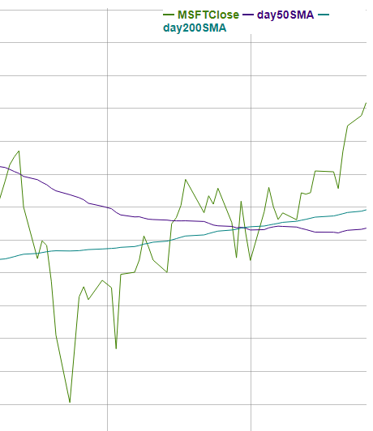
Microsoft Close, 50Day & 200Day
This is a “death cross” meaning the 50 day moving average goes below the 200 day…time to SELL!

Slide 28
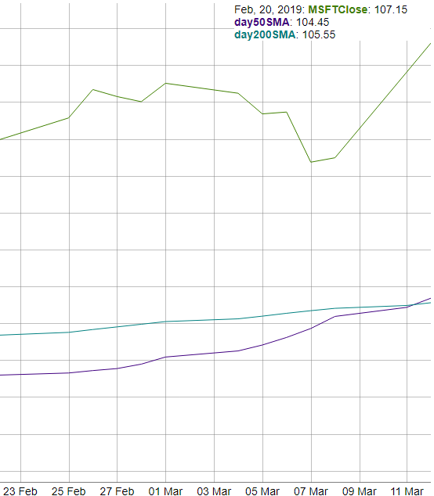
Microsoft Close, 50Day & 200Day
MSFT just had a “golden cross” meaning the 50 day went over the 200day…time to BUY!

Slide 29
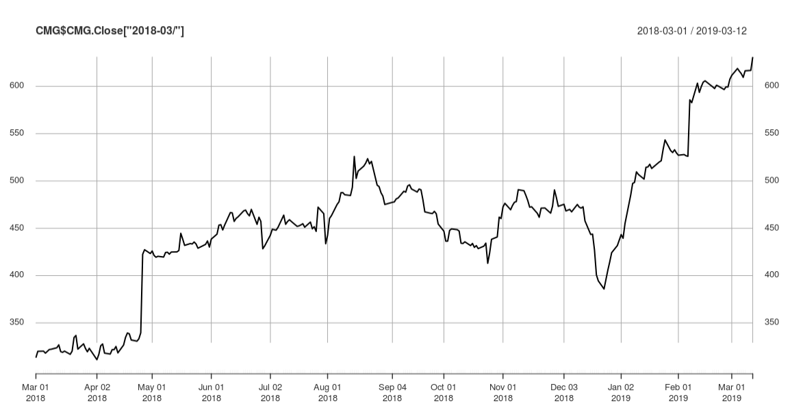
Now let’s apply the death & golden cross to CMG
An investor can “backtest” the strategy to find an acceptable “n” in case 50/200 doesn’t work. Once the best “n” is found, an investor can look for “crosses” to indicate buy/sell.

Slide 30

1_TTR_C_50Day_200Day_SMA

Slide 31
Agenda
Start | End | Item
 |  | Securities Summary
 |  | Securities Technical Trading Indicator- SMA
 |  | Securities Technical Trading Indicator- MACD
 |  | Securities Technical Trading Indicator- RSI
Next Class |  | Financial Risk Modeling
 |  | Non-Traditional Markets w/Daniel Chang

Slide 32
Moving Average Convergence Divergence
The MACD stands for moving average convergence divergence indicator. By measuring the moving average of two moving averages with different time frames, an investor hopes to capture when momentum is building or receding.
Instead of “n”:
nFast(12) – the smaller window to measure (12 periods)
nSlow(26)- the longer window to measure (26 periods)
nSig(9)- the number of periods used to measure the avg difference “signal”
Calculate the 12 (nFast) day & 26 (nSlow) day moving averages.
Calculate the difference between average from #1
Calculate the 9 day Moving Avg (nSig) of #2
When MACD is positive, the price is accelerating, positive momentum/money is coming to the equity which represents a buying opportunity. Converse is true.

Slide 33
One small addition difference.
MACD uses exponential moving averages (EMA).
SMA
EMA
Each value in the “n” window has an equal weight.
Each value in the “n” window has an different weight. The weights decrease the farther back in time e.g. recent data is more relevant.
For example:
vec <-c(1,2,3,4,5)
mean(vec) #sum(vec)/5 i.e. 15/5
3
Advantage:
Faster to recognize a buy/sell signal.
Disadvantage:
More false signals, more sensitivity

Slide 34
Open 1_TTR_D.R

Slide 35
Agenda
Start | End | Item
 |  | Securities Summary
 |  | Securities Technical Trading Indicator- SMA
 |  | Securities Technical Trading Indicator- MACD
 |  | Securities Technical Trading Indicator- RSI
Next Class |  | Financial Risk Modeling
 |  | Non-Traditional Markets w/Daniel Chang

Slide 36
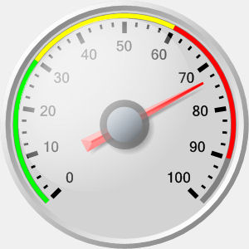
Relative Strength Index (RSI)
Momentum Oscillator
Index between 0-100
Compares average gains and losses in 14 day periods (“n”)
Usually interpreted as an overbought/oversold (over 70 / below 30)
* Usually uses EMA but we will do SMA.

Slide 37
Creates a control chart.
70
RSI
30
TIME
When the RSI dips below a threshold (30) the stock is considered “oversold” meaning the market has overreacted to something and RSI may indicate a buying opportunity. RSI greater than 70 indicates the market is over buying the stock so it may be good to exit your position.

Slide 38
Calculating the RSI
RSI = 100 - (100 / 1+RS)
Where RS:
RS = Avg Gain / Avg Loss
Avg Gain = For “up” days, total number of points up / number of “up” days
Avg Loss = For “down” days, total number of points down/ number of “down” days

Slide 39
Open 1_TTR_F.R

