Slide 1
Forecasting

Slide 2
Agenda
Start | End | Item
 |  | What is Forecasting?
 |  | Naïve Forecasting Methods
 |  | Time Series Decomposition
 |  | HoltWinters Forecasting
 |  | Appendix

Slide 3
Main ideas
Forecast future values of a time series
Distinction between forecasting (main focus) and describing/explaining
Before forecasting understand “periodicity”
Four components of time series (meta-data):
Level
Trend
Seasonality
Noise
Time series data is great for enrichment and engineering e.g. “event flags” but can be modeled as a standalone vector due to the meta data “inside” the vector.

Slide 4
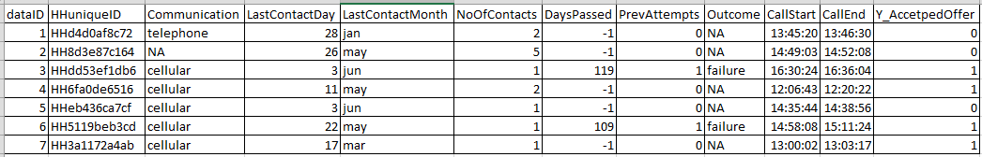
Difference between ML Data Setup & Time Series Data
ML Data Frame
Observations
Attributes for each observation
Each record is a standalone observation of a phenomena you are trying to predict, classify or cluster.
Records have defined attributes for each data row.
Notice time is not interacting between rows (or it had not better be) but is present at the observational row.

Slide 5
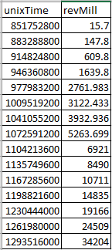
Difference between ML Data Setup & Time Series Data
Time Series Data
Data is typically (not always) in a single vector with each value being in sequence to the next.
Attributes may not be present because temporal information is held “within” the vector due to the relatedness of each record.
Observations
Attribute

Slide 6
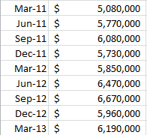
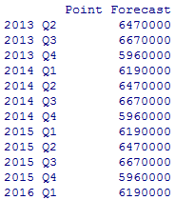

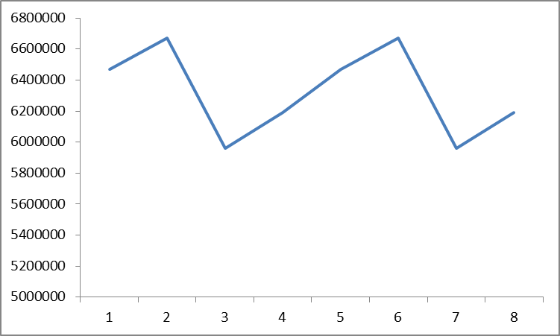
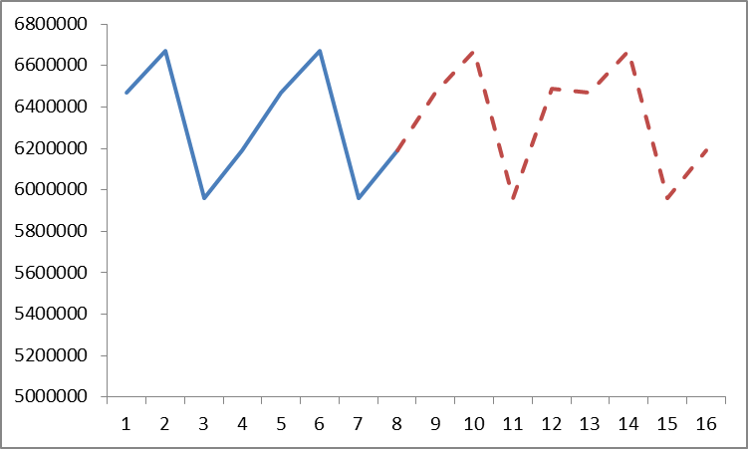
What is forecasting?
Forecasting is the process of applying mathematical tools on time series data to create future time series values, doesn’t have to explain the reason for observed changes.
Actual Time Series
Future Forecasted Values
Times Series Data > Forecast Methodology> Future Values

Slide 7
Explain Vs. Predict
Explanation is the goal of “time series analysis”
Models are based on causal argument
Models are not “black-box”
Example Explanations:
“The housing crisis reduced the expected bank revenue over a 2yr period”
“Inclement weather negatively affected holiday shopping at Target.”
Forecasting (our focus) seeks to predict future values
Example outcomes:
“Next quarter bank revenue is forecasted to rise to $XYZ”
“Wal-Mart’s 3rd quarter revenue will be $130B.”

Slide 8
The data inside the time series data
Level – an average of the observations “steady state”
Trend – are values increasing, decreasing or stationary
Seasonality – is there a repeating pattern in the periodicity
Noise – unexplained values or “residuals” from adding “trend”, “seasonality” and “level” together. Basically its what left, and unaccounted for.

Slide 9
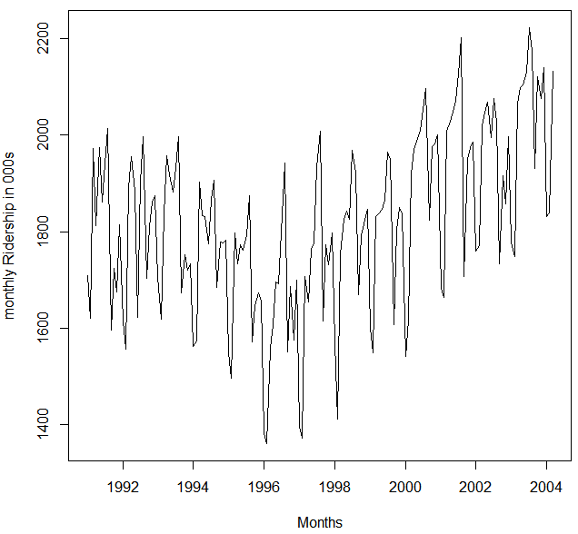

Amtrak Actual Riders
What do we observe?
Level?
Trend?
Seasonality?
Noise?
Notes:
Level - about 1,800,000 passengers per month
Appears to have U-shaped trend

Slide 10
Amtrak Actuals
What do we observe?
Level?
Trend?
Seasonality?
Noise?

Slide 11
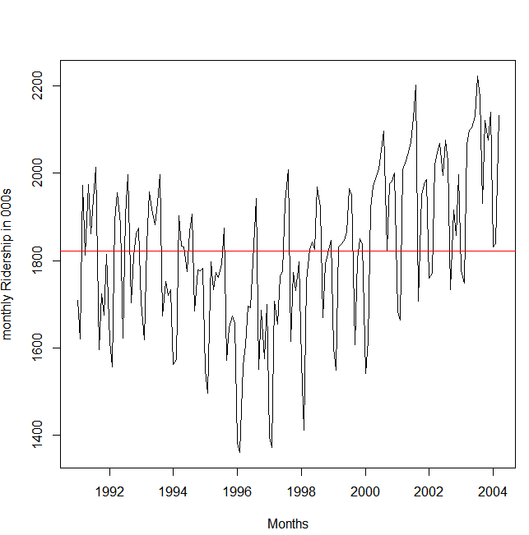
Amtrak Actuals
What do we observe?
Level?
Trend?
Seasonality?
Noise?

Slide 12
Amtrak Actuals
What do we observe?
Level?
Trend?
Seasonality?
Noise?

Slide 13
Zoom to 3 years (1997-1999)
Seasonality* appears:
Each year traffic peaks in summer
Noise:
Departure from the general level that is neither trend nor seasonality
Put another way, if you add the seasonal, trend and level values, the difference is the “noise”
* Don’t confuse the time series term “season,” which is the period over which a cyclical pattern repeats (e.g. a year), with the standard English seasons of the year (fall, winter, etc.)

Slide 14
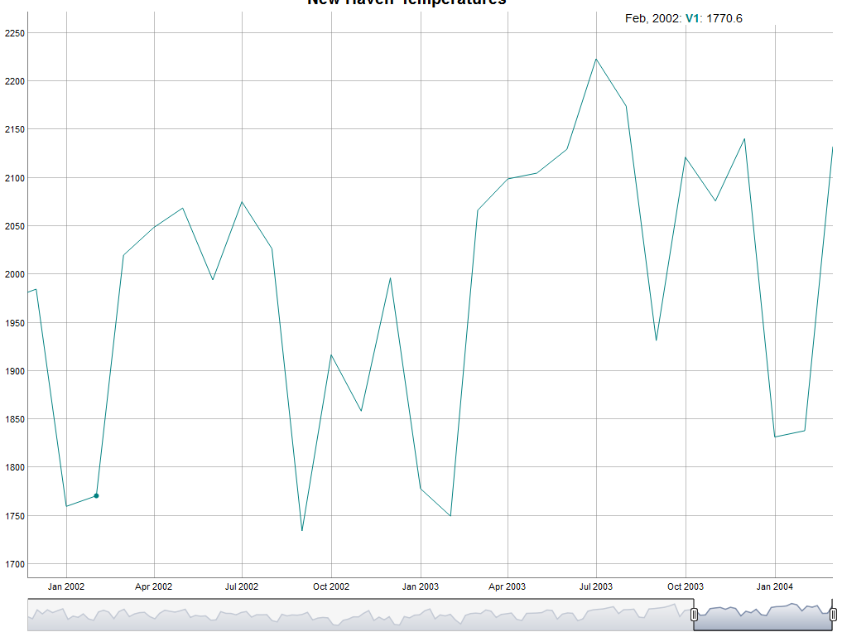
Zoom to 3 years (1997-1999)
Decline in Jan/Feb

Slide 15
Zoom to 3 years (1997-1999)
Increase in Mar

Slide 16
Zoom to 3 years (1997-1999)
Sustained increase until Aug

Slide 17
Open 0_amtrak.R
Let’s Practice!
Time Series Basics
Dynamic Plotting
Lubridate Functions

Slide 18
Machine Learning Partitioning
Divide data into training portion and validation portion
Test model on the validation portion
Training Data
All Data
Test Data

Slide 19
Time Series Partitioning is not random
Random partitioning would leave holes in the data, which causes problems
Forecasting methods assume regular sequential data
Instead of random selection, divide data into two parts
Train on early data
Validate on later data
Performance can be assessed against the “naïve benchmark” & historical accuracy naïve forecast is simply the most recent value in the time series
Temporal Data Points
Training Data
Validation
Sub-setting data with regard to time is called “out of time” sampling.

Slide 20
Summary
Focus is to predict (not describe/explain)
Four components
Level
Trend
Seasonality
Noise
Partition data by dividing into early/late

Slide 21
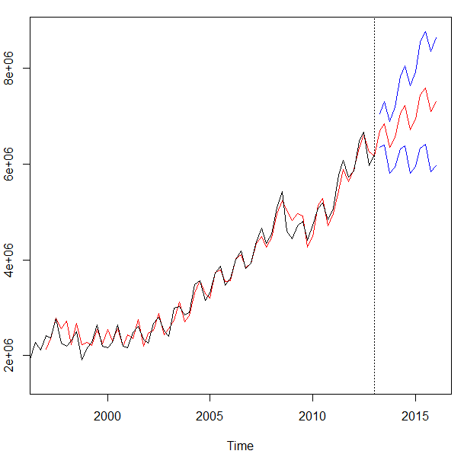
What types of business problems can be forecasted?
We will cover a set of common forecasting tools to make predictions. The goal is to create accurate future values and provide ranges of accuracy in real contexts.
Amazon’s Quarterly Revenue
Black is the actual through 2013
Red is the fit and after the dateline, the best fit-forecast.
Blue represents confidence intervals
Notes:
Other forecasts in business:
Supply management
Sales
Product life cycles
Call centers
…

Slide 22
Open 1_getRevenueData.R
Let’s grab a time series & plot it

Slide 23
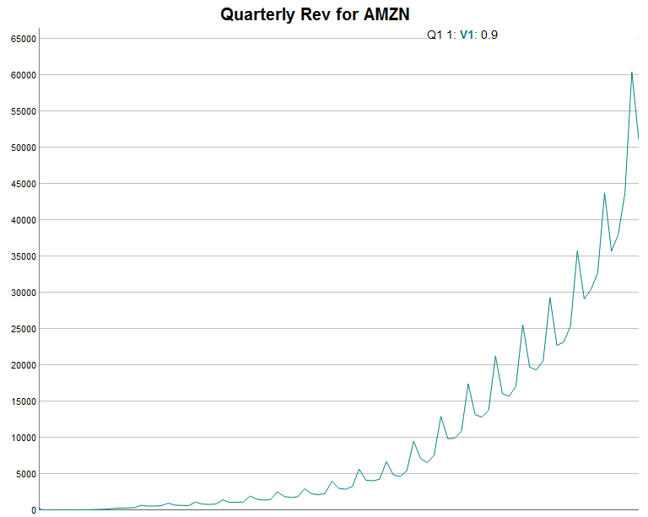
Inspecting meta data.
What is the meta data for AMZN?
Does the meta data exhibit a discernable pattern?
Do you think historical values are a basis for future values?
Notes:
Level?
Trend?
Pattern?

Slide 24
Agenda
Start | End | Item
 |  | What is Forecasting?
 |  | Naïve Forecasting Methods
 |  | Time Series Decomposition
 |  | HoltWinters Forecasting
 |  | Appendix

Slide 25
5 Common Methods
We will cover 3 common methods to forecasting.
Naive
Holt Winters
TSD
ARIMA
Linear Modeling
Most common
Easy/Fast
Usually not very accurate
Exponential Smoothing
Good w/Seasonality
Decomposes into meta-data components
Good for de-seasoning & investigating
Not really forecasting future
Accurate
Good with trends/trend reversals
Good with noisy series
Good w/Seasonality
”black box”
Essentially linear regression
Requires additional data manipulation & effort
ARIMA & Linear Model Forecasting is in the Appendix presentaion.
Their impact on the final will be minimized but some/few multiple choice questions from the book may appear.

Slide 26
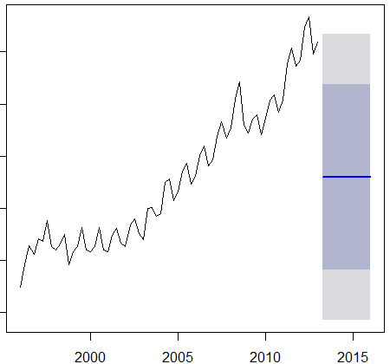
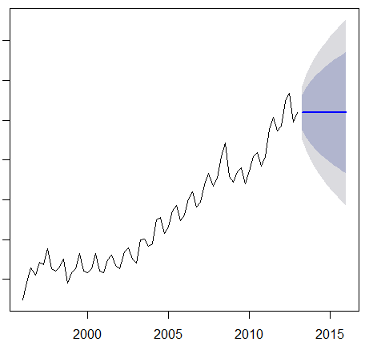
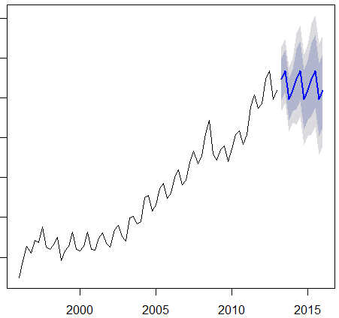
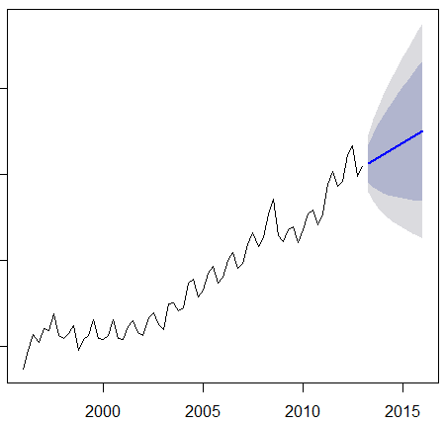
4 Methods of Naïve Forecasting
MEAN
Naïve
Seasonal
Naïve
Drift

Slide 27
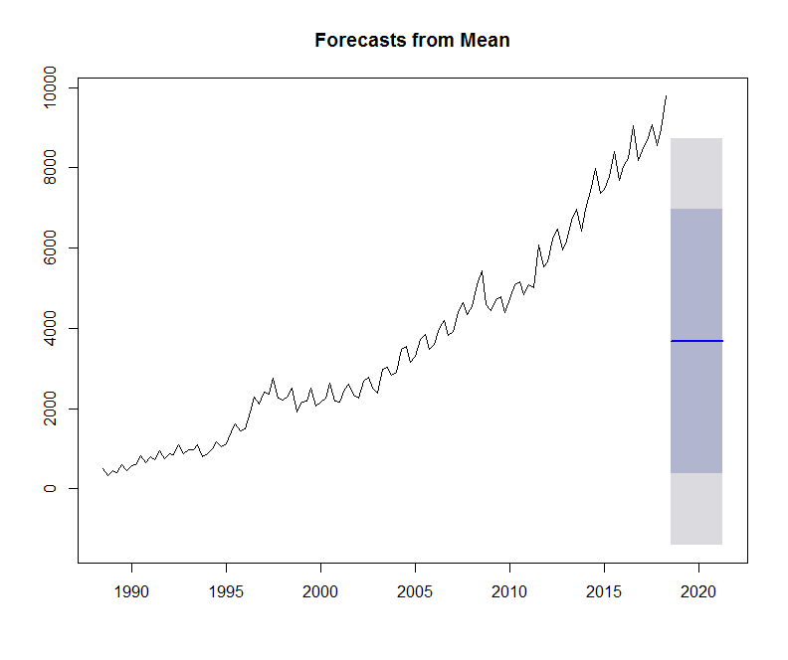
Naïve Forecast - Mean
Takes the mean for the series and repeats as future forecasts.
Does this look accurate?
When would this be appropriate?

Slide 28
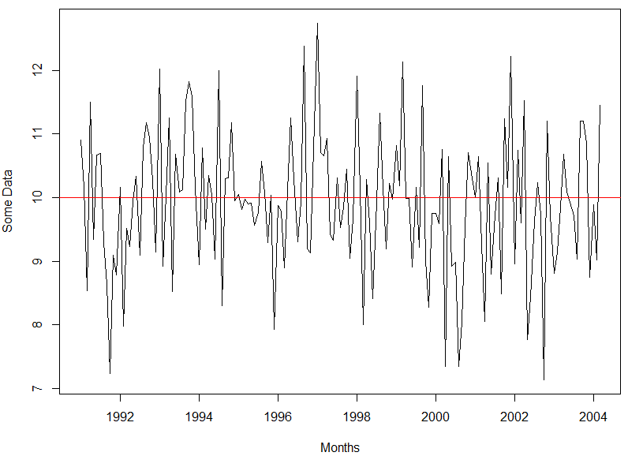
Naïve Forecast - Mean
Takes the mean for the series and repeats as future forecasts.
Does this look accurate?
When would this be appropriate?

Slide 29
Naïve Forecast - Drift
Average rate of change is added from the last known value.
More accurate than mean with strong trend.
Accuracy hurt by seasonality.

Slide 30
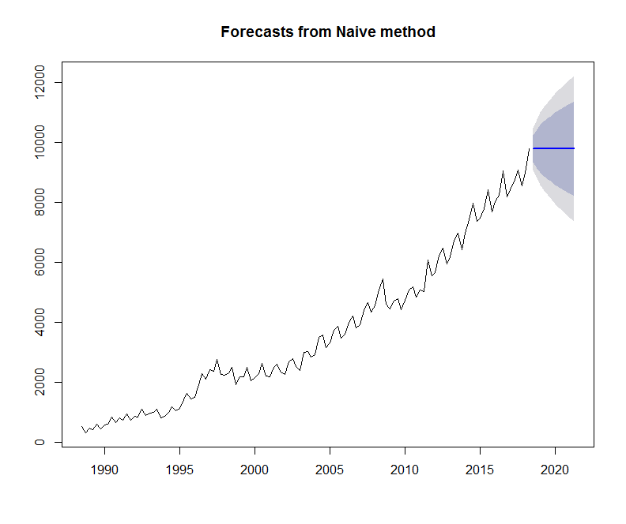
Naïve Forecast – Naïve (true)
Uses last value as future.
Does this look accurate?
When would this be appropriate?

Slide 31
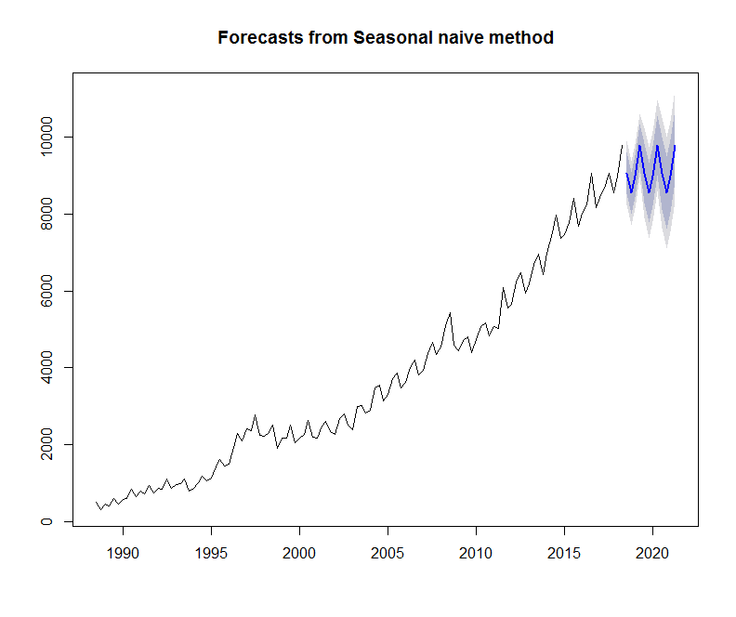
Naïve Forecast – Naïve Seasonal
Uses last corresponding seasonal values in a repeating pattern. Good if no trend.
Does this look accurate?
When would this be appropriate?

Slide 32
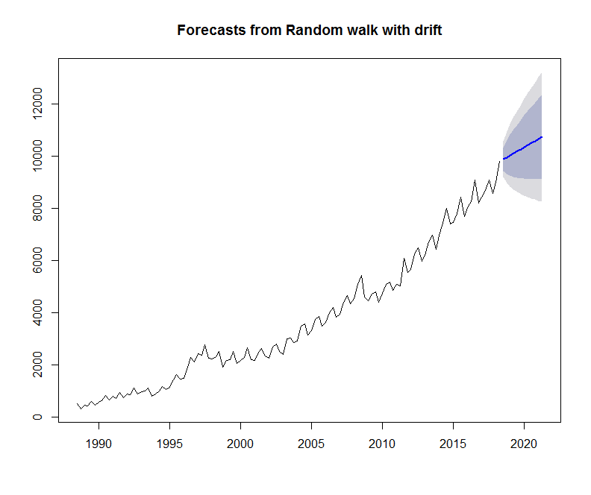
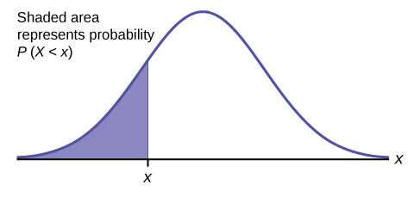
Shaded Forecast Area?
Independent and identically distributed random variables
Represents Prediction Intervals
Assumes a normal distribution
Lo 80
Hi 80
Lo 95
Hi 95
Each period increases standard deviation; stretching out the normal distribution.
As time progresses uncertainty increases
Mu:
Avg of population
Frequency
Values

Slide 33
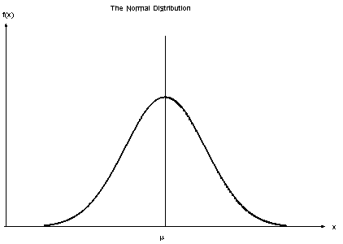
Shaded Forecast Area?
Laying the normal distribution onto the forecast you get a probability centered at the forecast.
Lo 80
Hi 80
Lo 95
Hi 95

Slide 34
Open 2_NaiveNike.R

Slide 35
Agenda
Start | End | Item
 |  | What is Forecasting?
 |  | Naïve Forecasting Methods
 |  | Time Series Decomposition
 |  | HoltWinters Forecasting
 |  | Appendix

Slide 36
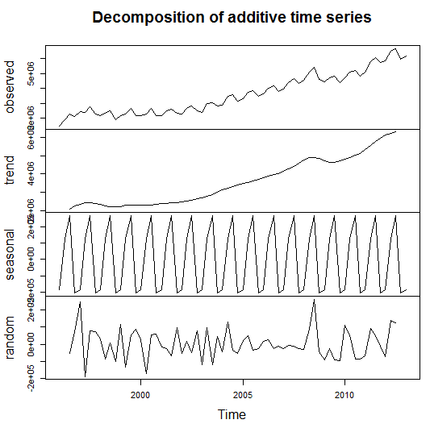
Time Series Decomposition
Decompose a time series into
Trend
Seasonal
Random (noise)
De-Season Data
Helps understand the underlying characteristics of a time series
Sometimes applying a forecast or model to the random component can improve accuracy

Slide 37
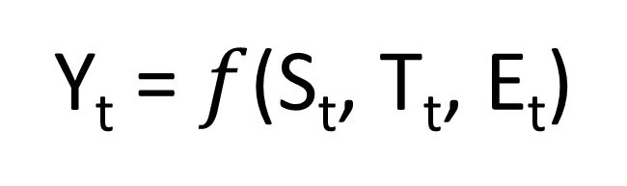
Time Series Decomposition
Y_{t} = $f$(S_{t}, T_{t}, E_{t})
Data at a specific time period (t) is equal to a mix* of seasonal values, trend values and whatever is left at the same time period.
Where (Math-speak version):
Y_{t} = data at period t
S_{t} = seasonal component at period t
T_{t} = trend component at period t
E_{t} = remainder or residual component at period t

Slide 38
Time Series Decomposition
Y_{t} = $f$(S_{t}, T_{t}, E_{t})
Data at a specific time period (t) is equal to a mix* of seasonal values, trend values and whatever is left at the same time period.
*Mix can either be
Additive – Y_{t}= Seasonal effect + Trend + Residual
An additive model assumes that the difference between each time period is approximately the same
For example, Jan trend is +100, so next Jan trend would add another +100.
Multiplicative - Y_{t}= Seasonal effect X Trend X Residual
A multiplicative model assumes changes are proportional and not constant.
For example Jan season is +100 as part of a 1,000 total (10%). The next Jan the total is 1500, and the seasonal adjustment would be 150 (10%).
Notes:
Additive – Every quarter the business grows by $10M
Multiplicative – Every quarter the business grows by 10%

Slide 39
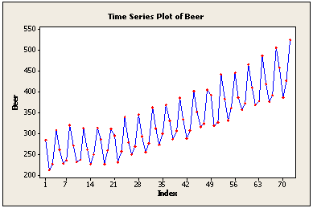
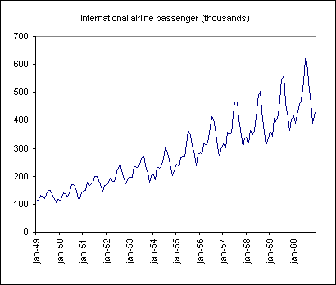
Time Series Decomposition
Additive
Multiplicative
Use additive models if the seasonality (repeating pattern) is similar.
Use multiplicative if the seasonality grows larger over time but is still the same proportion of the total
Notes:
Amplitude changes

Slide 40
Summary – Time Series Decomposition
Separates Trend, Seasonal and Random components of a time series
Components are combined by
Additive – adding components is appropriate if the seasonal pattern is consistent
Multiplicative – multiplying components is appropriate if the seasonal pattern changes over time but it proportional to the time series.
TSD can help you understand the data and can be done as part of EDA
Each component can be forecasted separately to (sometimes) improve accuracy then each forecast can be combined to arrive at a final forecast
De-seasoning data is possible by subtracting (additive TSD) or dividing (multiplicative TSD) it out of the time series

Slide 41
Open 3_TimeSeriesDecompositionAMZN.R

Slide 42
Agenda
Start | End | Item
 |  | What is Forecasting?
 |  | Naïve Forecasting Methods
 |  | Time Series Decomposition
 |  | HoltWinters Forecasting
 |  | Appendix

Slide 43
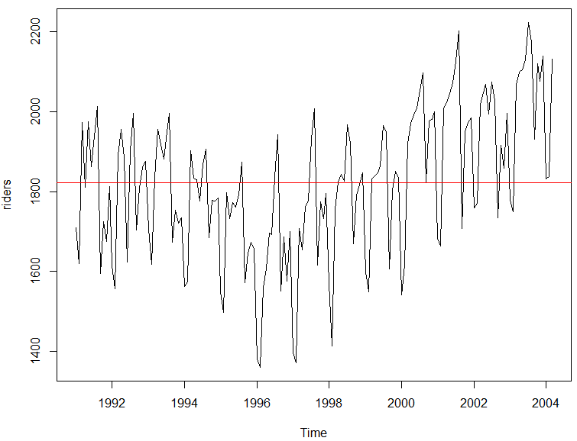
But first averages…
Mean Average – good for population summary
Add all values and divide by population
mean(riders)
[1] 1822.197
Each record has the same weight.
Number | Value
1 | 10
2 | 20
3 | 30
4 | 40
5 | 50
10+20+30+40+50
=30
5

Slide 44
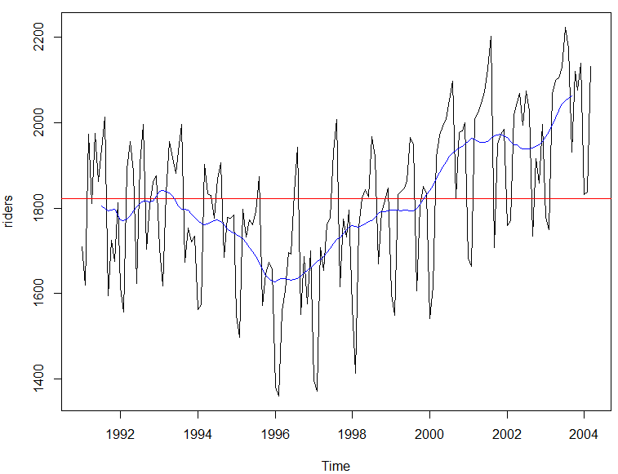
But first averages…
Centered Moving Average – smooths seasonality
Add all values and divide by population in the window
ma(riders, order =12)
Records in the window have the same weight.
Number | Value
1 | 10
2 | 20
3 | 30
4 | 40
5 | 50
t = 3
10+20+30
=15
3
…
30+40+50
=40
3
Descriptive because it uses values from the future so not good for forecasting.

Slide 45
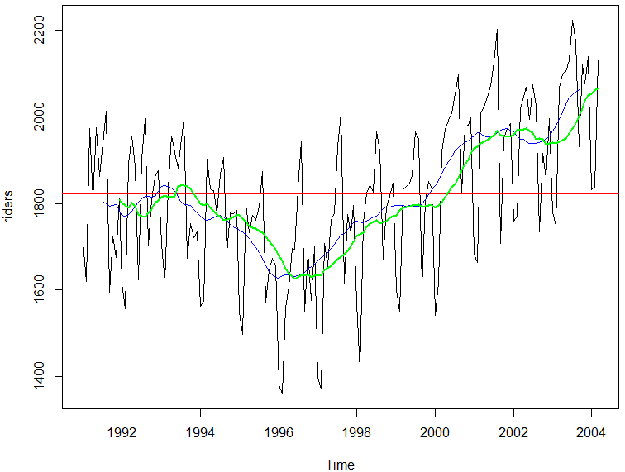
But first averages…
Trailing Moving Average – smooths seasonality
Add all values and divide by population in the window
rollmean(riders, k = 12, align = 'right'
Records in the window have the same weight.
Number | Value
1 | 10
2 | 20
3 | 30
4 | 40
5 | 50
t = 3
10+20+30
=20
3
20+30+40
=30
3
Uses preceding window values so ok for forecasts but lags for trend and seasonal.

Slide 46
But first averages…
Exponential Smoothing
Older records in the window have the diminishing weight
α is a parameter between 0 and 1.
0 = more weight is given to observations from the more distant past
Approaching 1= more weight given to recent
1 = all weight given to the most recent (same as a true Naïve forecast)
Values are weighted so their impact diminishes in the average the farther back.

Slide 47
Open 4_HoltWintersWMT.R
HW applies exponential smoothing to level, trend and seasonality individually then combines them.

