Slide 1
Forecasting

Slide 2
Agenda
Start | End | Item
 |  | What is Forecasting?
 |  | Naïve Forecasting Methods
 |  | Time Series Decomposition
 |  | HoltWinters Forecasting
 |  | Appendix

Slide 3
Appendix I – Regression Forecasting

Slide 4
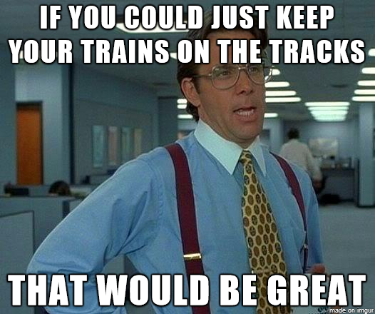
Regression Based Forecasting
Ridership Y is a function of time (t) and noise (error = e)
Y_{i} = B₀ + B₁*t + e
Thus we model 3 of the 4 components:
Level (B₀)
Trend* (B₁)
Noise (e)

Slide 5
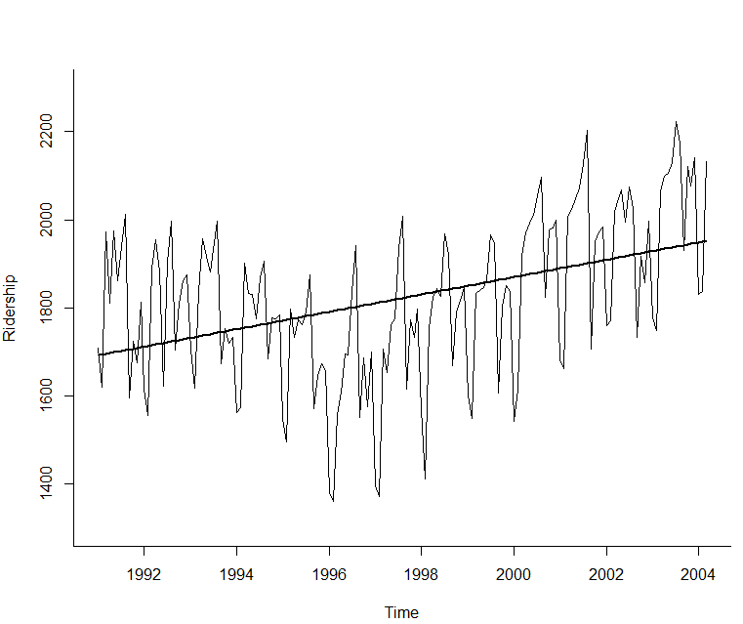
Time Series Linear Trend
# produce linear trend model
ridership.lm <- tslm(ridership.ts ~ trend)

Slide 6
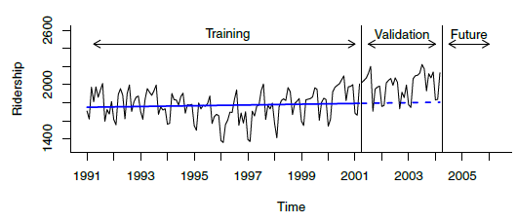
Linear Trend Predictions
train.lm.pred <- forecast(train.lm, h = nValid, level = 0)
Training Data
True Unknown
Validation

Slide 7
Open 5_Ch17.R

Slide 8

Exponential Trend – like amazon’s revenue
Appropriate model when increase/decrease in series over time is multiplicative
Replace Y with log(Y) then fit linear regression
log(Y_{i}) = B₀ + B₁t + e

Slide 9
Natural Logs – not to hard
“e” raised what power equals the time series value
Where “e” = ~2.718
log(2)
[1] 0.6931472
e^0.693
2.719^{(0.6931472)}
1.99
log(13)
[1] 2.564949
e^2.56949
2.719^{(2.56949)}
13.05568
Don’t worry, R handles with the log() function.

Slide 10
Exponential trend - forecast errors
Note that performance measures in standard linear regression software are not in original units
Model forecasts will be in the form log(Y)
Return to original units by taking exponent of model forecasts using the function exp()
Calculate standard deviation of these forecast errors to get RMSE

Slide 11
Open 5_Ch17.R (AGAIN)

Slide 12
Other Trends Polynomial Trend
Add additional predictors as appropriate
For example, for quadratic relationship add a t² predictor
Fit linear regression using both t and t²

Slide 13
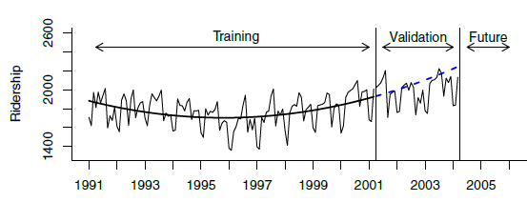
Quadratic Trend
# fit quadratic trend using function I(), which treats an # object "as is".
train.lm.poly.trend <- tslm(train.ts ~ trend + I(trend^2))
summary(train.lm.poly.trend)
train.lm.poly.trend.pred <- forecast(train.lm.poly.trend,
h = nValid, level = 0)
Due to time constraints, please review pg 408.

Slide 14
Handling Seasonality in Regression
Just make dummy variables for seasons…but beware of multi-collinearity!
Month | Ridership | Season
Jan 1991 | 1709 | Jan
Feb 1991 | 1621 | Feb
Mar 1991 | 1973 | Mar
Month | Ridership | Season | Jan | Feb | Mar | … | Nov
Jan 1991 | 1709 | Jan | 1 | 0 | 0 | … | 0
Feb 1991 | 1621 | Feb | 0 | 1 | 0 | … | 0
Mar 1991 | 1973 | Mar | 0 | 0 | 1 | … | 0
… | … | … | . | . | . | … | 1
Nov 1991 | 1675 | Nov | 0 | 0 | 0 | … | 1
Dec 1991 | 1813 | Dec | 0 | 0 | 0 | 0 | 0
To avoid multi-collinearity, there is no Dec.

Slide 15
Final model, Amtrak data
Incorporates trend and seasonality
13 predictors
11 monthly dummies
t = trends
t² = quadratic trend ( to get the positive and negative trend slopes)
train.lm.trend.season <- tslm(train.ts ~ trend +
I(trend^2) + season)

Slide 16
Regression Based Forecasting is great for events
Month | Ridership | Season | Jan | Feb | Mar | … | Nov | Summer Promo | Holiday Promo
Jan 1991 | 1709 | Jan | 1 | 0 | 0 | … | 0 | 0 | 0
Feb 1991 | 1621 | Feb | 0 | 1 | 0 | … | 0 | 0 | 0
Mar 1991 | 1973 | Mar | 0 | 0 | 1 | … | 0 | 0 | 0
… | … | … | 0 | 0 | 0 | 0 | 0 | 0 | .0
Nov 1991 | 1675 | Nov | 0 | 0 | 0 | … | 1 | 0 | 1
Dec 1991 | 1813 | Dec | 0 | 0 | 0 | 0 | 0 | 0 | 1

Slide 17
Summary – Regression Based Forecasting
Can use linear regression for exponential models (use logs) and polynomials (exponentiation)
For seasonality, use categorical variable (make dummies)
For Events, use more dummy variables

Slide 18
Open 6_TK_RegressionModel.R

Slide 19
Appendix II - ARIMA

Slide 20
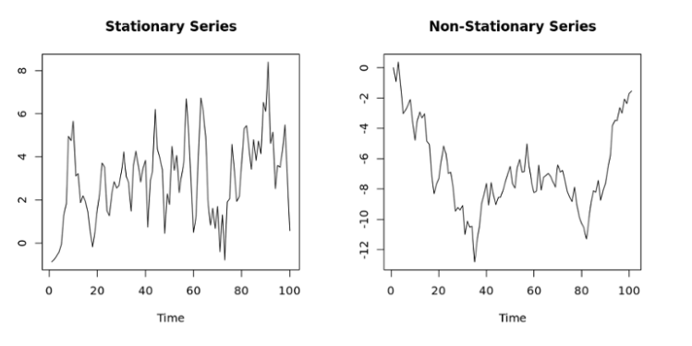
ARIMA - Stationary
Fitting an ARIMA model requires the series to be stationary. A series is said to be stationary when its mean, variance, and autocovariance are time invariant.
More simply non-stationary means the average values change through time, levels change, etc.

Slide 21
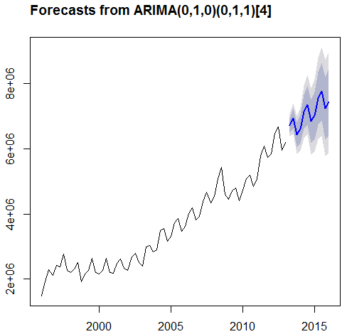
Auto Regressive Integrated Moving Averages ARIMA Analogy
Arima forecasts using a combination of p, d, q inputs
p is the number of autoregressive terms,
d is the number of nonseasonal differences, and
q is the number of lagged forecast errors in the prediction equation
Good Reference:
http://people.duke.edu/~rnau/411arim.htm
As a tire rolls across a bumpy road, one can adjust the tread, air pressure, and diameter to get the smoothest ride. ARIMA adjust these inputs to get a close fit to the bumpy road. Think of these inputs as similar to the PDQ
Auto.arima() will adjust lags and p/d/q to extract more of the auto correlation (information shared between rows)

Slide 22
Let’s Practice
7_autoArima_AMZN.R

Slide 23

Before you Embark on Forecasting - Random walks
Before forecasting, consider “is the time series predictable or is it a random walk?
When we do any forecasting first try to do an AR(1) model.
Test that slope = 1 in an AR(1) model (i.e. that the forecast for a period is the most recently-observed value)
If the beta coefficient has a small p-value then the values are predictable and you should do a forecast (not a random walk)

