Slide 1
Manual and Automation Testing

Slide 2
Manual Testing:
SDLC vs STLC
White and Black box testing
Smoke, Sanity, Regression Testing
Adhoc Testing
End to End testing
Verification and Validation
Bug Life Cycle
Test Design Techniques
Defect Reporting
Agile Methodology :

Slide 3
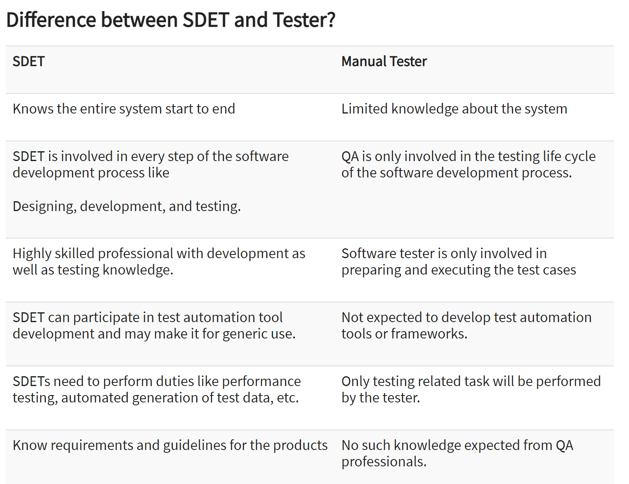

Slide 4
Manual and Automation testing
Some key benefits of Test Automation are:
Manual intervention is less, so the possibility of errors diminishes.
It ensures higher ROI on the huge investments required initially.
Automated tests make the process more reliable and the tests more dependable.
Automation helps you find bugs at an early stage.
You can test 24*7 from a remotely–held device as well.
It makes the test scripts reusable – need new scripts every time even with changes in the version of the OS on the device and the tests can recur without any errors.
Most importantly, it enables testing in volumes. For instance, it allows you to run tests on thousands of mobile devices. Now, this is impossible with Manual Testing.
Selenium is the most popularly used freeware and open source automation tool. The benefits of Selenium for Test Automation are immense

Slide 5
Benefits of selenium
Open Source
Language Support (Python, PHP, Java, C#, Ruby, JavaScript etc)
Works Across Multiple OS
Cross Browser Compatibility Testing
Supports Multiple Frameworks and Languages
Cross-Device Testing
Community Support
Easy to Implement
Mouse Cursor and Keyboard Simulation

Slide 6
Hybrid Framework from scratch
TestNG
Data Driven
Page Object Model
Keyword Driven
Implement by following OOP’s concepts
Code is integrated with CI/CD : Jenkins
Git hub

Slide 7
QA

