Slide 1
Evaluation of RAG Systems using the RGB Benchmark

Slide 2
    Motivation
RAG systems rely on external documents
Documents can be noisy or contradictory
Hallucinations are a major risk

Slide 3
    What is RGB?
Benchmark for RAG robustness
Evaluates realistic failure scenarios
Focuses on behavior, not just accuracy

Slide 4
    Models Evaluated
We evaluate three instruction-tuned open-source LLMs without fine-tuning:
Phi-3.5-Mini-Instruct (~3.8B parameters)
Qwen-2.5-7B-Instruct (7B parameters)
Mistral-7B-Instruct-v0.3 (7B parameters)

Slide 5
    RGB Capabilities
The RGB benchmark evaluates four robustness dimensions:
Noise Robustness: Accuracy under increasing irrelevant document noise
Negative Rejection: Ability to abstain when information is insufficient
Information Integration: Ability to combine evidence from multiple documents
Counterfactual Robustness: Ability to detect and correct contradictory facts

Slide 6
    Experimental Setup
Zero-shot evaluation
Fixed prompts
Google Colab GPU

Slide 7
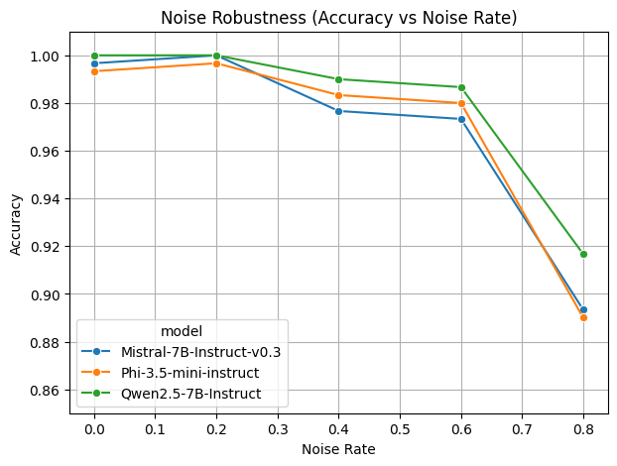
    Noise Robustness Results
Mistral strongest
Qwen close behind
Phi drops faster with noise

Slide 8
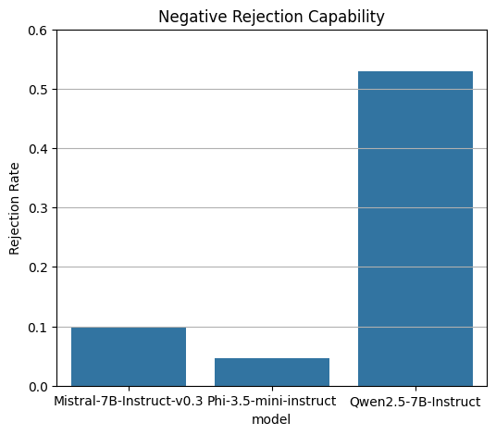
    Negative Rejection
Qwen best at rejecting
Mistral / Phi most prone to hallucination

Slide 9
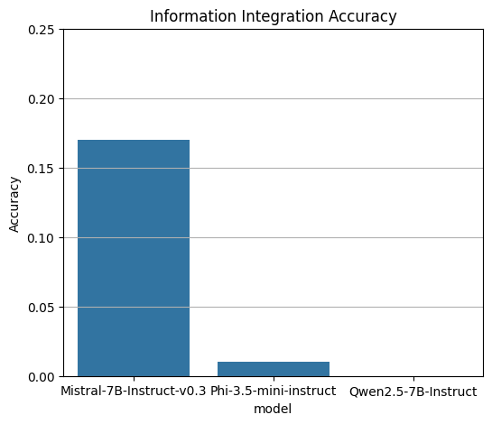
    Information Integration
All models struggle
Mistral performs best

Slide 10
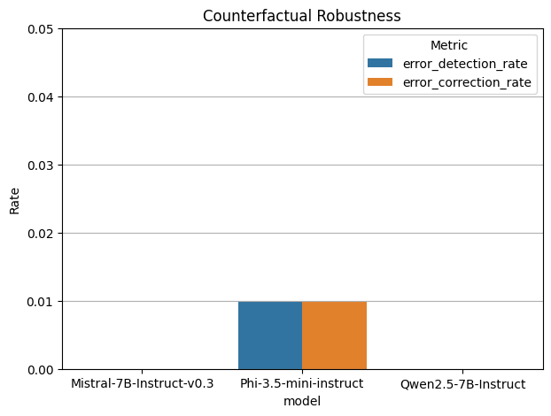
    Counterfactual Robustness
All models score 0.0 ~0.01
No contradiction detection

Slide 11
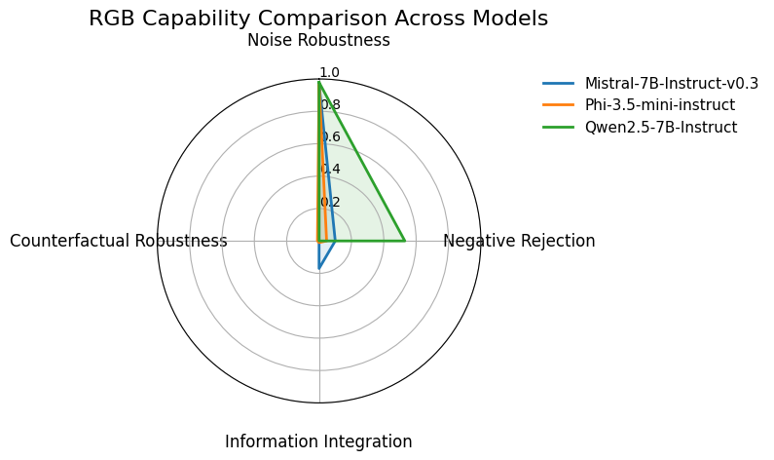
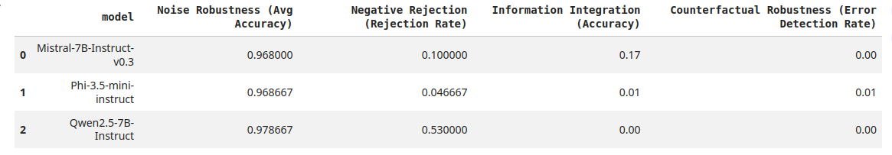
    Key Takeaways
Strong noise tolerance
Weak factual verification
Counterfactual reasoning unsolved

Slide 12
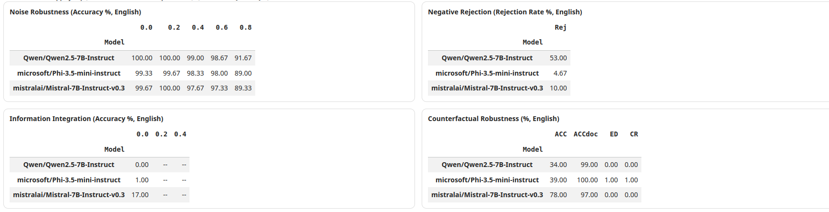
Analysis and Discussion
Noise Robustness
Mistral-7B demonstrates the strongest robustness to noisy contexts, maintaining high accuracy even when up to 80% of the documents are irrelevant.
Qwen-2.5-7B also performs well but shows slightly greater degradation.
Phi-3.5-Mini is more sensitive to noise, likely due to its smaller parameter count.
Negative Rejection
Qwen-2.5-7B achieves the highest rejection rate, indicating strong safety alignment and a conservative answering strategy.
Mistral-7B rejects inconsistently.
Phi-3.5-Mini frequently attempts to answer even when information is insufficient, increasing hallucination risk.
Information Integration
Mistral-7B outperforms other models in integrating information across multiple documents.
However, absolute accuracy remains low across all models,
suggesting that multi-document reasoning is still a challenging problem for current LLMs.
Counterfactual Robustness
All evaluated models score zero on both error detection and error correction.
This indicates a fundamental limitation:
instruction-tuned LLMs do not reliably recognize or resolve contradictions unless explicitly prompted or supported by additional verification mechanisms.

Slide 13
Conclusion
This is to demonstrates that modern open-source LLMs exhibit strong robustness to noisy and incomplete information in RAG settings, particularly Mistral-7B and Qwen-2.5-7B.
However, all evaluated models fail to achieve counterfactual robustness, highlighting a significant unresolved challenge.
Addressing factual inconsistency detection and correction is essential for deploying reliable and trustworthy RAG systems in real-world applications.

Slide 14
REFERENCES
[1] T. Chen et al., “RGB: A Robustness Benchmark for Retrieval-Augmented Generation,” arXiv preprint arXiv:2309.01431, 2023.
[2] P. Lewis et al., “Retrieval-Augmented Generation for Knowledge-Intensive NLP Tasks,” Advances in Neural Information Processing Systems (NeurIPS), 2020.
[3] J. Wei et al., “Chain-of-Thought Prompting Elicits Reasoning in Large Language Models,” NeurIPS, 2022.
[4] Hugging Face, “Transformers Library,” https://huggingface.co/docs/transformers
[5] Mistral AI, “Mistral-7B Model Card,” https://huggingface.co/mistralai

