Slide 1
“FingerPrint Based Voting System”
Mini Project – I
Risheek D S 1NH19EC412
Prashanth B 1NH18EC088
VB Vasu 1NH18EC115
M Rishi 1NH18EC070
Guided By
Dr. A B Gurulakshmi
Professor
Dept. of ECE
New Horizon College of Engineering, Bengaluru

Slide 2
Contents
Introduction
Proposed System
Block Diagram
Hardware & Software Specification
Algorithm / Flow Chart
Program Code
Results
Advantages
References
Progress Work
Milestones/Schedule

Slide 3
Introduction
We have designed a finger print based voting machine where there is no need for the user to carry his ID.
The person at the polling booth needs only to place his Finger on the device, thus allows on-spot fingerprint from the voter which serves as an identification.
This data is passed onto the controlling unit for the verification. The controller fetches the data from the reader and compares this data with the already existing data stored during the registration.
If the data matches with the pre-stored information of the registered fingerprint, the person is allowed to cast his vote.

Slide 4
If not, a warning message is displayed and the person is barred from polling his vote.
In our project we have used fingerprint for the purpose of voter identification or authentication. As the thumb impression of every individual is unique, it helps in minimizing the error.
A database is created containing the fingerprint images of all the voters as required. Illegal votes and repetition of votes is checked for in this system with accurate coding.
Hence with the application of this fingerprint based EVM system elections could be made fair and free from rigging.

Slide 5
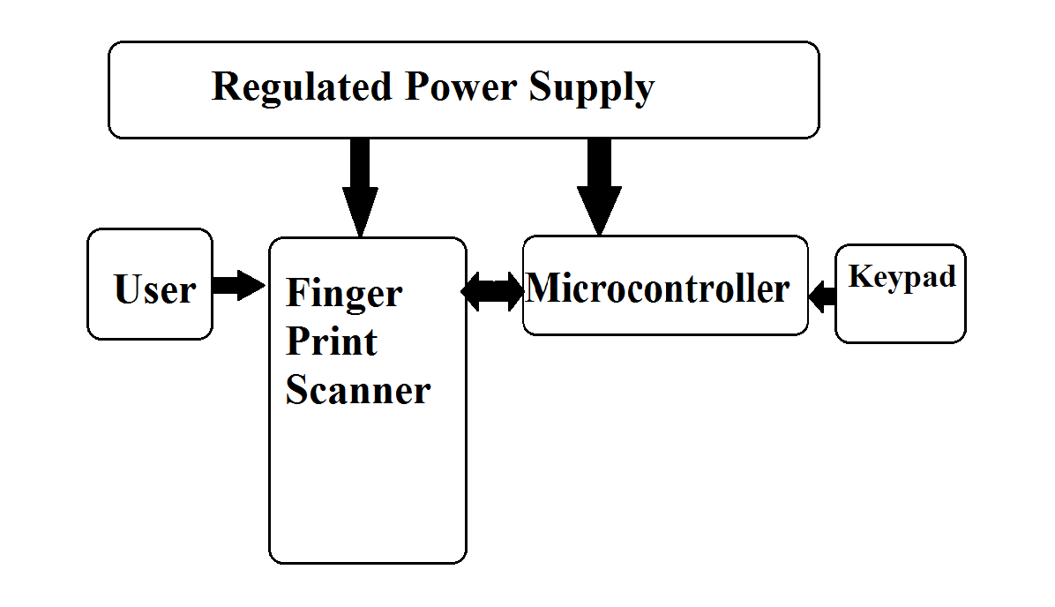
Proposed System
Block Diagram

Slide 6
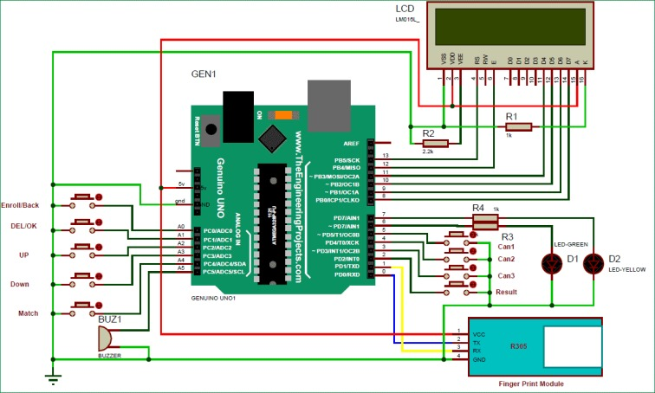
Working

Slide 7
The block diagram defines the working of the module, When the module is turned on the finger print takes 200ms time to boot at that time the LCD display shows Initializing.
On the next step the user gives the input and he gets two options start/ enroll, Start takes to the voting process and the enroll takes to the registration process.
After start the user has to vote the candidate and the process is to end

Slide 8
Hardware & Software Specification
Software Used:
Arduino
Hardware:
Arduino UNO MICROCONTROLLER
16*2 LCD DISPLAY YELLOW
PUSH BUTTON SWITCHES
12V POWER ADAPTER
R307 FINGERPRINT SENSOR
BREAD BOARD & Jumper Cables

Slide 9
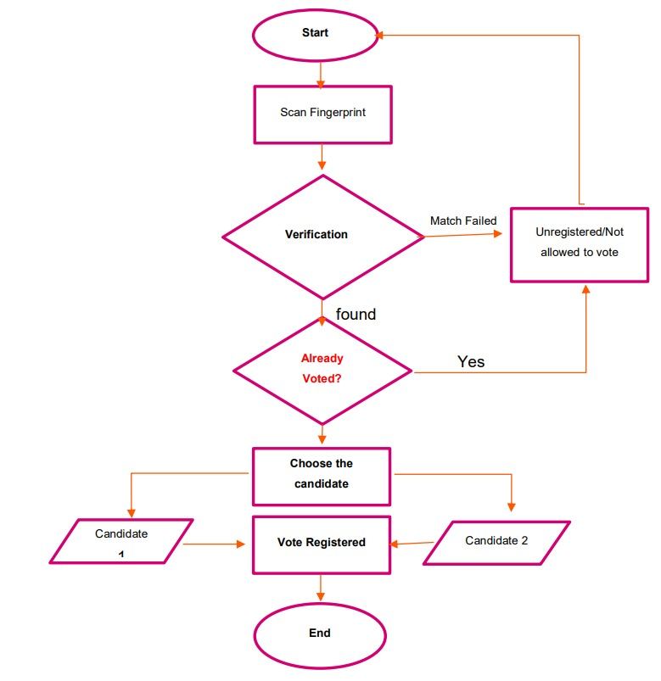
Algorithm / Flow Chart

Slide 10
Advantages
Cost effective
This system allows only authenticated voting as the person is identified based on his Fingerprint which is unique to each individual.
Low power consumption
It is economical
Less manpower required
Time conscious, less time required for voting & counting
Avoids invalid voting as it prevents unregistered voters from voting.
Ease of transportation due to its compact size.
Convenient on the part of voter.

Slide 11
Conclusion & Future Scope
Conclusion:
The project “Fingerprint Based Voting Machine” was mainly intended to develop a fingerprint based advanced Electronic Voting Machine (EVM) which helps in free and fair way of conducting elections which are basis for democratic country like India.
Applications:
This project can be used as a voting machine to prevent rigging, during the elections in the polling booths.
Fast track voting which could be used in small elections, like resident welfare association, “panchayat” level election and other society level elections, where results can be instantaneous.
It could also be used to conduct opinion polls during annual meeting.
It could also be used to conduct general assembly elections where number of candidates are less than or equal to eight in the current situation

Slide 12
References
[1] https://nevonprojects.com/fingerprint-voting-system-project-2/
[2] https://ieeexplore.ieee.org/document/9036777
[3]. https://www.ripublication.com/ijaerspl20/ijaerv15n1spl_14

Slide 13
Progress Work
Group – Prashanth, Risheek , Rishi ,Vasu | Work Achieved
ALL | Title / Project selection
ALL | Selecting and bringing Components
ALL | Making project
ALL | PPT

Slide 14
Milestones/Schedule
Milestone | Baseline Date | Target Date | Achievement
Title of the project | 15/04/2021 | 29/04/2021 | Success
Approval of the project | - | 05/05/2021 | Success
First Review | 24/05/2021 | 31/05/2021
Second Review | 1/07/21 | 17/07/21

Slide 15
Thank You

