Slide 1

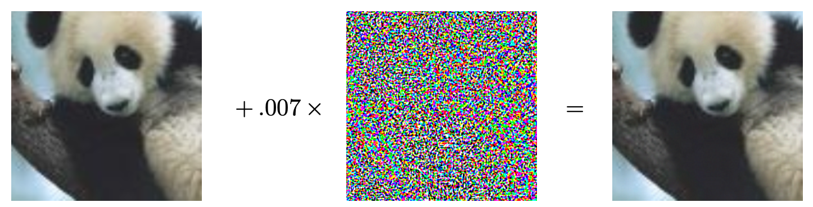

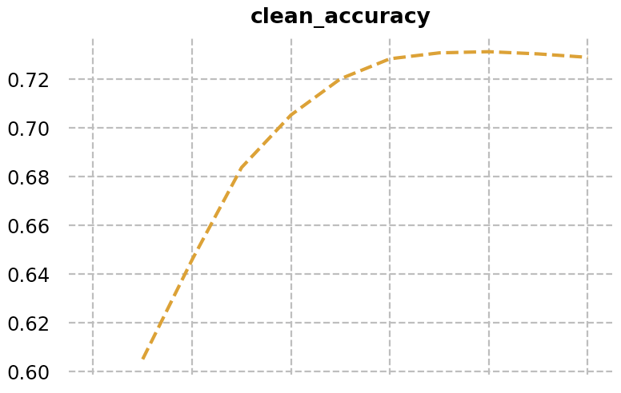
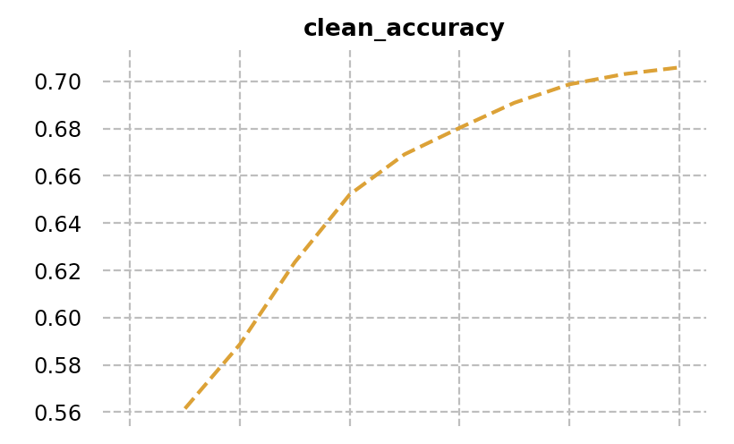
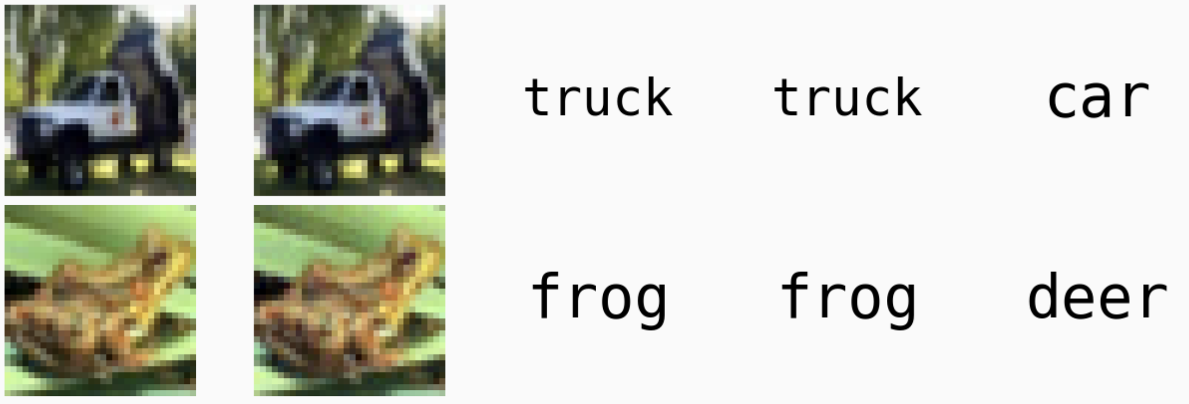
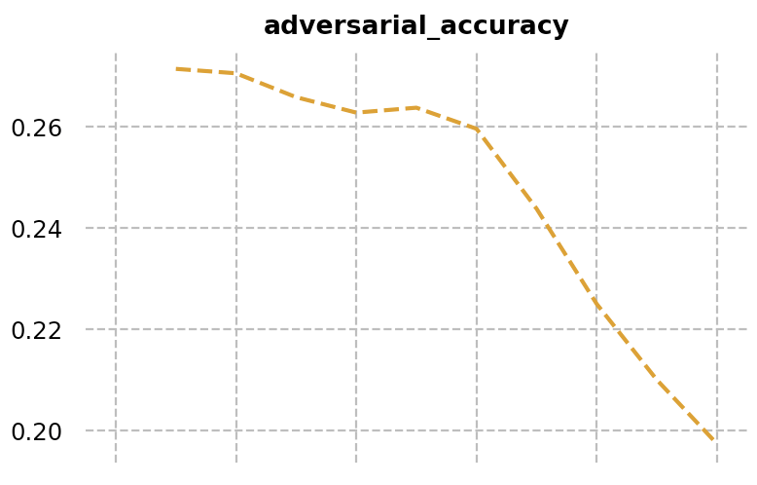
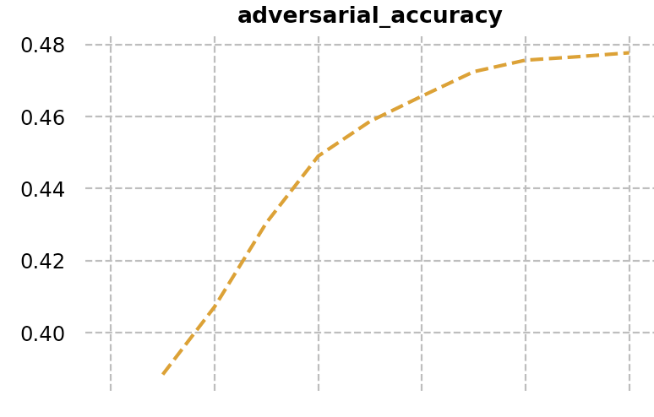
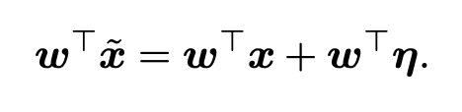
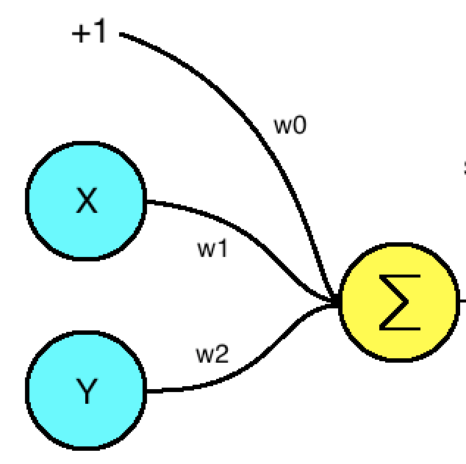
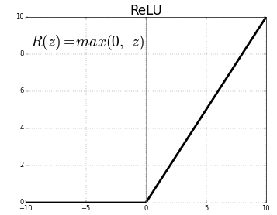


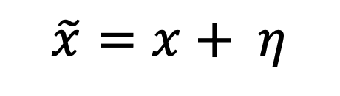
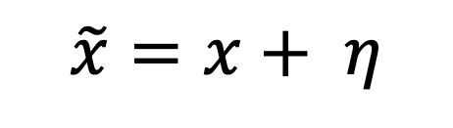
Implementing Adversarial attacks and Adversarial Training In Deep Networks
Xiaomeng Dong
University of Oklahoma
Adversarial Examples
Fast Gradient Sign Attack
Adversarial Training
Panda, 57.7% confidence
Small Perturbation
Gibbon, 99.7% confidence
$$\tilde{x}=x+ η$$
“Train on original images and adversarial examples together”
FGSM^{[2]} attack on Cifar10 with LeNet^{[3]}:
Adversarial Images Illustration ^{[1]}
x
x_adverse
label
clean prediction
adv prediction
Adversarial Images on Cifar10
Linear Explanation
$$\tilde{x}=x+ η$$
$$W^{T}η$$
Test Clean Acc: 0.7178
Acc Drop: 0.45
Test Adv Acc: 0.2674
Test Clean Acc: 0.6962
Test Adv Acc: 0.4758
Acc Drop: 0.22
Contact
References
Xiaomeng Dong
University of Oklahoma
Email: Xiaomeng.dong-1@ou.edu
[1] Szegedy, Christian, Liu, Wei, Jia, Yangqing, Sermanet, Pierre, Reed, Scott, Anguelov, Dragomir, Erhan, Du- mitru, Vanhoucke, Vincent, and Rabinovich, Andrew. Going deeper with convolutions. Technical report, arXiv preprint arXiv:1409.4842, 2014.
[2] GOODFELLOW, I. J., SHLENS, J., AND SZEGEDY, C. Explaining and harnessing adversarial examples. arXiv preprint arXiv:1412.6572 (2014).
[3] LeCun, Y., Bottou, L., Bengio, Y., and Haffner, P. Gradient-based learning applied to document recognition. Proceedings of the IEEE, 86(11):2278–2324, November 1998.

