Slide 1

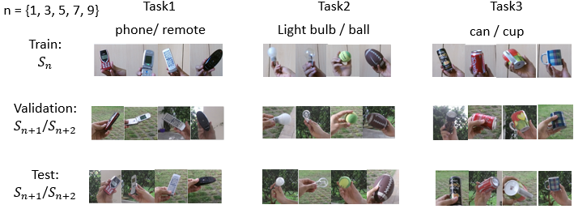
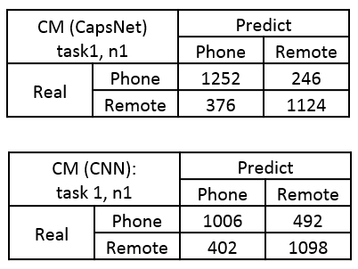
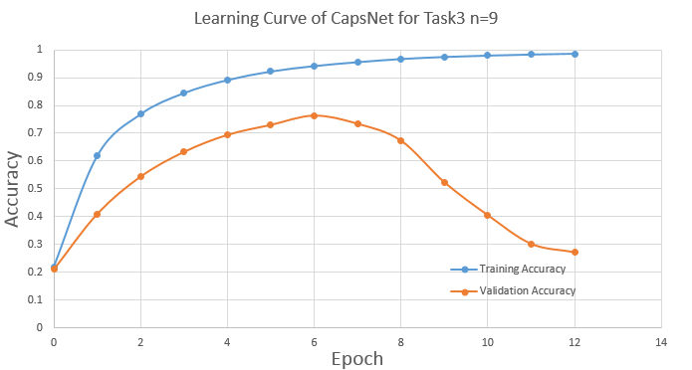
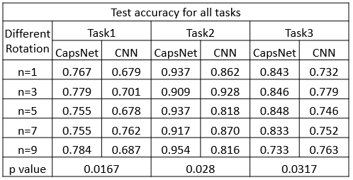
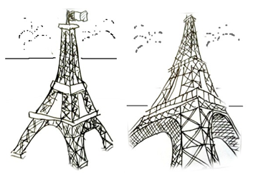
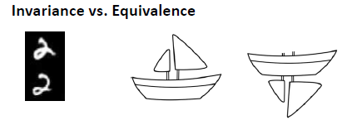
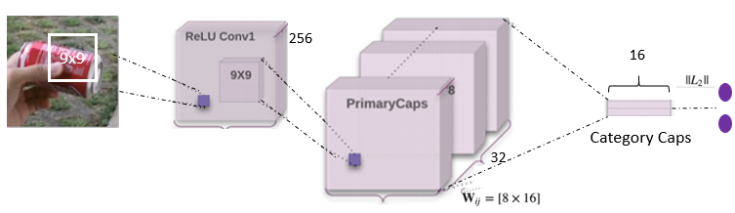
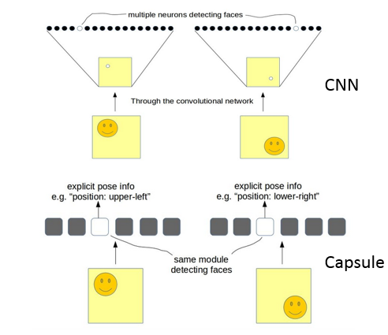
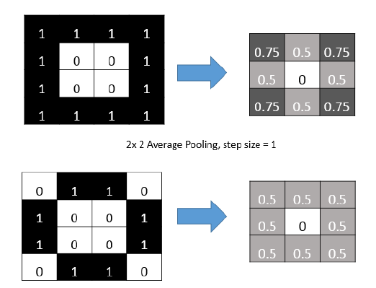
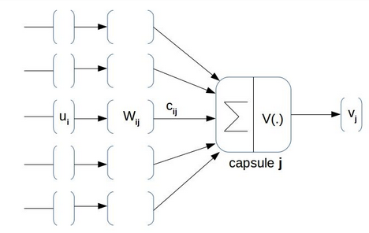
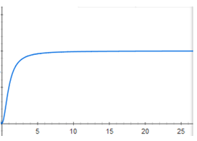


Capsule Networks in Recognizing Object Under Novel Viewpoints
Xiaomeng Dong
University of Oklahoma, Data Science & Analytics
Abstract
Problem: Identifying Objects On Novel Viewpoints
Results
A capsule is a group of neurons that represents a specific type of entity such as an object or object part. A capsule can be mathematically modeled as a vector-in-vector-out computing units. It can recognize objects under different angle by controlling meaningful information flow.
Capsule Network is a new deep network architecture proposed by Hinton [1]. It has certain advantage over traditional Convolutional Neural Networks at recognizing object under novel viewpoints. In this study, it is shown that Capsule Network can effectively recognize objects in different backgrounds. Capsule Network demonstrates higher testing accuracy in Core 50 dataset than a comparable Convolutional Neural Networks with similar number of parameters.
Supervised Classification, input: 128x128 RGB image, output: one-hot label vector.
Core50 dataset [2]: 11 session (viewpoints), 50 objects, 10 category.
Three binary classification tasks:
Implemented a CNN with similar number of parameters to compare with CapsNet.
Train on session 1/3/5/7/9 , validate and test on session 2,3/ 4,5/6,7/8,9/10,11.
Use accuracy as performance metric.
Hypothesis: the average test score of CapsNet is better than CNN on test sessions
Paired bootstrap randomization is used to test the hypothesis
Introduction
Limitation of CNN: generalizing on novel viewpoints (Figure 1).
A successful recognition requires identifying both invariance and equivalence (Figure 2).
CNN’s invariance is provided by pooling, but cannot handle equivalence (Figure 3).
Human brain can recognize equivalence under different viewpoints with the help of capsule[1].
A capsule is a group of neurons whose activity vector represents the parameters of a specific type of entity such as an object or an object part[1].
Capsule can control meaningful information flow through a routing process (Figure 4).
Figure 5. Core50 data and different tasks in the study
Approach: Capsule Networks
First layer is the traditional convolutional layer.
Primary Capsule Layer is convolutional layer with output reshaped as vector layers:
[h , w, #conv] --> [$h×w×\frac{\# conv}{dim⁡_cap}$, dim_cap].
After primary capsule layer, apply “squashing function” (activation function for vector).
Affine transformation of vector by a weight matrix $W_{ij}$.
Calculate the information flow weight (c) by “Routing by Agreement” algorithm.
Squash the output, go back to step 6 until desired routing iterations.
Category Capsule Layer has dimension [#classes, 16], calculate L2 norm along the last dimension.
Final prediction layer is a vector, with each element represents the P(class) .
Figure 2. Invariance V.S. Equivalence
Discussion and Conclusion
Figure 1. Different Viewpoints of Same Objects.
On Core50 dataset, when testing on novel viewpoints, Capsule Network generalize better than CNN. It can be a promising model to overcome the limitation of CNN.
Capsule’s generalization robustness results from controlling meaningful information flow. No pooling is used in Capsule Network.
Capsule is a vector-in-vector-out computational units. Each capsule encodes a specific type of entity, such as an object or object part.
Future work:
Test Capsule Network on other datasets to fully demonstrate its pros and cons.
Invent new architecture and new objective function to customize the model to different recognition task.
New regularization scheme is required for Capsule Network, such as “capsule drop out”, or “transformation matrix with shared weight”.
“Routing by Agreement”
Figure 3. Invariance in CNN Provided by Pooling
Figure 4. Routing meaningful information to the correct capsule
Contact
References
Xiaomeng Dong
University of Oklahoma
Email: Xiaomeng.dong-1@ou.edu
[1] Sara S, Nicholas F, and Hinton G.(2017) Dynamic routing between capsules. In Advances in Neural Information Processing Systems, pp. 3859–3869.
[2] Vincenzo L, Davide M. (2017) CORe50: a New Dataset and Benchmark for Continuous Object Recognition. CoRR abs/1705.03550.
[3] Geoffrey H, Sara S, Nicholas F. (2018) Matrix capsules with EM routing. International Conference on Learning Representations.

